Slide 1
Optimized-MNIST-Digit-Classification-through-Feature-Selection-and-Dimensionality-Reduction
KAVESH.D CB.EN.U4CCE22016
VIJAY VENKATESAN.V CB.EN.U4ECE22058

Slide 2
Dataset
The MNIST (Modified National Institute of Standards and Technology) dataset is a widely used benchmark in the field of machine learning and computer vision.
The MNIST dataset consists of 70,000 grayscale images of handwritten digits, ranging from 0 to 9.
Each image is 28x28 pixels in size, resulting in 784 features per image.
The pixel values range from 0 (black) to 255 (white), representing the intensity of the pixels.
Despite its simplicity, it provides a robust testbed for a variety of techniques, including image processing, feature extraction, and classification.

Slide 3
Checking for null values
Null values (or missing values) can lead to incorrect analyses and biased model predictions.
Identifying and handling null values is essential for maintaining data quality and reliability.
CODE:
# Check for null values in the training dataset
print("Missing values in df_train:", df_train.isna().sum().sum())
# Check for null values in the test dataset
print("Missing values in df_test:", df_test.isna().sum().sum())

Slide 4
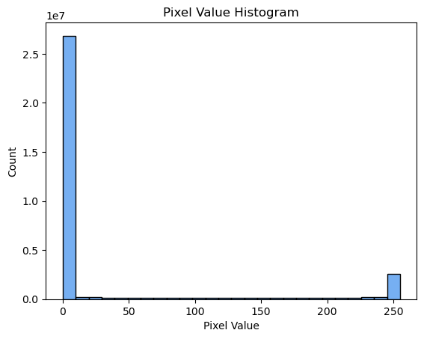
Pixel Value Histogram
CODE:
ax = sns.histplot(x=X_train.flatten(), color='#4895EE')
_ = ax.set(title='Pixel Value Histogram', xlabel='Pixel Value')
Visualizes the distribution of pixel intensities in the dataset.
Helps to understand the range and frequency of pixel values.

Slide 5
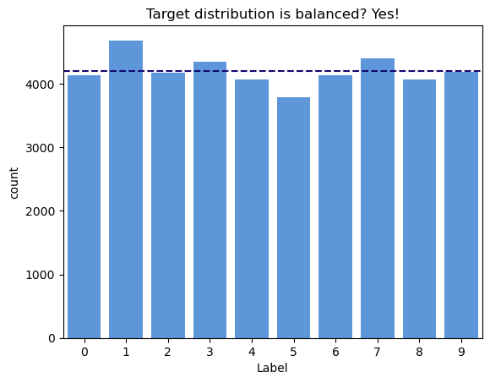
Target Distribution Plot
CODE:
ax = sns.countplot(x=y_train, color='#4895EE')
ax.set(title='Target distribution is balanced? Yes!',xlabel='Label')
_ = ax.axhline(y=4200, color='#12086F', linestyle='--')
Visualizes the distribution of digit labels in the training set.
The horizontal line indicates the average count per label, helping to quickly assess if the dataset is balanced.
Ensures that the dataset has a roughly equal number of samples for each digit, which is crucial for training unbiased models.

Slide 6
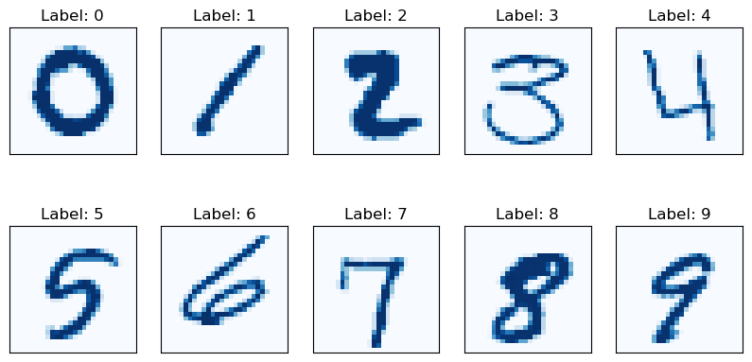
Visualizing a sample of handwritten digits from the MNIST dataset, providing insights into the data's structure and characteristics.

Slide 7
Preprocessing (normalisation)
Before Scaling:
Pixel values range from 0 to 255.
High variance can negatively impact some machine learning algorithms.
Using MinMaxScaler:
Scales data to a range of 0 to 1.
fit_transform() method is used to apply the transformation.
After Scaling:
New pixel values range from 0.0 to 1.0.
Normalization ensures all features contribute equally and improves model performance.

Slide 8
Feature Reduction
We employed three distinct pipelines, each utilizing a different feature reduction technique, to assess their effectiveness in reducing dimensionality while preserving information:
Principal Component Analysis (PCA) :
We utilized PCA to reduce the dimensionality of our dataset. By transforming the features into a lower-dimensional space while retaining as much variance as possible, PCA helped streamline the data for subsequent modeling.
Independent Component Analysis (ICA) :
We employed Independent Component Analysis to separate mixed signals into their independent components. By untangling complex dependencies within the data, ICA enabled us to extract meaningful features that were statistically independent.
Autoencoder Pipeline:
We utilized autoencoders to learn efficient representations of the dataset through unsupervised learning. By compressing the feature space into a low-dimensional latent space and then reconstructing it back to the original space, autoencoders effectively reduced dimensionality while preserving important information.

Slide 9
Feature Selection
We utilized three different feature selection techniques, namely Recursive Feature Elimination (RFE), Lasso Regression, and SelectKBest with a classification-based scoring function, to identify and retain the most pertinent features for our modeling task.
In the RFE pipeline, features were systematically eliminated based on their importance ranking until the desired number remained, ensuring that only the most relevant features were retained. Lasso Regression, on the other hand, applied L1 regularization to shrink less important features' coefficients to zero, promoting sparsity in the feature set. Finally, SelectKBest assessed each feature's significance in predicting the target variable using a classification-based scoring function and selected the top k features with the highest scores.
By comparing the performance of models trained on features selected using these techniques, we evaluated their effectiveness in streamlining the dataset while maintaining predictive power. This comprehensive approach allowed us to identify the most suitable feature selection technique for our specific modeling requirements, facilitating improved model interpretability and potentially enhancing predictive performance.

Slide 10
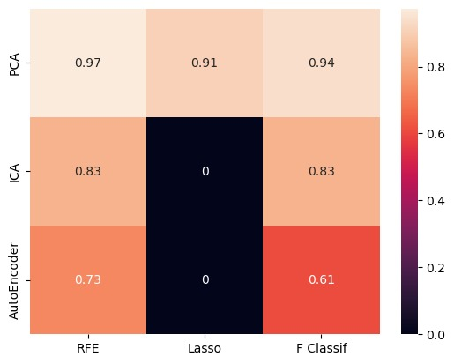
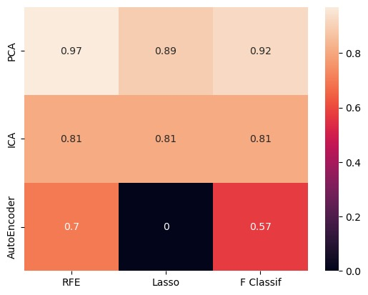
SVM KNN

