Slide 1

Exploratory Data Analysis on EV-Cars Specifications
By
Vijay Golliwar

Slide 2
PROBLEM OBJECTIVE :
Problem Statement:
The adoption of Electric Vehicles (EVs) is increasing rapidly across the globe, especially in developed markets like Germany. However, customers and manufacturers face challenges in understanding how various performance factors — such as battery capacity, range, efficiency, and weight — influence the price and availability of EVs.
Goal:
To analyze electric car data and find key factors that influence their price and availability.

Slide 3
Objective of the Project:
Perform web scraping to collect real-world electric car data from ev-database.org.
Conduct Exploratory Data Analysis (EDA) to clean, visualize, and understand the data.
Analyze how features like brand, model, battery capacity, range, weight, and price are related.
Identify key trends and insights that influence electric car prices and availability.
Provide a data-driven understanding of the electric vehicle market for buyers and manufacturers.

Slide 4
Web Scarping Process:
Selected Website – Collected data about electric cars from ev-database.org.
Checked Website Structure – Identified where car details like model, price, battery, and range are located in the HTML.
Scraped Data – Used Python libraries such as BeautifulSoup and Requests to extract the required information.
Stored Data – Organized the scraped data into a structured Pandas DataFrame .
Cleaned Data – Removed duplicates, handled missing values, converted data types, and saved the cleaned dataset for EDA.

Slide 5
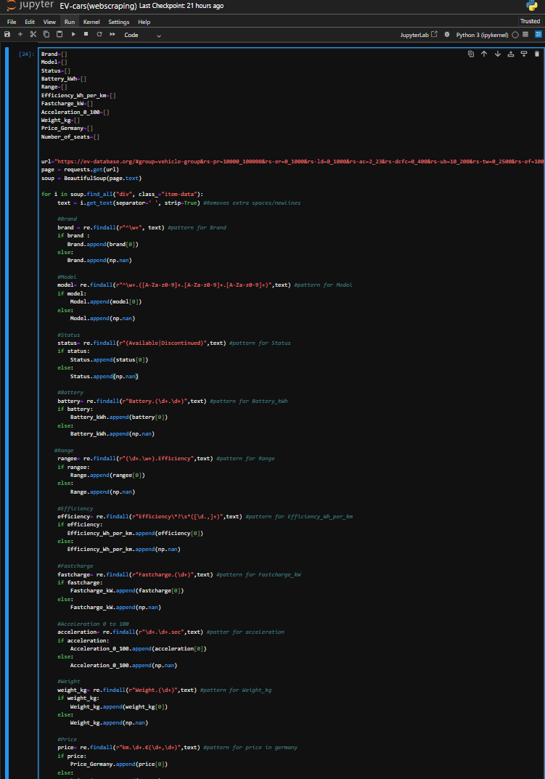

Slide 6
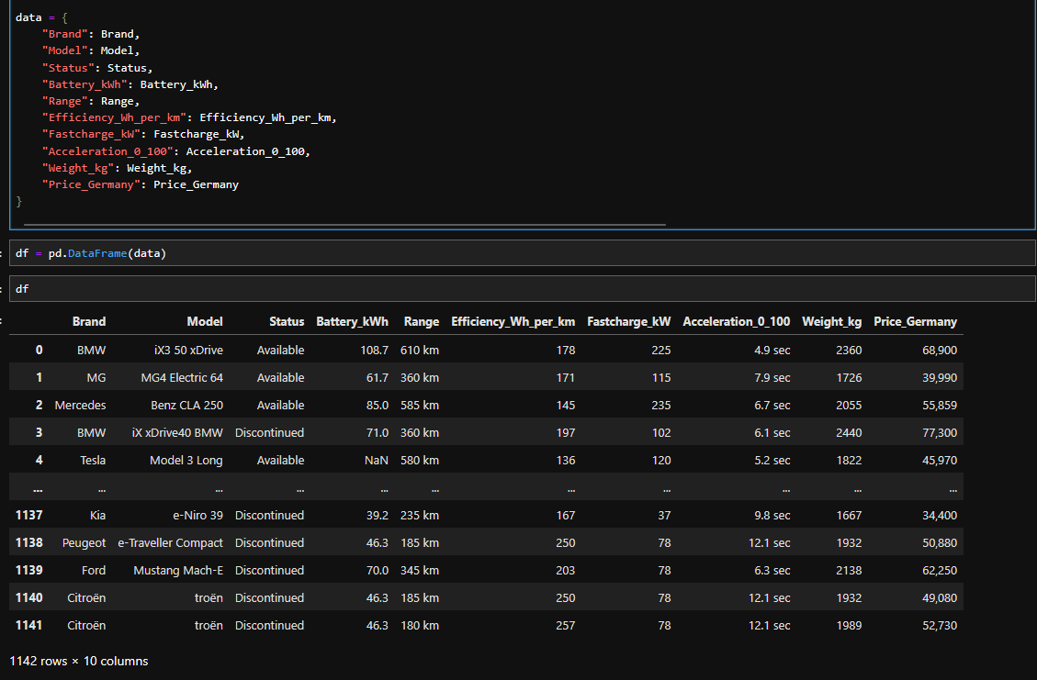

Slide 7
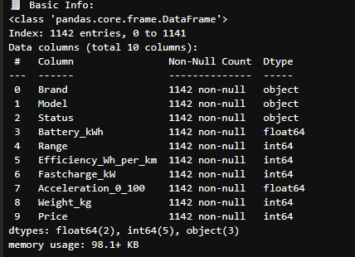
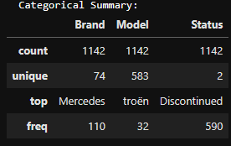
Data Summary:

Slide 8
Data Cleaning:
The raw data from EV-Database.org contained missing values, inconsistent formats, and extra columns.
Handling Missing Values:
Filled missing Model with corresponding Brand or "Unknown".
Replaced missing numeric values (Battery_kWh, Weight_kg, Fastcharge_kW, Price) with median.
Renamed & Removed Columns:
Renamed Price_Germany → Price for simplicity.
Removed unwanted columns like Unnamed: 0 created during CSV save/load.
Data Type Conversion:
Converted text-based numbers (like '56,859') to numeric using astype(float).
Ensured numeric type for Battery_kWh, Weight_kg, and Fastcharge_kW.
Duplicate & Formatting Fixes:
Dropped duplicate rows to keep unique data.
Cleaned extra spaces and standardized text (e.g., “tesla” → “Tesla”).

Slide 9
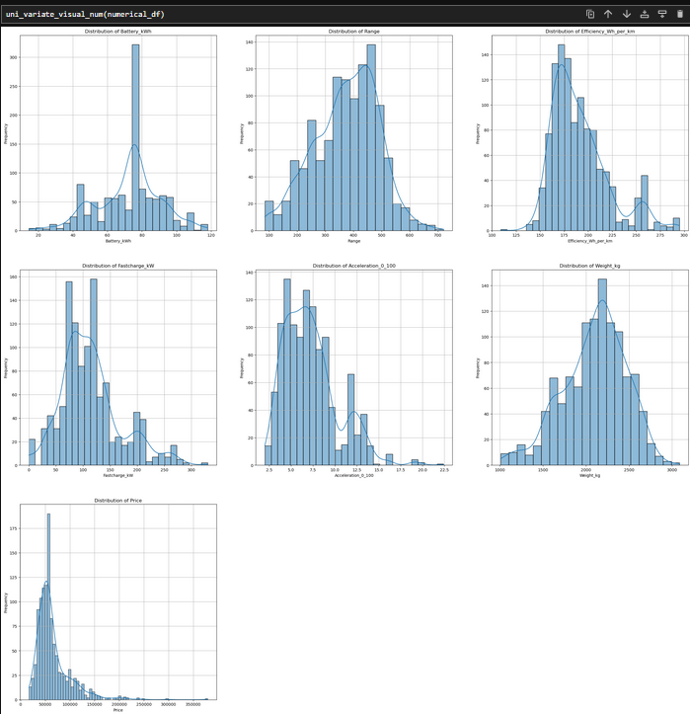
Univarite Analysis for Numerical columns

Slide 10
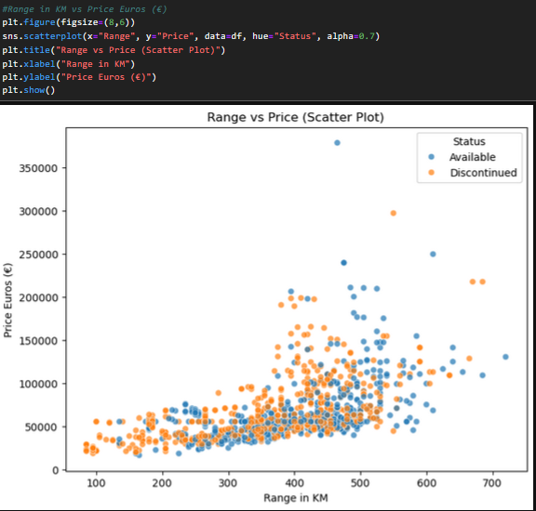
Bivariate Analysis (Continuous vs Continuous) :

Slide 11
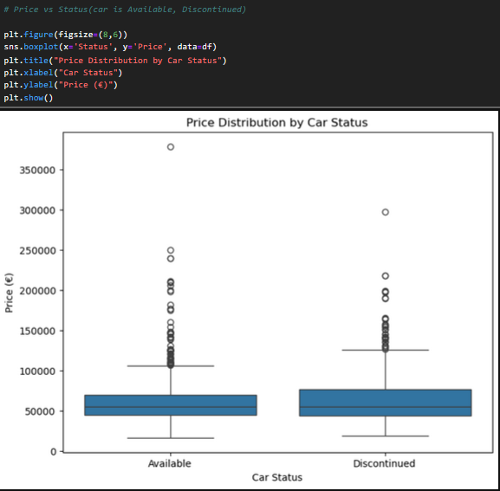
Bivariate Analysis (Continuous vs Categorical) :

Slide 12
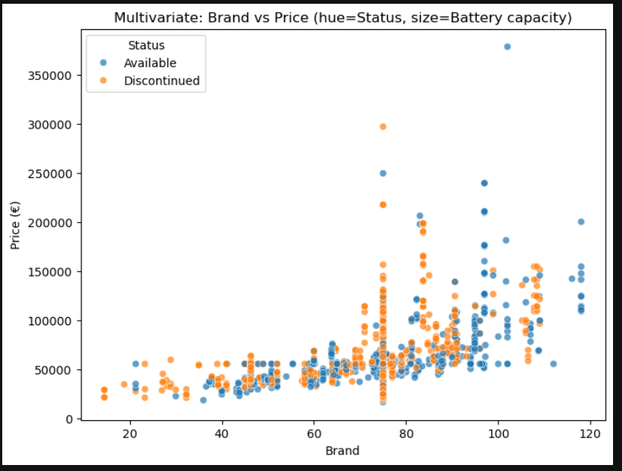
Multivariate

Slide 13
Challenges:
Inconsistent HTML structure while scraping data from EV-Database.org.
Extracting multiple values (like Battery, Range, Price) from unstructured text blocks.
Handling missing values and converting text numbers with symbols (€, commas, etc.) to numeric format.
Managing data type mismatches and removing unnecessary columns like Unnamed: 0.
Cleaning and aligning columns for accurate analysis and visualization.

Slide 14
Learnings:
Gained strong understanding of web scraping techniques using BeautifulSoup and regex.
Improved in data cleaning and preprocessing (handling missing, inconsistent, and noisy data).
Learned how to perform Exploratory Data Analysis (EDA) and visualize insights effectively.
Enhanced overall workflow from data collection → cleaning → analysis → visualization.

Slide 15
Conclusion:
EVs with larger battery capacity, higher range, and better efficiency have higher prices.
Models with faster acceleration and advanced features (like fast-charging) show greater market value and user preference
Newer, tech-advanced models are priced higher, while older or discontinued ones have lower value.

Slide 16

THANK YOU

