Slide 1


GROCERY STORE MANAGEMENT
Name :Golliwar Vijay
Batch: 422

Slide 2
INTRODUCTION
The Grocery Store Management System is an SQL-based project designed to handle daily store operations.
It manages information about products, suppliers, customers, employees, and sales.
The system uses SQL queries to store, organize, and analyze data efficiently.
It helps find top-selling products, loyal customers, and sales trends.
The project improves accuracy, decision-making, and business performance in retail management.

Slide 3
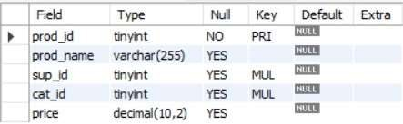
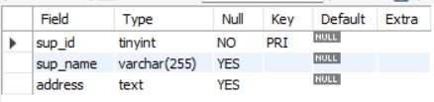


TABLES
SUPPLIERS TABLE
PRODUCTS TABLE
EMPLOYEES TABLE
.
CUSTOMERS TABLE

Slide 4
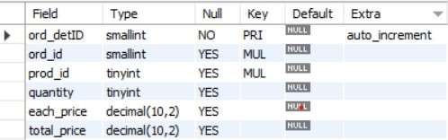
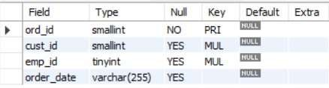

ORDER_DETAILS TABLE
ORDERS TABLE
.
CATEGORIES TABLE

Slide 5
PROBLEM STATEMENT
The grocery store needs a system to store and manage data about products, suppliers, customers, and orders.
Managers find it difficult to retrieve and analyze information efficiently.
The goal is to build a relational database that organizes all store operations.
Using SQL queries, the system should generate insights like best-selling products, top customers, and sales trends.
This helps in better decision-making and improving overall business performance.

Slide 6
Objectives
The main goals of this SQL project are:
To design and implement a relational database for a grocery store.
To retrieve and manipulate data using SQL queries.
To perform data analysis for business insights such as top customers, best-selling products, and revenue trends.
To practice using joins, aggregations, subqueries, and filtering techniques.

Slide 7
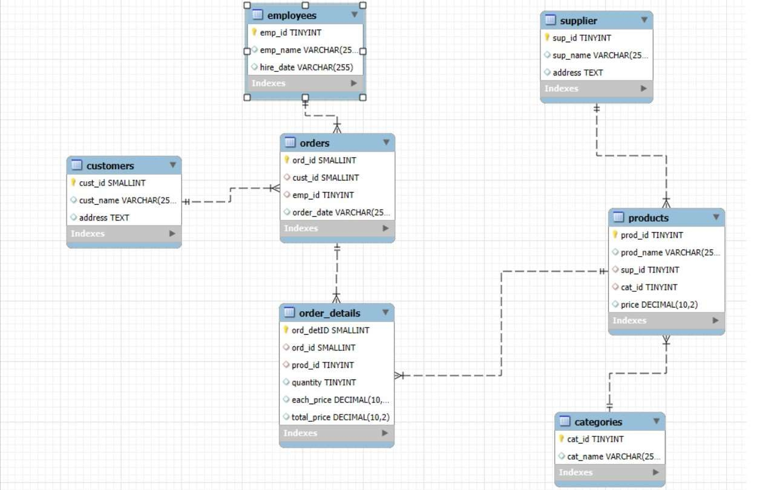
ER DIAGRAM
.

Slide 8


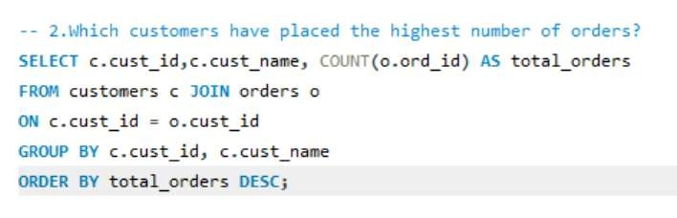

1.How many unique customers have placed orders?
output
2.Which customers have placed the highest number of orders?
output

Slide 9
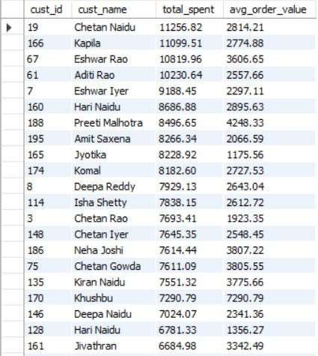
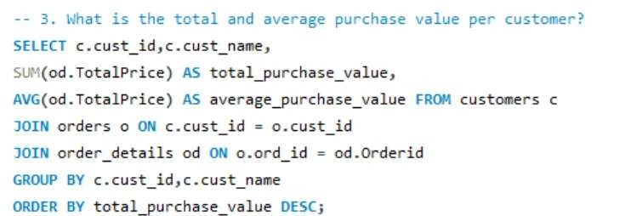
3.What is the total and average purchase value per customer?
output

Slide 10
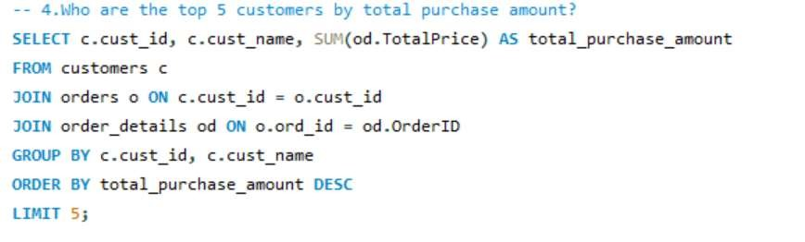
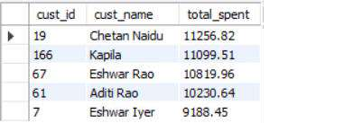
4.Who are the top 5 customers by total purchase amount?
output

Slide 11
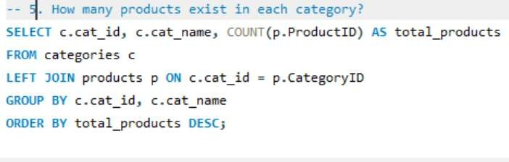
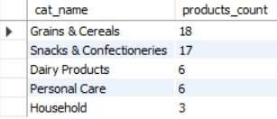
5.How many products exist in each category?
output

Slide 12
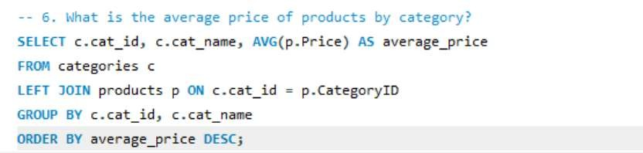
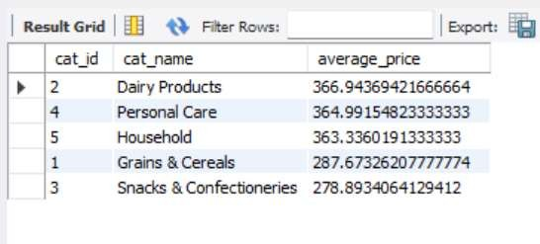
6.What is the average price of products by category?
output

Slide 13
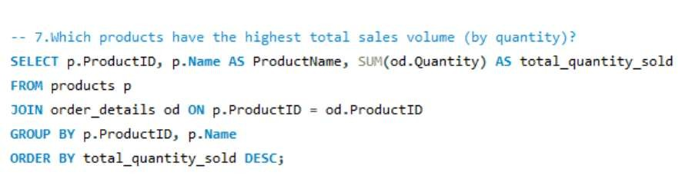

7.Which products have the highest total sales volume (by quantity)?
output

Slide 14
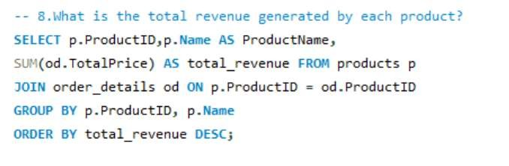
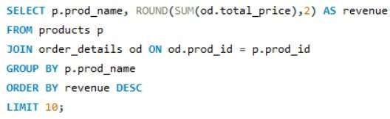
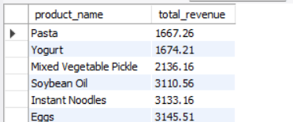
8.What is the total revenue generated by each product?
output

Slide 15
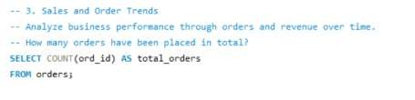
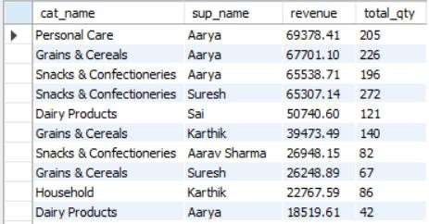
9.How do product sales vary by category and supplier?
0utput

Slide 16

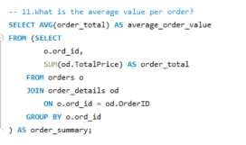

10.How many orders have been placed in total?
output
11.What is the average value per order?
output

Slide 17
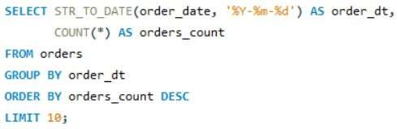

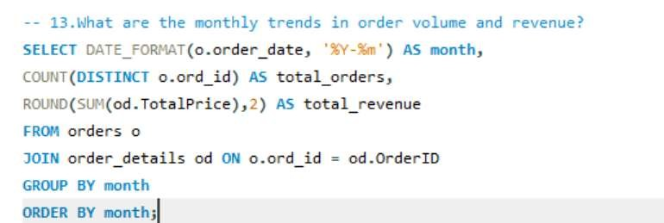

12.On which dates were the most orders placed?
output
13.What are the monthly trends in order volume and revenue?
output

Slide 18
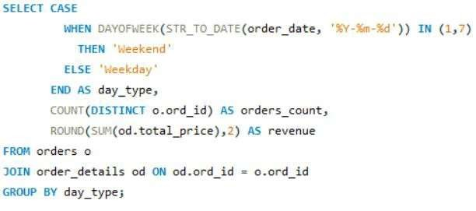

14.How do order patterns vary across weekdays and months?
output

Slide 19


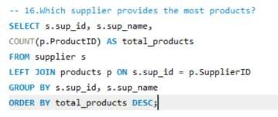
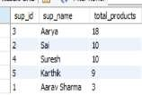
15.How many suppliers are there in the database?
output
16.Which supplier provides the most products?
output

Slide 20

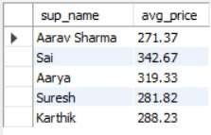
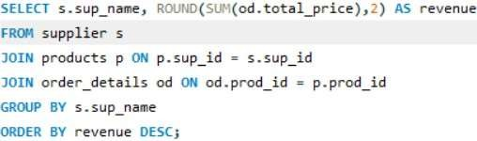
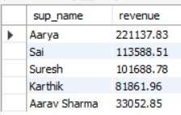
17.What is the average price of products from each supplier?
output
18.Which suppliers contribute the most to total product sales (by revenue)
output

Slide 21


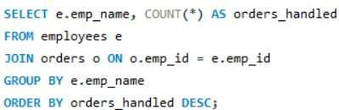
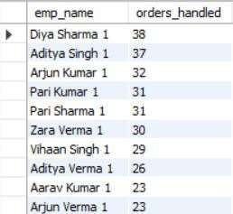
19.How many employees have processed orders?
output
20.Which employees have handled the most orders?
output

Slide 22
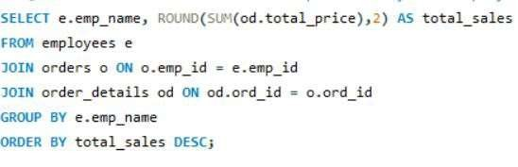
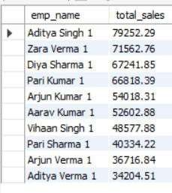
21.What is the total sales value processed by each employee?
output

Slide 23
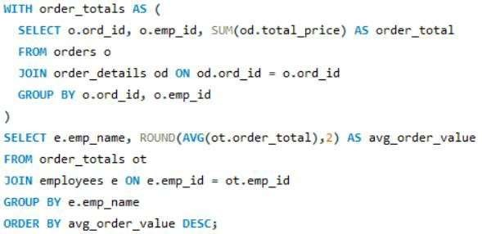
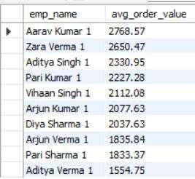

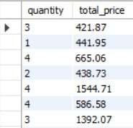
22.What is the average order value handled per employee?
output
23.What is the relationship between quantity ordered and total price?
output

Slide 24
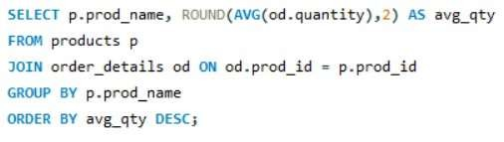
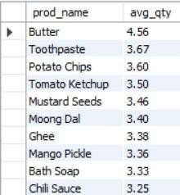
24.What is the average quantity ordered per product?
output

Slide 25
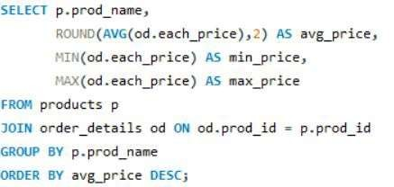
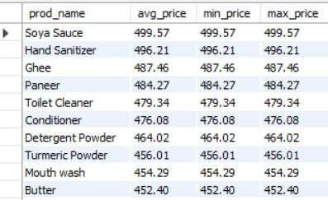
25.How does the unit price vary across products and orders?
0utput

Slide 26
CHALLENGES
Understanding and mapping relationships between multiple interconnected
tables.
Choosing the correct SQL joins (INNER, LEFT, RIGHT) to avoid missing or
duplicated data.
Managing foreign key constraints to maintain data consistency across suppliers,
products, orders, and customers.
Performing accurate aggregations (SUM, AVG, COUNT) when working with
joined tables to avoid incorrect totals.
Ensuring correct grouping to compute metrics like revenue, order value, and sales volume without errors.
Managing large datasets during import and query processing, especially with multiple joins.

Slide 27
C O N C L U S I O N
The project shows how SQL databases help manage and improve retail operations.
It analyzes products, customers, suppliers, and employees using structured tables and queries.
SQL features like joins, aggregations, and subqueries were applied effectively.
Insights from sales and revenue trends highlight the importance of data analysis.
Overall, it is a practical and scalable system for managing grocery store data.

Slide 28


THANK
YOU

