Slide 1

ONLINE MEDICAL STORE
Developed At
Neeasoft IT Services Pvt .Ltd.
Department of Information Technology
Faculty of Technology, Dharmsinh Desai University
Developed By:
Vijeet Sharma (IT-116)
INTERNAL GUIDE: EXTERNAL GUIDE:
Prof. Vimal Vachhani Mr. Neel Gupta

Slide 2
INTRODUCTION
Online Medical Store is an Android application which sells prescribed and non-prescribed medicines drugs with detailed description.
Say 'goodbye' to the days when you stood in line waiting, and waiting, and waiting some more for a medical store clerk to finally check out your items. Online shopping transactions occur instantly-saving you time to get your other errands done! Additionally, unlike a store, with Online Medical Store you can purchase 24 hours a day, 7 days a week and we assist you with locating, purchasing and shipping your medicines.

Slide 3
PURPOSE
The purpose of this system is to save time and money of the customers who want to purchase medicines.
The main purpose of the Online Medical Store is to automate the existing manual system for purchasing medicines by the help of computerized equipment, fulfilling their requirements, so that their valuable data/information can be stored for a longer period with easy accessing and manipulation of the same.
User can get his require information easily and without any complexity.

Slide 4
SCOPE
User can purchase prescribed as well as non-prescribed medicines.
Provides the searching facilities based on various factors such as search by category and search by product.
Shows the information and the detailed description of the Medicines.
User has to upload the prescription in order to purchase prescribed medicines.

Slide 5
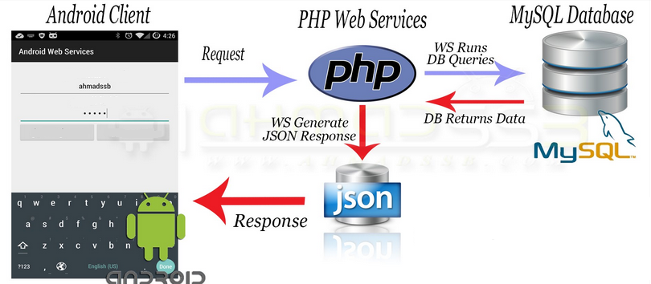
FLOW CHART OF PROJECT

Slide 6


APPLICATION REQUIREMNETS
Hardware Requirements :-
Processor → 600 MHz Above
RAM → 512 Mb Above
Free Space → 100 Mb
Resolution (min) → 800*600
Software Requirements :-
OS → Android
Version (Min) → 4.0.1
Connectivity → Internet Connection

Slide 7
SUMMARY OF WORK DONE
System design model | Spiral model
Number of use cases prepared | 14
Number of sequence diagrams prepared | 4
Line of Code in project | 10000(approximately)
Line of Code in project excluding auto-generated code | 7000(approximately)
No of forms implemented | 23

Slide 8
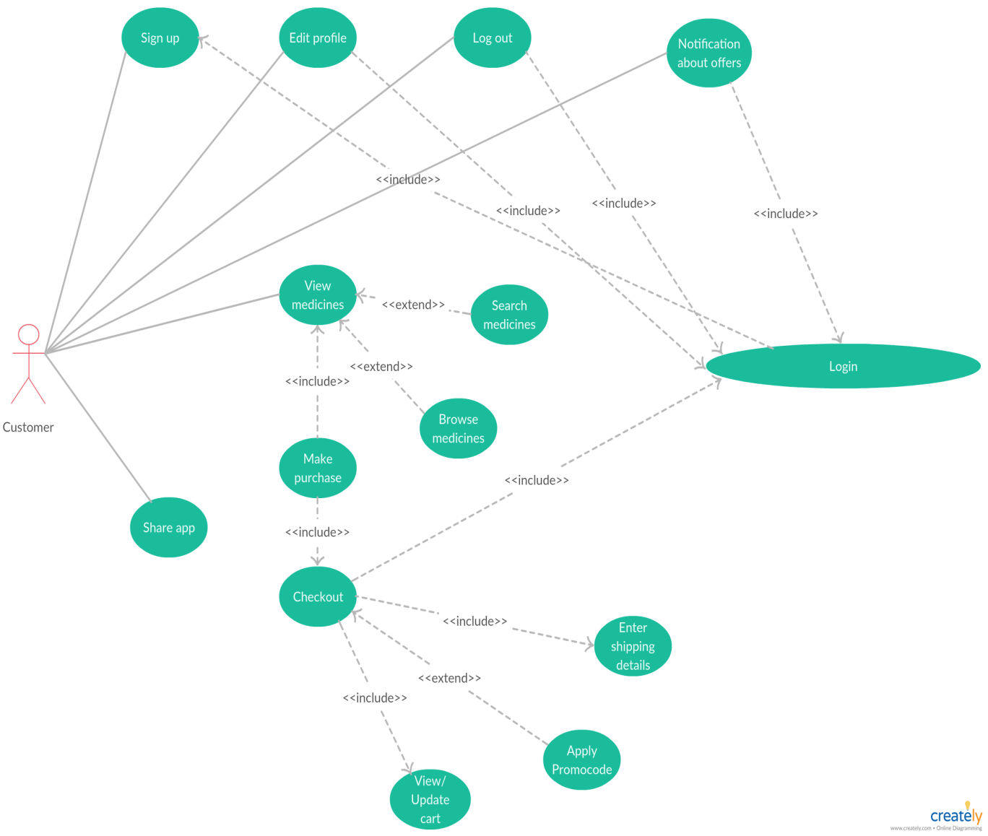
USE CASE DIAGRAM

Slide 9
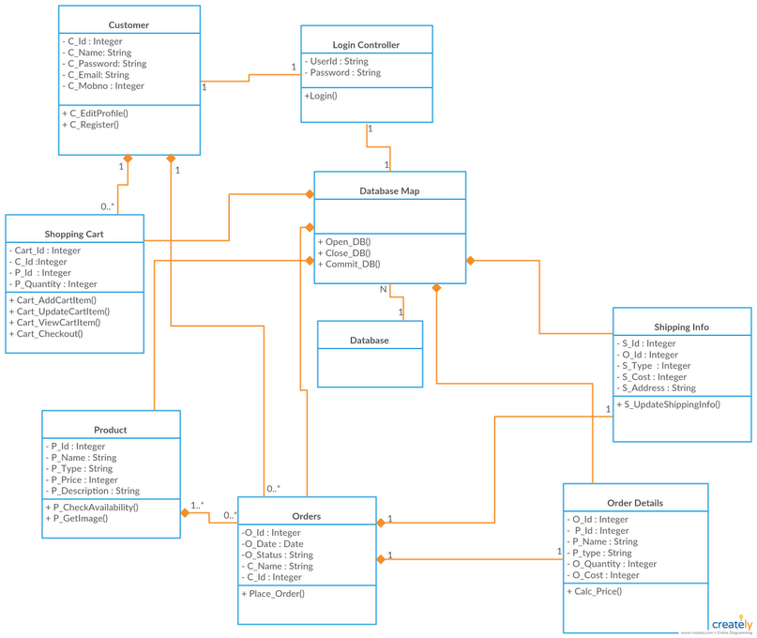
CLASS DIAGRAM

Slide 10
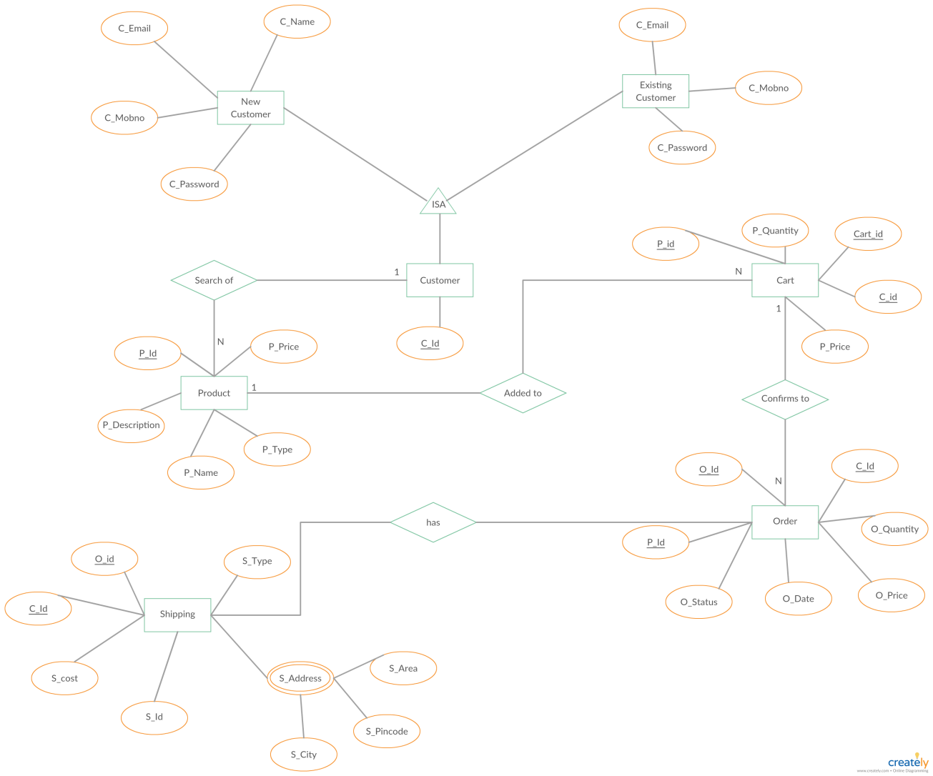
E-R DIAGRAM

Slide 11
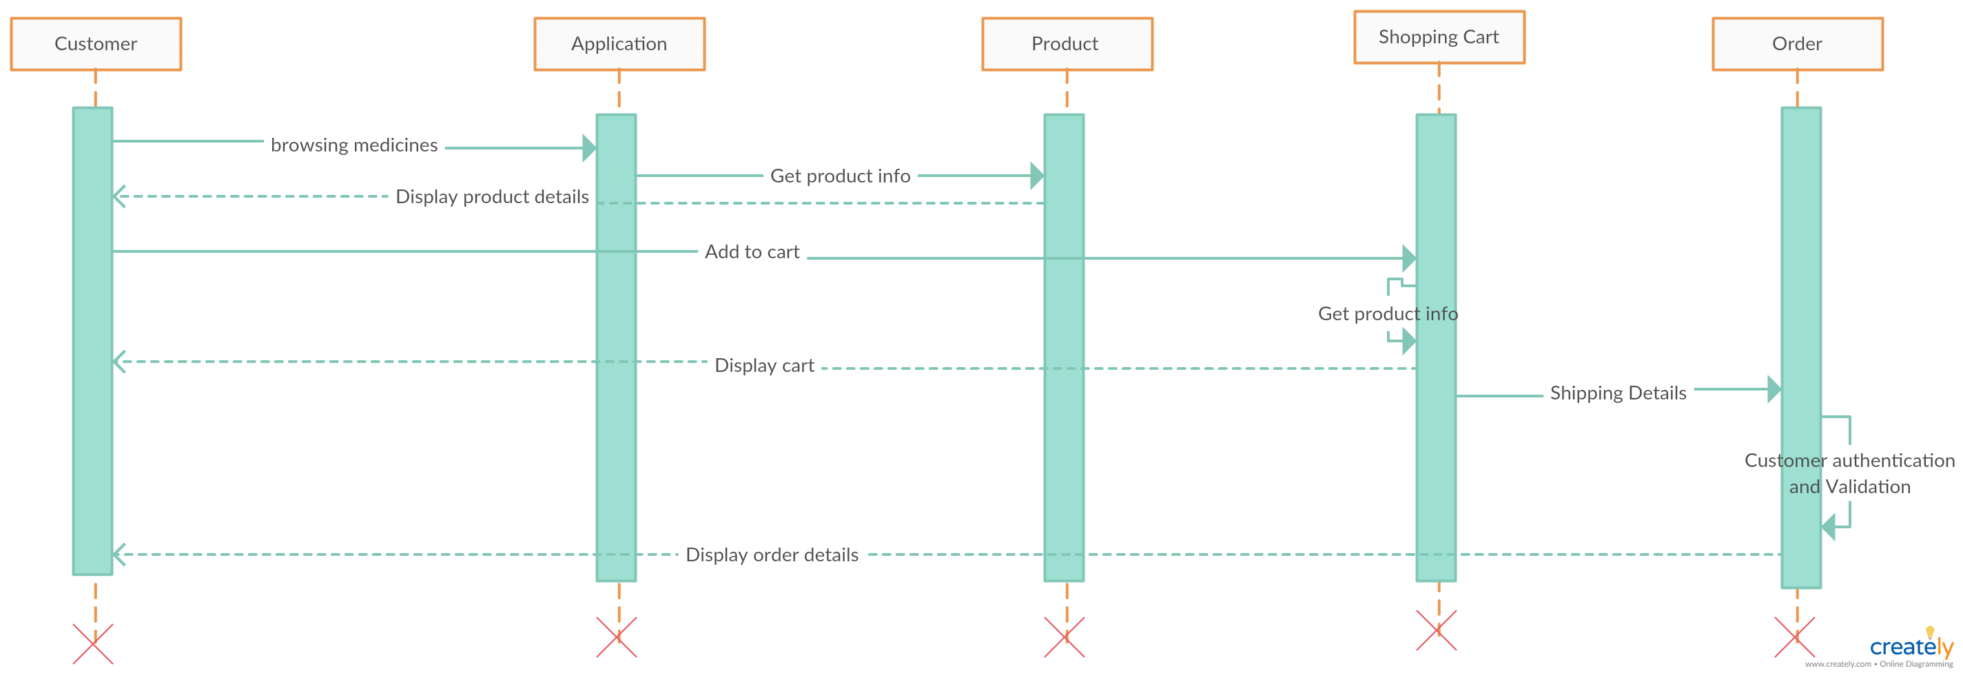
SEQUENCE DIAGRAM

Slide 12

SPLASH SCREEN
This screen appears as the0 application starts.

Slide 13
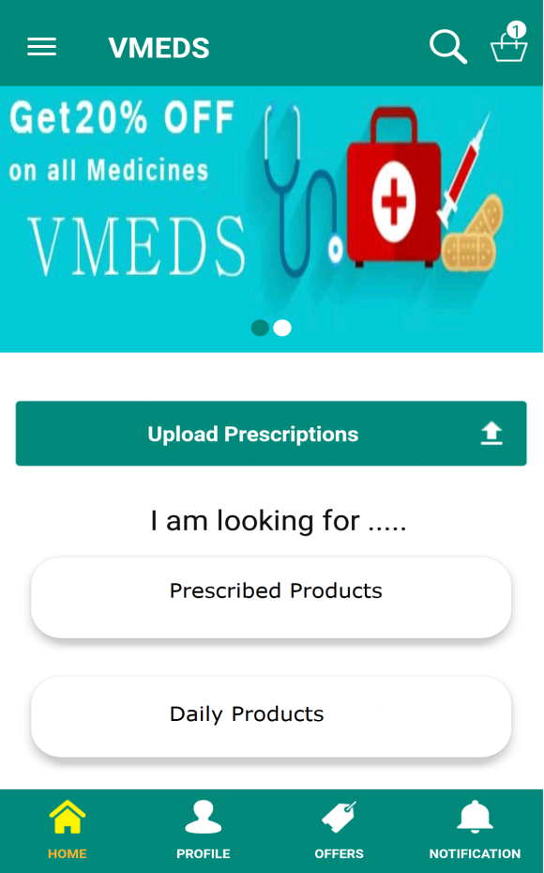
HOME SCREEN
This is the home page of the application from where the user can navigate to entire application.

Slide 14
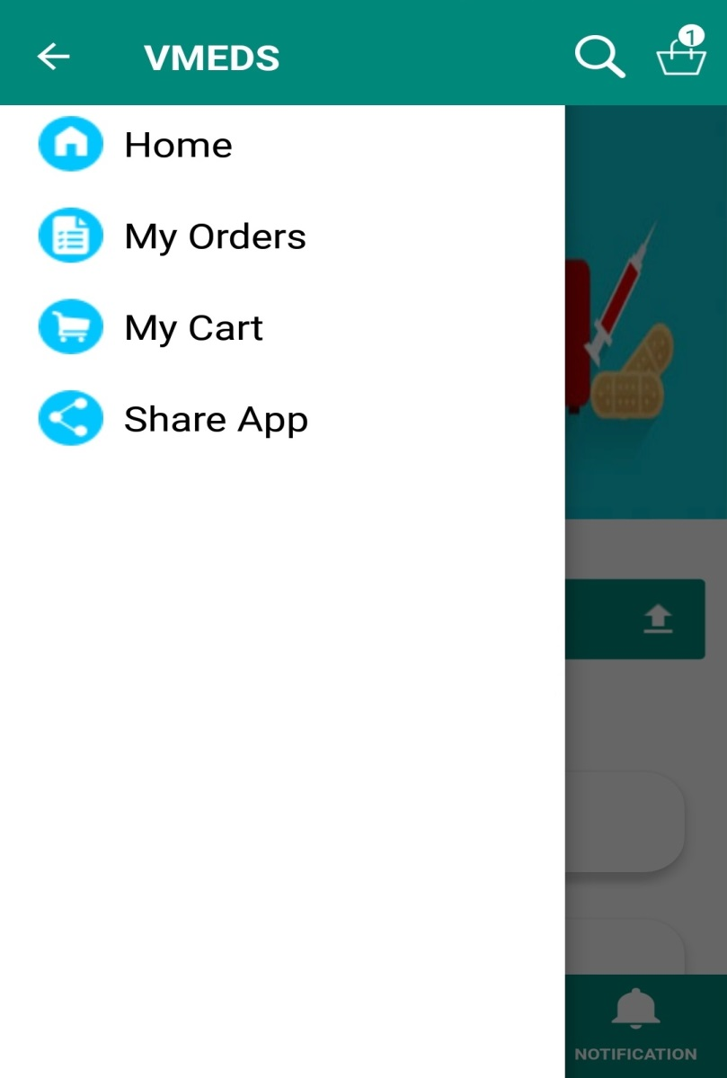
NAVIGATION DRAWER
It appears on clicking three lines at top left corner of the home page.

Slide 15
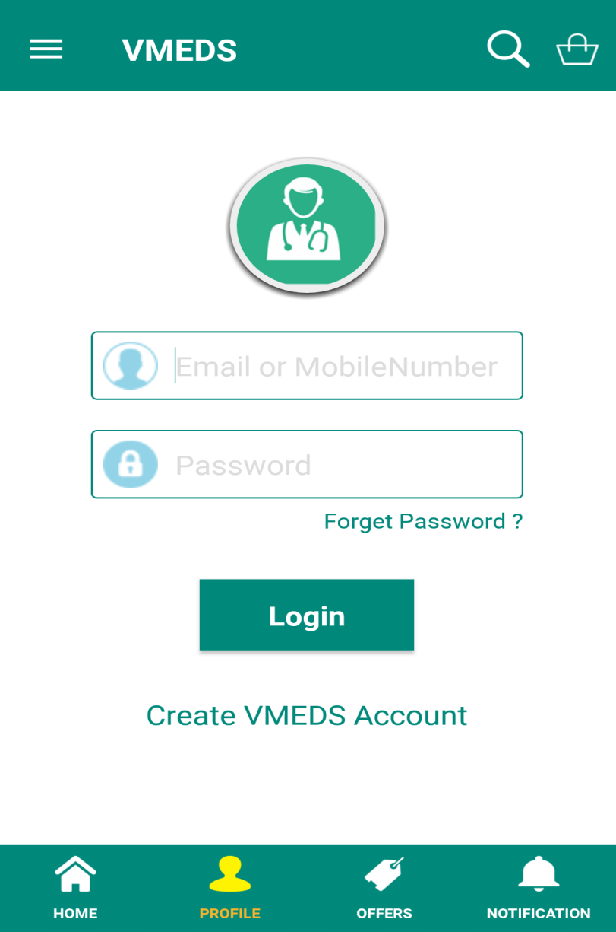
LOGIN SCREEN
This is the login page from which a user can login into his account.

Slide 16
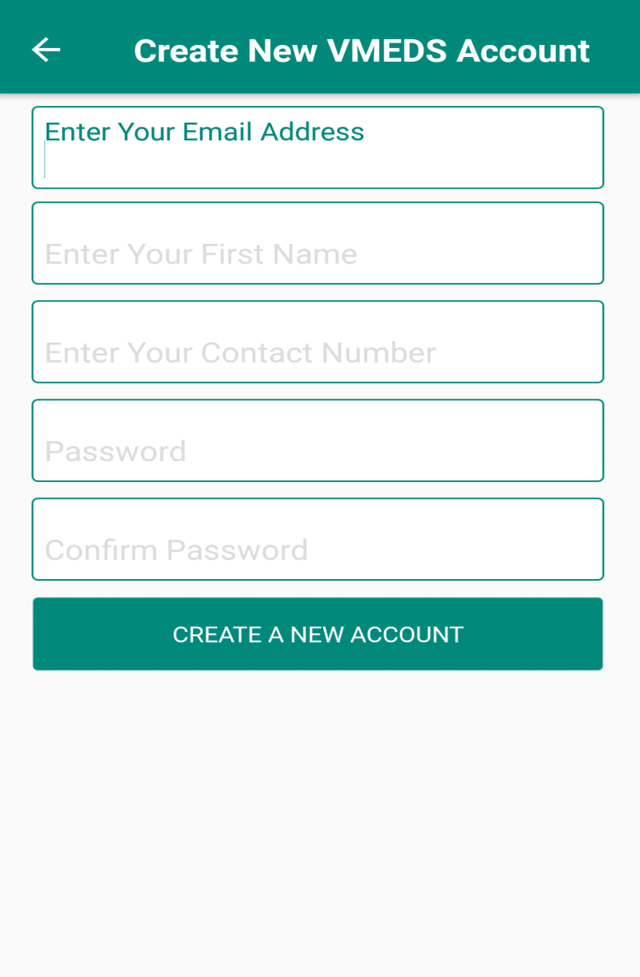
SIGN UP
This is the Sign up page from through which a user a register itself.

Slide 17
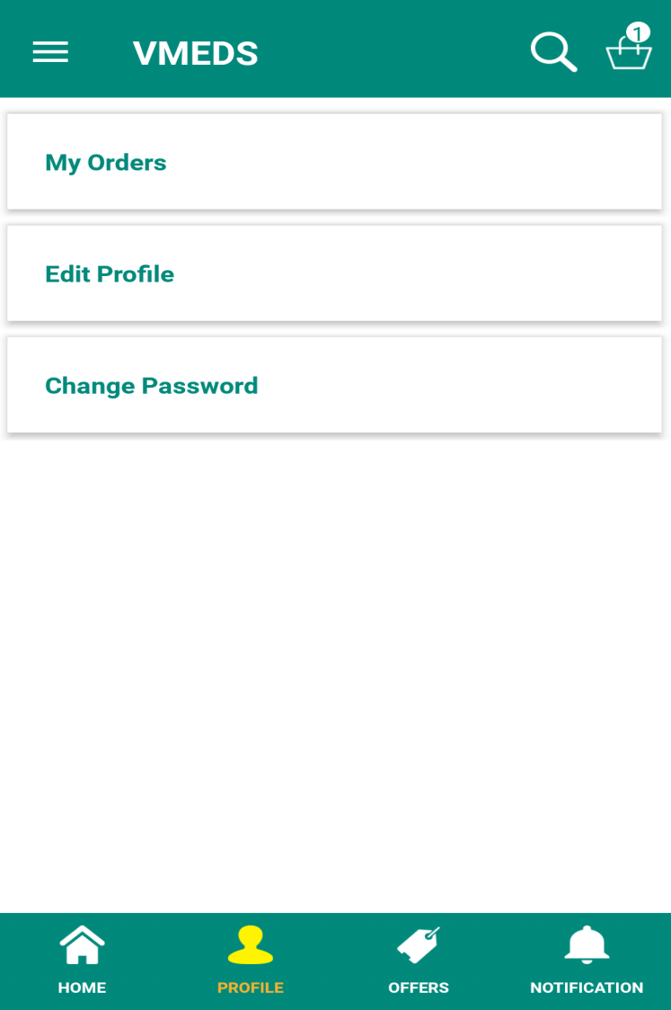
USER PROFILE
This is the user profile where
a user can access or edit various account account information.

Slide 18
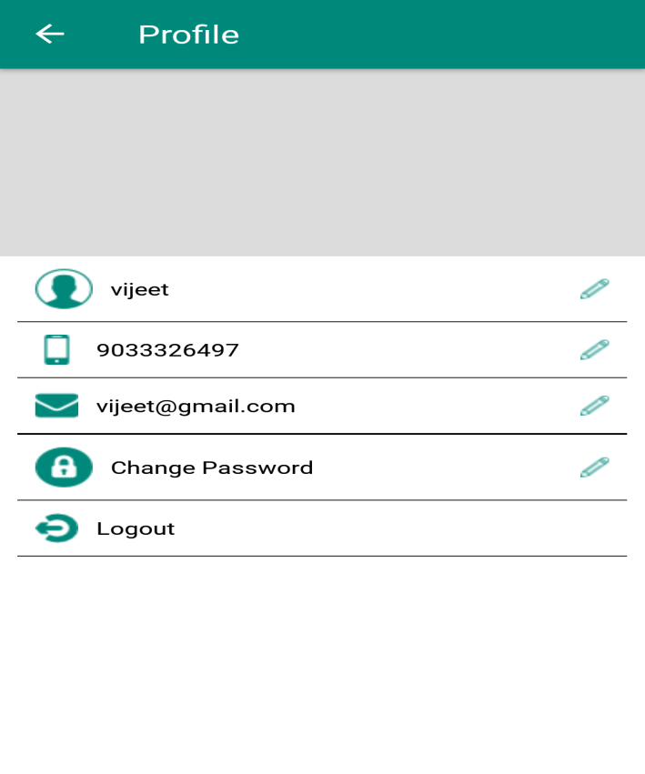
EDIT PROFILE
This is edit profile page from which a user can edit his information.

Slide 19
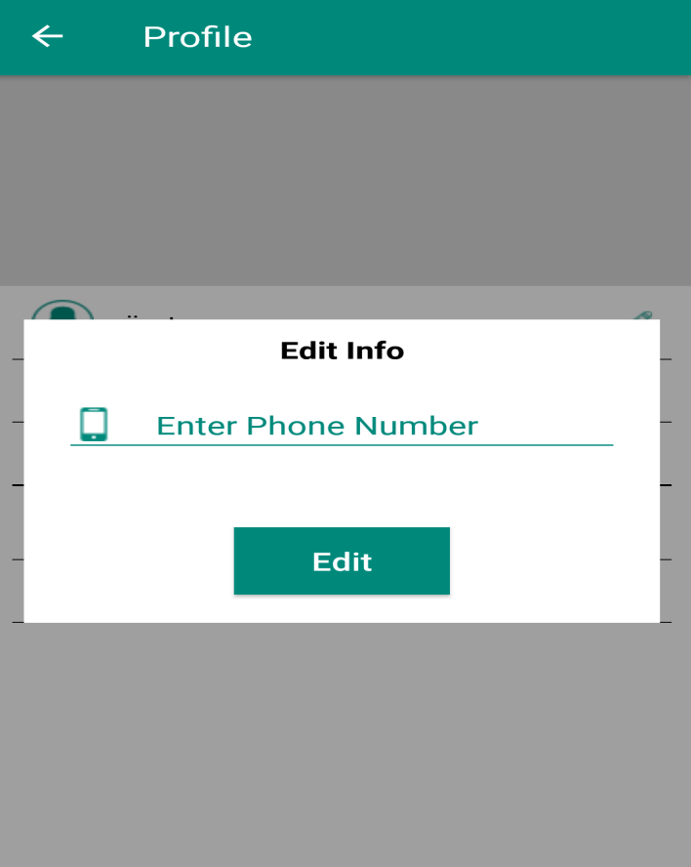
EDIT PROFILE
This is edit profile from which user can edit his various information.

Slide 20
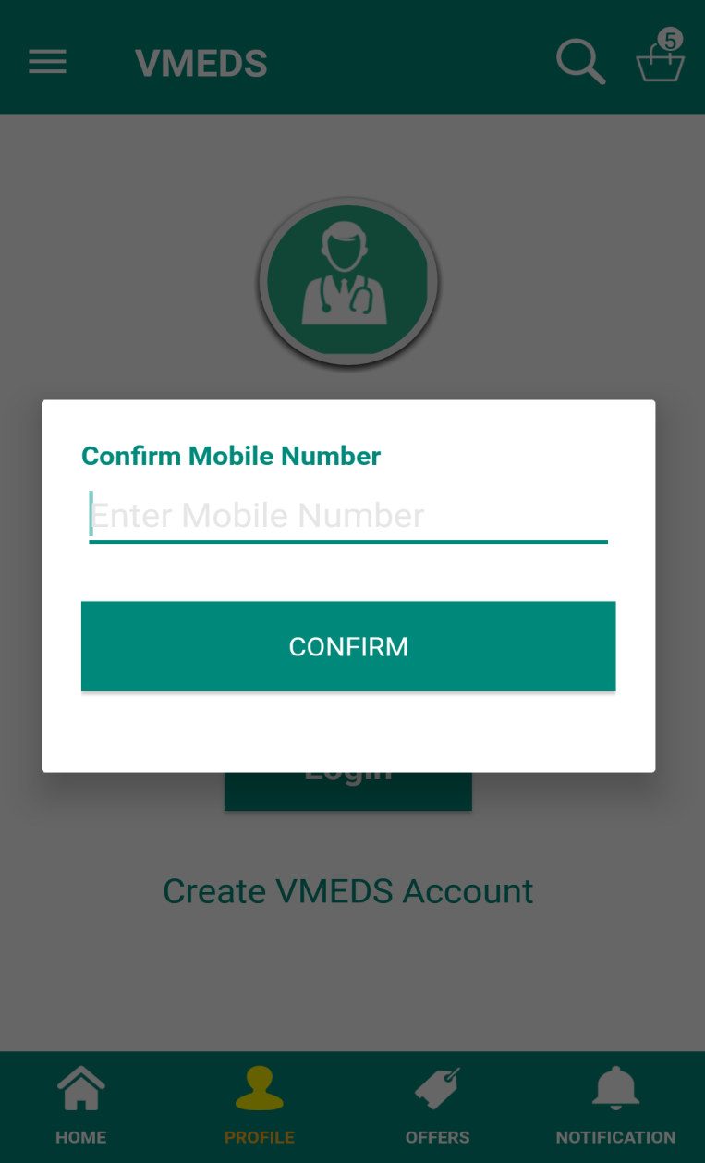
FORGOT PASSWORD
In case if a user forgets password an otp will be send to his mobile through which password can be reset.

Slide 21
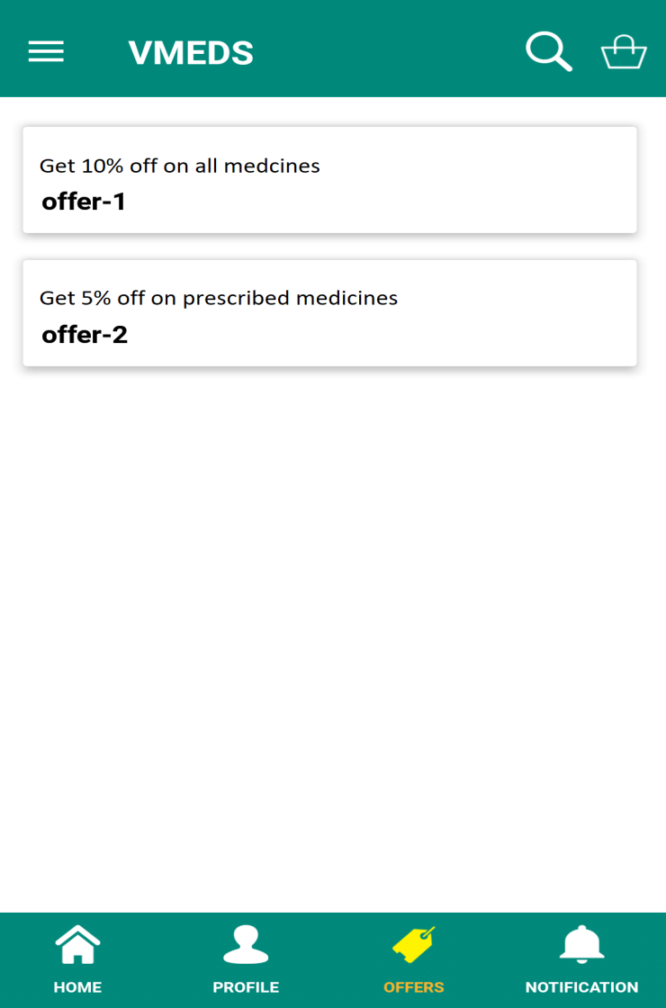
OFFERS SCREEN
This screen contains all the available offers.

Slide 22
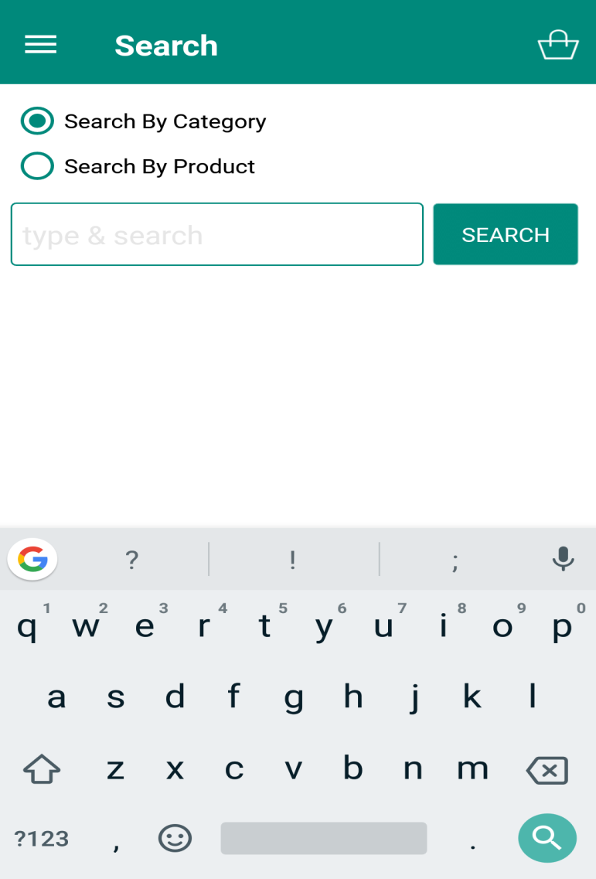
SEARCH MEDICINES
This is the search page from
user can search medicines.

Slide 23
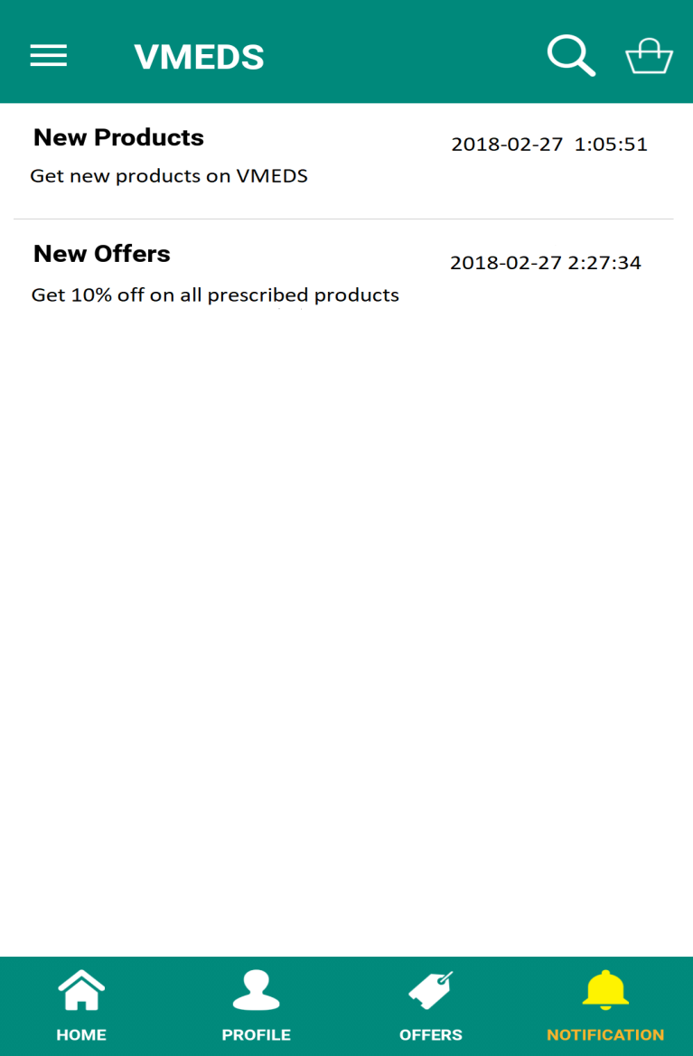
NOTIFICATION SCREEN
This screen has all the notifications which are sent to you.

Slide 24
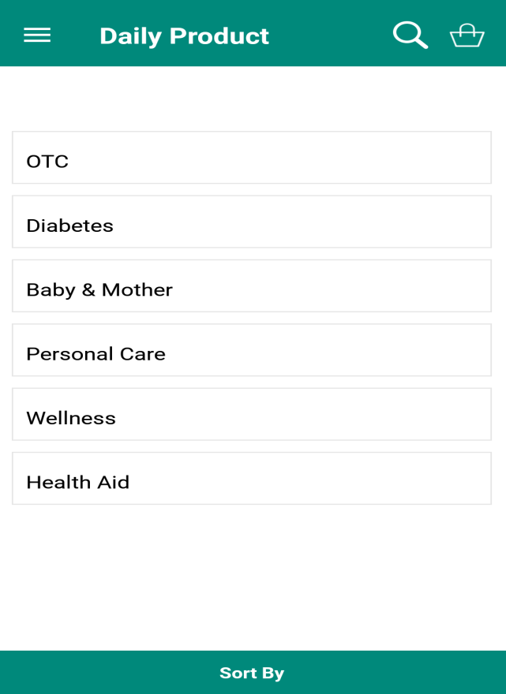
DAILY PRODUCTS
After clicking on daily products there are different categories available.

Slide 25
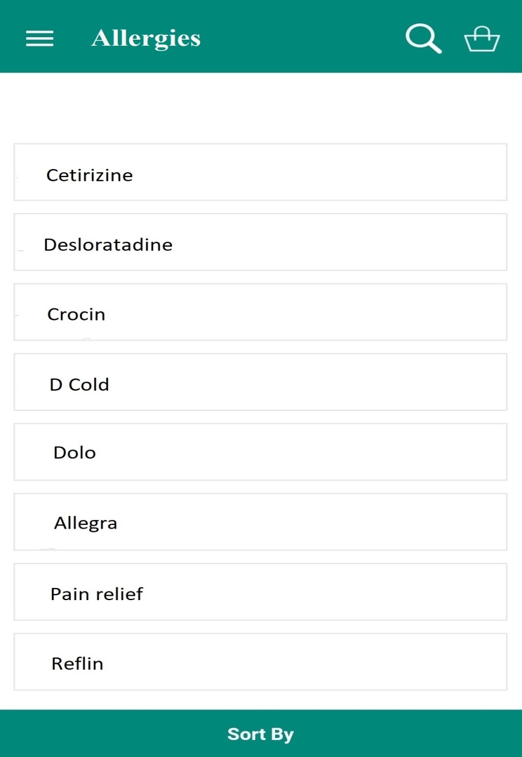
SUB CATEGORY
These are the sub categories of
categories of daily products.

Slide 26
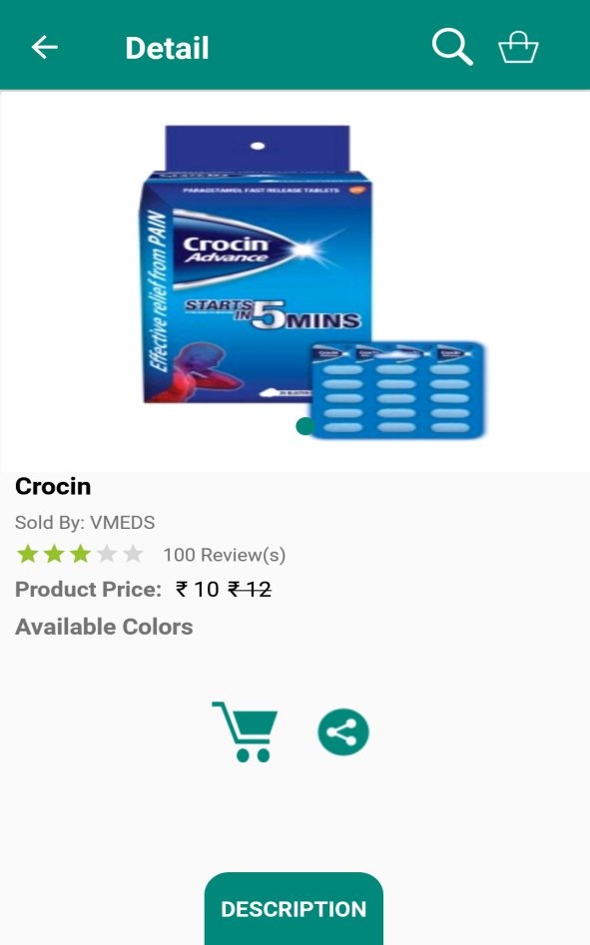
PRODUCT SCREEN
This is the screen of the particular medicine.

Slide 27
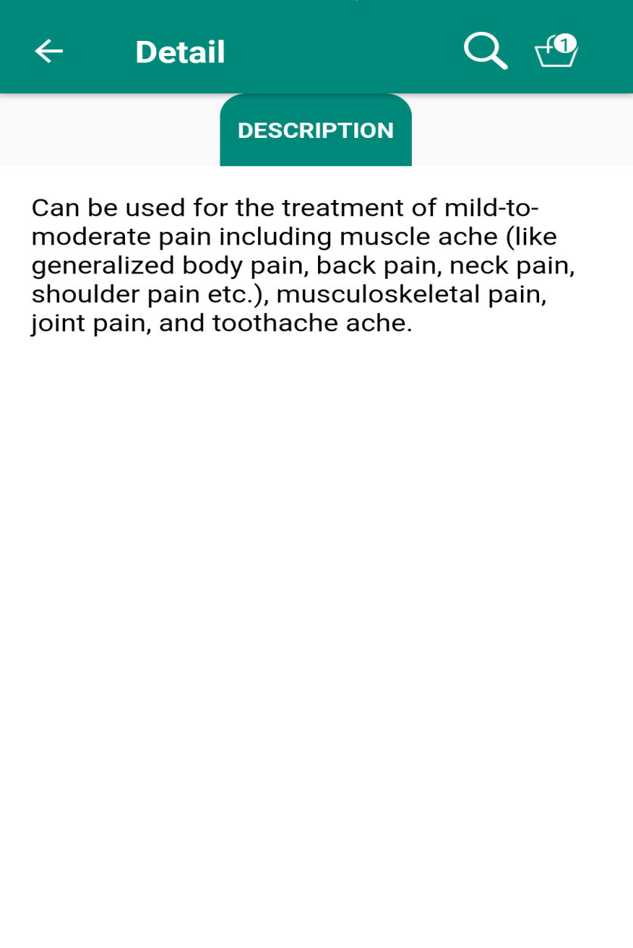
DESCRIPTION SCREEN
When description button is clicked on the particular product a detailed description is shown.

Slide 28
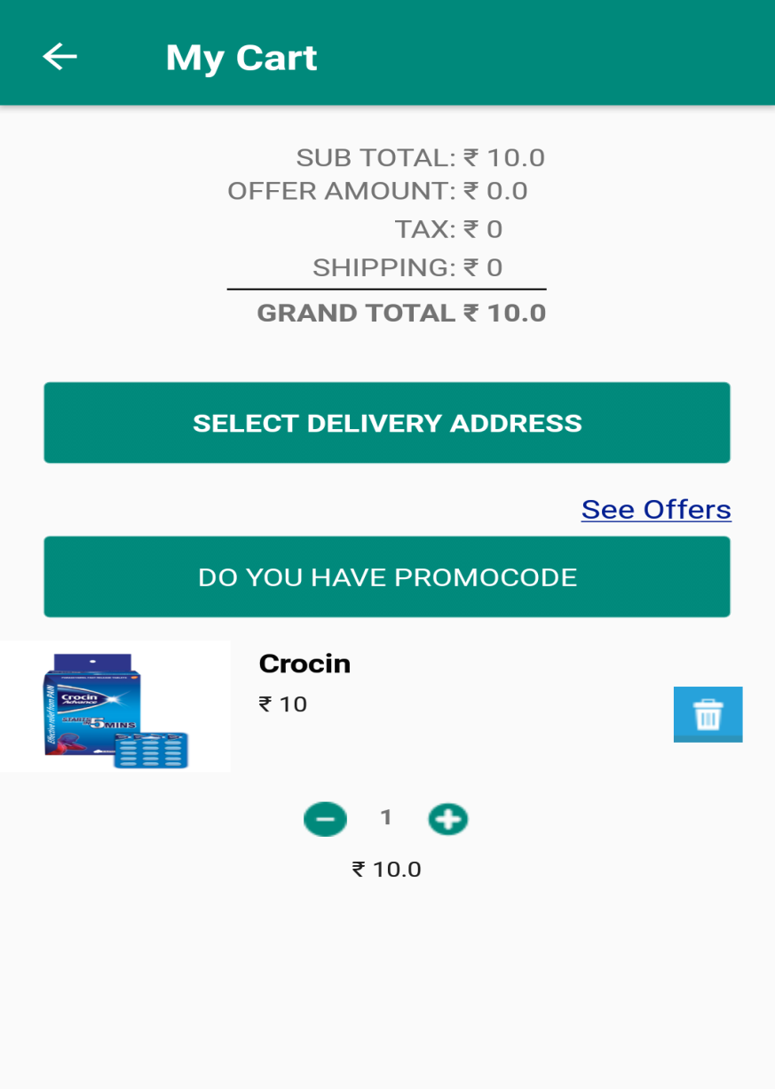
MY CART
This is the shopping cart where all the added medicines are displayed.

Slide 29
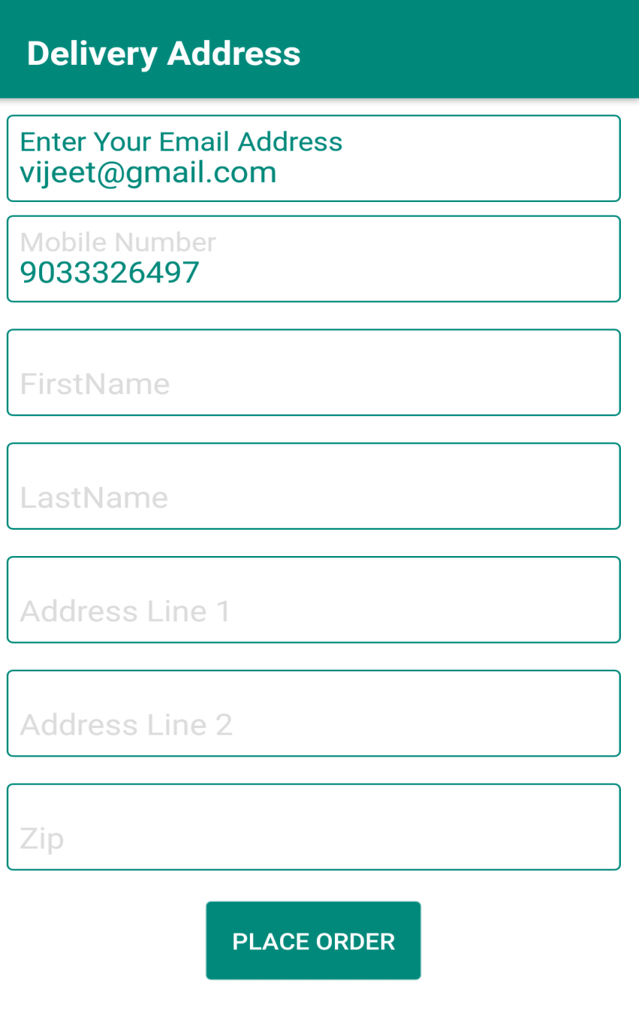
SHIPPING DETAILS
After adding shipping details an order can be placed.

Slide 30
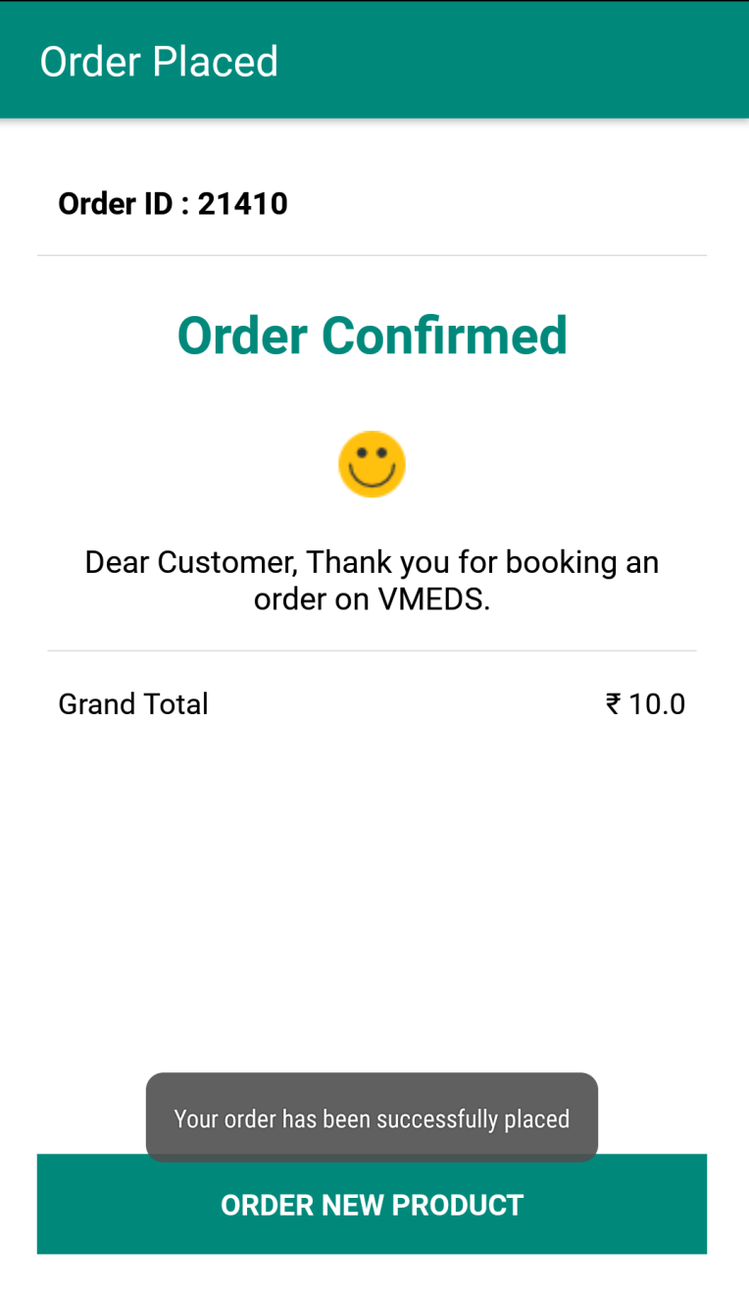
ORDER SUMMARY
This is the order summary where all the information about ordered medicine is displayed.

Slide 31
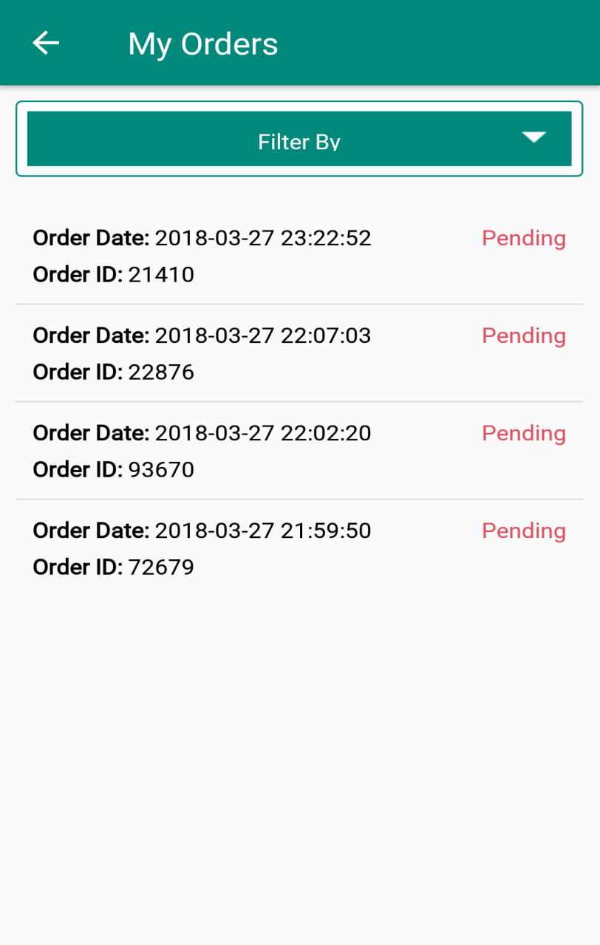
MY ORDERS
My order contains all the ordered medicines with their information.

Slide 32
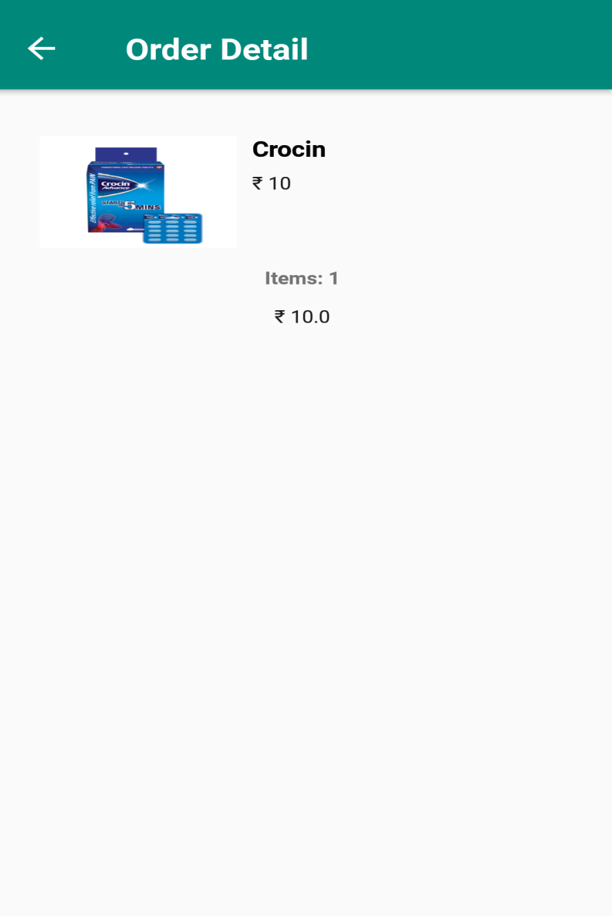
ORDER DETAILS
A After clicking on one of the orders in the My orders, it’s order details are shown.

Slide 33
CONCLUSION
The conclusion is that the project, Online Medical Store is working successfully and is providing a great experience to its users. The project can be further enhanced for the better performance and accuracy.
This Project was a more of a learning phase and exposing myself to the industry. I experienced that developing this software helped enhance my technical skills of programming, managing time and resources, working in team and many other aspects.

Slide 34
FUTURE ENHANCEMENT
I will like to implement other payment options and third party applications for payment.
In case if a medicine is not available I like to have a substitutes option so that customer can purchase medicines.
I will like to have a wish list feature in which user can save his favourite products.
I will like to implement admin panel which manages the entire application.

Slide 35
REFERENCES
https://www.stackoverflow.com
https://www.tutorialspoint.com
https://www.androidhive.com
https://www.developer.android.com

Slide 36
THANK YOU
.

