Slide 1


Where Every Search Leads to Success!
Vijendra Singh
Roll No: 20220756
Where Every Search Leads to Success!

Slide 2
OverView
HomeQuest is a real estate mobile app to simplify the process of finding and buying/renting Home, Office, Warehouse, factory etc
revolutionize way to search property with Map and grid View via Virtual reality or Augmented realty site tour

Slide 3
Features
Revolutionizing property search and buying/renting process by simplifying user interface
Grid and map view with interactive filtering with AR interface
Two-way communication with buyers, sellers, and agents to build trust

Slide 4
Features
Feed back, Review and Rating for trusted agents and hot property
Social Media Sharing with friends and family for easy decision
Incorporate virtual reality (VR) or augmented reality (AR) technology to provide immersive virtual property tours for saving time and effort

Slide 5
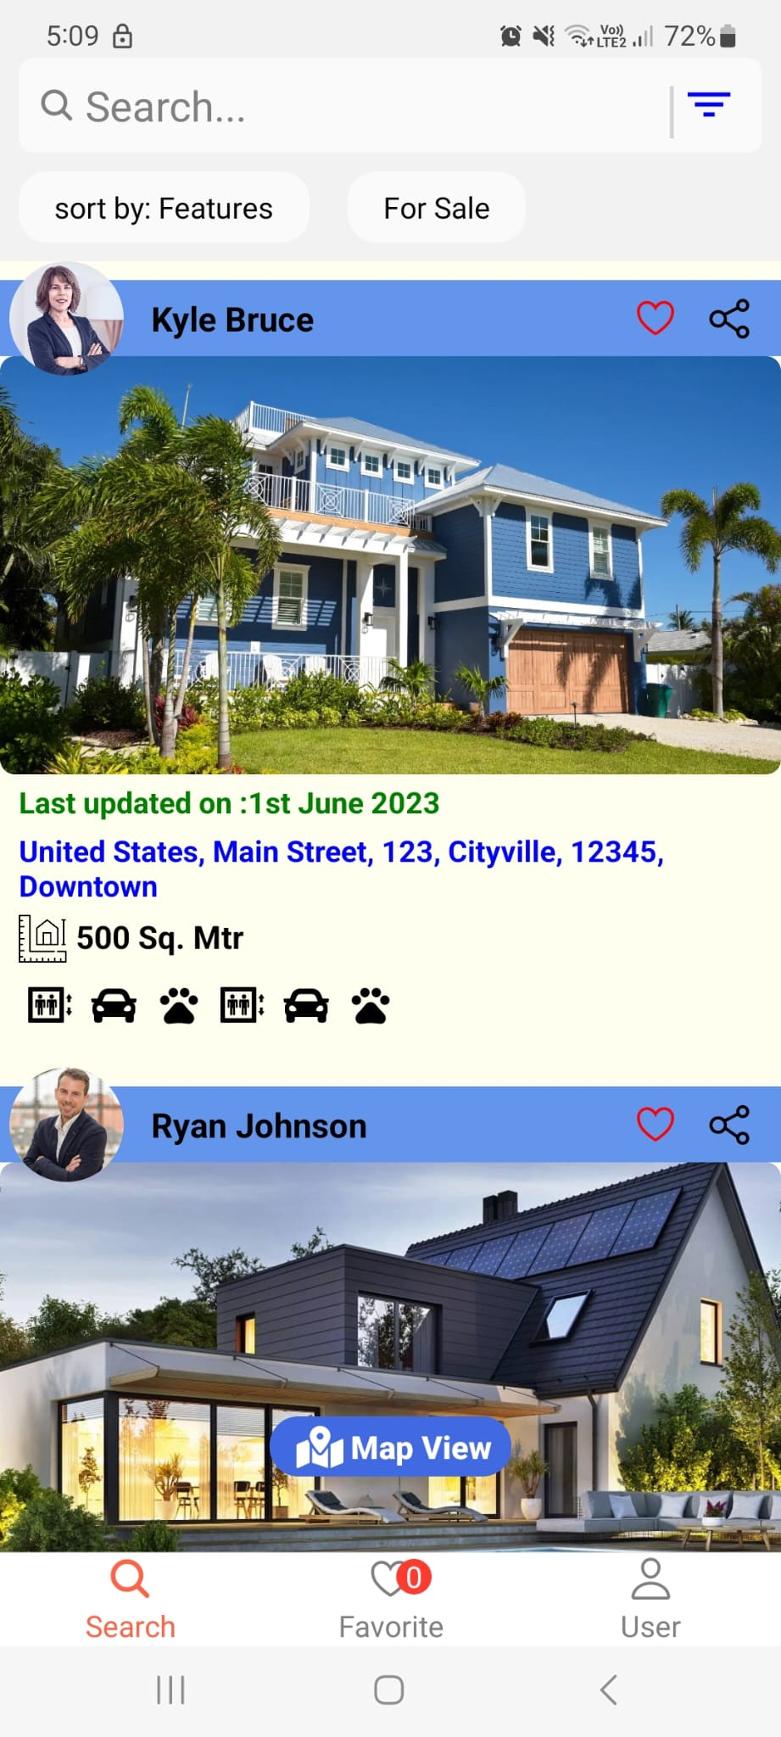
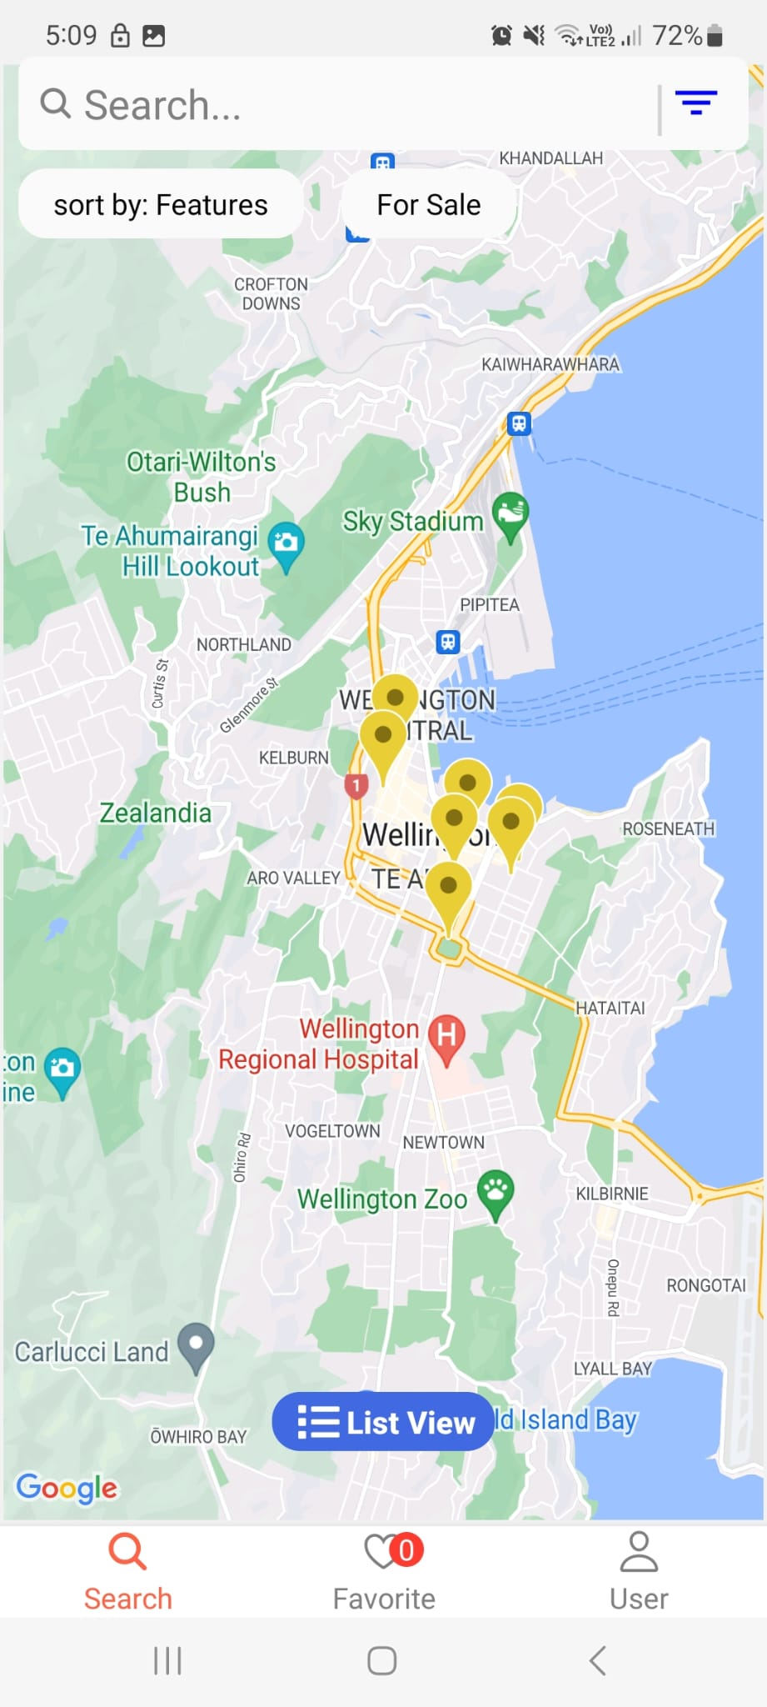
App View

Slide 6
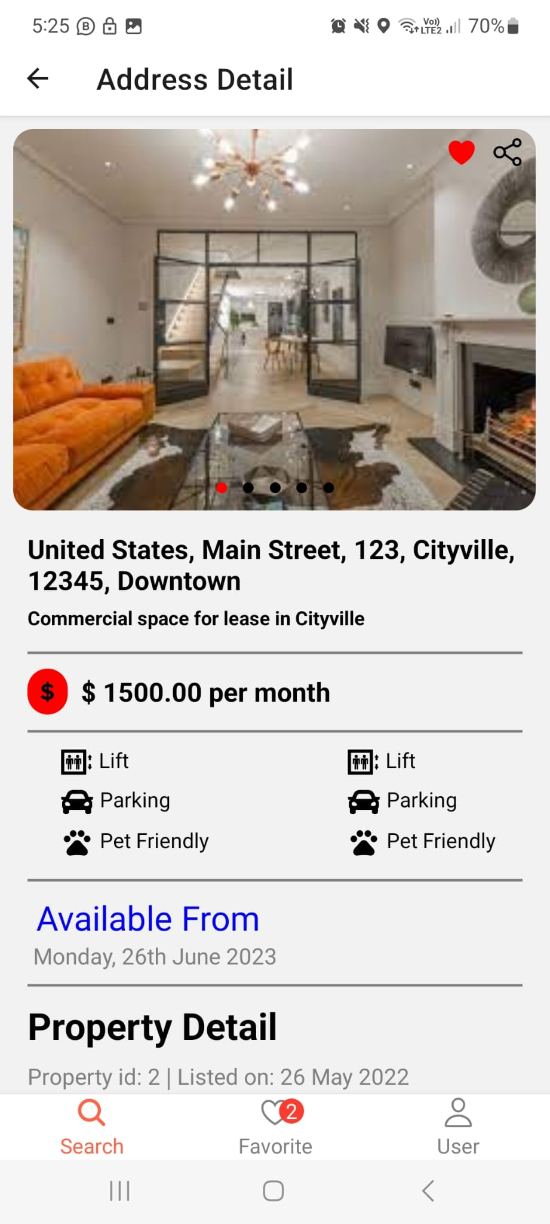
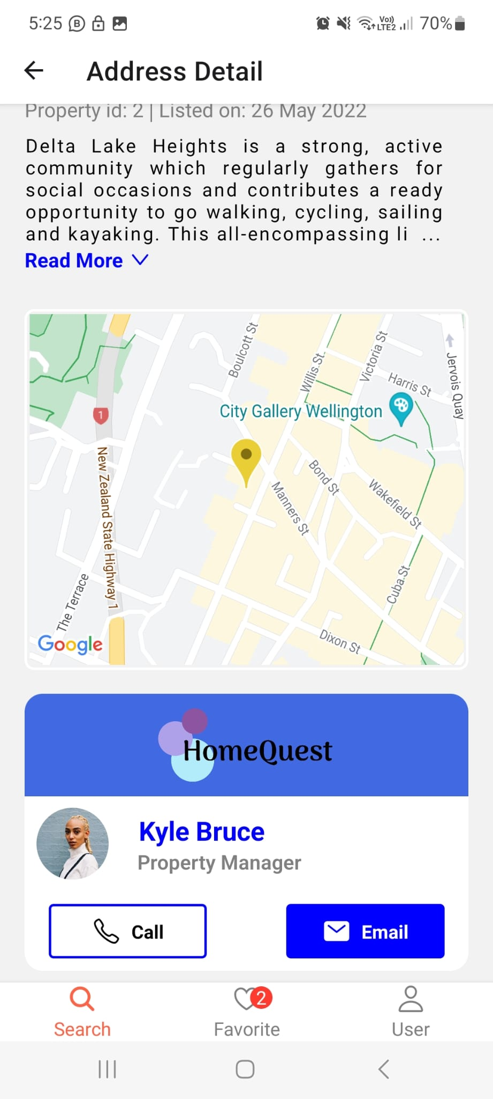
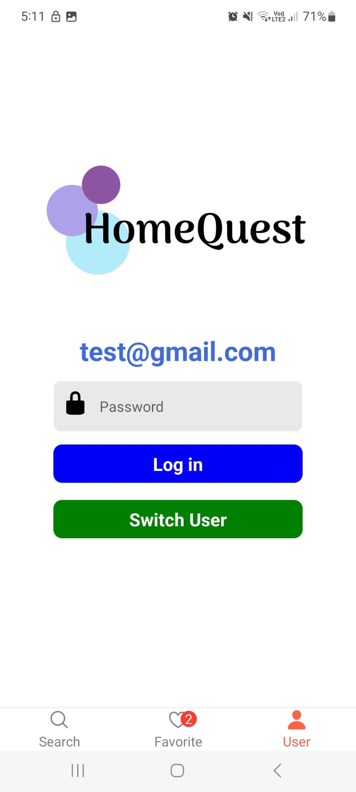

Slide 7
Challenges
User Interface Design :
for a simplify layout for best user experience , conducted usability testing and with iterative user feedback and followed design principle and best practice for cohesive interface achieved simple design to switch view and filter data

Slide 8
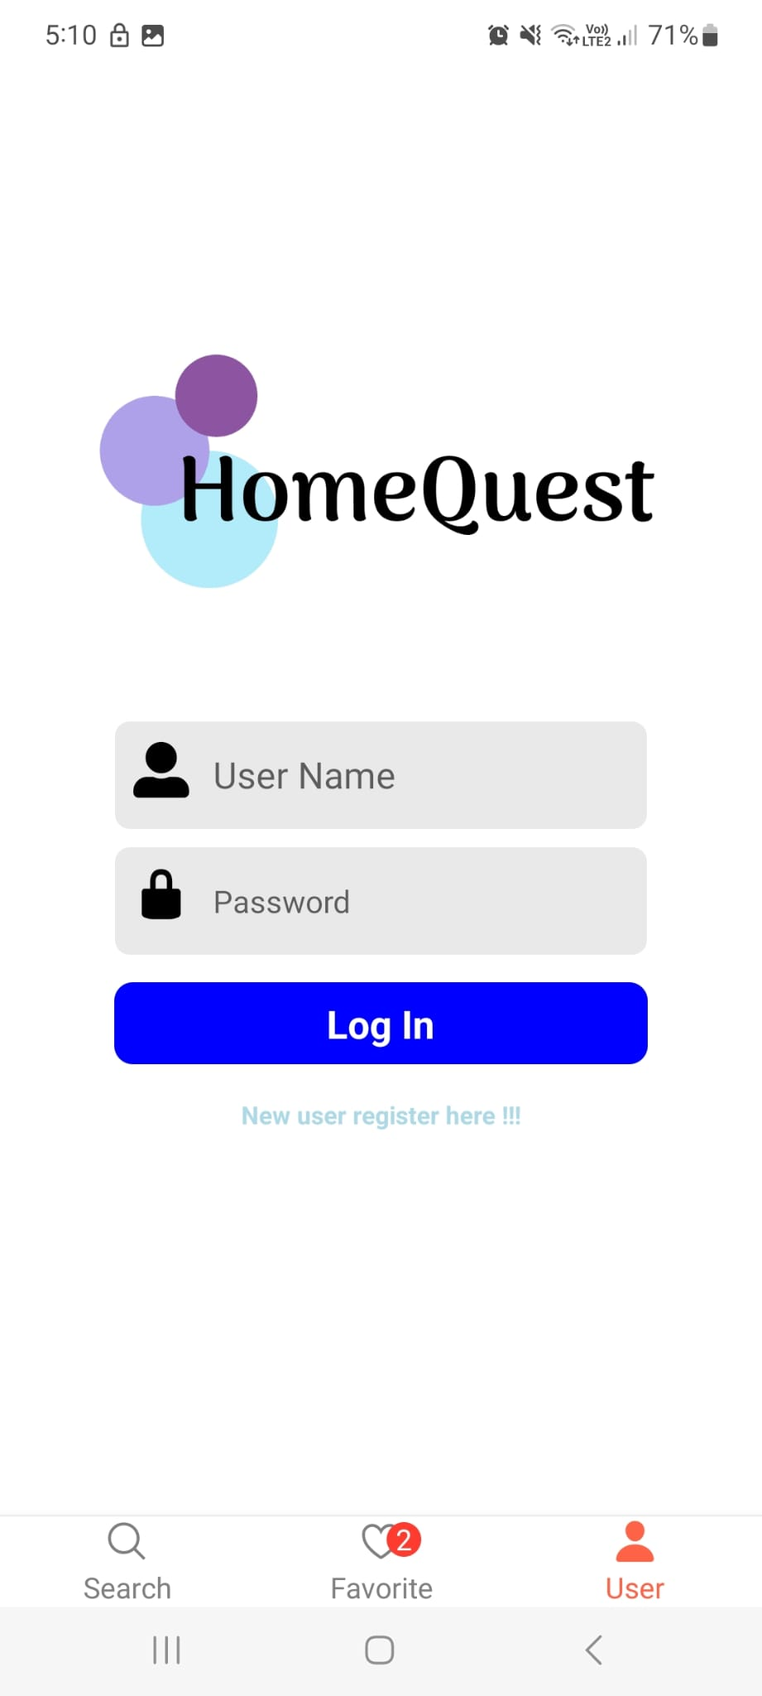
Challenges
User Interface Design :
Login feature for user to save time, use last login information. we use Async storage for last user credentials

Slide 9
Challenges
User Interface Design :
Add favourite property and update total number of properties in bottom navigation , Utilize Redux-Toolkit for centralized database management and provide quick overview of favorite property quality

