Slide 1
Defect Management System
Vijendar Gudipelli
Vijendarreddy.g@gmail.com

Slide 2
Executive Summary
Classical case of NLP Classification Task.
81% Accuracy(on new data) with tuning the Hyper parameters.
In Description has few clusters/similarity. Seems like these were bongs to specific scenario of Defect/Intent.
Similarity in Invalid defect comments as well.
Traditional ML Models were overfitting for the given small of Data.
Topic model embeddings were also poor results.
Intent recognition Deep Learning Models performed poorly, need to fine tuned.
For generating comment text for Invalid defects, we need to collect more data and with proper Text.

Slide 3





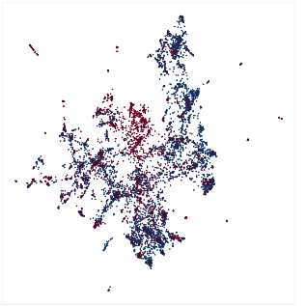

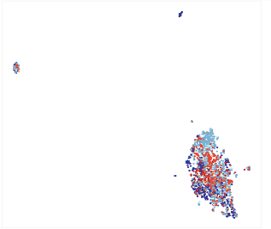

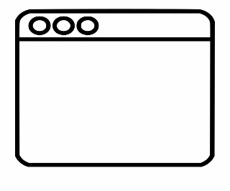


Process Flow
Supervised
Un Supervised
Input Description, Priority, Product Category
Description
Application ID
Status
.
Comments
Application ID
Status
.
Traditional ML Models
Deep learning Models
Clustering/
Intent Recognition
Classification
Input Data from GUI
Deployment
Valid - 80%
In Valid - 20%

Slide 4
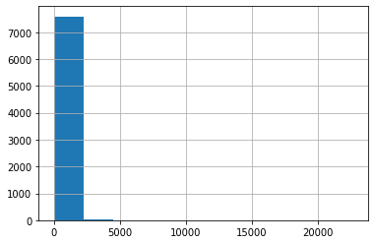
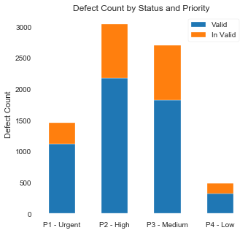
Exploratory Data Analysis
Average defect Description length is 550 and Max is 22k.
Oversampled with Valid Defects (70-30)
No correlation between priority and status.
Proportional distribution.

Slide 5
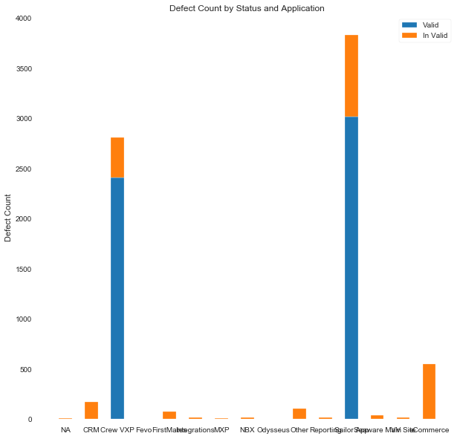
Cont
Top 2 application accounts for 86% of defects.
Only 2 Application have Valid Defects.
Application info is highly correlated with Status output.
This might be sampling error.

Slide 6
Classification
Traditional ML Algorithms are overfitting on Description text Data
Naïve Bayes performs better in Capturing the maximum information/generalized bias.
Priority feature hasn’t improved the metrics.
Application info is biased.
Context embeddings(LDA) were also performing poorly.
Deep Learning Models (BERT), hasn’t shown good results (tried initial modeling)

Slide 7
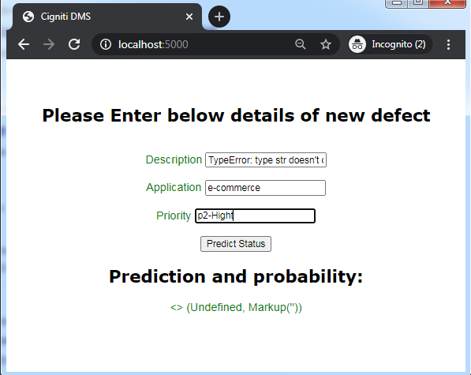

Deployment
Deployed Naïve Bayes Model.
Takes Description, Application Name and Priority info.
Predicts Defect status and probability of classification.

Slide 8
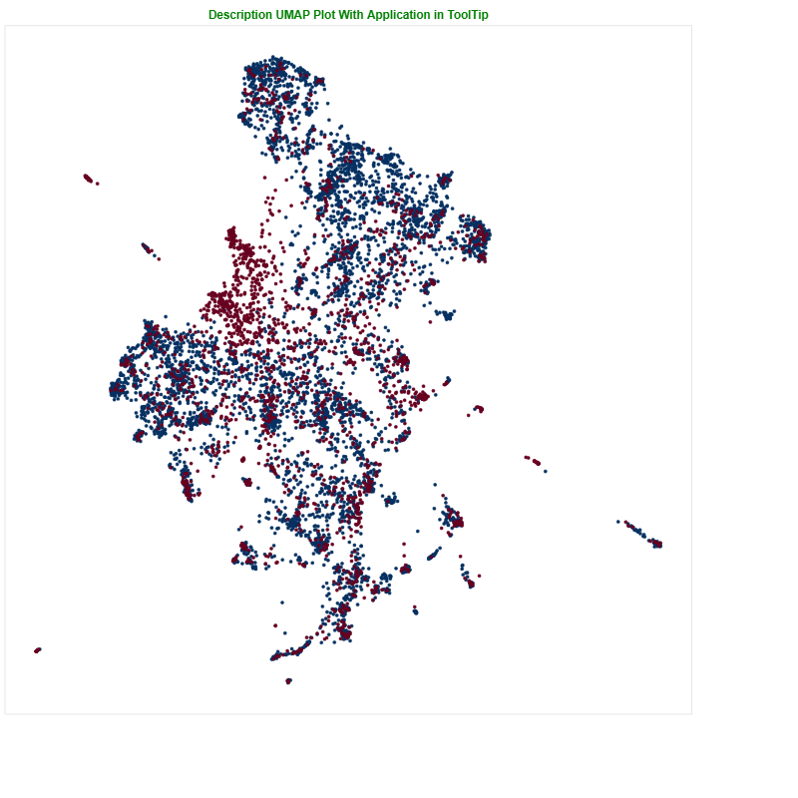
Clustering Analysis
Description text has intuition for Valid and In Valid Defect.
Clusters are of same Application and/ Priority.
Business Knowledge and Cluster info help in better classification models.
Top2Vec and Clustering will add more value.

Slide 9
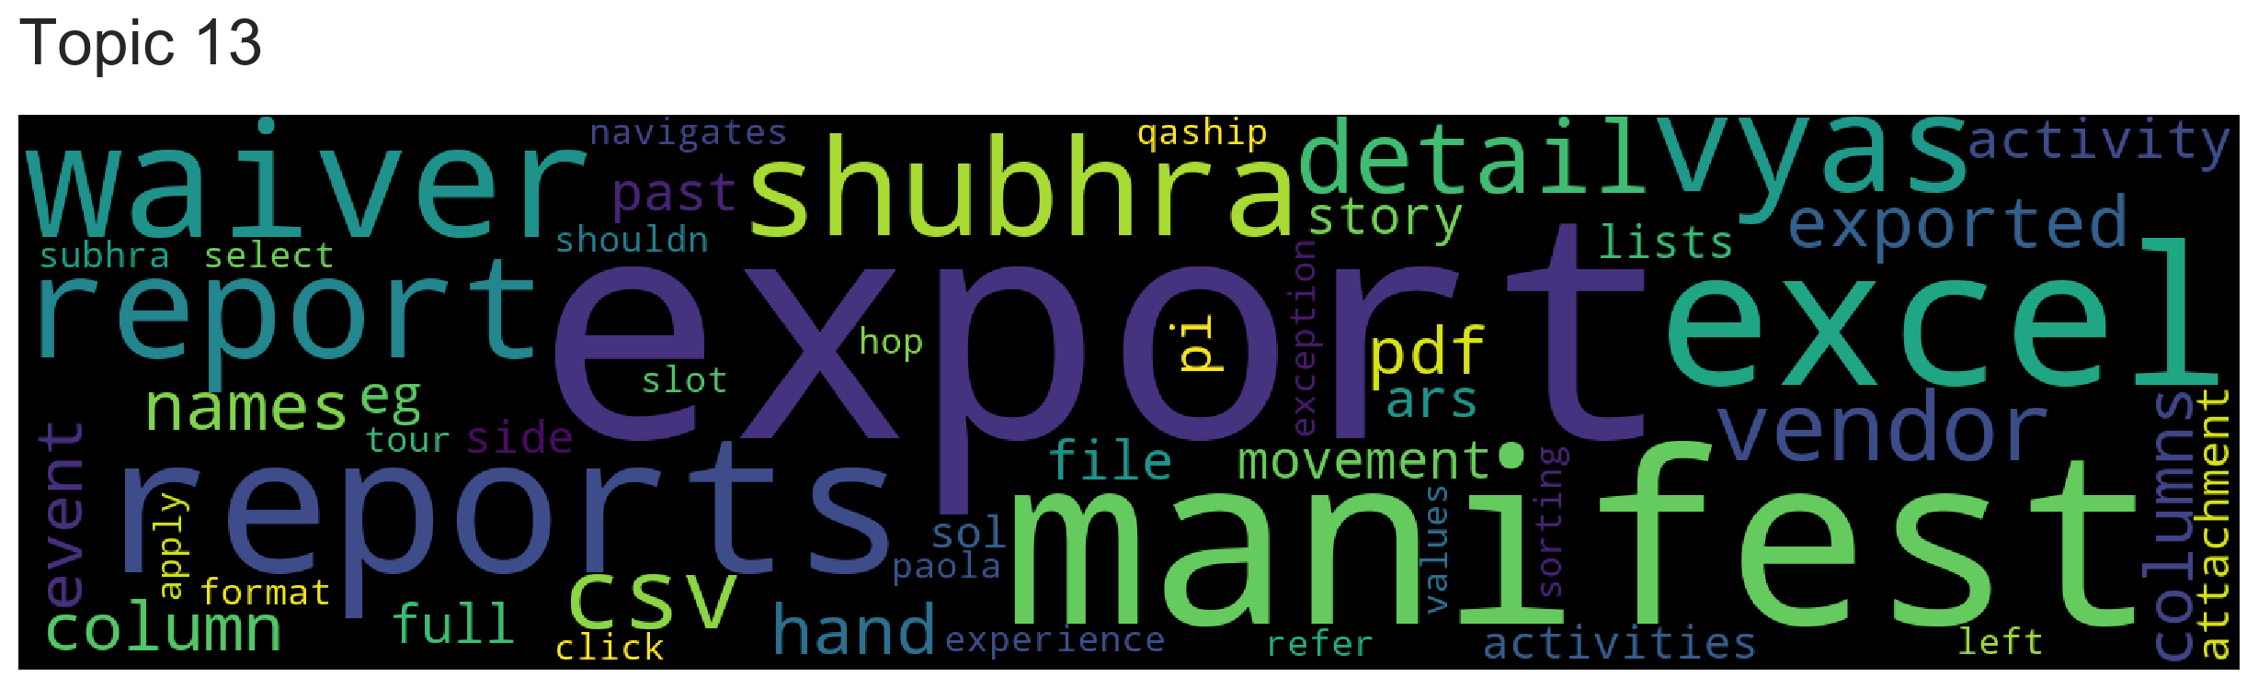
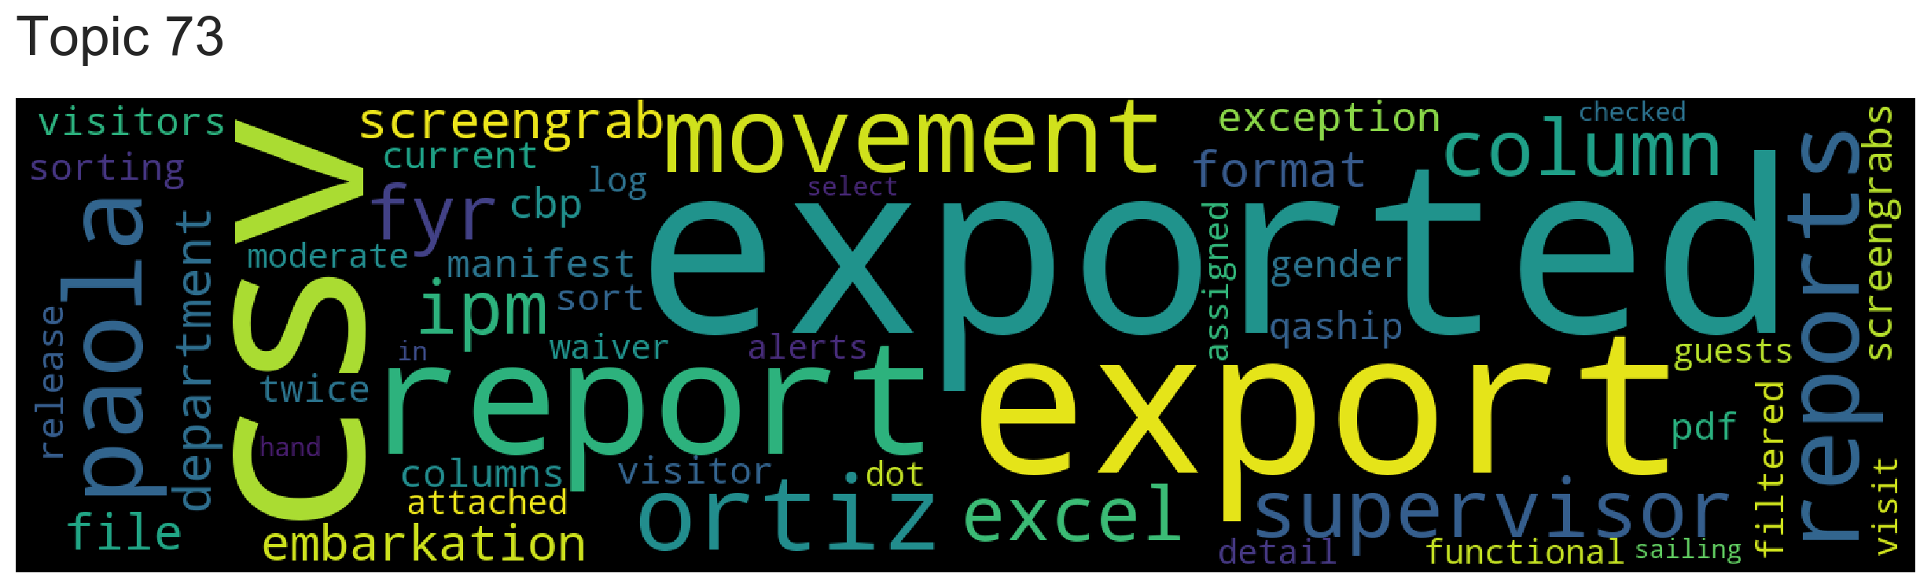
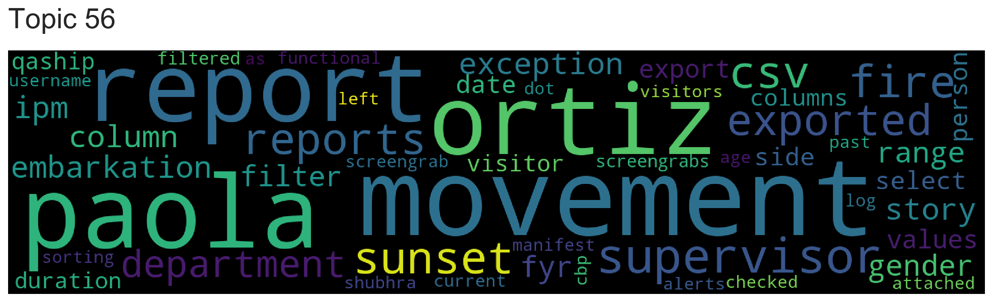
Top2Vec - Wordcloud of Duplicate

Slide 10
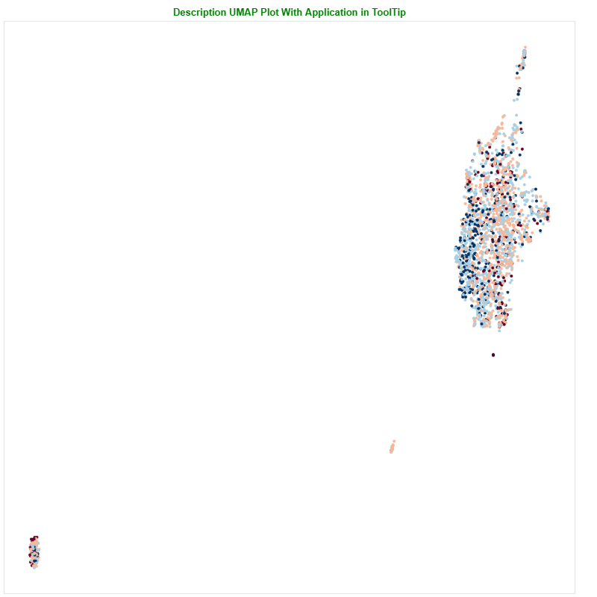
Comment Text
Patterns in comment text.
Color code with priority and Application info in tooltip.
Helps in comment text generation

Slide 11
Recommendations
Collect more Defects data for better results.
Label proper/reasonable comments for Invalid Defects.

Slide 12
Queries..?
Thank you..!

