Slide 1


K.RAMAKRISHNAN COLLEGE OF TECHNOLOGY
(AUTONOMOUS), TRICHY.
DEPARTMENT OF
COMPUTER SCIENCE AND ENGINEERING
20CS5501 DESIGN PROJECT-1
Batch No. : 20
Date : 07.12.2024

Slide 2
Online Pre-owned/Used Car Management System
Guided by Team
Mr. P.Matheswaran,M.E.,(Ph.D)., Sivaprakasam K(811722104149)
Assistant Professor, CSE Vignesh V(811722104180)
Vijendhiran A(811722104183)

Slide 3
OBJECTIVE OF THE PROJECT
To develop an intuitive platform that enables users to search, view, and rent pre-owned cars seamlessly.
To provide detailed car information, including specifications, images, and ownership history, for informed decision-making.
To automate key processes such as listing, pricing, and availability updates to streamline operations.
To ensure transparency in transactions through fair pricing and clear terms.

Slide 4
ABSTRACT
The Online Pre-owned/Used Car Management System is a user-friendly web application designed to bridge the gap between buyers and sellers of used cars.
This system provides a streamlined platform where users can browse, search, and inquire about available pre-owned cars, eliminating the need for physical visits to showrooms.
Sellers can easily list and manage their inventory, enhancing their reach and visibility to potential buyers.
The application aims to simplify the car trading process, ensuring convenience, efficiency, and accessibility for all users.

Slide 5
LITERATURE SURVEY
TITLE OF THE PAPER | AUTHOR (S) | PUBLISHER | PAPER GIST | TECHNOLOGY USED
“A Comprehensive Study of Online Used Car Marketplaces” | John Doe, Alice Smith | International Journal of E-Commerce Studies, 2019 | This paper discusses various online platforms for pre-owned car transactions, focusing on their market reach, user engagement, and the technological features that enhance customer experience. | Web-based platforms, AI-powered recommendation systems, secure payment gateways, and third-party vehicle history APIs.
“Improving Trust and Transparency in Pre-owned Car Sales: A Blockchain-based Approach” | Michael Taylor, Emily Zhao | Blockchain Technology and Applications Journal, 2020 | The paper explores the use of blockchain technology to ensure trust and transparency in used car transactions | Blockchain, smart contracts, decentralized data storage, and peer-to-peer networking.

Slide 6
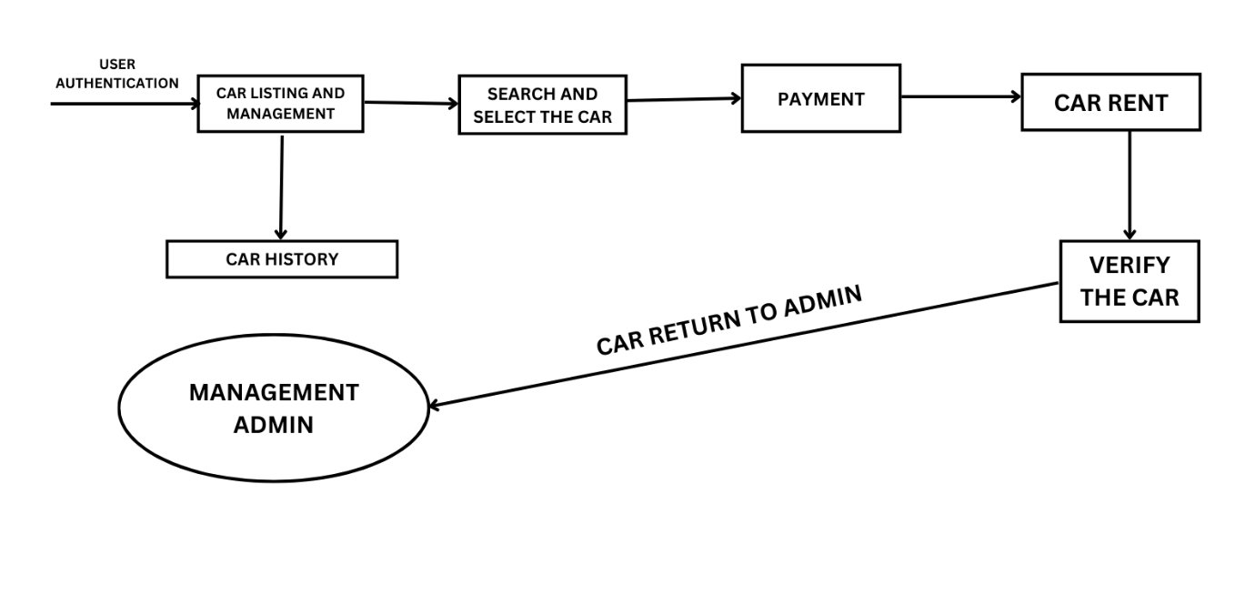
PROPOSED SYSTEM ARCHITECTURE

Slide 7
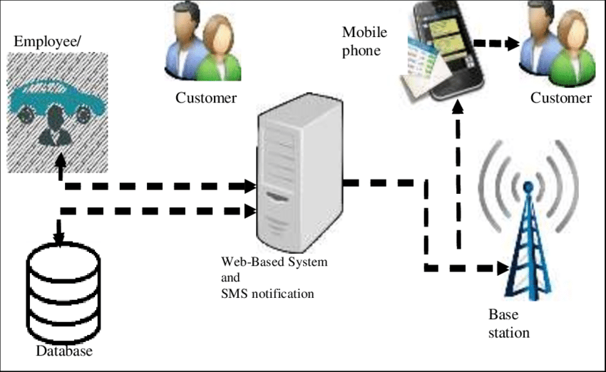
EXISTING SYSTEM ARCHITECTURE

Slide 8
SOFTWARE AND HARDWARE REQUIREMENTS
HARDWARE
SOFTWARE
Operating System: Windows/Linux/macOS
Database: MySQL or PostgreSQL
Backend Language: Python/Django, or Node.js
Frontend: React.js or Angular
Web Server: Apache or Nginx
API Integration: RESTful APIs for vehicle history and financing
Payment Gateway: Integration for secure transactions (PayPal, Stripe)
Server with a minimum of 8 GB RAM and 4-core processor
Secure data storage for car images and documents
Internet connection for data exchange between buyers and sellers

Slide 9
MODULES
User Module
Car Management Module
Search and Filter
ModuleBooking and Payment Module
Feedback and Review Module

Slide 10
SUMMARY OF MODULE-1 USER MODULE
The User Module is designed to handle the registration, login, and profile management for customers. It allows users to create an account, log in with secure credentials, and manage their personal details, such as contact information and payment methods. After logging in, users can search for pre-owned cars based on various criteria (brand, price, location, etc.) and view detailed car listings, including specifications, images, and condition reports. Users can also check availability, book cars for rent, and review their past rental history. Additionally, this module can provide users with notifications or reminders related to their bookings or account activities.

Slide 11
SUMMARY OF MODULE-2 Car Management Module
This module allows administrators or authorized personnel to manage the car listings on the platform. It includes the ability to add new cars, update existing car details, and remove cars that are no longer available. Each car listing includes detailed information such as the make, model, price, mileage, fuel type, year, and condition. High-quality images can be uploaded to give users a clear view of the car. Additionally, this module ensures that all cars listed on the platform are properly vetted and meet specific quality standards, helping to build customer trust. This module might also include a history tracking feature, showing the car's maintenance records or past ownership details to ensure transparency.

Slide 12
SUMMARY OF MODULE-3 Search and Filter Module
The Search and Filter Module enables users to easily find the cars they are interested in by using various filters. Users can search for cars based on specific criteria such as price range, make, model, year, fuel type, color, and location. The module helps users refine their search to find the perfect match based on their preferences, reducing time spent on browsing. It also allows users to view the availability status of cars (whether they are available for rent or have already been booked), making the experience more efficient and personalized. This module enhances the overall user experience by providing a smooth and customized browsing process.

Slide 13
SUMMARY OF MODULE-4 Booking and Payment Module
The Booking and Payment Module handles the entire process from car booking to payment. Users can reserve a car for a specified rental period, selecting the car of their choice and finalizing the booking. The module integrates a secure payment gateway for processing payments, offering various payment options such as credit/debit cards, e-wallets, or bank transfers. Once the payment is successfully processed, the module generates a booking confirmation and an invoice for the user. The system may also allow users to modify or cancel bookings based on platform policies. For admins, this module tracks all payment transactions, ensuring smooth financial operations and keeping records for future reference.

Slide 14
SUMMARY OF MODULE-5 Feedback and Review Module
The Feedback and Review Module allows customers to share their experiences with the cars they rented or purchased. After completing a transaction, users are encouraged to leave a rating (e.g., 1 to 5 stars) and provide comments on the condition of the car, the accuracy of the listing, and the overall rental experience. This feedback is valuable for both future users and car owners, providing insights into the quality of service and the cars listed. Positive reviews help build trust and transparency in the platform, while constructive criticism can lead to improvements in car listings or customer service. The module may also include a moderation feature, where admins can review and approve feedback before it’s displayed to ensure that all reviews meet platform guidelines.

Slide 15
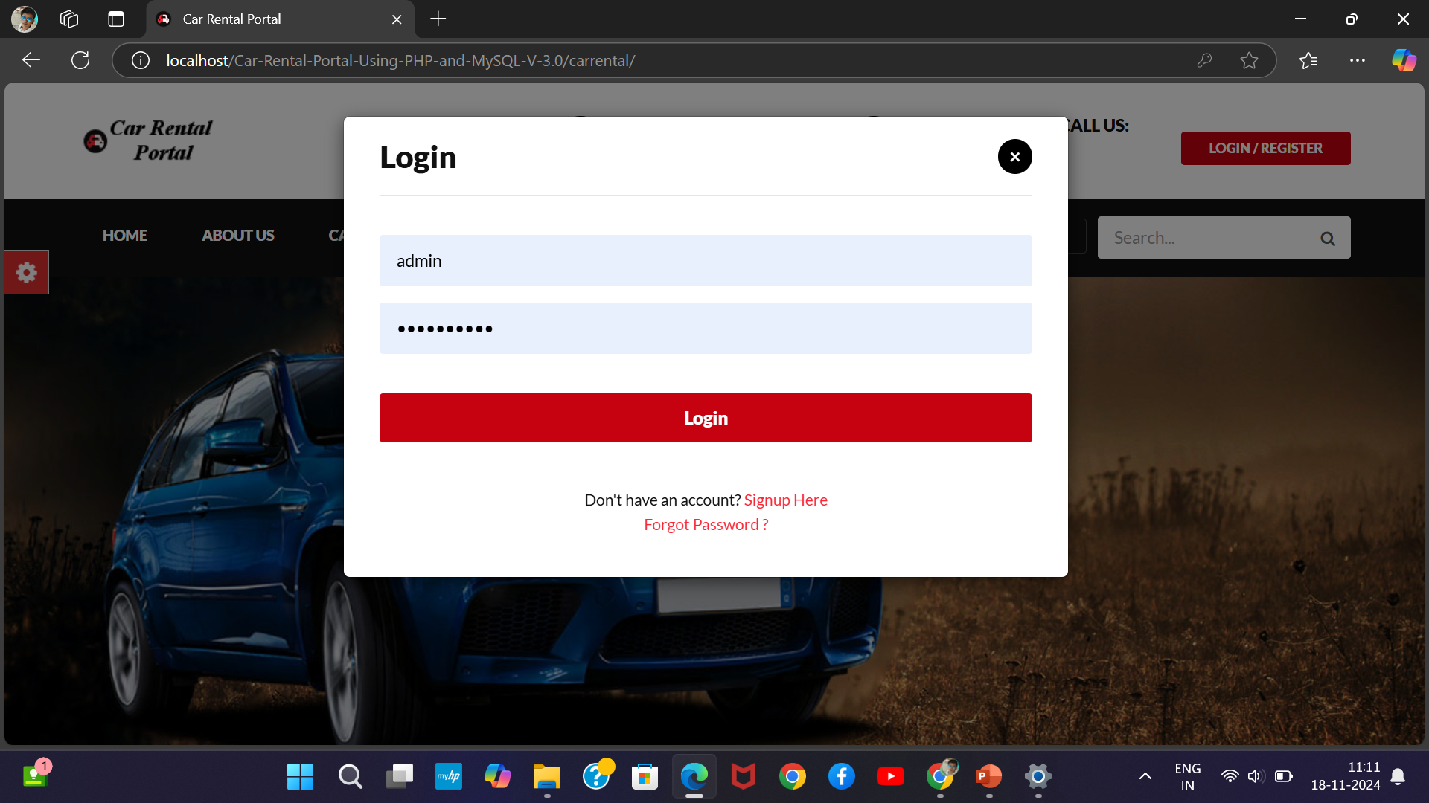
RESULTS AND DISCUSSION
Login

Slide 16
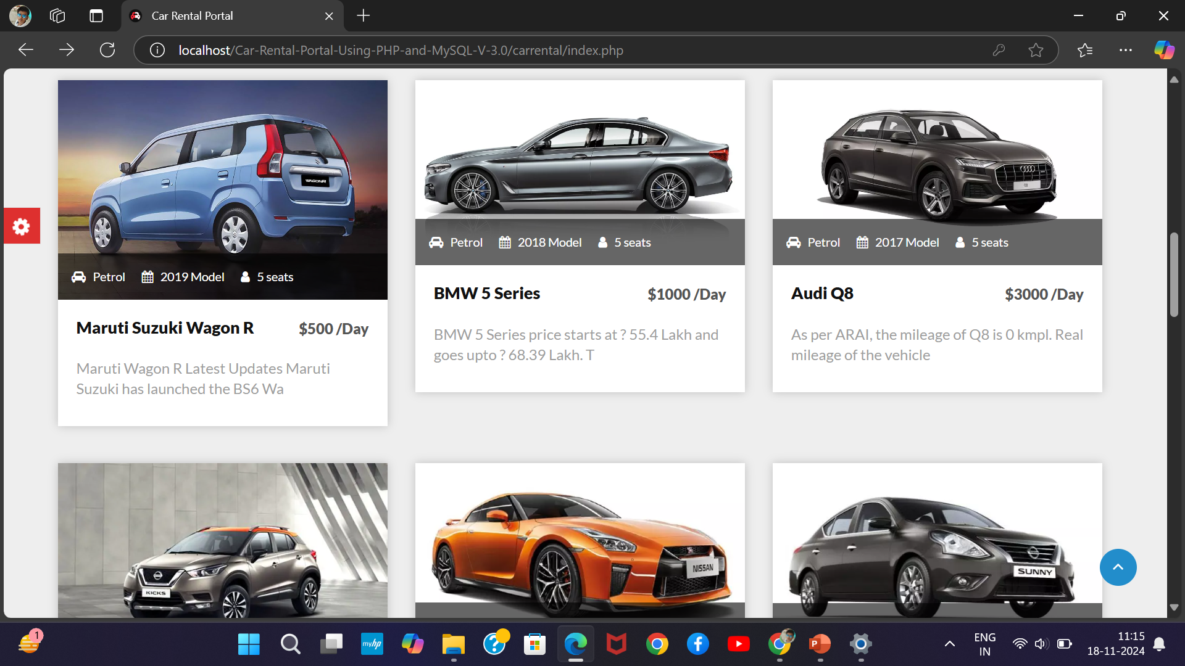
RESULTS AND DISCUSSION
Listing cars

Slide 17
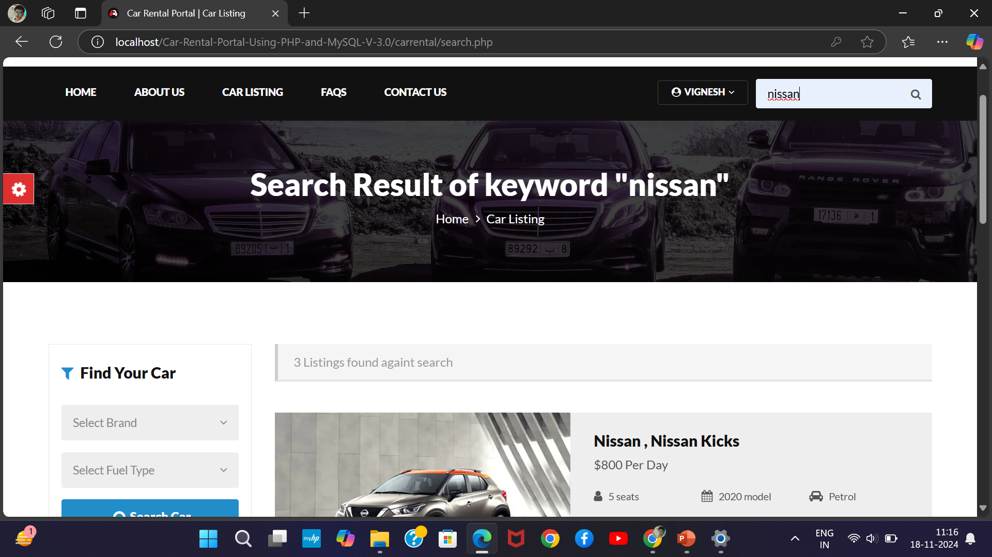
RESULTS AND DISCUSSION
Search cars

Slide 18
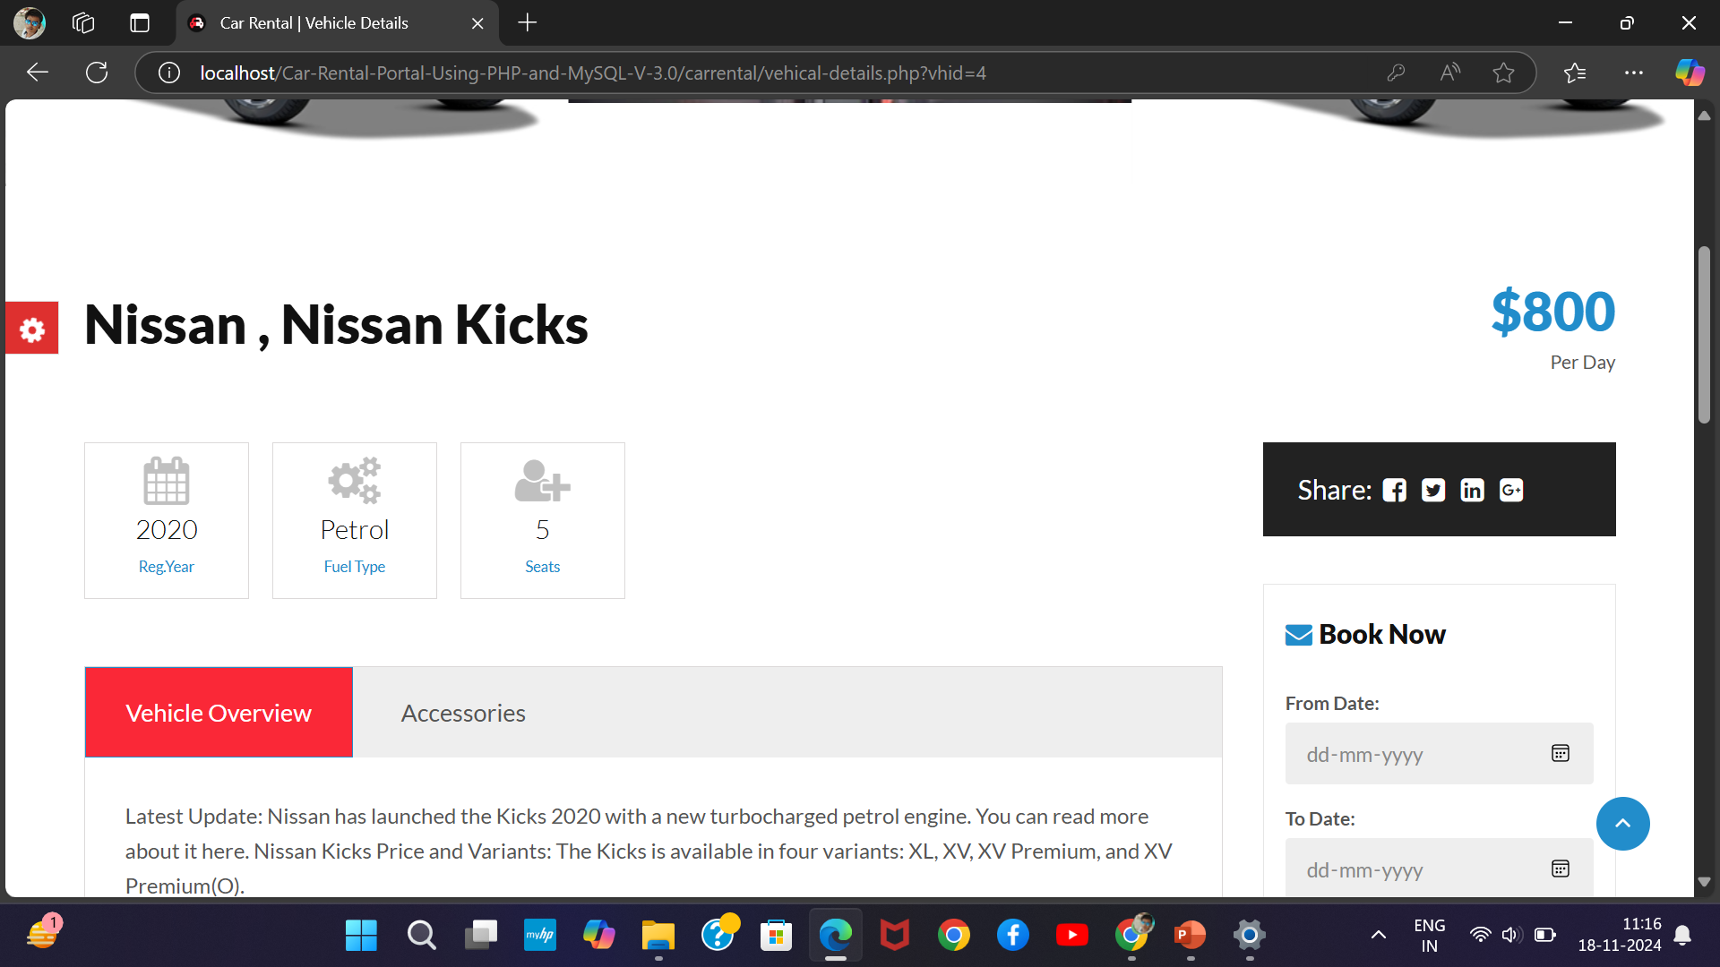
RESULTS AND DISCUSSION
Pricing car

Slide 19
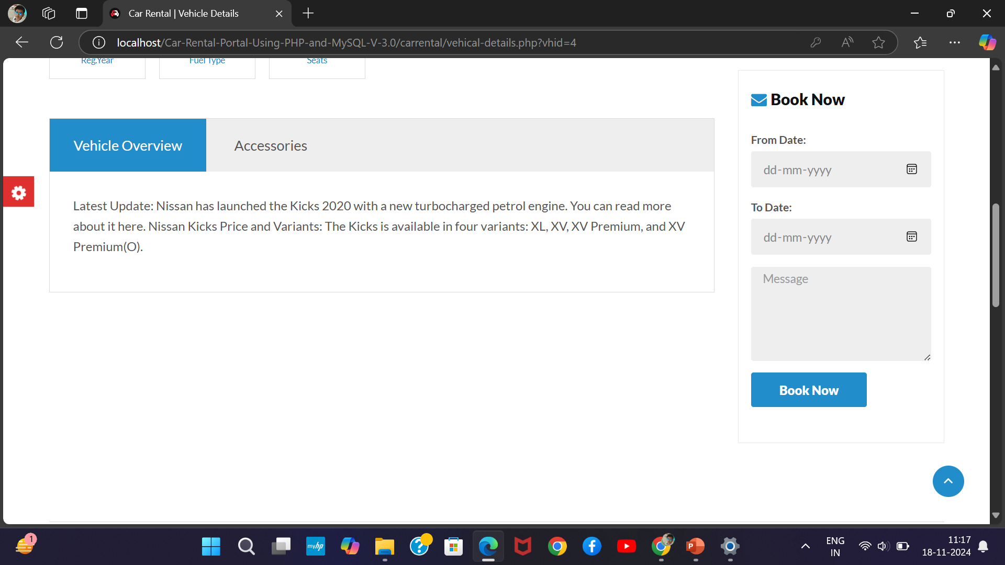
RESULTS AND DISCUSSION
History of car

Slide 20
CONCLUSION
The Online Pre-owned/Used Car Management System provides a comprehensive solution for buying and selling used cars.
The platform will enable users to easily browse, negotiate, and purchase vehicles online, providing greater transparency and efficiency than traditional methods.
With the integration of advanced features like a recommendation engine, dynamic pricing, and secure payment gateways, the system will benefit both sellers and buyers, making it easier to manage used car transactions in a reliable and secure manner.

Slide 21
THANK YOU

