Slide 1
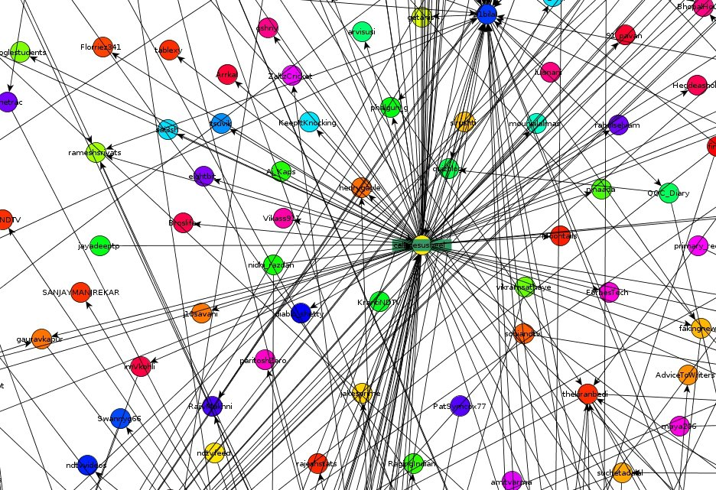
Complex Networks A parallel search algorithm in power law networks
Project By:
Vijesh M
Vijay Mahantesh SM
Guided By:
Dr. Kavi Mahesh

Slide 2
The Story so Far…
Learning Phase:
Random walks on networks
Hotspots – Strategic locations for network navigation
Reinforcement Learning – Edge Weighting
Navigation Phase:
Pheromonic Walks
Path Concatenation Algorithm

Slide 3
Power Law Networks
A scale-free network is a network whose degree distribution follows a power law, at least asymptotically. That is, the fraction P(k) of nodes in the network having k connections to other nodes goes for large values of k as
where is a normalization constant and is a parameter whose value is typically in the range 2 < gamma < 3, although occasionally it may lie outside these bounds.
A power law is a special kind of mathematical relationship between two quantities. When the frequency of an event varies as a power of some attribute of that event (e.g. its size), the frequency is said to follow a power law.
Source: en.wikipedia.org

Slide 4
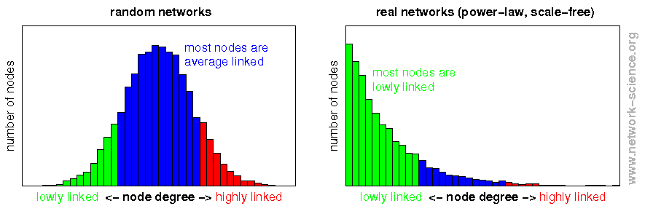
Power Law Networks
Source: network-science.org

Slide 5
Central Idea of the Algorithm
Scale Free Networks follow a power law degree distribution. Hence, a hierarchy of nodes is formed. We exploit this fact in our algorithm to navigate through the network.
The walkers A and B start the navigation with the source and the destination nodes in a parallel fashion.
At each stage, the walkers hop to that neighbor with the highest degree. The intuition behind this algorithm is that the shortest path between any two nodes in the network passes through the hubs in the network.

Slide 6
Central Idea of the Algorithm
When one of the walkers intersects the path of the other, we find the node common to both the paths and integrate the path from the source and the destination.
The contrasting difference between this algorithm and our previous algorithm is the availability of global information.
In our previous algorithm, we had assumed that we have the global knowledge of the network. But in the current algorithm, we use only local information in order to navigate within the network.

Slide 7
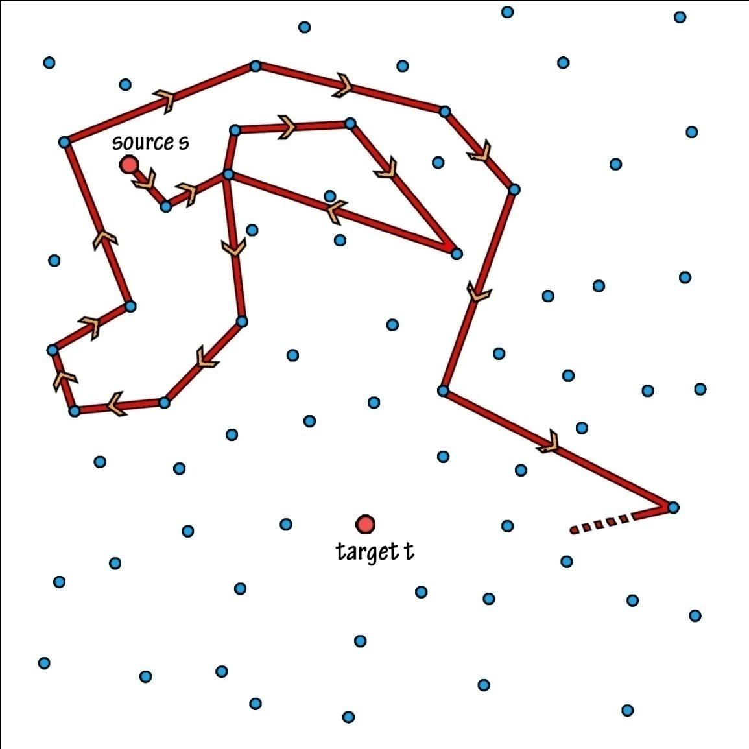
Random Walks
1-Raw Random Walk

Slide 8
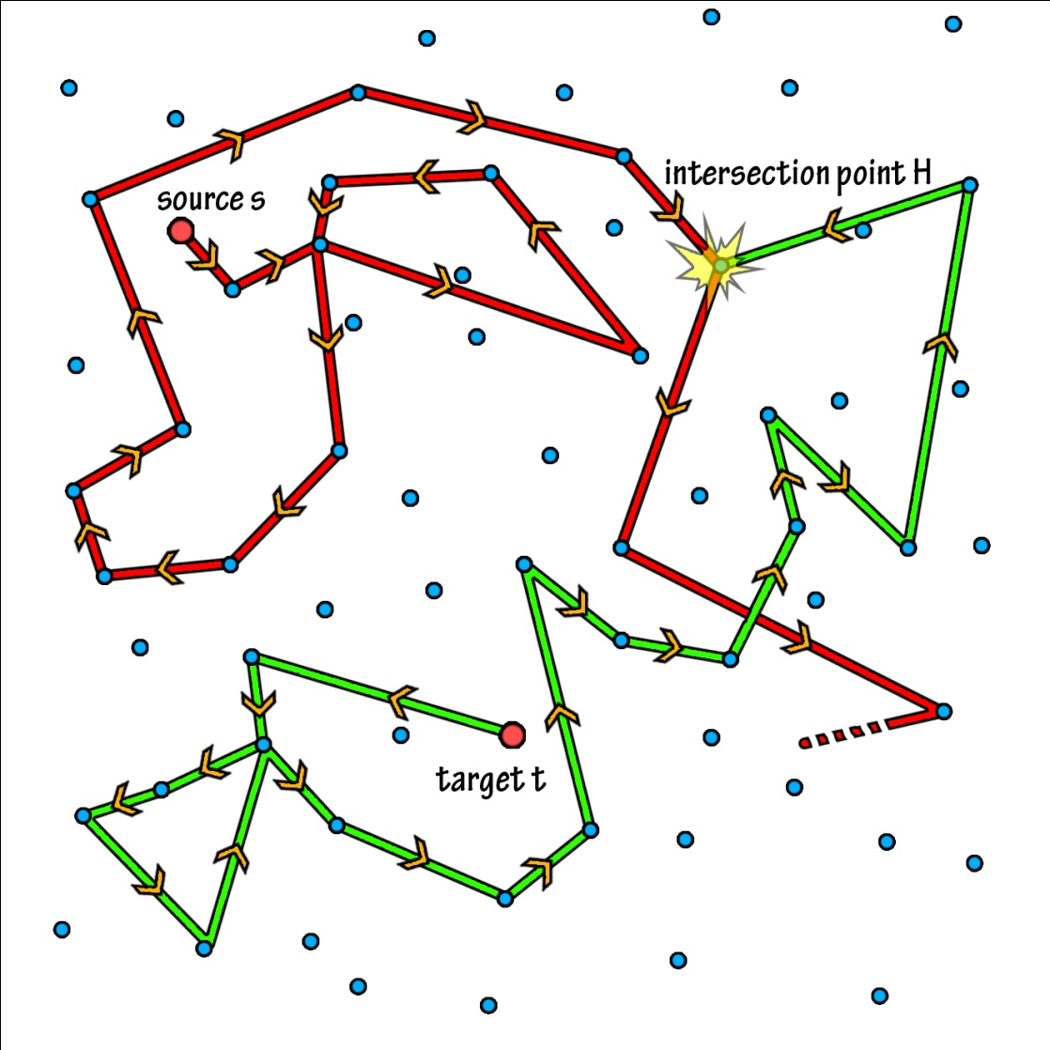
Random Walks
2-Raw Random Walk

Slide 9
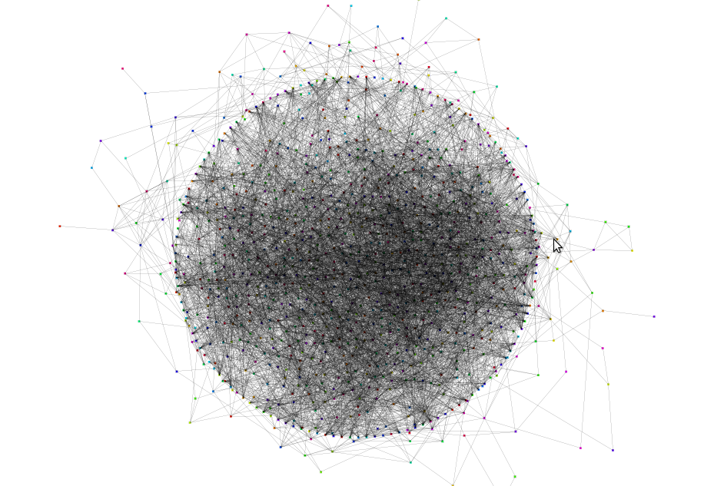
Applications: Word Morph Game
Word Morph Graph

Slide 10
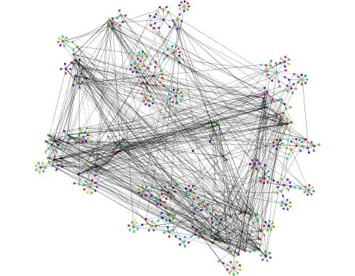
Applications : Gnutella peer-to-peer network

Slide 11
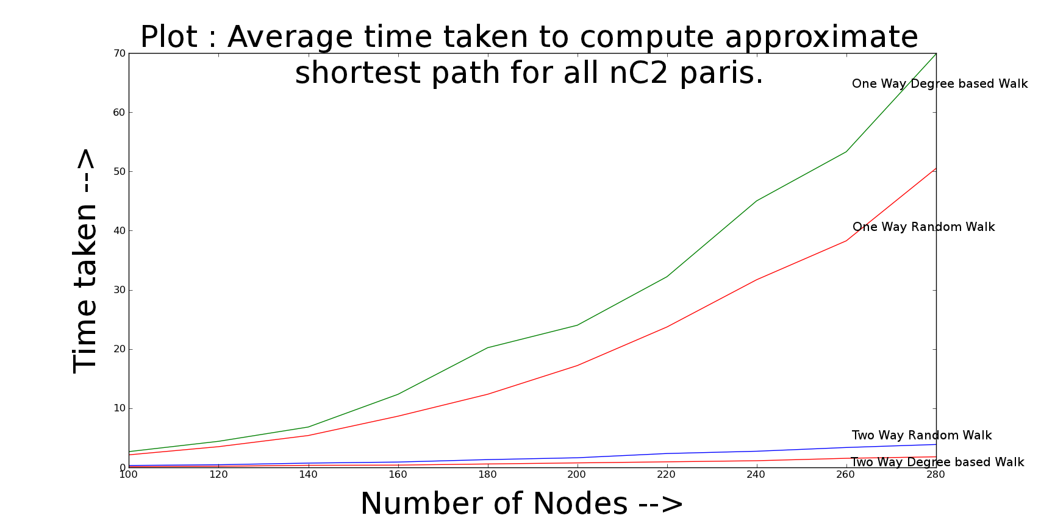
Results

Slide 12
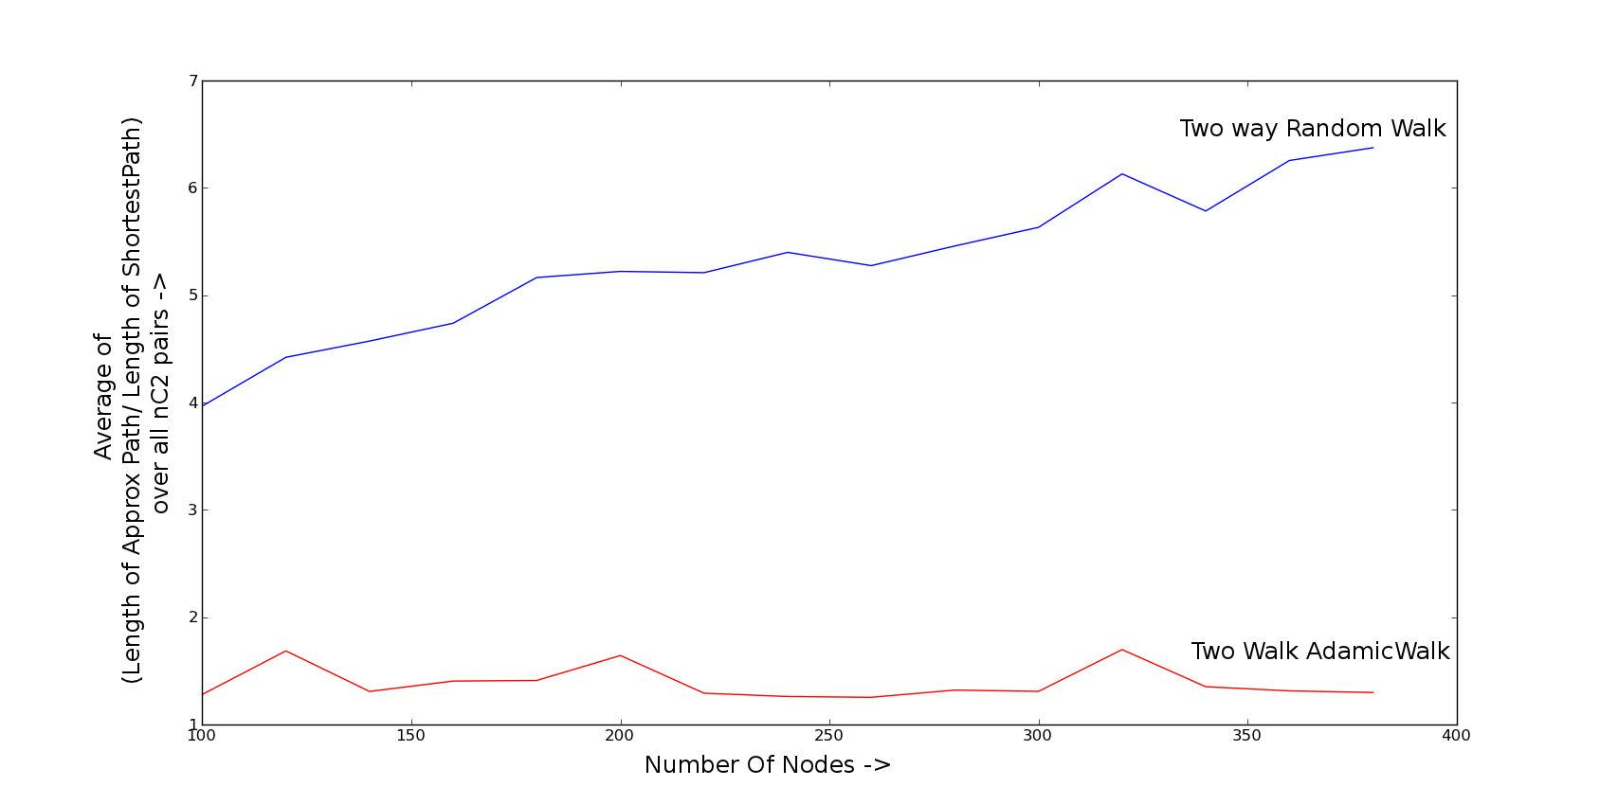
Results

Slide 13
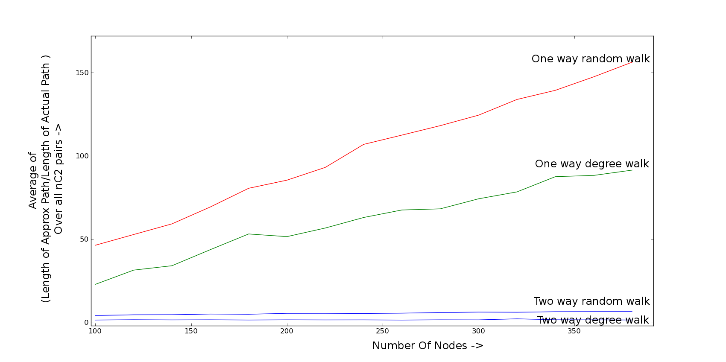
Results

Slide 14
What We Learnt…
Python Programming
Packages: networkx, matplotlib, pickle
LaTeX 2e – Documentation Markup Language
Complex Network Theory
Social Networks
yEd Graph Visualization Tool
Reinforcement Learning

Slide 15
Ideas!!!
Community Detection
Edge Weighting Techniques – Edge Weight Function, Progressive Weighting
Vertex Centrality Measures – Flag Centrality
Edge Centrality Measures – Pheromonic Edge Centrality

Slide 16
Taking It Further…
Development of Mathematical Model
Application of the Algorithm to Real World Networks such as Road Networks
Extension of the Algorithm to suit dynamically changing networks.

