Slide 1
Entity Linking with Graph Neural Network
Vijeta Deshpande
November 18, 2021

Slide 2
Content
Background
Entity linking
Problem formulation
Data

Slide 3
Background
Entity linking a subtask in language understanding
Language understanding
Named entity recognition
Named entity disambiguation (Entity linking task)
Downstream tasks (medical domain)
Medical term normalization
Risk stratification
Onset prediction

Slide 4
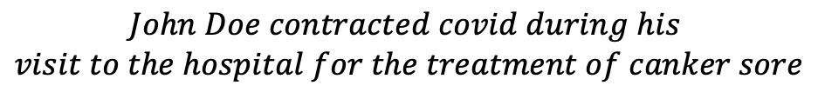
Entity linking
$$John Doe contracted covid during his$$
$$visit to the hospital for the treatment of canker sore$$
NER
Disease code: disease formal name
.
.
.
AAA: corona virus disease 2019
.
.
.
BBB: aphthous ulcer
.
John Doe, covid, hospital, canker sore
Mentions
covid
Canker sore
External source of information
(knowledge base)

Slide 5
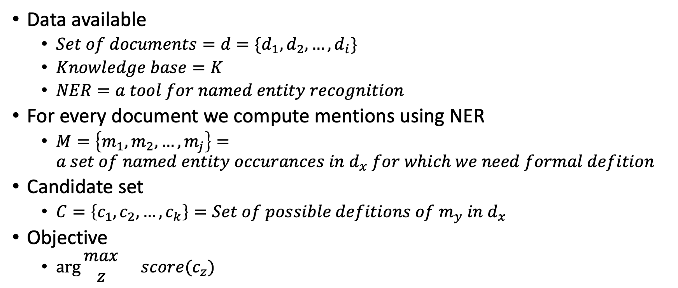
Problem formulation
Data available
$Set of documents=d=\{d_{1}, d_{2}, …, d_{i}\}$
$Knowledge base=K$
$NER=a tool for named entity recognition$
For every document we compute mentions using NER
$M=\left\{m_{1},m_{2},…, m_{j}\right\}=a set of named entity occurances in d_{x} for which we need formal defition$
Candidate set
$C=\left\{c_{1},c_{2},…, c_{k}\right\}=Set of possible defitions of m_{y} in d_{x}$
Objective
$\arg{\begin{matrix}max \\ z\end{matrix}{score(c_{z})}}$

Slide 6
Data
Set of documents
SMM4H-2017
Twitter data with annotated disease mentions and corresponding definitions in the MedDRA knowledge base
A knowledge base
MedDRA: Medical Dictionary for Regulatory Activities
A tool for named entity recognition
BERT based model for NER
en_ner_bc5cdr_md
Spacy model trained on BC5CDR corpus
Entity types: DISEASE, CHEMICAL
Effectively covers drug and disease mentioned in a given text
BioBERT

