Slide 1



TRAVEL BLOGGING PLATFORM
PROJECT MENTOR : Ms. R. AARTHI
PROJECT MEMBER : VIJETH B
23ITR170

Slide 2
OBJECTIVES
To design and develop a full-stack Travel Blogging Platform.
To provide secure login and authentication for users.
To enable users to create and share travel blogs easily.
To allow social interaction through likes, comments and follows.
To create a simple and user-friendly travel sharing platform.
2

Slide 3
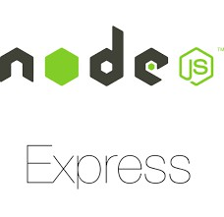




Technology Stack
MongoDB – Database for users, blogs, trips, and packages
Express.js – Backend framework for REST APIs
React.js – Frontend library for building UI
Node.js – Server-side runtime environment
JWT & Google Oauth – Secure authentication and user management
VS Code, GitHub, Postman – Development and testing tools
4

Slide 4
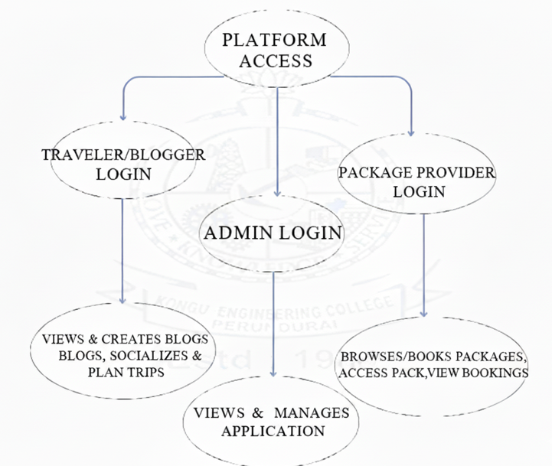
WORK FLOW FOR TRAVEL BLOG

Slide 5
USE CASE FOR TRAVEL BLOG
Login
Posts Packages
Package Provider
Traveler/Blogger
Searching blogs ,feed
Package Booking
Review Application
Admin
Plan Trips / Find Travel Companions
Managing Overall Flow of the Application

Slide 6
API REFERENCES
Implement JWT and Google OAuth for authentication and user management
Provides secure signup, login, and session handling
Supports role-based access for travelers , admins and package providers
Simplifies integration with React.js frontend and Node.js backend
Ensures scalable and secure user identity management

Slide 7




FRONT END DEVELOPMENT
Used React.js for building dynamic and reusable UI components
Implemented responsive design with HTML, CSS, and Material-UI
Created traveler and admin dashboards for role-based interaction
Integrated JWT and Google OAuth authentication for secure login and signup
Enabled blog creation, social interactions, trip planning and package booking with smooth navigation

Slide 8
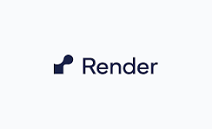

BACKEND DEVELOPMENT
APIs will be developed in Express.js for blogs , trips and bookings
Access control will be role-based implemented for Admin, Traveller, and Package Provider
Data will be stored and managed in MongoDB collections
The application will be deployed on Render for accessibility
9

Slide 9
ADMIN PANEL
.
Provides a centralized dashboard for platform management
Monitors and manages users (travelers & package providers)
Approves, updates, or removes blogs ,travels packages for quality control
Tracks bookings and system activity for transparency
Ensures secure and smooth functioning of the portal

Slide 10
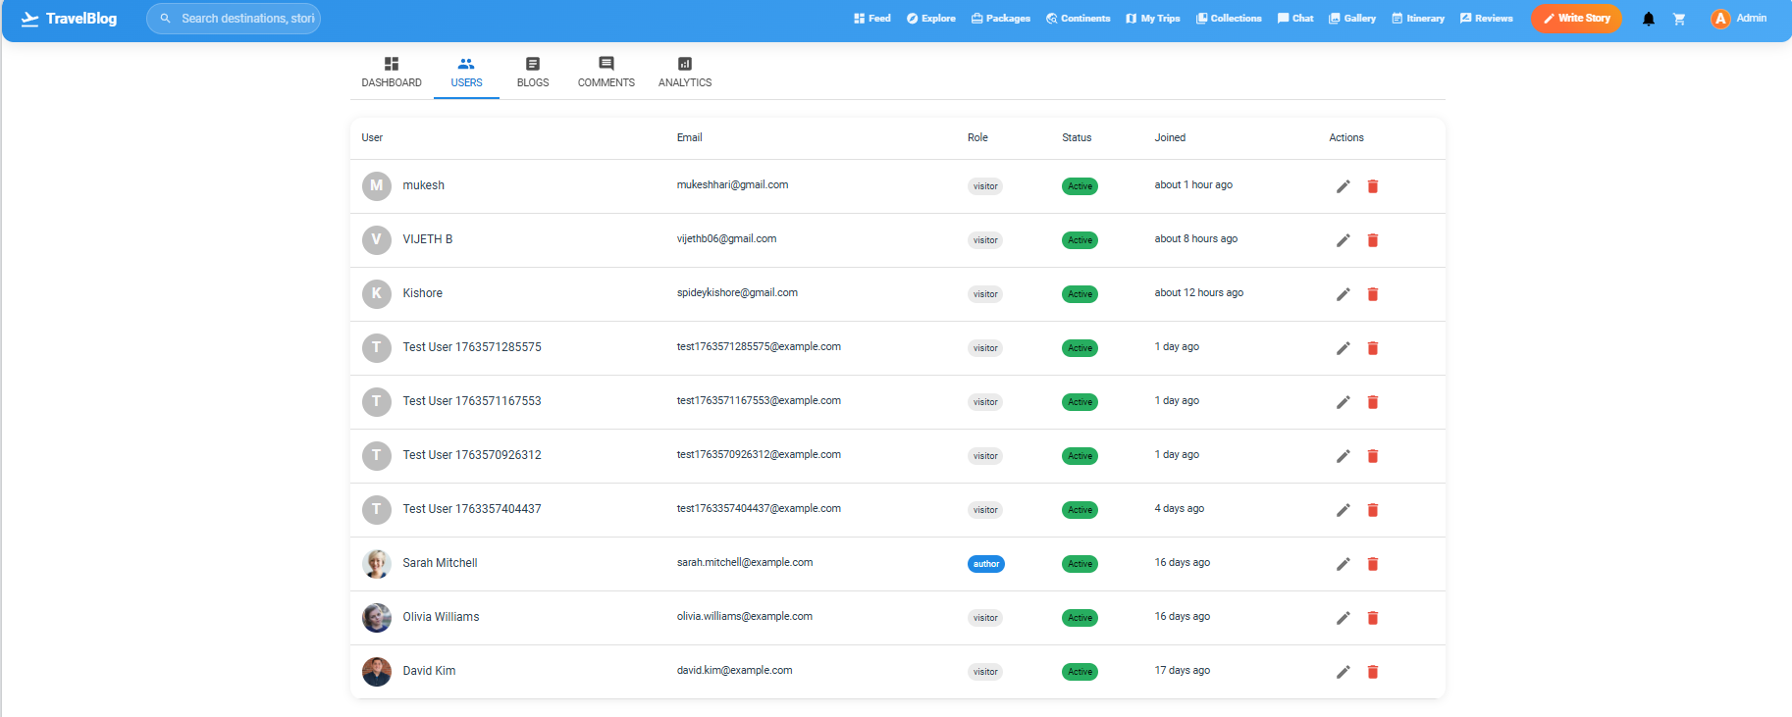
ADMIN PANEL REPORTS
.

Slide 11
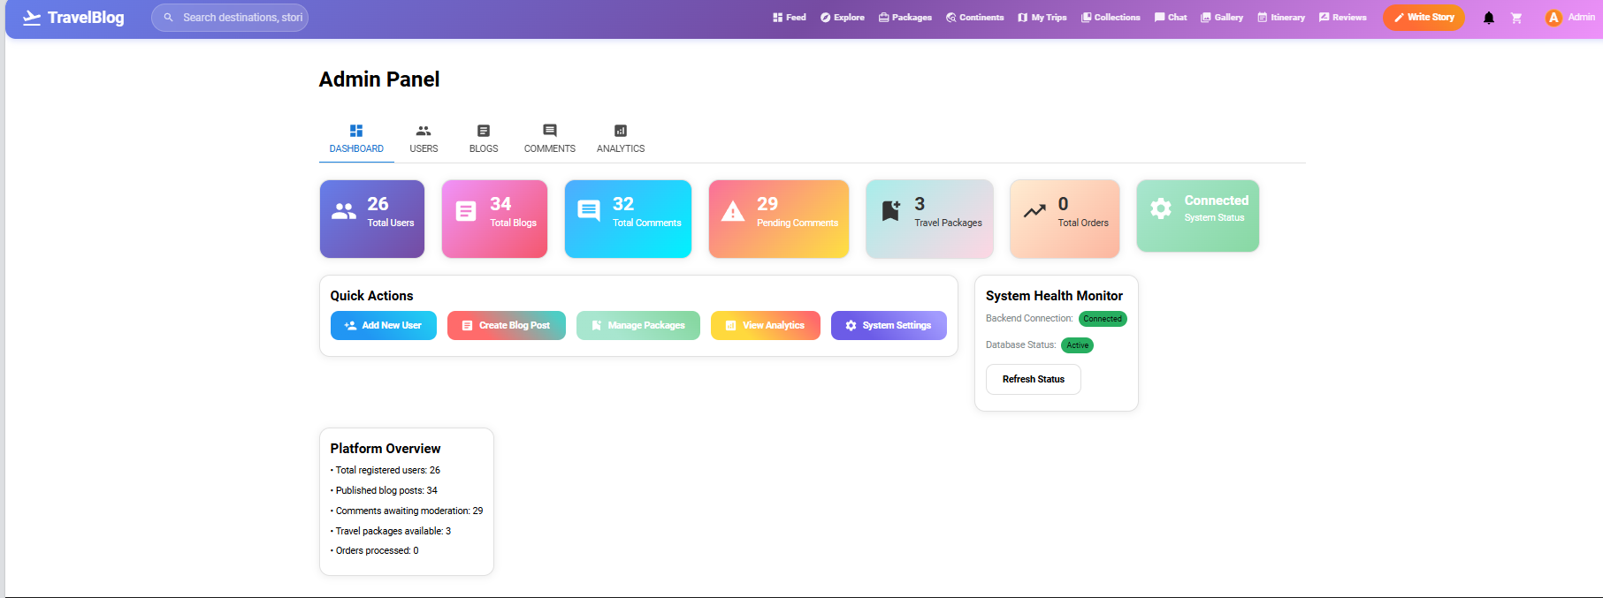
ADMIN PANEL REPORTS
.

Slide 12
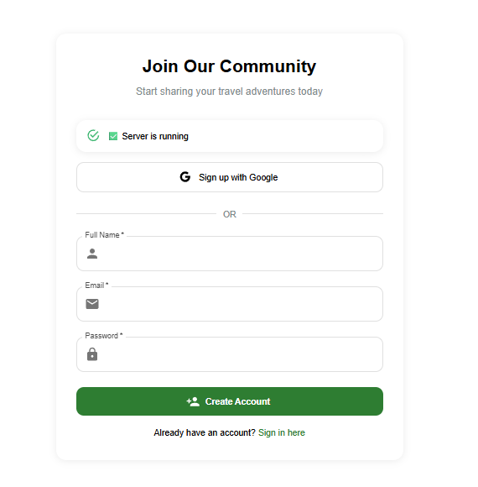
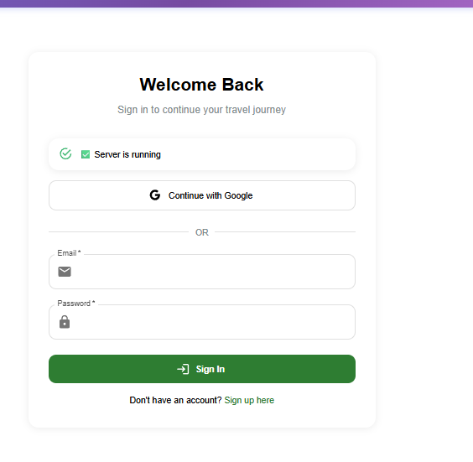
OUTPUT FOR SIGN UP & LOGIN
OUTPUT

Slide 13
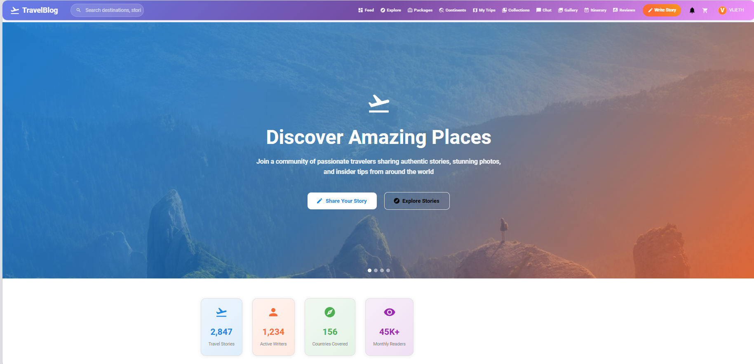
OUTPUT FOR MAIN PAGE

Slide 14
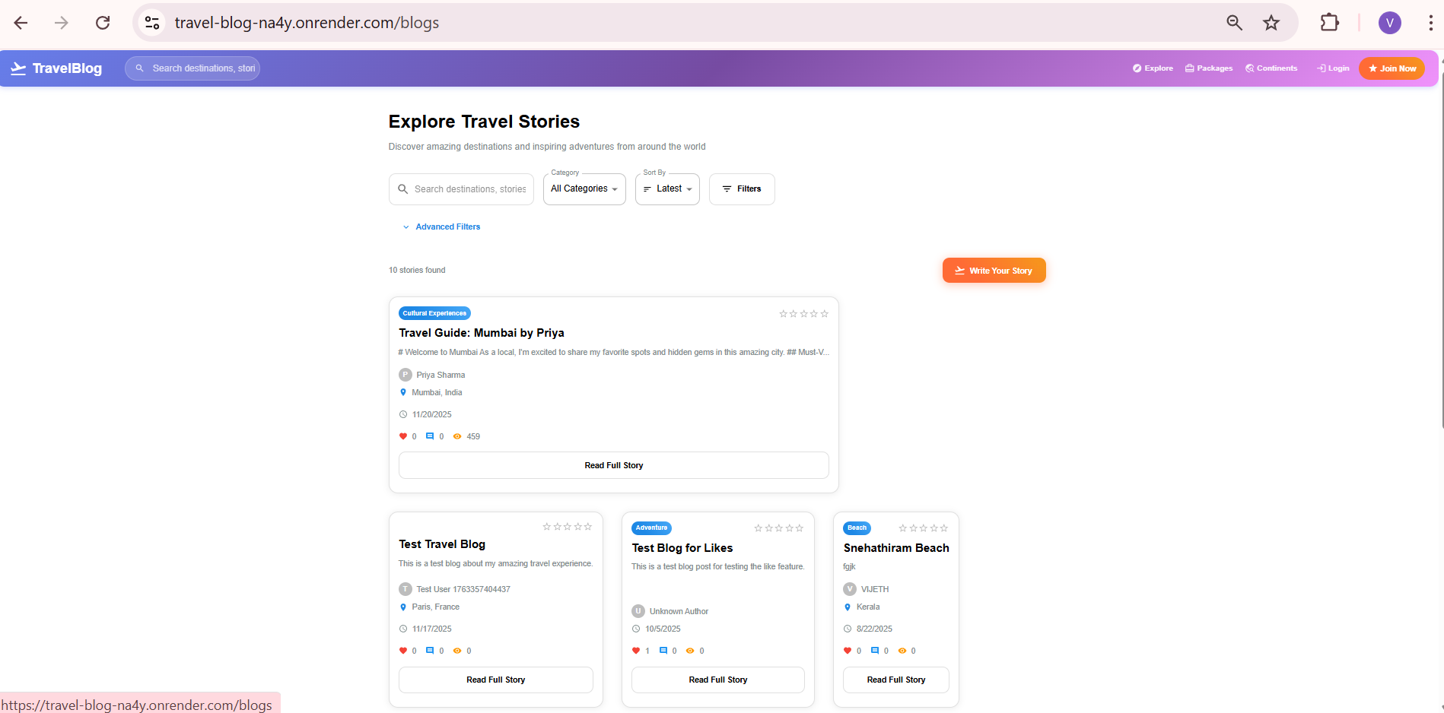
OUTPUT
OUTPUT FOR BLOG PAGE

Slide 15
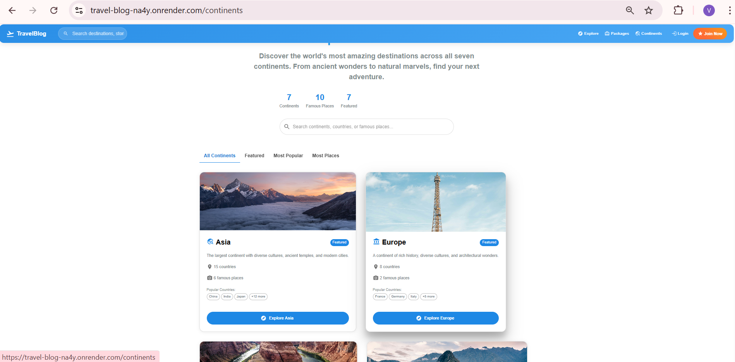
OUTPUT FOR CONTINENT PAGE

Slide 16
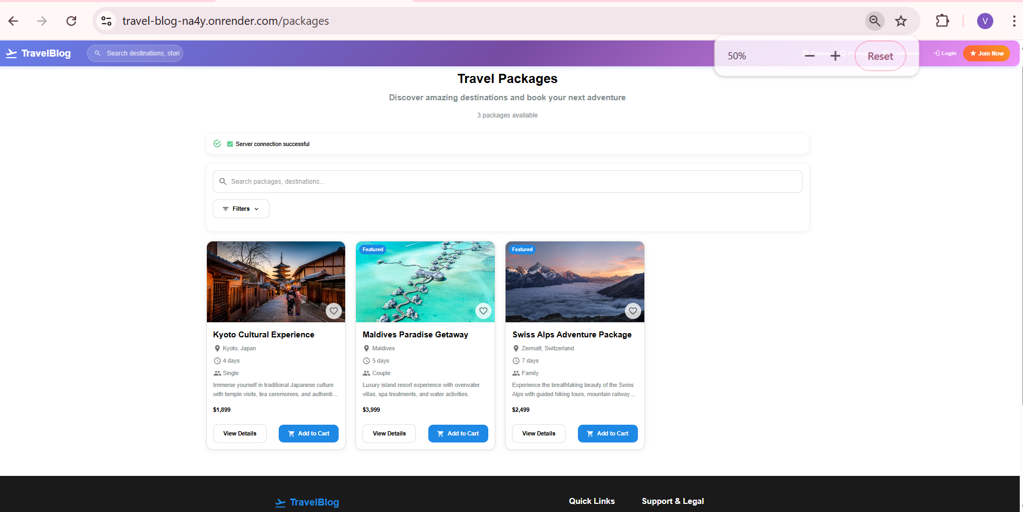
OUTPUT FOR SEEING THE PACKAGES

Slide 17
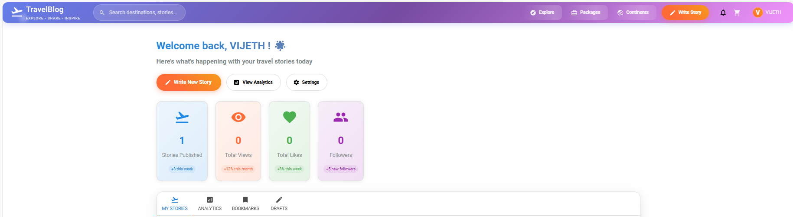
OUTPUT FOR DASHBOARD

Slide 18
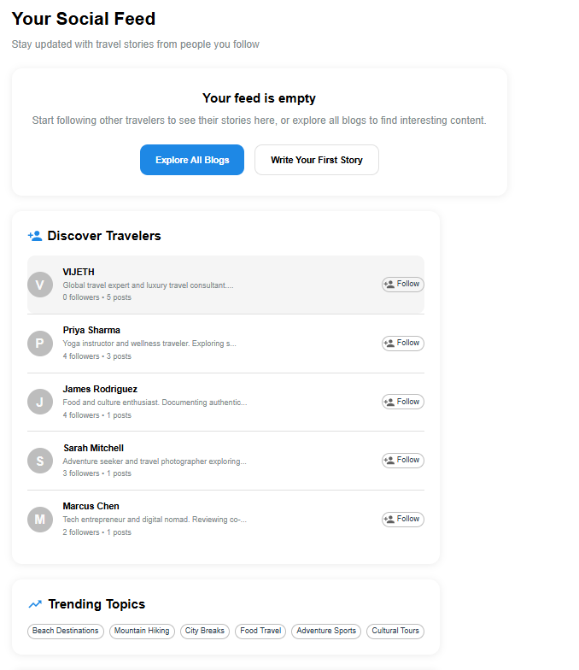
OUTPUT FOR SOCIAL FEED

Slide 19
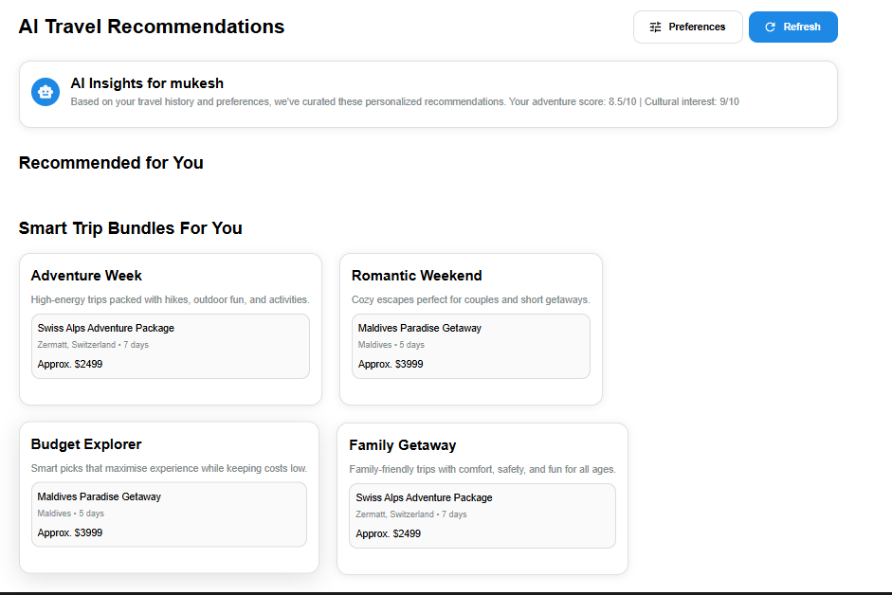
OUTPUT FOR AI RECOMMENDATION

Slide 20
REFERENCES – TRAVEL BLOG
GITHUB LINK : https://github.com/vijeth06/Travel-blog-
LIVE DEMO
: https://travel-blog-na4y.onrender.com

Slide 21
THANK YOU !

