Slide 1
Performance Analysis of AODV in a MANET Using NS-3
with a Comparison against OLSR and DSDV
Alternate Assessment · Network Programming (23CS7PCNWP)
Tanmay Agarwal (1WA23CS010) · Viamrsh Buyanni (1WA23CS039)
Yeruva Taniya Paul (1WA23CS053) · Vijeth MD (1WA23CS041)
Faculty in charge: Prof. Sunayana S · Department of CSE, BMSCE
Notes:
Introduce the team and the topic: how the AODV routing protocol performs in a mobile ad hoc network, measured in the ns-3 simulator, and how it compares with two proactive protocols, OLSR and DSDV.

Slide 2



Why routing in a MANET is hard
A mobile ad hoc network has no access point or router: every node forwards packets for the others, and the routing protocol must keep finding paths as nodes move.
Partitions
Mobility
Shared channel
A sparse network splits into parts. If no path exists, no protocol can deliver.
Moving nodes break links. Routes must be detected as broken and repaired quickly.
Data and routing control packets compete for one radio channel, hop after hop.
Notes:
Three things make MANET routing hard: partitions in sparse networks, link breaks caused by mobility, and a shared radio channel. Our three experiments vary exactly these: node density, node speed and traffic load.

Slide 3
Objectives
1
Implement a MANET in ns-3.48 with a UDP client–server application
420
2
Measure AODV as node density, speed and traffic load change
3
Compare AODV with OLSR and DSDV on identical topologies
simulations
4
14 settings × 3 protocols × 10 random topologies
Measure routing overhead, jitter and packets dropped at the source
5
Validate the results and report 95% confidence and significance
Notes:
The original project studied AODV alone. This version keeps that study exactly and adds the comparison with OLSR and DSDV, plus overhead and jitter.

Slide 4



Three protocols, two approaches
AODV
OLSR
DSDV
Reactive · distance vector
Proactive · link state
Proactive · distance vector
Port
UDP port 654
Routes
Finds a route only when needed; buffers packets meanwhile
Control messages
RREQ, RREP, RERR; Hello every 1 s
Port
UDP port 698
Routes
Routes always in the table; drops packets without a route
Control messages
HELLO every 2 s; TC every 5 s via multipoint relays
Port
UDP port 269
Routes
Routes always in the table; buffers until a route appears
Control messages
Full update every 15 s plus triggered updates
Notes:
AODV is reactive: it looks for a route only when the source has data. OLSR and DSDV are proactive: they exchange control messages all the time so routes are always in the table. Note the difference in what happens without a route: AODV and DSDV buffer the packet, OLSR drops it.

Slide 5
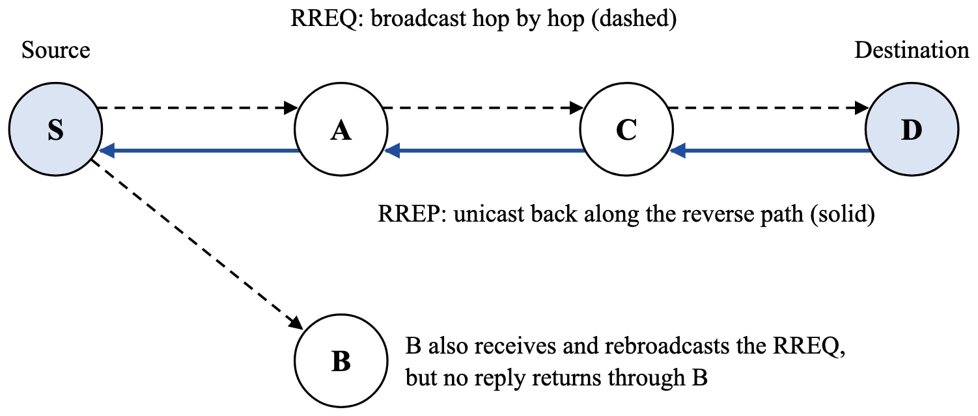
AODV finds routes on demand
RREQ
The source broadcasts a route request; every node records a reverse route and rebroadcasts it.
RREP
The destination replies by unicast along the reverse path, installing the forward route.
RERR
When a link on an active route breaks, a route error tells the nodes using it.
Seq. no.
Destination sequence numbers keep routes fresh and loop-free.
Notes:
Walk through the diagram: S broadcasts an RREQ, which floods through A and C (and also reaches B). D answers with an RREP that travels back along the reverse path. A broken link triggers an RERR and a new discovery.

Slide 6


Research gap and problem statement
Research gap
Problem statement
Results change with density, mobility and load, so rankings depend on the scenario
Many MANET simulations cannot be repeated or report no spread
New AODV variants are all judged against standard AODV, so a reproducible baseline comparison is needed
Implement a MANET in ns-3.48 with a UDP client–server application and determine, with repeated runs and statistical confidence, how AODV’s delivery, delay, jitter and overhead change with density, speed and load, and how it compares with OLSR and DSDV on the same topologies.
Notes:
The literature shows performance depends on the scenario and that many studies are hard to repeat. We narrowed this to one gap: a reproducible, statistically reported comparison of standard AODV with proactive baselines on a current ns-3 release.

Slide 7
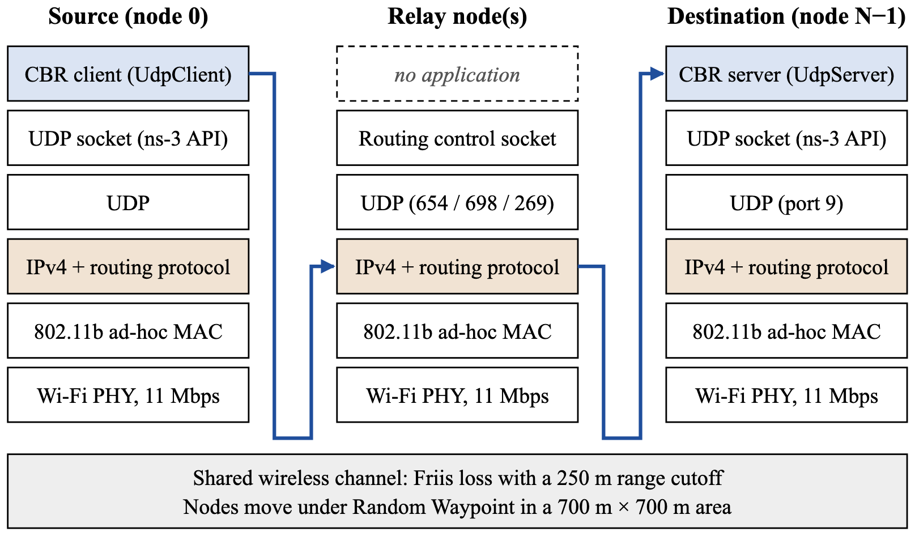
System architecture
Every node runs the same stack: 802.11b ad-hoc Wi-Fi, IPv4 with the routing protocol, UDP and the ns-3 socket API
Relays forward data at the IPv4 layer using the protocol’s routes
FlowMonitor measures the data flow; packet traces count control packets
Notes:
The source runs the CBR client, the destination the server, and every other node only routes. A data packet goes down the source stack, across the shared channel, up to IPv4 at a relay, and up the destination stack.

Slide 8
Socket programming in the simulation
BSD socket call | ns-3 Socket API | Use in this project
socket() | Socket::CreateSocket(node, UdpSocketFactory) | Client, server and routing sockets
bind() | Bind(InetSocketAddress(addr, port)) | Server port 9; routing 654 / 698 / 269
connect() | Connect(InetSocketAddress(dst, 9)) | Client fixes the server address
send() / sendto() | Send(packet) / SendTo(packet, 0, dst) | Data every 1/λ s; routing messages
recvfrom() | RecvFrom(from) in a receive callback | Server counts packets; routing reads updates
setsockopt(SO_BROADCAST) | SetAllowBroadcast(true) | RREQ, HELLO and update broadcasts
ns-3 has no kernel, so these are C++ calls on simulated sockets. Nothing may block in a discrete-event simulator, so reception is event-driven through SetRecvCallback() instead of a blocking recvfrom().
Notes:
This is the network programming core of the project. The UDP client and server, and every routing protocol, use the ns-3 socket API, which mirrors BSD sockets call for call. The main difference is event-driven reception.

Slide 9
Experimental setup
Simulator | ns-3.48 (C++)
Area, nodes | 700 m × 700 m, 10 nodes
Wi-Fi | 802.11b ad-hoc, 11 Mbps, 250 m range
Mobility | Random Waypoint, 5 m/s, 0 s pause
Traffic | UDP CBR, 512 B, 4 packets/s, node 0 → N−1
Time | 60 s (traffic 2–59 s)
Repetitions | 10 runs; run k = same topology for all protocols
A
Number of nodes
5, 10, 15, 20
B
Node speed
1, 5, 10, 15 m/s
C
Traffic load
10 – 800 packets/s
One parameter changes at a time; the others keep their defaults.
Notes:
All three experiments change one parameter at a time. Because run k uses the same positions and movement for every protocol, we can compare the protocols run by run with paired tests.

Slide 10






What we measured
Packet delivery ratio
Throughput
End-to-end delay
Received ÷ sent data packets
Delivered bits per second at the IP layer
Mean transit time of delivered packets
Jitter
Routing overhead
Source drops
Mean change in delay between consecutive packets
Control packets sent by all nodes; per delivered packet = NRL
Packets dropped at the source for lack of a route
Overhead is counted with the Ipv4L3Protocol Tx trace because FlowMonitor ignores broadcast packets; sent data packets are counted at the client because OLSR drops packets before FlowMonitor sees them.
Notes:
Two measurement details matter. FlowMonitor ignores broadcasts, so routing overhead is counted with a packet trace on every node. And OLSR drops packets with no route before FlowMonitor sees them, so the sent count comes from the client application; otherwise OLSR's delivery ratio would be inflated.

Slide 11
More nodes help every protocol; AODV stays ahead
AODV
74% → 97%
OLSR
70% → 88%
DSDV
59% → 85%
Denser networks rarely split, so a path almost always exists.
Notes:
From 5 to 20 nodes all protocols improve because partitions become rare. AODV is ahead at every density.

Slide 12
Under mobility, AODV holds its delivery
At 15 m/s
75%
AODV delivery
50%
47%
OLSR delivery
DSDV delivery
Proactive tables refresh every 2–15 s, so fast nodes leave them stale; AODV repairs routes on demand.
Notes:
This is the clearest result. AODV stays near 75% at every speed; OLSR and DSDV fall from about 70% to about 50%. The difference at 15 m/s is significant (p ≤ 0.002).

Slide 13
Heavy load congests every protocol
Up to 200 packets/s
Throughput follows the offered load; delivery stays at its low-load level
At 800 packets/s
PDR falls to 57% (AODV), 54% (DSDV) and 50% (OLSR); delay rises to 170–240 ms
Notes:
Below about 1.7 Mbps of offered load the network copes; above it the shared multi-hop channel congests for every protocol. AODV still delivers the most.

Slide 14
The price: routing overhead and delay
≈ 2×
AODV control packets vs OLSR and DSDV (10 nodes: 630 vs 353 / 325)
41 ms
AODV mean delay at 10 nodes, vs 2 ms for OLSR: AODV buffers packets during discovery
Notes:
AODV's reliability is paid for with overhead and delay. It sends about twice as many control packets, except at 20 nodes where DSDV sends the most. OLSR's delay is tiny because it drops packets it cannot route instead of buffering them.

Slide 15



Comparative summary
77.9%
66.2%
65.0%
AODV: mean PDR over 13 settings
OLSR: mean PDR over 13 settings
DSDV: mean PDR over 13 settings
AODV delivers significantly more in 12 of 13 settings than OLSR and 9 of 13 than DSDV, and never significantly less
AODV sends about twice the routing overhead and has a higher mean delay and jitter
Paired by topology, so differences are significant despite large run-to-run spread
Notes:
Paired t-tests on the 13 distinct settings. AODV's delivery advantage is significant in almost every setting against OLSR and in most against DSDV.

Slide 16

The results are validated
Regression
Packets sent
All 140 AODV runs identical to the original study
57 s × rate in all 420 runs
Loss and PDR
Throughput
Loss = 100 − PDR in all 420 runs
Equals offered load × PDR within 0.002 kbps
OLSR overhead
Source drops
Matches N × 30 HELLOs (every 2 s) plus TC messages
0 for AODV and DSDV, which buffer packets
Notes:
Each check guards a step of the measurement chain: the regression check proves the extension did not change AODV, and the OLSR overhead check matches the protocol's timers.

Slide 17
Conclusion and future work
Findings
Future work
AODV delivered the most packets: 77.9% vs 66.2% (OLSR) and 65.0% (DSDV)
Its advantage is largest under mobility: 75% vs about 50% at 15 m/s
The cost is about twice the routing overhead and a higher delay
Single runs ranged from 0% to 100%: repeated, paired runs are essential
Tune protocol timers and add a warm-up period
More concurrent flows and TCP traffic
More runs per setting and a fading radio model
Energy use and black hole attack resilience
Thank you — questions?
Notes:
Summarise: AODV is the most reliable of the three in this scenario, especially under mobility, at the cost of more control traffic and delay. Then invite questions.

