Slide 1
Apache Kudu
By Vijet Muley

Slide 2
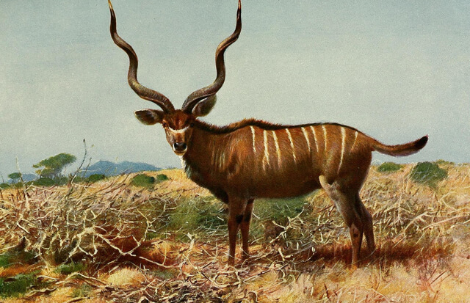
The African Kudu
Notes:
Image obtained from: https://thenewstack.io/apache-kudu-fast-columnar-data-store-hadoop/
The name Kudu was derived from African antelope Kudu because of its vertical stripes which represent the column-orientation of data storage

Slide 3
What is Apache Kudu?
Apache Kudu is a column-oriented data storage system
First version was released on 19th September 2015

Slide 4
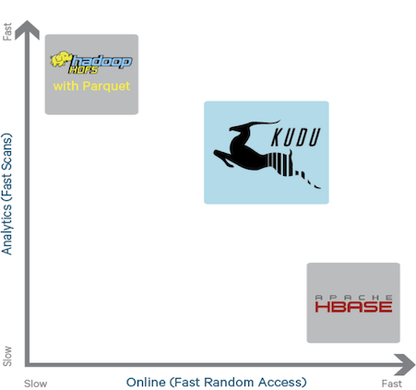
Why was Kudu made?
Notes:
Image obtained from: https://medium.com/@lewisdgavin/apache-kudu-in-5-minutes-91e9371a4f8f

Slide 5
Why was Kudu made?
HDFS with Paraquet (or Avro) works on static data and provides fast analytics
HBase is used for fast random read and write operations
Many Cloudera customers wanted both and were using makeshift solutions
There were issues with these solutions
Cloudera decided to come up with Apache Kudu
It does not outperform either in their respective specialities
It is termed middle ground for both the use cases

Slide 6
CAP theorem

Slide 7
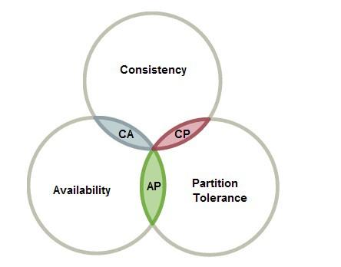
For Apache Kudu
Apache Kudu is CP in order to leverage the distribution and scalability of Hadoop
Kudu treats every mutation as a transaction and guarantees consistency at the expense of availability
Notes:
Image obtained from: https://towardsdatascience.com/cap-theorem-and-distributed-database-management-systems-5c2be977950e

Slide 8
Cluster Architecture for Kudu

Slide 9
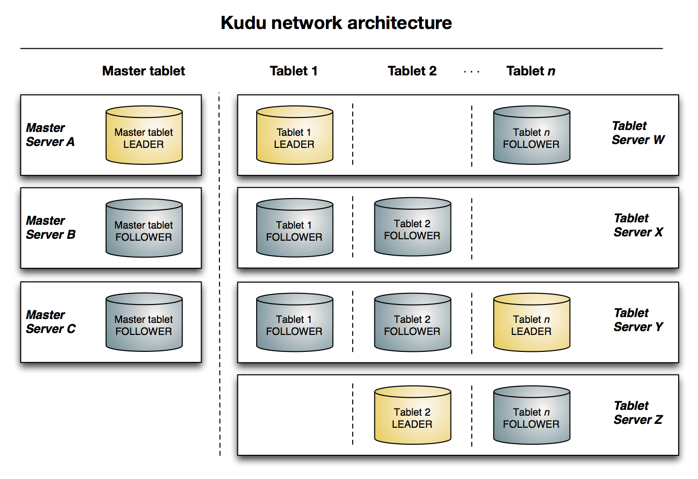
Notes:
Image obtained from: https://kudu.apache.org/docs/

Slide 10
Data Model
Apache Kudu has tables that are store in column-oriented fashion
User needs to decide a primary key
Primary key can be one or group of more than one columns
Primary key not nullable
Primary key immutable
Column data type cannot be altered after creation
Only indexing is on primary key; it is indexed
Tables are partitioned horizontally, called tablets
2 types of partition: 1). Range 2). Hash
Can have combination of the partition strategies
Notes:
Kudu supports limited data types for columns: integers, decimals, UTF-8 encoded string, binary, 64 bit microsecond time

Slide 11
Good design for Kudu
Read and writes are distributed evenly over tablet servers, avoiding imbalance
Addition of data to tablets is even
Least number of reads to extract data for a query
First 2 are based on partitioning, last based on partitioning and primary key selection

Slide 12
Competitors

Slide 13
Possible competitors to Kudu
BigTable is a competitor to Apache Kudu
They have similar architectures
In Hadoop ecosystem, usage depends on particular case
Kudu is good if the user’s requirement span beyond benefits of HDFS or HBase
Kudu cannot outperform either HDFS or HBase in fast reads (analytics) or fast random access respectively
But it is a good balance

Slide 14
Challenges & Limitations

Slide 15
Some limitations to Apache Kudu
Many changes over different versions
Limited number of data types
Multi-row transactions are prohibited
Allows 300 columns at max for a table
Primary keys cannot be altered or updated (no addition or removal from PK subset)
Partitions are immutable; except range partitions
Partitions cannot be split further or combined
Does not have SQL like interface; need to use Impala or other query language
Notes:
Limited data types is challenging for the variety property of big data
300 columns may be a challenge in case of actual big data

Slide 16
References for the paper
Lipcon T., Alves D., Burkert D., Cryans J., Dembo A., Percy M., Rus S., Wang D., Bertozzi M., McCabe C. P., Wang A. (2015). Kudu: Storage for Fast Analytics on Fast Data. https://kudu.apache.org/kudu.pdf
Cloudera. (n.d.). Apache Kudu Schema Design. Retrieved from https://kudu.apache.org/docs/schema_design.html
Zabavskyy, A. (2017, March 10). A Closer Look at Apache Kudu. Retrieved from https://www.slideshare.net/andrijz/a-closer-look-at-apache-kudu?from_action=save
n.d. (2019, December 4). Apache Kudu. Retrieved from https://en.wikipedia.org/wiki/Apache_Kudu

Slide 17
Where to find my paper?
Paper can be found on my GitHub:
https://github.com/vijetmuley/IST769/tree/master/Paper

Slide 18
Thank you!

