Slide 1
Austin Weather Forecast
-Vijet Muley

Slide 2
Source and purpose:
Source:
https://www.kaggle.com/grubenm/austin-weather
Purpose:
The dataset is a subset from the Austin Bike-sharing dataset
The purpose is to see how weather conditions affect the pattern of bike sharing
The data is time-series data
This project is a subset of the larger project

Slide 3
Description of the data:
Rows: 1319
One row for one day
The time span covered is from 21st December 2013 to 31st July 2017
Columns: 21
Columns:
Date
Temperature in F (Maximum, Minimum, Average)
Dew Point Temperature in F (Maximum, Minimum, Average)
Humidity Percentage (Maximum, Minimum, Average)
Sea Level pressure in Inches (Maximum, Minimum, Average)
Visibility in Miles (Maximum, Minimum, Average)
Wind Speed in Miles per Hour (Maximum, Minimum, Average)
Precipitation in Inches (Sum)
Events (Weather events)

Slide 4
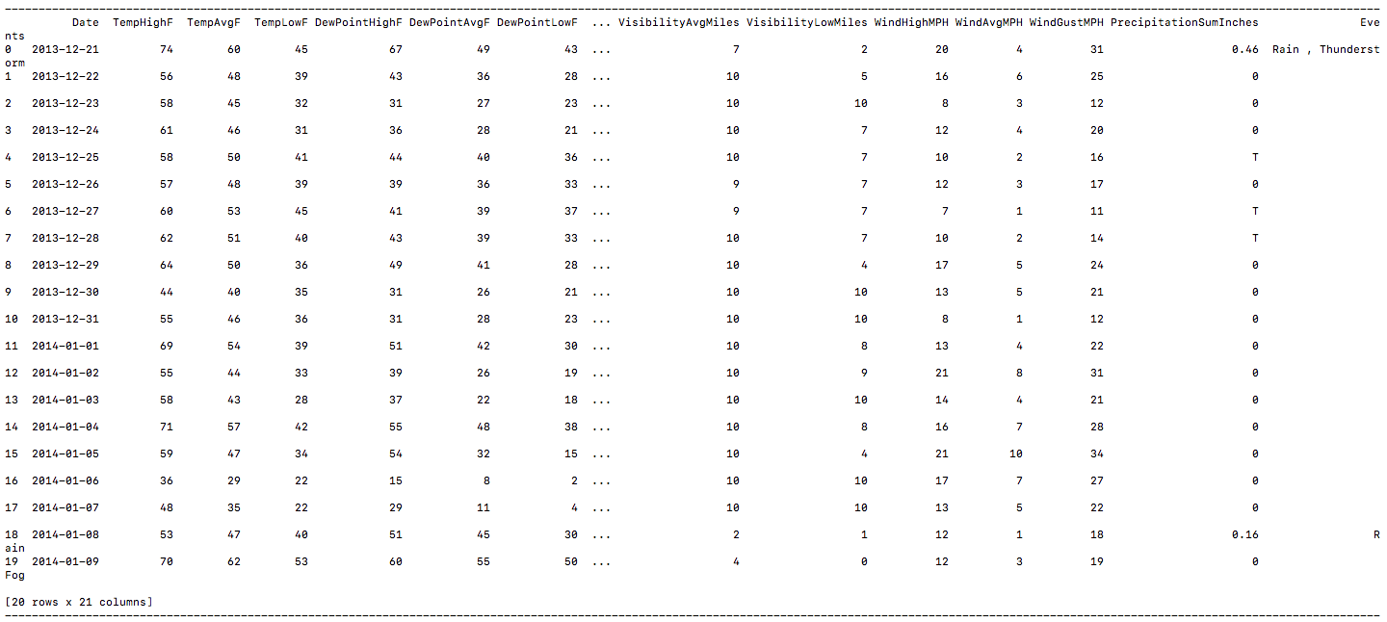
Glimpse of the raw data:

Slide 5
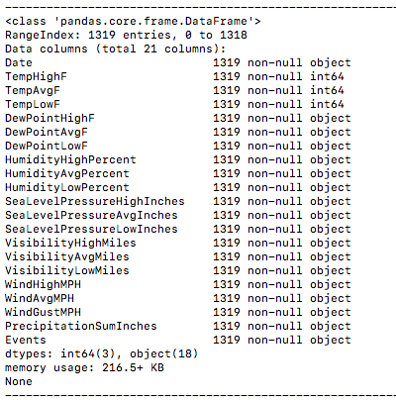

Slide 6
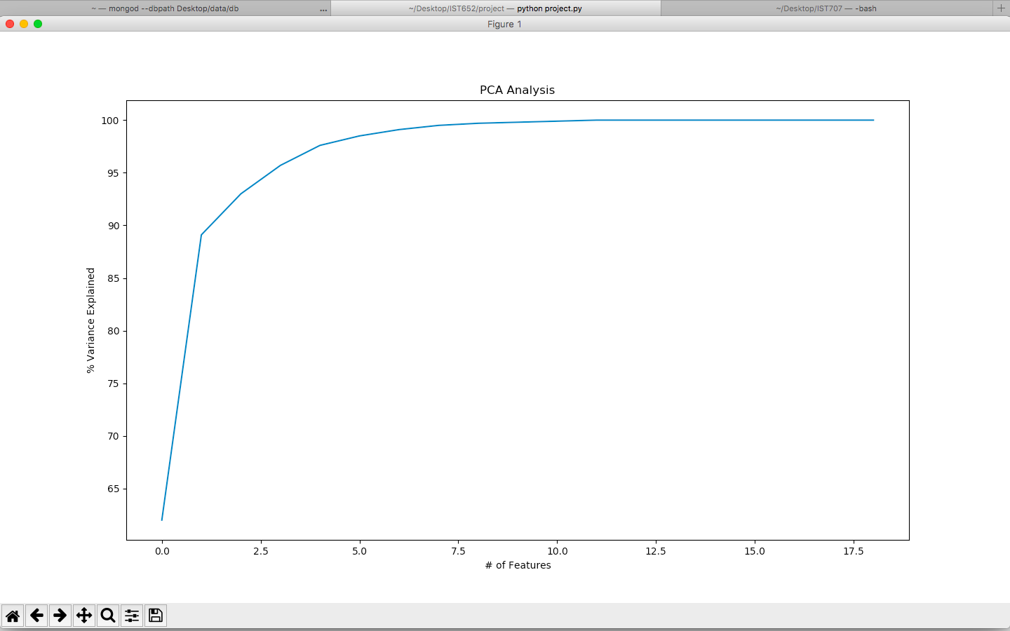
Reducing Dimensionality:
The columns have correlation between themselves
Used Principle Component Analysis on the dataset
Data Munging for PCA:
Removed ‘Date’ and ‘Events’ column
Replaced non-numeric entries in the columns with 0
The output shows that total variance in the dataset can be accounted using 7-8 factors
Using ’average’ values will make it more general
Sklearn package’s decomposition class has the ‘pca’ method

Slide 7
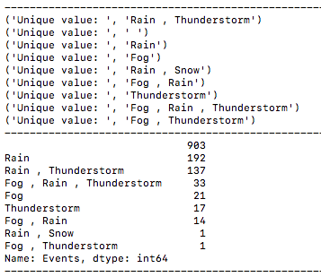
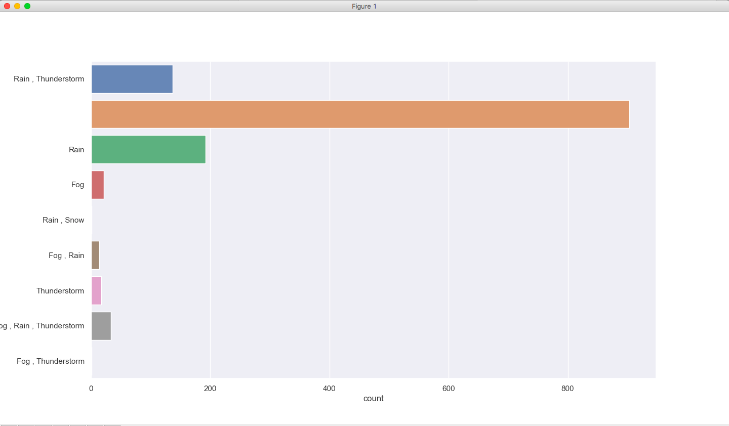
Cleaning the data:
Having a look at the composition of the ‘Events’ column
When there was no adverse weather condition, the entry is a ‘ ‘ (space)

Slide 8
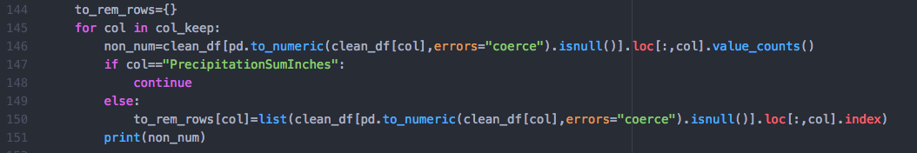
Replaced the space (“ “) with ‘Clear weather’. Reason, since there were no adverse weather events, ‘Clear weather’ seems to be a good fit
Other changes:
Every ‘Rain’ and ‘Rain, Snow’ event labelled as ‘Rain’
’Rain, Thunderstorm’ labeled as ‘Rain+Thunderstorm’
Everything else gets classified under one category, ‘Fog+Rain+Thunderstorm’
It was visible that most of the columns were ‘Object’ type. It is a hint that they contain non-numeric data
Using following snippet of code to check for non-numeric entries:
Notes:
For there is just one mention of snow.
Reason for last one: Fog occurs with other events more than it occurs on its own (just fog 21 mentions), that’s why everything binned together.
Code uses a bool mask, track the rows that are non numeric for they will be coerced and then counts the occurrence of every non numeric character

Slide 9
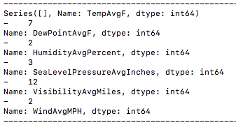
Will also get the row numbers for non-numeric data from that snippet
Combining individual list of row numbers into one, while removing redundancy
There were ‘T’ entries in ‘PrecipitationSumInches’ column. They signify that the precipitation value is very small (close to 0)
So, the ’T’ are replaced with 0. But in order to differentiate between 0 precipitation and trace amount, introduced a dummy variable
Dummy is 1 when there was trace amount of precipitation, else it is 0

Slide 10
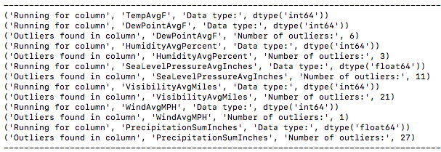
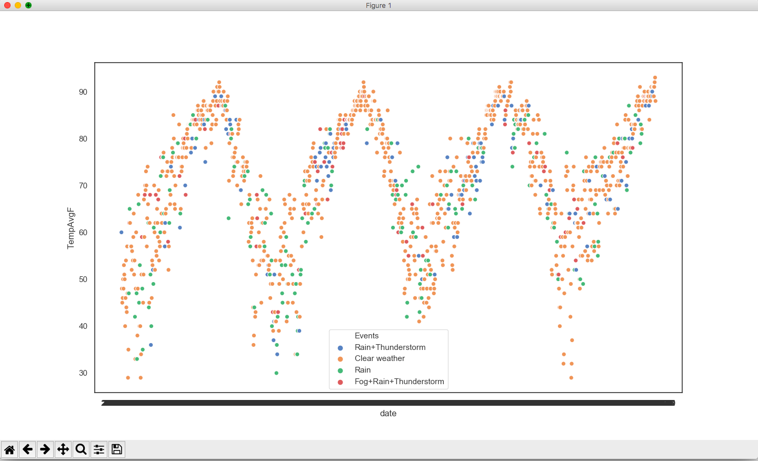
Checking for outliers:

Slide 11
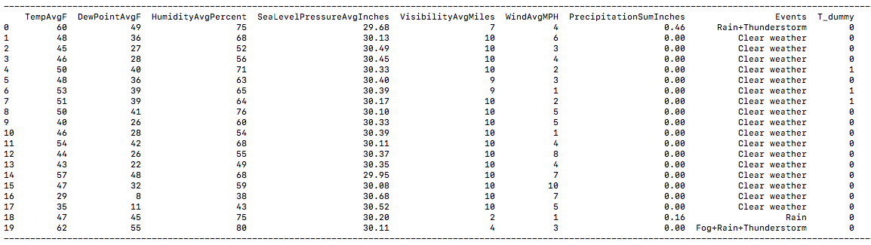
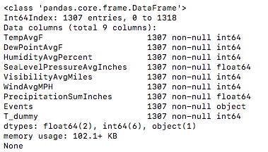
Cleaned data set:

Slide 12
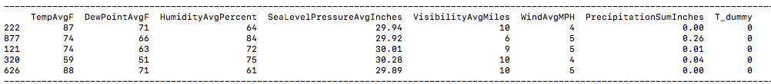
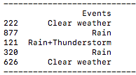
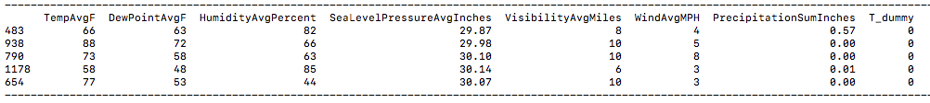
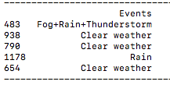
Predictive modeling:
GaussianNB method from sklearn package’s naïve_bayes class
Used Gaussian Naïve Bayes, but with 2 types of scalers:
Standard Scaler
Min Max Scaler
Used the train_test_split from sklearn package’s model_selection class to split the data into training and testing; the split was random:

Slide 13
Standard Scaler vs Min Max Scaler:
Scaling is a part of the pre-processing of data before analysis
Standard scaler shifts the mean to 0 and squeezes the data so that the standard deviation equals to 1
Standard scaler is effective to maintain the effect of outliers in the data
MinMaxScaler will range the data points from 0 to 1
The minimum value in the data will go down to 0 and the maximum will go down to 1
Both the scalers are functions from sklearn package’s preprocessing class

Slide 14
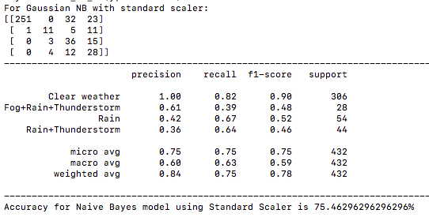
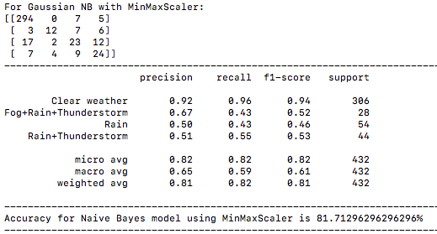
Output:

Slide 15
Conclusion and Reason:
Raw cleaned data provided to both the sub-methods is same
So the scalers are making a difference
MinMaxScaler is giving a better accuracy
A potential reason maybe that the data for this project has low number of outliers and also, the outlier may not be too extreme
Notes:
Not too extreme for the variance and standard deviation in our data can’t be drastic, as it is weather data
So the effect of outliers may not be that huge
Eg, precipitation won’t have extreme outliers. The outliers shown are due to small variation most probably
Say mean precipitation is 0.08. Since it doesn’t always rain, a lot many values may be 0 and a few days it may rain heavily and the value may be too high with respect to the mean
However, it’d contribute same to the fact that it rained.
Maybe that’s why min max scaler is better here

Slide 16
Additional prediction
Implemented multinomial logistic regression
Used the Logistic Regression function from sklearn package’s linear_model class.
Solver used: newton-cg

Slide 17
Thank You

