Slide 1
Black Friday data analysis

Slide 2
Naïve Bayes model:
Gaussian Naïve Bayes model is used.
The Naïve Bayes model did not need any different kind of pre-processing and munging of data than Random Forest Classifier.
Highest accuracy achieved: 63.23%
This accuracy was achieved when the target variable was binned into 3 bins.

Slide 3
Summary on the basis of accuracy:
Linear Regression:
Adjusted R-Squared: 0.300
16 out of 19 parameters are significant.
Random Forest Regressor:
Smallest Root Mean Squared Error : 2902.718761271851
Maximum number of leaf nodes pertaining to this error: 2000
Random Forest Classifier:
Highest Accuracy: 62.18%
Setting: Number of trees in the forest: 150, maximum leaf nodes: 1500, Gain (entropy) criteria.
Naïve Bayes:
Highest Accuracy: 63.23%
Target variable binned into 3 categories

Slide 4
Comparison on the basis of time:
Linear regression:
Total execution: 5.888156890869141 seconds
Random Forest Regressor:
Pre-processing: 1.8084118366241455 seconds
Execution: 11.367883920669556 seconds
Random Forest Regressor:
Pre-processing: 1.984044075012207 seconds
Execution:90.13988089561462 seconds
Naïve Bayes:
Pre-processing: 5.1625471115112305 seconds
Execution: 5.461106061935425 seconds

Slide 5
So, which model is the best?
However, the result is not as satisfactory as Random Forest Classifier.
The highest accuracy was achieved when the target variable was binned into 3 bins.
When the number of bins was increased to 4, the accuracy dropped down drastically to 48.46%
Possible reason is that as the number of bins increase, the data on the increasing number of borders is increasing.
Thus, the model is not correctly classifying that data correctly.
The reason behind saying that Naïve Bayes isn’t as good as Random Forest Classifier in our case, is the drastic drop in accuracy.
With Random Forest Classifier, the drop was there, but it wasn’t this drastic.

Slide 6
Conclusion:
For the Black Friday sales data, Random Forest Classifier proved to be the best model, on the basis of accuracy.
However, it is also the model that took relatively the most amount of time to be executed.
Despite that, we’d conclude that Random Forest Classifier is the best possible solution of all the implemented solutions.

Slide 7
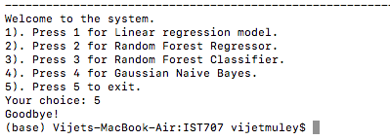
Summary of the project
Menu driven system, terminal based.

Slide 8

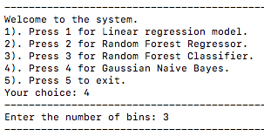

Flexibility:
Random Forest Regressor:
Random Forest Classifier:

Slide 9
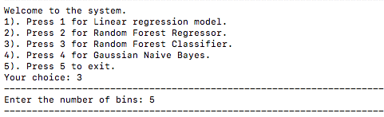
Random Forest Regressor:

Slide 10
Issues faced:
New to machine learning concepts:
Took time to understand before implementing.
May be a reason why we couldn’t implement more models.
Data integrity:
Almost every model needed data to be munged differently.
Ran into a lot of errors due to data not being in proper format as required by the models.
Maximum amount of time and efforts were spent on data cleaning and re-formatting.
Another issue that was faced was overfitting.

Slide 11
What we intended to do:
Clean and re-format the Black Friday sales data.
Analyze the data.
Implement machine learning in an attempt to predict the amount spent by a customer based on the customer’s details.
Compare the models implemented on the basis of accuracy and time taken.
Add a functionality in the system so that the models can make a prediction for a previously unknown customer based on the details entered by the user.

Slide 12
What we managed to complete:
Clean and re-format Black Friday sales data.
Ran statistical and visual analysis.
Succeeded in implementing 4 predictive models to learn patterns from the data and help in forecasting sales amount.
Compared the models based on the accuracy and time taken.
What we could not complete:
Add the functionality to make a prediction for an unknown customer.

Slide 13
Thank You!

