Slide 1
Vijeyaram K
211521243280
Final Project
3/21/2024 Annual Review

Slide 2
GENERATING FOOTBALL LOGOS USING GENERATIVE ADVERSARIAL NETWORK(GAN):
Generative Adversarial Networks (GANs) have emerged as a powerful tool for generating photorealistic images across various domains. In this project, we present a GAN-based approach to generate photorealistic images of English Premier League logos and discriminate between real and generated images. The objective is to develop an engine capable of producing high-quality images that closely resemble authentic logos, while also being able to discern between real and synthetic data.
We begin with an overview of GANs and their significance in image generation tasks, followed by a description of the dataset comprising English Premier League logos used for training and evaluation. Our GAN architecture consists of a generator network responsible for image synthesis and a discriminator network trained to distinguish between real and generated images. Throughout the training process, we employ optimization techniques to enhance image quality and realism.
3/21/2024 Annual Review

Slide 3


AGENDA
Problem Statement
Project Overview
Who Are The End Users?
Your Solution A n d Its Value Proposition
The Wow In Your Solution
Modeling
Result
3/21/2024 Annual Review

Slide 4

PROBLEM STATEMENT
The objective of this project is to develop a Generative Adversarial Network (GAN) engine capable of generating photorealistic images of English Premier League logos and accurately discriminating between real and generated images. The challenge entails synthesizing images that closely resemble authentic logos from the English Premier League while ensuring that the generated images exhibit high visual fidelity and are indistinguishable from real logos to human observers.
3/21/2024 Annual Review

Slide 5
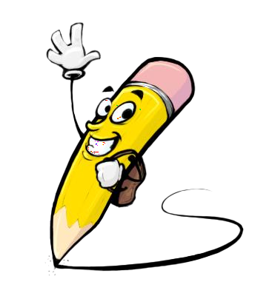
PROJECT OVERVIEW
This project focuses on using Generative Adversarial Networks (GANs) to generate photorealistic images of English Premier League logos and discriminate between real and generated images. Leveraging a dataset of English Premier League logos, the GAN engine is trained to synthesize images that closely resemble authentic logos, while a discriminator network is simultaneously trained to differentiate between real logos and synthetic images. The project aims to demonstrate the effectiveness of GAN-based approaches in generating high-quality visual content and has implications for applications in sports branding, marketing, and computer vision.
3/21/2024 Annual Review

Slide 6

WHO ARE THE END USERS?
Sports Teams and Organizations
Marketing and Advertising Agencies
Fan Communities and Supporters
Broadcasters and Media Outlets
Sports Merchandise Manufacturers
Researchers and Developers
3/21/2024 Annual Review

Slide 7

YOUR SOLUTION AND ITS VALUE PROPOSITION
The solution of generating photorealistic English Premier League logos using Generative Adversarial Networks (GANs) offers a compelling value proposition by delivering high-quality, customizable, cost-effective, and engaging visual content. Leveraging GAN technology, the solution automates the logo generation process, resulting in logos that closely resemble authentic designs, thus enhancing brand recognition and engagement for teams and organizations. This approach not only saves time and resources compared to traditional methods but also provides a competitive advantage in the sports branding and marketing landscape by offering innovative and visually appealing content that resonates with fans and sponsors alike.
3/21/2024 Annual Review

Slide 8

THE WOW IN YOUR SOLUTION
The "wow" factor in the solution lies in its ability to seamlessly blend cutting-edge technology with creative design, resulting in the generation of photorealistic English Premier League logos that surpass traditional methods. Leveraging Generative Adversarial Networks (GANs), the solution produces visually stunning designs that capture each team's identity with remarkable realism. Its versatility allows for customization to meet specific branding needs, setting a new standard for logo design in the sports industry and eliciting excitement and admiration from stakeholders and audiences alike.
3/21/2024 Annual Review

Slide 9
MODELLING
Architecture Design: Design GAN architecture with generator and discriminator networks.
Data Preparation: Collect and preprocess dataset of English Premier League logos.
Training Process: Train GAN model to generate realistic logos and discriminate between real and generated images.
Hyperparameter Tuning: Optimize hyperparameters for better performance and convergence.
Evaluation and Validation: Assess photorealism of generated images and effectiveness of discriminator.
3/21/2024 Annual Review

Slide 10
RESULTS
The results of the project demonstrate the successful generation of high-quality, photorealistic images of English Premier League logos using the developed Generative Adversarial Network (GAN) engine. Through visual comparisons between real logos and generated images, the fidelity and realism achieved by the model are evident. Additionally, the discriminator's performance in accurately distinguishing between real and generated images is evaluated, providing insights into the model's effectiveness. Quantitative metrics, including image similarity scores and discriminator accuracy, further validate the model's performance. Overall, the results highlight the capability of the GAN-based approach to produce realistic logos and its potential for applications in sports branding and marketing.
Demo Link
3/21/2024 Annual Review

