Slide 1

GitHub : What, Why and How !!!

Slide 2

WHAT
?

Slide 3

01
01
Cloud based Platform

Slide 4
02
Allows developers to manage and share their code.

Slide 5
03
Based on Git (Version Control System)

Slide 6

GitHub Jargons
Version Control System
Repository
Branch
Merge
Fork

Slide 7
GitHub Jargons
Pull
Push
Fetch
Clone
Commit

Slide 8

Why
??

Slide 9

Collaboration

Slide 10
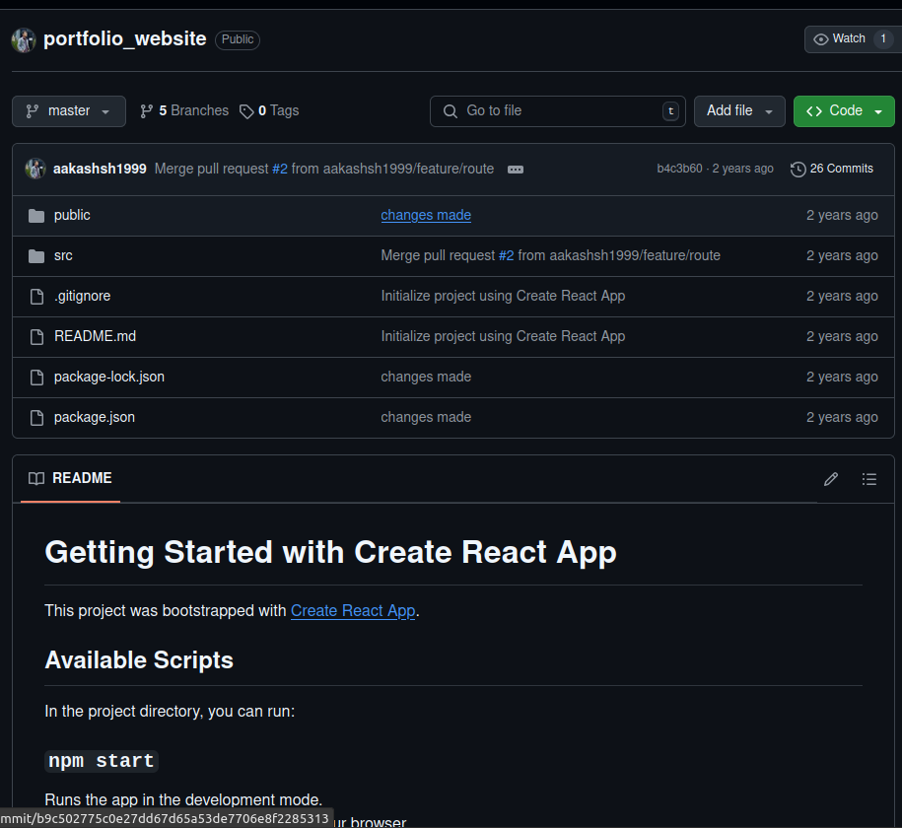
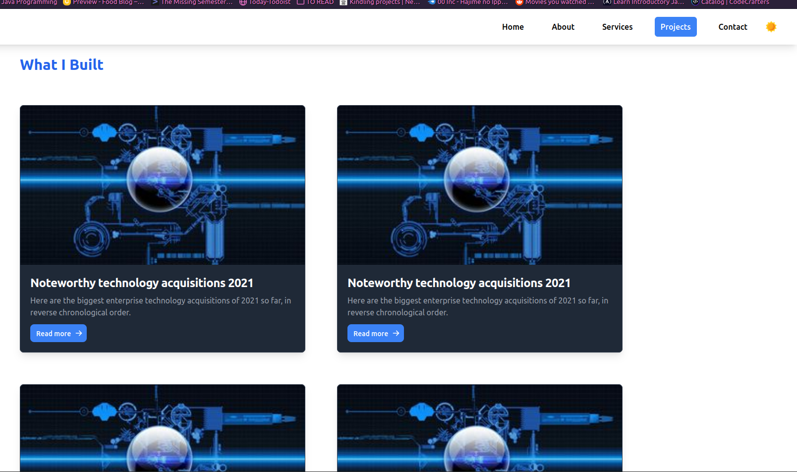
Portfolio

Slide 11


Slide 12
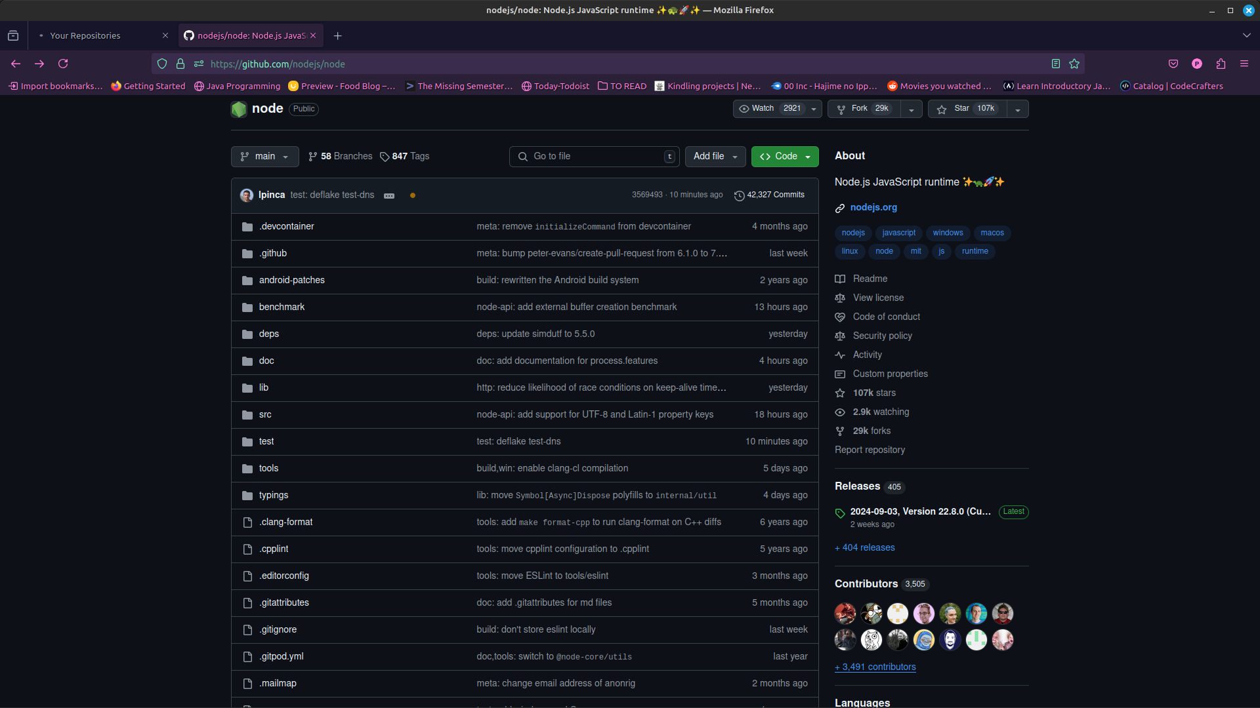
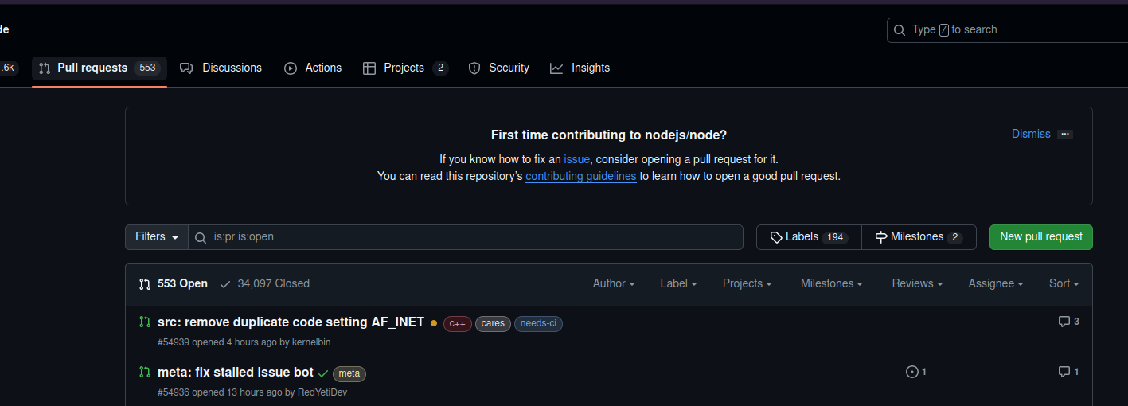

Slide 13
Time For some Hands-On Experience

Slide 14

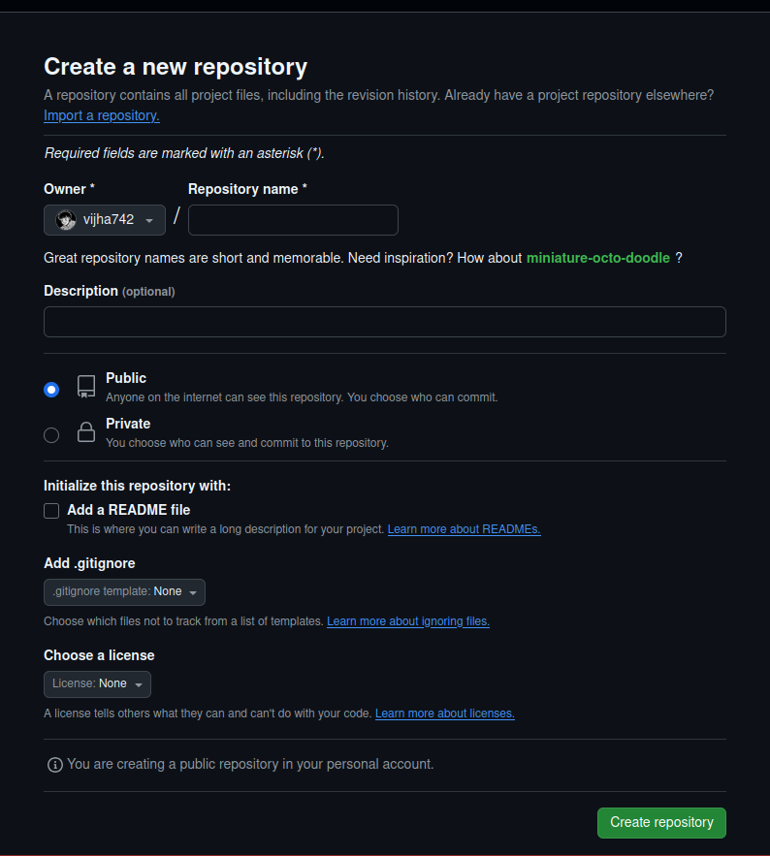
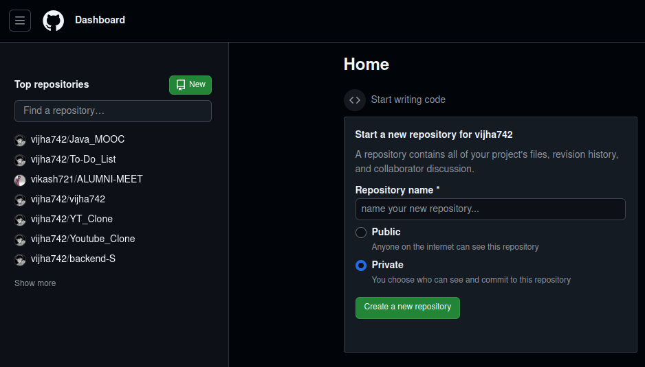
How to Create A Repository

Slide 15

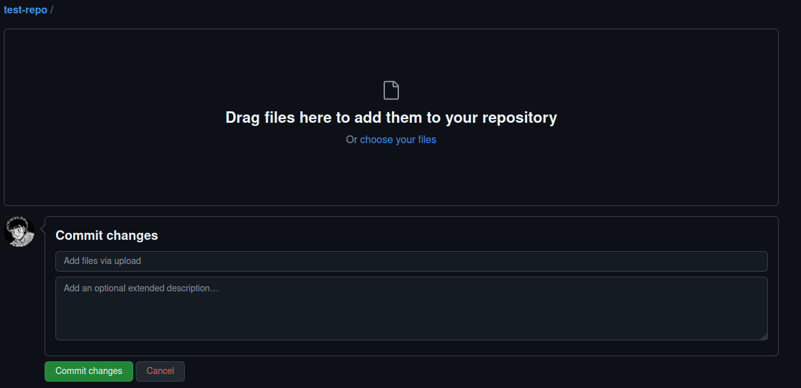
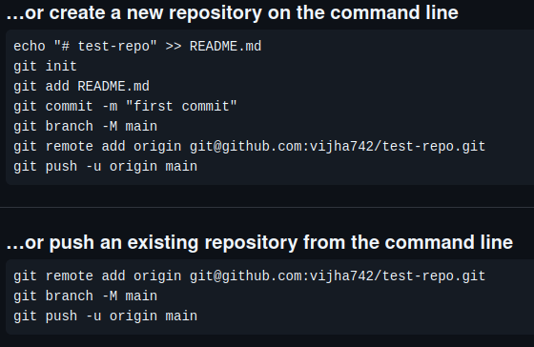
Uploading Files on the GitHub

Slide 16
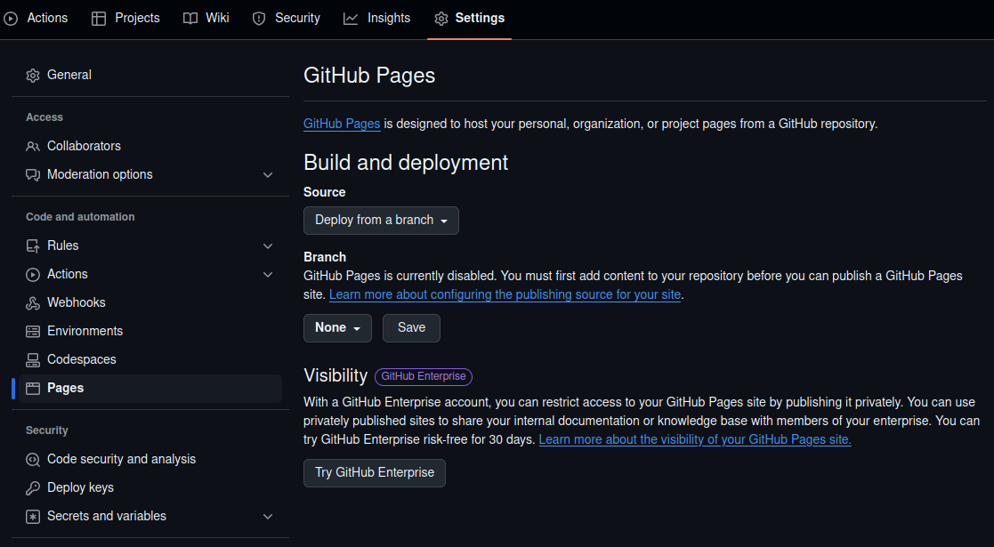
Running a static website via GitHub

Slide 17
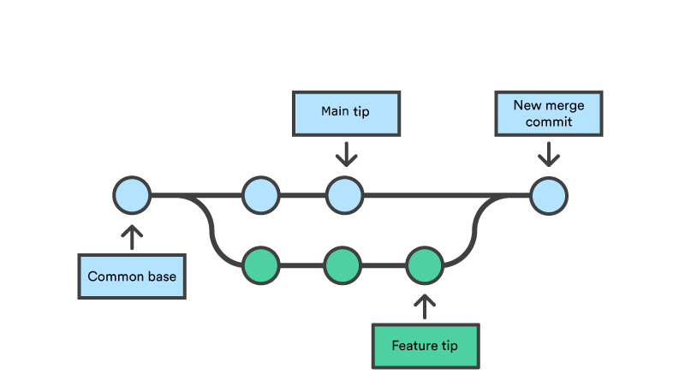
Branch and Merge

Slide 18
Future Topics :
GitHub issues and Project management
Collaboration via GitHub
GitHub Actions
Security Features of GitHub
GitHub Pages

Slide 19

Resources
GitHub Docs
FreecodeCamp GitHub Crash Course
Net Ninja’s Playlist
Kunal Kushwaha’s Video

