Slide 1

Intro to cloud

Slide 2

Intro To New Slide

Slide 3
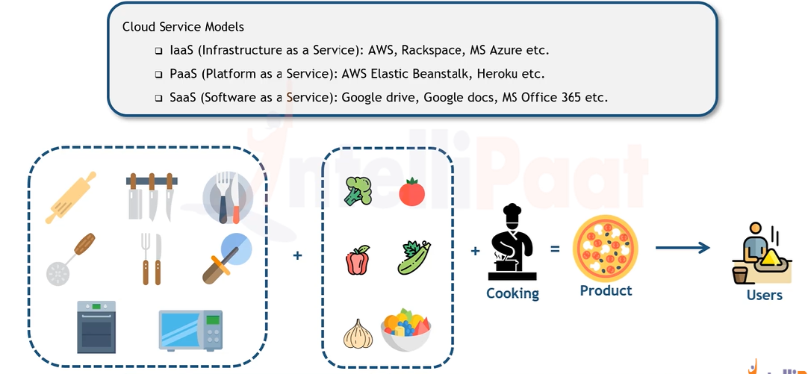
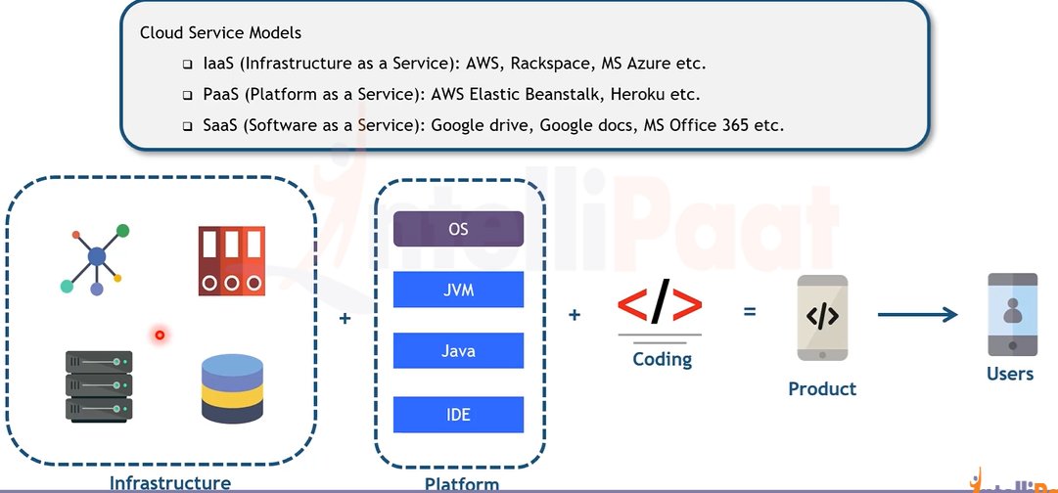

Slide 4
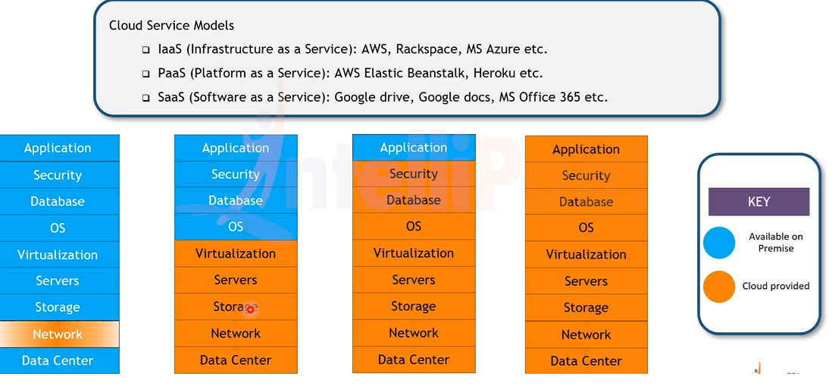

Slide 5
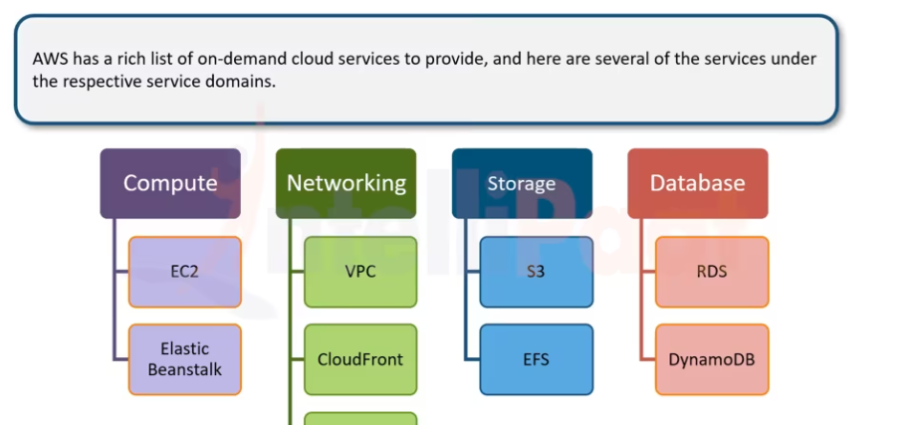

Slide 6
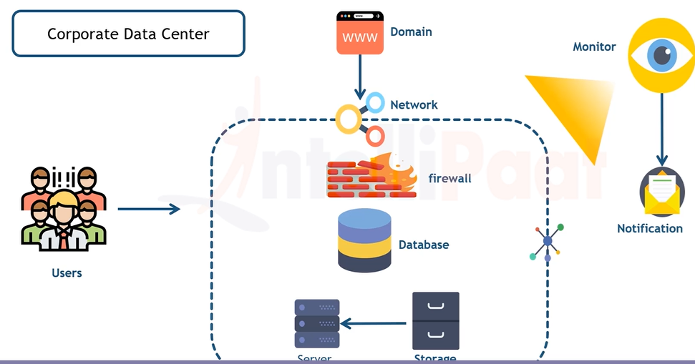
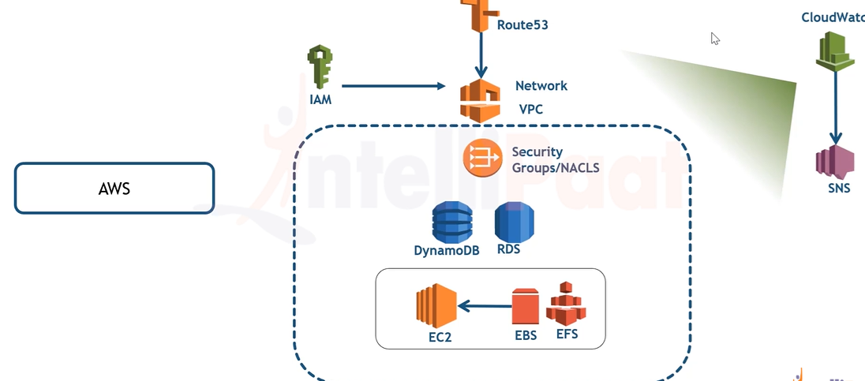

Slide 7
How To Run Pulsar Locally. Getting Started with Apache Pulsar Using Docker Compose - YouTube

