Slide 1

JavaScript - Functional Programming
Callbacks, Higher Order
Functions and Array Methods
Functions are values. Once that clicks, your loops start disappearing.
The last big mindset shift before React.

Slide 2




AGENDA
What we cover today
1
2
3
4
Callback functions
Pure and impure
Higher order functions
map, filter, reduce
passing a function into another function as an argument
side effects, and why predictability matters
writing generic code instead of repeating yourself
the three built-in HOFs you will use forever
Everything today rests on one idea: in JavaScript, a function is just another value you can pass around.
Functional Programming in JavaScript
1

Slide 3
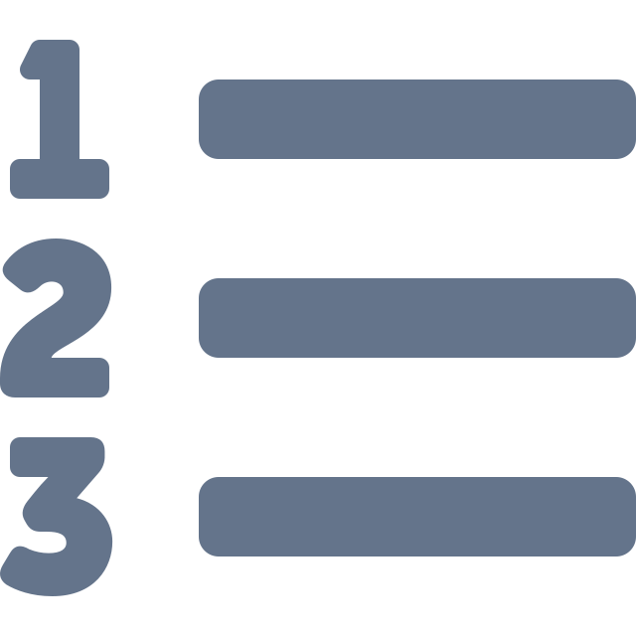


PARADIGMS
Three ways to organise code
A paradigm is a style of structuring a program. JavaScript lets you write in all three, but it leans functional.
Procedural
Object Oriented
Functional
A sequence of steps and procedures, run top to bottom.
Data and behaviour bundled together into objects and classes.
Build programs by composing functions, and avoid changing data.
C
Java, C++
JavaScript
Functional Programming in JavaScript
2

Slide 4

SECTION 1
Callback functions
A function handed to another function.
01

Slide 5
CONCEPT
A function can be an argument
script.js
WHAT IS HAPPENING
function printName(cb) {
console.log('Shikhar');
cb(); // call what we were given
}
function printLastName() { console.log('Singh'); }
function printAge() { console.log(24); }
printName(printLastName);
printName(printAge);
printName( cb )
an empty slot
printLastName
prints Singh
Shikhar Singh Shikhar 24
printAge
prints 24
Same container, different behaviour plugged in.
Functional Programming in JavaScript
3

Slide 6
DRY RUN
You can pass several at once
script.js
order of execution
line
prints
function printName(cb1, cb2, cb3) {
console.log('Shikhar');
cb1();
cb2();
cb3();
}
printName(printLastName, printAge, printAddress);
console.log
Shikhar
cb1()
Singh
cb2()
24
cb3()
Delhi
A callback is simply a function passed as an argument, then called later by the function that received it.
The order you pass them in is the order they run. Nothing magical, just three calls in sequence.
Functional Programming in JavaScript
4

Slide 7
QUIZ 1
What exactly is a callback function?
A function that calls itself
A function passed to another function as an argument
A
B
A function that always returns a value
A built-in JavaScript method
C
D
Hands up for A, B, C, D. Then ask someone to point at the callback in our printName example.
Functional Programming in JavaScript
5

Slide 8

SECTION 2
Pure and impure
Same input, same output. Every single time.
02

Slide 9
CONCEPT
Pure and impure functions
IMPURE - has a side effect
PURE - no side effects
var c = 0;
function sum(a, b) {
return a + b + c++;
}
console.log(sum(2, 3)); // 5
console.log(sum(2, 3)); // 6
function sum(a, b) {
return a + b;
}
console.log(sum(2, 3)); // 5
console.log(sum(2, 3)); // 5
Same arguments, different answers. It reaches outside itself and changes c, so you cannot predict it by reading the call alone.
Depends only on its arguments, touches nothing outside, and returns the same result forever. You can trust it.
Functional Programming in JavaScript
6

Slide 10
QUIZ 2
A function reads a global counter and increases it each time it runs. What is it?
Pure, because it still returns a value
Impure, because it has a side effect
A
B
Pure, as long as the arguments do not change
Neither, that is a callback
C
D
Chorus answer. Then ask: what would you change to make it pure?
Functional Programming in JavaScript
7

Slide 11

SECTION 3
Higher order functions
Stop repeating yourself.
03

Slide 12
CODING QUESTION
The problem: three near-identical functions
Given an array of radii, find the area, circumference and diameter of each circle.
calculateArea
calculateCircumference
calculateDiameter
function (arr) {
let result = [];
for (let i = 0;
i < arr.length; i++) {
result.push( ... );
}
return result;
}
function (arr) {
let result = [];
for (let i = 0;
i < arr.length; i++) {
result.push( ... );
}
return result;
}
function (arr) {
let result = [];
for (let i = 0;
i < arr.length; i++) {
result.push( ... );
}
return result;
}
3.14 * r * r
2 * Math.PI * r
r * 2
the only line that differs
the only line that differs
the only line that differs
This breaks the DRY principle. Do not Repeat Yourself. The loop, the result array and the return are copied three times. Only one line actually changes.
Functional Programming in JavaScript
8

Slide 13
HIGHER ORDER FUNCTION
The fix: pass the logic in
script.js
The definition
function circleArea(r) { return Math.PI * r * r; }
function circleCircumference(r) { return 2 * Math.PI * r; }
function circleDiameter(r) { return 2 * r; }
function calculate(radiusArr, logic) {
let result = [];
for (let i = 0; i < radiusArr.length; i++) {
result.push(logic(radiusArr[i]));
}
return result;
}
calculate(myRadiusArray, circleArea);
calculate(myRadiusArray, circleDiameter);
A higher order function is a function that takes one or more functions as arguments, or returns a function as its result.
Is calculate pure?
Yes. It builds a brand new result array every time and never touches the original radius array. That is the functional programming rule in one line.
one loop, three behaviours
Never mutate your original array.
Functional Programming in JavaScript
9

Slide 14

5 minute break
Callbacks and HOFs covered
Next up map, filter and reduce

Slide 15

SECTION 4
map, filter, reduce
Three higher order functions built into every array.
04

Slide 16
DRY RUN
map: transform every element
the long way
original
let squares = [];
for (let i = 0; i < arr.length; i++) {
squares.push(arr[i] * arr[i]);
}
1
2
3
4
5
num => num * num
with map
let squares = arr.map(function (num) {
return num * num;
});
new array
1
4
9
16
25
the loop is built in, and the original array is untouched
same length, every element transformed
Functional Programming in JavaScript
10

Slide 17
USING MAP
Problem: convert rupees to dollars
script.js
in rupees
const transactions = [1000, 3000, 4000,
2000, -898, 3800, -4500];
const inrToUsd = 80;
let inDollars = transactions.map(function (amount) {
return amount / inrToUsd;
});
1000
3000
4000
2000
-898
divide each by 80
in dollars
12.5
37.5
50
25
-11.2
Whenever you want to apply the same operation to every element and get a new array of the same length, reach for map.
Note the negatives came along too. map transforms everything, it never filters.
Functional Programming in JavaScript
11

Slide 18
DRY RUN
filter: keep what passes a test
script.js
original
let evens = myArr.filter(function (num) {
return num % 2 == 0;
});
1
2
5
7
8
2
6
num % 2 == 0 gives true or false
map vs filter
tested
1
2
5
7
8
2
6
map runs an operation on every element and keeps them all.
filter runs a true or false test, and keeps only the ones that pass. The callback must return a boolean.
result
2
8
2
6
shorter array
Functional Programming in JavaScript
12

Slide 19
QUIZ 3
An array of 7 numbers goes through .map(). How many elements does the result have?
Always 7
Depends on the callback
A
B
Only the ones that passed
Always 1
C
D
Vote. Then ask the same question about filter, and about reduce.
Functional Programming in JavaScript
13

Slide 20
DRY RUN
reduce: many values into one
script.js
arr = [1, 2, 3, 4, 5]
acc
num
new acc
let total = arr.reduce(function (acc, num) {
acc = acc + num;
return acc;
}, 0);
0
1
1
1
2
3
3
3
6
Two things to notice
6
4
10
acc is the accumulator, the running total carried between steps.
The 0 after the closing brace is its starting value. Forget it and reduce behaves unpredictably.
10
5
15
answer: 15
Functional Programming in JavaScript
14

Slide 21
SUMMARY
The three, side by side
WHAT IT DOES
CALLBACK RETURNS
RESULT SIZE
map
transforms every element
the new value
same length
filter
keeps elements that pass a test
true or false
same or shorter
reduce
folds everything into one value
the accumulator
a single value
All three are higher order functions, all three are pure, and none of them touch your original array.
Functional Programming in JavaScript
15

Slide 22
LIVE CODE - SWITCH TO VS CODE
All three on one array
script.js
SAY THIS WHILE YOU TYPE
const transactions = [1000, 3000, -898, 3800, -4500];
// only the positive ones
let credits = transactions.filter(function (amt) {
return amt > 0;
});
// convert them to dollars
let inUsd = credits.map(function (amt) {
return amt / 80;
});
// add them up
let total = inUsd.reduce(function (acc, amt) {
return acc + amt;
}, 0);
console.log(transactions); // still untouched
Start with filter: only the positive transactions survive.
Then map over that result to convert each one.
Then reduce the whole thing down to a single total.
Each step produces a new array, so nothing is lost.
Print the original at the end. Completely unchanged.
Functional Programming in JavaScript
16

Slide 23

CLASS ACTIVITY
Rows of four, one scribe
Your turn: sum of an array using reduce
Time: 7 min
PROMPT Solve JS Core - Sum of Array Using reduce() from the assignment.
1
Take 7 minutes on your own. Write the dry run table before the code
2
Decide what acc starts at, and what the callback must return
3
Rows of four: compare whether anyone forgot the initial value
4
Hands up if your row wants me to unfold the ask before we solve it
Functional Programming in JavaScript
17

Slide 24


Recap
The whole picture
Callbacks
Pure functions
a function passed in, called later by the receiver
same input, same output, no side effects
Higher order functions
map
take a function in, or return one out
transform every element, same length out
filter
reduce
keep what passes a true or false test
fold many values into one, using an accumulator
Functional Programming in JavaScript
18

Slide 25

Questions and doubts
Practice: take any for loop you have written and rewrite it with map, filter or reduce.
Rule of thumb never mutate your original array
Functional Programming in JavaScript
19

