Slide 1
LLD (Low Level Documentation)
Revision Number : 1.2
Last Date Of Revision : 25/09/2022

Slide 2
Document Control
Date | Version | Description | Author
25/09/22 | 1.0 | Introduction, Problem Statement | Vijit Kumar
25/09/22 | 1.1 | Dataset Information, Architecture Description | Vijit Kumar
25/09/22 | 1.2 | Final Revision | Vijit Kumar

Slide 3
Contents
Document Version Control ..................................................................2
Introduction .............................................................................4
1.1. What is Low-Level design document?..............................4
1.2. Scope........................................................................................ 4
2. Architecture ...................................................................................... 5
3. Architecture Description ................................................................ 6
3.1. Data Description .......................................................................... 6
3.2. Data Ingestion.................................................................................6
3.3. Data Validation ............................................................................ 6
3.4 Data Transformation ....................................................................6
3.5 Model Building................................................................................7
3.6 Model Evaluation.......................................................................... 7
3.7 Model Deployment ........................................................................7

Slide 4
1. Introduction
1.1. What is Low-Level design document?
The goal of LLD or a low-level design document (LLDD) is to give the internal logical design of the
actual program code for Mushroom Prediction.LLD describes the class diagrams with the
methods and relations between classes and program specs. It describes the modules so that the
programmer can directly code the program from the document.
1.2. Scope
Low-level design (LLD) is a component-level design process that follows a step-by step refinement
process. This process can be used for designing data structures, required software architecture,
source code and ultimately, performance algorithms. Overall, the data organization may be
defined during requirement analysis and then refined during data design wo

Slide 5
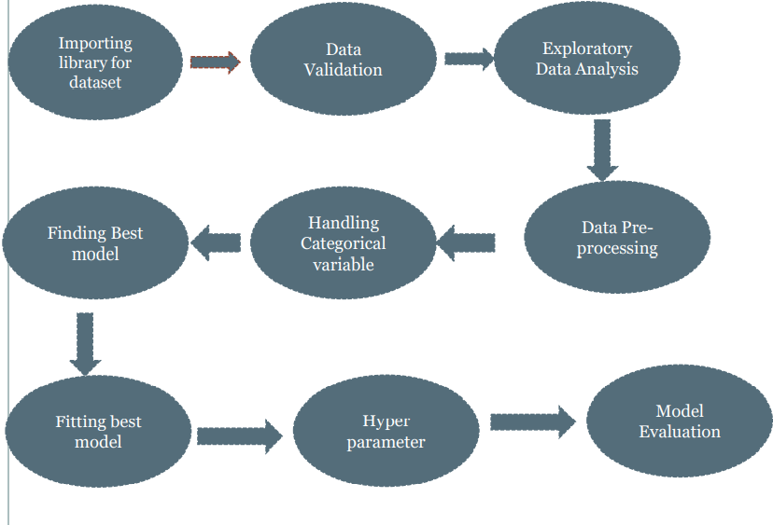
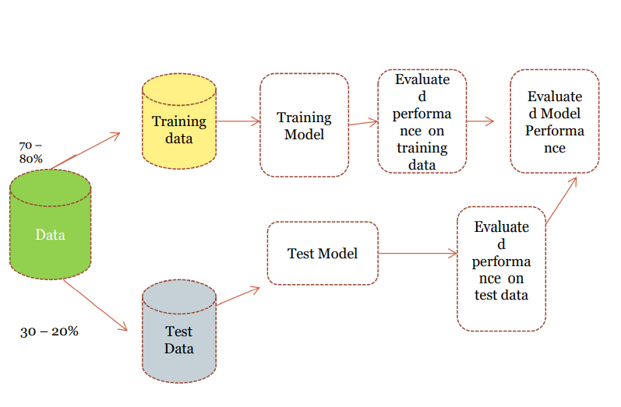
2. Architecture

Slide 6
3. Architecture Description
3.1. Data Description
This dataset contains 8000 records along with 23 columns like capshape,capcolor,veil type ,veil color etc.
3.2. Data Ingestion
In data ingestion step we load the data from database
after splitting into test and train data
3.3. Data Validation
In Data validation steps we could use Null value handling, outlier handling, Imbalanced
data set handling, Handling columns with standard deviation zero or below a
threshold, etc.
3.4 Data Transformation
In this step we will transform out data. We will use standard scaler for numeric data and we
will convert categorical data into numeric data using one-hot encoding technique so that
machine can understand it.

Slide 7
3.5 Model Building
Here we will build the Machine Learning model using all classification algorithms.
3.6 Model Evaluation
Here model evaluation will be done on the pre processed model. All we select best classification algorithm which have best accuracy for our given model.
3.7 Model Deployment
Here model will be deployed to Local Host Platform

