Slide 1
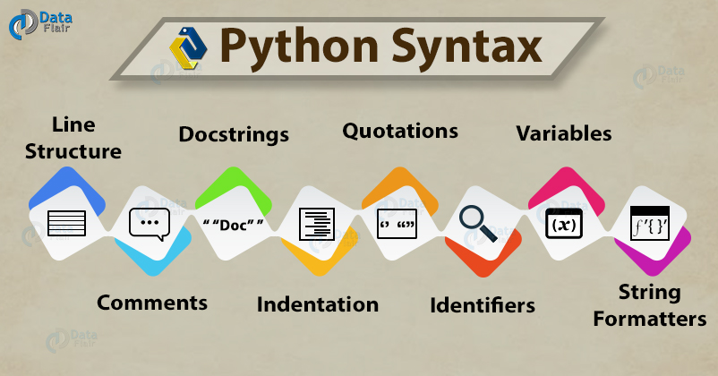

Slide 2
Python Syntax
The term syntax is referred to a set of rules and principles that describes the structure of a language. The Python syntax defines all the set of rules that are used to create sentences in Python programming. For example – we have to learn grammar when we want to learn the English language. In the same way, you will need to learn and understand the Python syntax in order to learn the Python language.

Slide 3
Example of Python Syntax
Python is a popular language because of its elegant syntax structure. Let’s take a quick look at a simple Python program and you will get an idea of how programming in Python looks like.
#Simple Python Program to see if a user is eligible to vote or not.
# getting user’s name
print("Enter your name:")
name = input()
# getting user’s age
print("Enter your age:")
age = int(input())
# condition to check if user is eligible or not
if( age >= 18 ):
print( name, ' is eligible to vote.')
else:
print( name, ' is not eligible to vote.')

Slide 4
Python Multiline Statements
This one is an important Python syntax. Python does not mandate semicolons. A new line means a new statement. But sometimes, you may want to split a statement over two or more lines. It may be to aid readability. You can do so in the following ways.
Use a backward slash
>>> print("Hi\
how are you?")
We can also use it to distribute a statement without a string across lines.
>>> a\
=\
10
>>> print(a)
Output:

Slide 5
Python Comments
Python Syntax ‘Comments’ let you store tags at the right places in the code. You can use them to explain complex sections of code. The interpreter ignores comments. Declare a comment using an octothorpe (#).
>>> #This is a comment

Slide 6
Python Docstrings
A docstring is a documentation string. As a comment, this Python Syntax is used to explain code. But unlike comments, they are more specific. Also, they are retained at runtime. This way, the programmer can inspect them at runtime. Delimit a docstring using three double-quotes. You may put it as a function’s first line to describe it.
>>> def func():
"""
This function prints out a greeting
"""
print("Hi")
>>> func()

Slide 7
Python Indentation
Since Python doesn’t use curly braces to delimit blocks of code, this Python Syntax is mandatory. You can indent code under a function, loop, or class.
if 2>1:
print("2 is the bigger person");
print("But 1 is worthy too");

Slide 8
Python Multiple Statements in One Line
You can also fit in more than one statement on one line. Do this by separating them with a semicolon. But you’d only want to do so if it supplements readability.
>>> a=7;print(a);

Slide 9
Python Quotations
Python supports the single quote and the double quote for string literals. But if you begin a string with a single quote, you must end it with a single quote. The same goes for double-quotes.
The following string is delimited by single quotes.
>>> print('We need a chaperone');
Output:
We need a chaperone
This string is delimited by double-quotes.
>>> print("We need a 'chaperone'");
Output:
We need a ‘chaperone’
Notice how we used single quotes around the word chaperone in the string? If we used double quotes everywhere, the string would terminate prematurely.
>>> print("We need a "chaperone"");
Output:
SyntaxError: invalid syntax

Slide 11
Python Identifiers
An identifier is a name of a program element, and it is user-defined. This Python Syntax uniquely identifies the element. There are some rules to follow while choosing an identifier:
An identifier may only begin with A-Z, a-z, or an underscore(_).
This may be followed by letters, digits, and underscores- zero or more.
Python is case-sensitive. Name and name are two different identifiers.
A reserved keyword may not be used as an identifier. The following is a list of keywords.

Slide 12
Python Variables
In Python, you don’t define the type of the variable. It is assumed on the basis of the value it holds.
>>> x=10
>>> print(x)
>>> x='Hello'
>>> print(x)

Slide 13
Python String Formatters
% Operator
You can use the % operator to format a string to contain text as well as values of identifiers. Use %s where you want a value to appear. After the string, put a % operator and mention the identifiers in parameters.
>>> x=10; printer="HP"
>>> print("I just printed %s pages to the printer %s" % (x, printer))
Output:
I just printed 10 pages to the printer HP
Format Method
The format method allows you to format a string in a similar way. At the places, you want to put values, put 0,1,2,.. in curly braces. Call the format method on the string and mention the identifiers in the parameters.
>>> print("I just printed {0} pages to the printer {1}".format(x, printer))

