Slide 1
Prediction of Factors affecting Super Bowl Winning over the years
Vijitha, Rama, PrAmodhKUMAR and Ishani

Slide 2
Outline
Introduction
Project summary
Data Matrix
Some Sample Data
Data analysis Methodology
Preliminary Analysis
Dataset Summary
Status
Contribution

Slide 3
Introduction
The National Football League (NFL) is a professional American football league consisting of 32 teams.
32 teams are divided into two conferences NFC (National Football Conference) and AFC (American Football Conference) with 16 teams in each conference.
The NFL's 17-week regular season with each team playing 16 games and having one bye week.
Following the conclusion of the regular season, six teams from each conference (four division winners and two wild card teams) advance to the playoffs.
A single-elimination tournament culminating in the Super Bowl, played between the champions of the NFC and AFC. (source Wiki)

Slide 4
Project Summary
In this project, NFL Super Bowl team scores are considered to determine which factors influence the most in attaining their final winning score.
For this analysis, we consider the following factors:
Total Offensive Plays
Total Rushing Yards
Total Passing Yards
Penalties
Touchdown
Field Goals

Slide 5
Data Matrix
The data from 1967 to 2015 is considered for the analysis
The dataset is obtained from the NFL site
(http://www.nfl.com/superbowl/history)

Slide 6
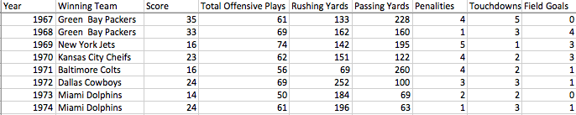
Sample Data

Slide 7
Data Analysis Methodology
Regression analysis will be done with the considered factors as the independent variables and the final score obtained by the winning team as the dependent variable.
The initial dependencies of the factors are calculated using a Correlation Matrix
p values will help us in identifying which of the factors are most important in leading the team to win the game.
Lower the p value, more significant is the relationship between that factor and the dependent variable
The software we will be using for analysis is R studio.

Slide 8
Preliminary Analysis
No Null values are present in the Dataset
The factors Score, Rushing Yards, Penalities, Touchdowns, Field Goals are skewed to the right i.e. are positively skewed while Total Offensive Plays, Passing Yards are negatively skewed.
Dataset was checked for outliers by plotting scatterplots. No outliers were found.

Slide 9
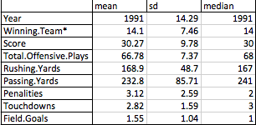
Dataset Summary
Statistical summary for the dataset

Slide 10
Status
Dataset from 1967 to 2015 has been aggregated into a single csv file
Preliminary analysis is complete
Have started working on the Abstract and Introduction part of the Project Report

Slide 11
Project Contribution
Dataset Collection - Ishani and Pramod
Report Writing – Rama and Vijitha
Preliminary and Regression Analysis – Vijitha
PPT creation for presentation – Pramodh and Rama
Presentation - Ishani

