Slide 1

STEGANOGRAPHY – HIDING MESSAGE IN AN IMAGE

Slide 2

STUDENT DETAILS
NAME : Vijitha Mittapalli
SKILLSBUILD EMAIL ID : vijithamittapalli2003@gmail.com
COLLEGE NAME : Puducherry Technological University
COLLEGE STATE : Puducherry
INTERNSHIP DOMAIN : Cyber Security
INTERNSHIP START AND END DATE : 13th October 2023 to 26th November 2023.

Slide 3
PROJECT TITLE/Problem Statement
In the digital age, the protection of sensitive textual information during transmission is crucial.
Traditional encryption methods have their limitations, and there is a need for an innovative approach.
The challenge is to develop an effective steganographic system that conceals text within images seamlessly, ensuring both robust security against detection techniques and optimal visual quality.
This project aims to explore and implement advanced techniques to hide text within images, offering a secure and imperceptible method for transmitting confidential information.

Slide 4
AGENDA
Project Overview
Who are the End users
Solution and its Value Proposition
Project Customization
Modelling
Results
References

Slide 5
PROJECT OVERVIEW
Purpose:
The application addresses the need for secure data transmission by seamlessly hiding and revealing text within digital images, enhancing confidentiality.
Scope:
Focused on developing an intuitive GUI, the project enables users to encode and decode messages, ensuring data security and visual integrity.
Objective:
The goal is to implement advanced steganography techniques for practical data concealment, providing a user-friendly tool for secure communication systems.

Slide 6
WHO ARE THE END USERS of this project?
This project caters to a diverse set of users, including everyday individuals, business professionals, researchers, security-conscious users, and casual photographers. With its user-friendly interface, the application allows individuals to easily conceal and reveal text within digital images, enhancing data security in their communication.
Business professionals benefit from a reliable tool for secure data transmission, ensuring compliance with confidentiality regulations. Researchers and developers find a practical platform for studying and experimenting with steganography techniques.
Security-conscious users appreciate the additional layer of privacy, while casual photographers creatively embed messages within images for a unique and personalized touch. Overall, the application addresses various user needs by providing a seamless and accessible solution for secure digital communication.

Slide 7
SOLUTION AND ITS VALUE PROPOSITION
Image steganography is a GUI-based project in which we are hiding a secret message within the image using encoding and decoding functions. We are creating a window in which there are two buttons: encoding and decoding.
For encoding, select any image, this image will be converted into png format. Type message in the message box then it will convert into base64, merge this encoded string into image and the user can save the image where he/she wants.
For decoding, select the image which is encoded, the base64 string will get separated by decoding, and by Tkinter module hidden text is shown in the textbox.

Slide 8
WOW IN SYSTEM
Security Enhancement: Employs advanced steganography for discreet text embedding within digital images, surpassing traditional encryption methods.
User-Friendly Interface: Ensures accessibility with an intuitive graphical user interface for users with diverse technical backgrounds.
Privacy and Confidentiality: Guarantees data privacy by concealing information within images, meeting the security needs of personal and professional users.
Educational and Research Significance: Provides a practical platform for researchers to study and experiment with steganography techniques, contributing to secure communication advancements.
Creative Communication: Allows casual users, including photographers, to creatively embed messages within images, adding a unique and personalized dimension to shared content.

Slide 9
MODELLING – Technologies used
The Image Steganography Application utilizes key technologies to achieve its innovative solution.
Tkinter (GUI Framework in Python):
Employs Tkinter for creating an intuitive and user-friendly graphical interface, enhancing user engagement.
Pillow (Fork of PIL):
Utilizes Pillow for efficient image processing tasks, ensuring compatibility with various image formats and providing essential functionality for steganography operations.
BytesIO (Python Library):
Implements BytesIO for in-memory binary data handling, contributing to the efficiency of image processing and data manipulation.

Slide 10
ENCODING METHODOLOGY
Text-to-Binary Conversion:
Converts the user-entered text into binary representation, establishing the foundation for data embedding.
Image Pixel Iteration:
Iterates through the pixels of the selected input image to extract RGB values, providing the canvas for concealing binary data.
Data Embedding:
Utilizes steganographic techniques(LSB) to subtly embed the binary representation of the text within the least significant bits of selected image pixels.
Image Reconstruction:
Reconstructs the steganographically modified image with the concealed text, preserving the visual integrity and format of the original image.
Output Image Saving:
Allows users to save the newly generated image with concealed text, ensuring a seamless and secure output.

Slide 11
DECODING METHODOLOGY
Image Pixel Iteration:
Similar to the encoding process, iterates through the pixels of the steganographically modified image to extract RGB values.
Data Extraction:
Extracts the least significant bits from the pixel values, retrieving the concealed binary representation of the text.
Binary-to-Text Conversion:
Converts the extracted binary data back into human-readable text, reconstructing the original message.
Output Presentation:
Presents the decoded text to the user, facilitating the extraction of hidden information from the steganographically modified image.

Slide 12
Results
The Image Steganography Application, built with Tkinter and PIL, securely conceals text within digital images using the Least Significant Bit (LSB) method, ensuring visual integrity preservation. Its intuitive GUI promotes user accessibility, while the adoption of advanced steganography techniques, including LSB embedding, enhances data security. The positive user feedback and the application's versatility underscore its effectiveness, making it a valuable tool for secure communication, research, and education in the steganography domain.

Slide 13
links
The project is available at :https://github.com/vijithamittapalli/AICTE-CYBER-SECURITY-INTERNSHIP

Slide 14
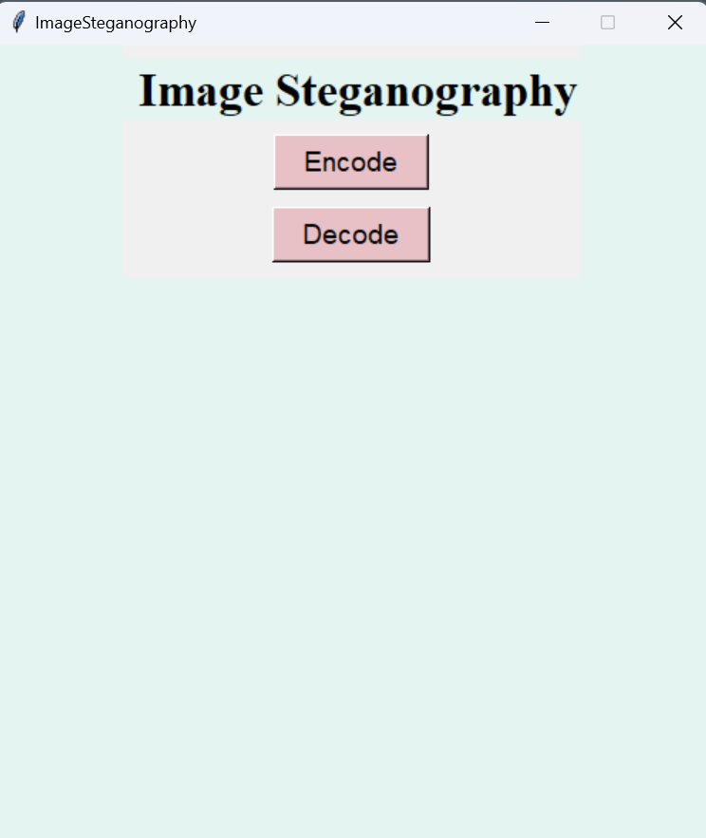
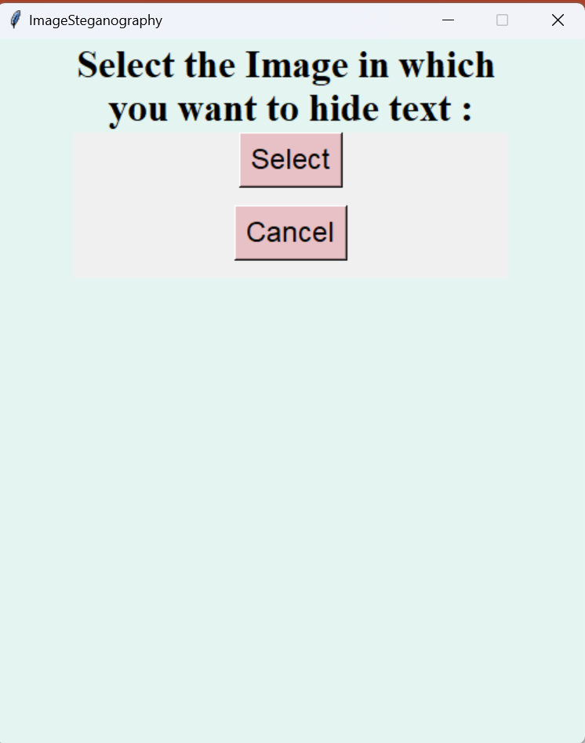
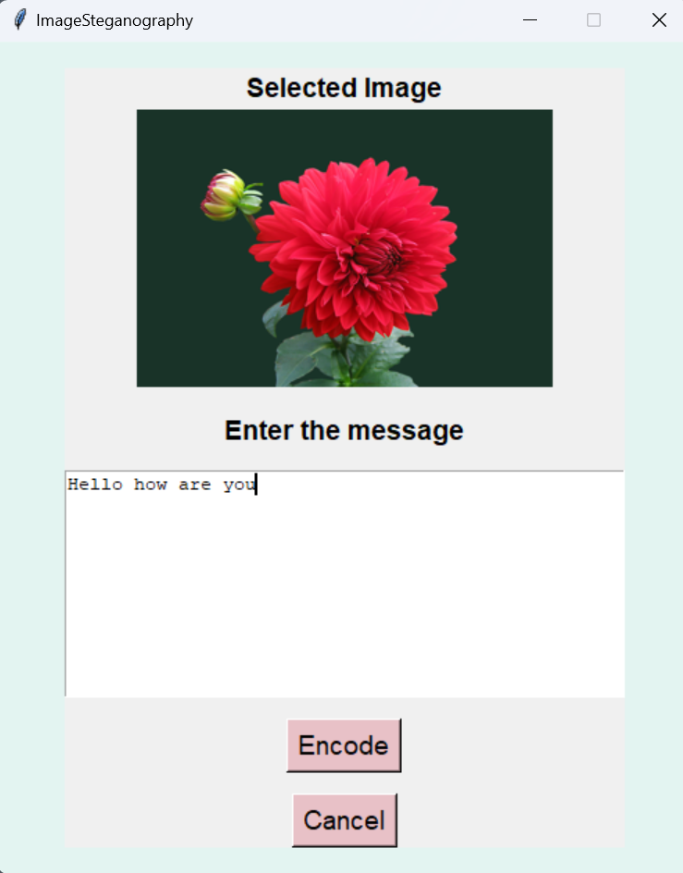
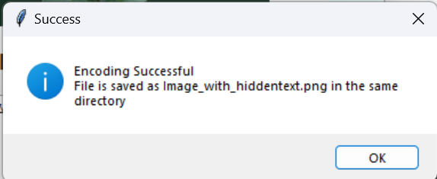
SCREENSHOTS

Slide 15
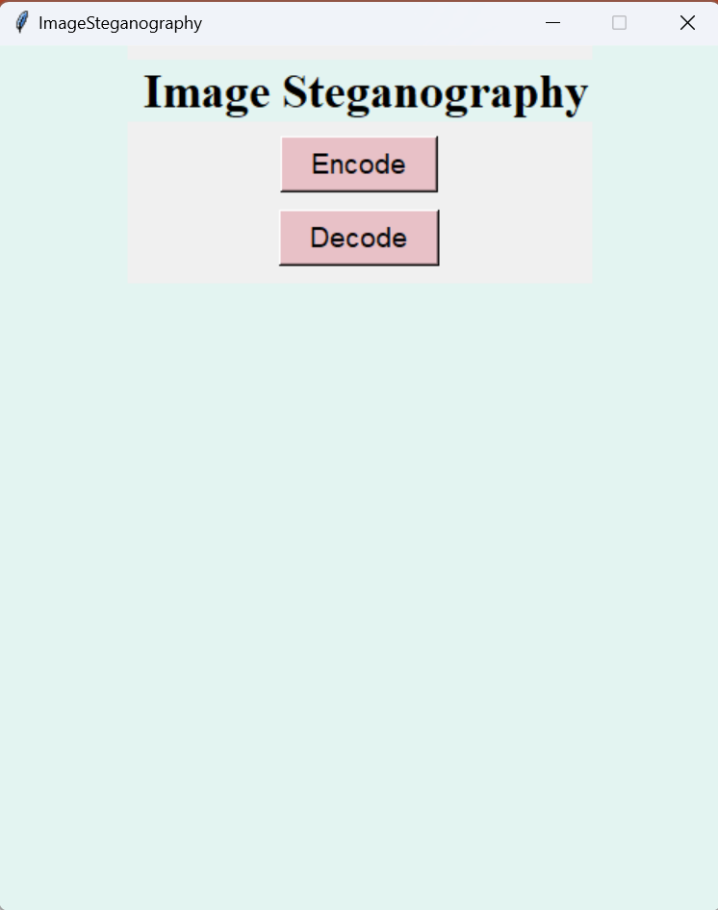
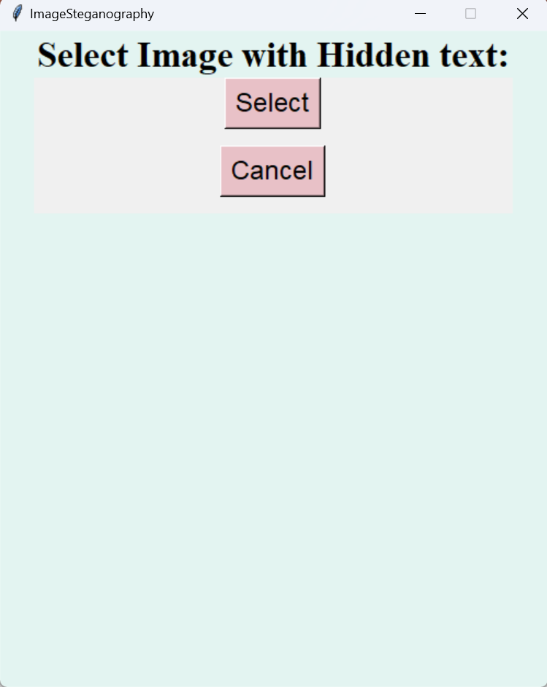
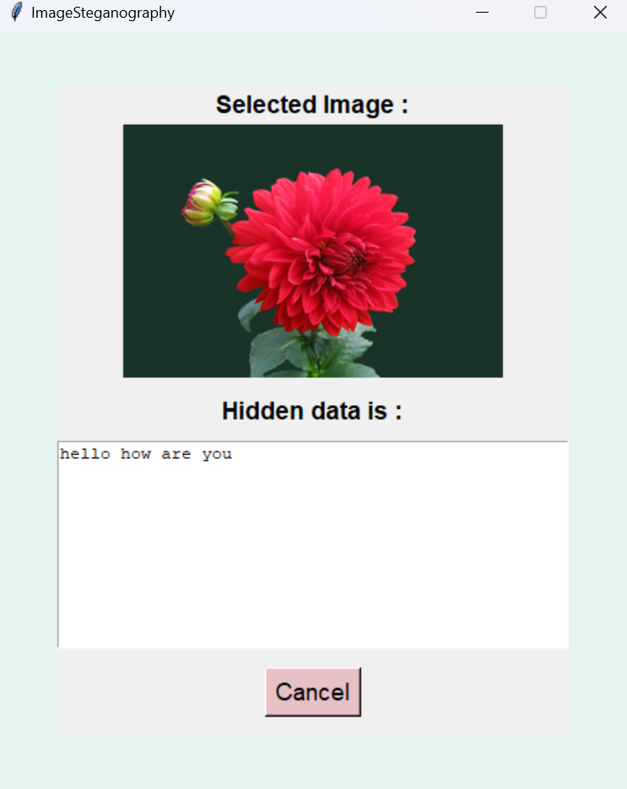
SCREENSHOTS

Slide 16
tHANK YOU!

