Slide 1
Figures

Slide 2
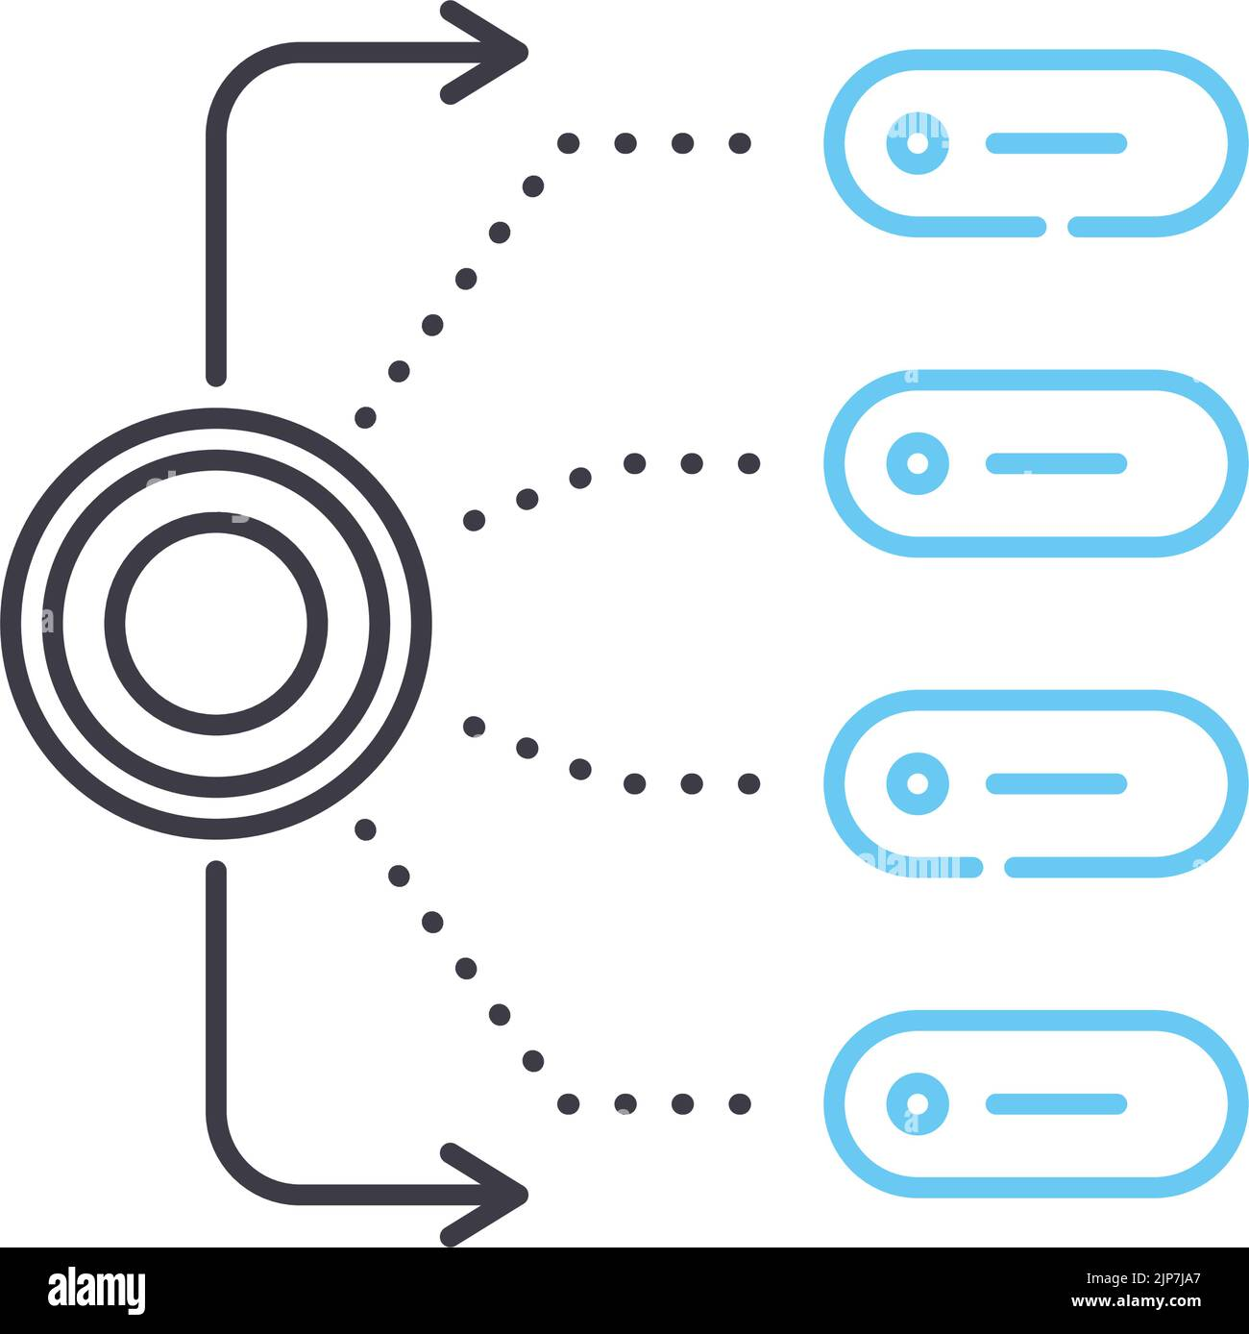



Fig1
*CC(c1ccccc1)*
SMILES
Feature generation
Chemical descriptors
Encoder
Add & Norm.
FCNN
Add & Norm.
Regressor
Predictions
Multi head attention
layer
Contextual features
Un-labelled data
Embeddings
Labelled data

Slide 3

GPR
Fig1
Predictions
Chemical descriptors
Feature generation
*CC(c1ccccc1)*
SMILES
Encoder
Contextual features
Add & Norm.
FCNN
Add & Norm.
Multi head attention
layer
Regressor
Un-labelled data
Embeddings
Labelled data
Predictions

Slide 4
Datasets
Table1
Dataset | Property | No.of data points | C.V folds
Eea | Electron affinity | 368 | 5
Egb | Bandgap(Bulk) | 561 | 5
Egc | Bandgap(chain) | 3380 | 5
Ei | Ionization energy | 370 | 5
Xc | Crystallisation tendency | 432 | 5
OPV | Power conversion efficiency | 1203 | 5
EPS | Dielectric constant | 382 | 5
Nc | Refractive index | 382 | 5
LiC | Conductivity | 271 | 5
Eatm | Atomization energy | 351 | On test data

Slide 5
Table2
PROPERTY | RMcSE |  |  |  |  | R2 score
 | Chem | Transpolymer | TransChem | MT | MT+Chem | Chem | Transpolymer | TransChem | MT | MT+chem
Eea | 0.393 | 0.315 | 0.297 | 0.300 | 0.294 | 0.86 | 0.91 | 0.920 | 0.922 | 0.925
Egb | 0.601 | 0.52 | 0.501 | 0.467 | 0.508 | 0.903 | 0.93 | 0.933 | 0.942 | 0.9309
Egc | 0.63 | 0.45 | 0.44 | 0.508 | 0.510 | 0.834 | 0.92 | 0.920 | 0.888 | 0.891
EI | 0.452 | 0.39 | 0.377 | 0.399 | 0.373 | 0.785 | 0.84 | 0.841 | 0.823 | 0.837
Xc | 17.010 | 16.57 | 16.203 |  |  | 0.483 | 0.50 | 0.521
OPV | 2.141 | 1.92 | 1.775 |  |  | 0.161 | 0.32 | 0.423
EPS | 0.551 | 0.52 | 0.512 | 0.541 | 0.543 | 0.744 | 0.76 | 0.778 | 0.750 | 0.754
Nc | 0.138 | 0.1 | 0.089 | 0.097 | 0.095 | 0.70 | 0.82 | 0.830 | 0.824 | 0.835
LiC | 0.721 | 0.827 | 0.685 |  |  | 0.573 | 0.327 | 0.623
Eatm | 0.0392 | 0.053 | 0.034 |  |  | 0.98 | 0.97 | 0.989

Slide 6
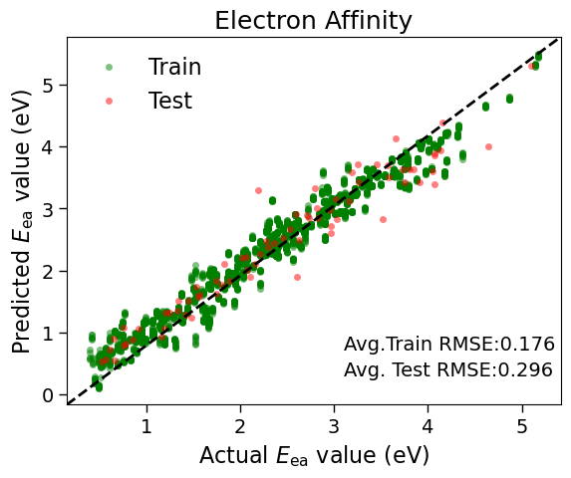
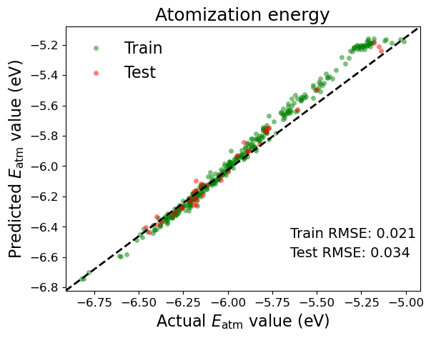
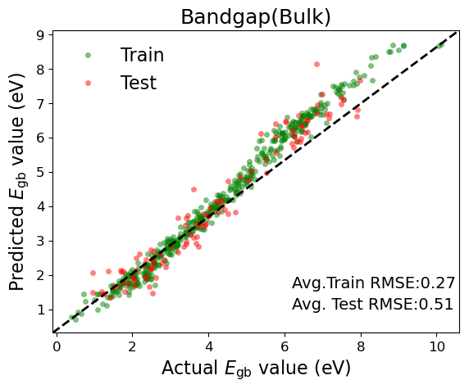
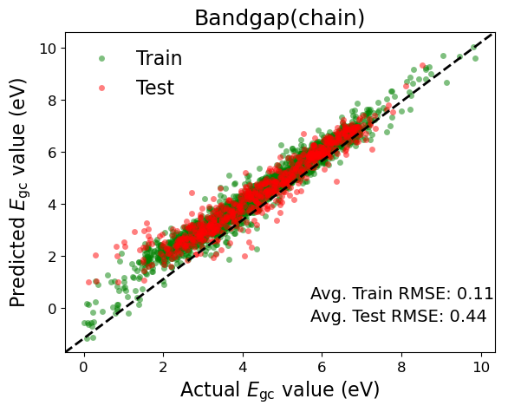
Parity plots
Parity plots
Fig2
a)
b)
c)
d)

Slide 7
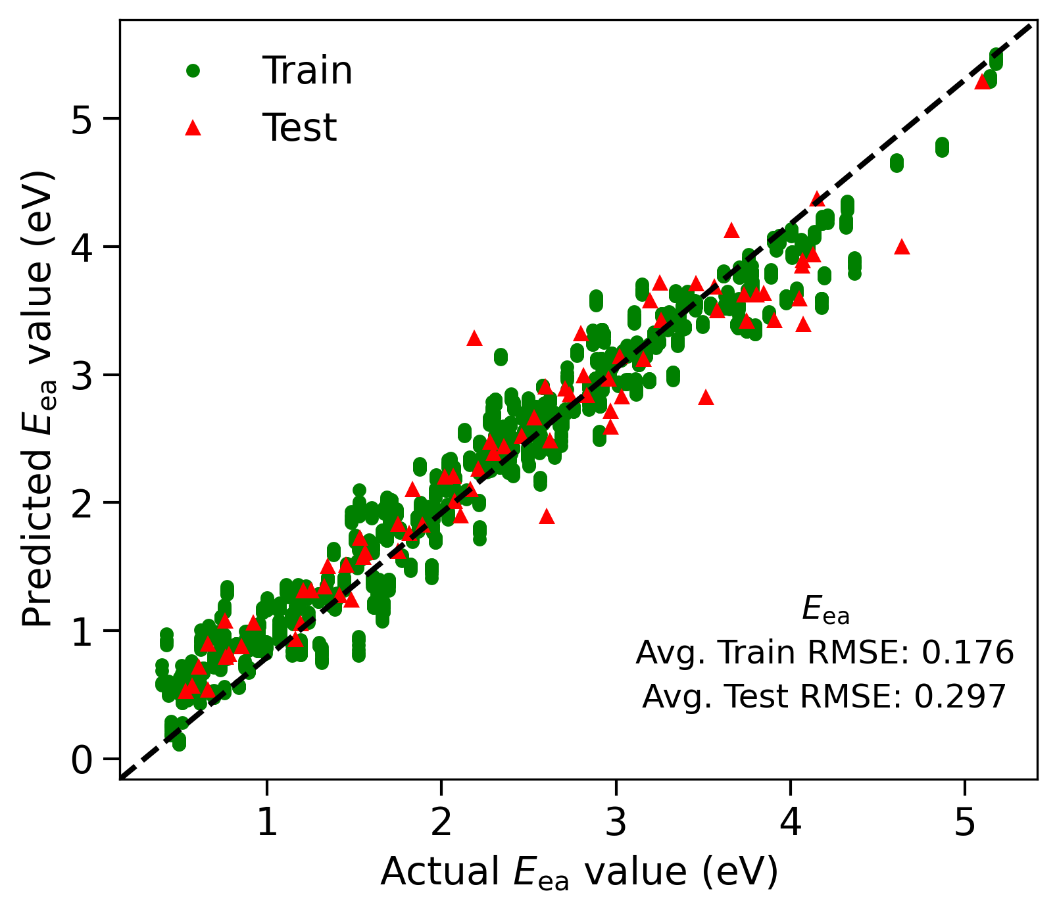
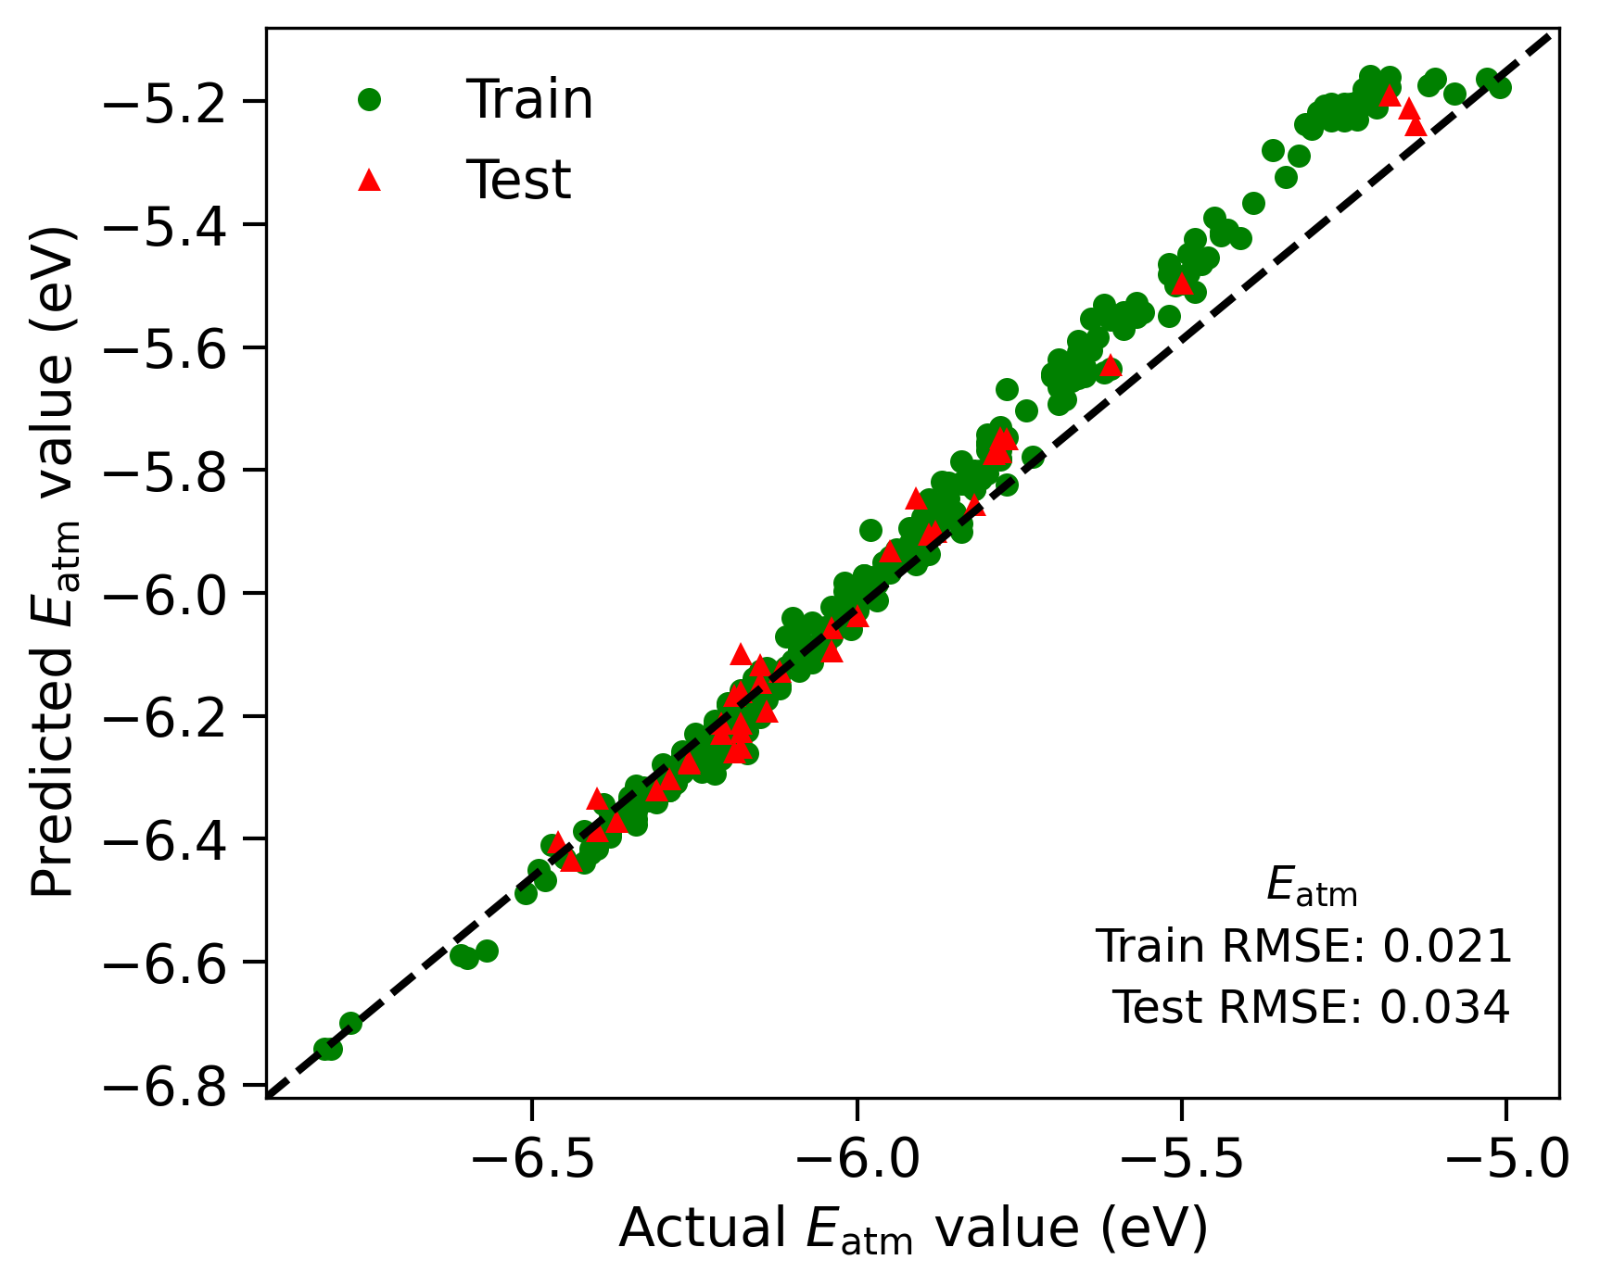
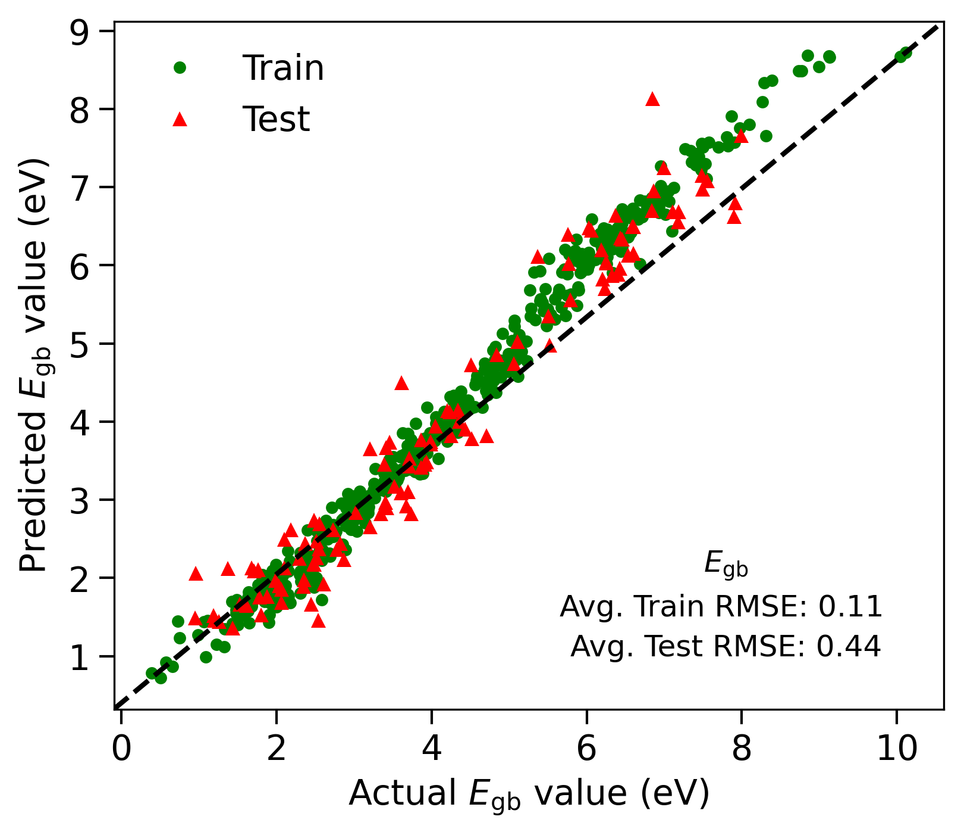
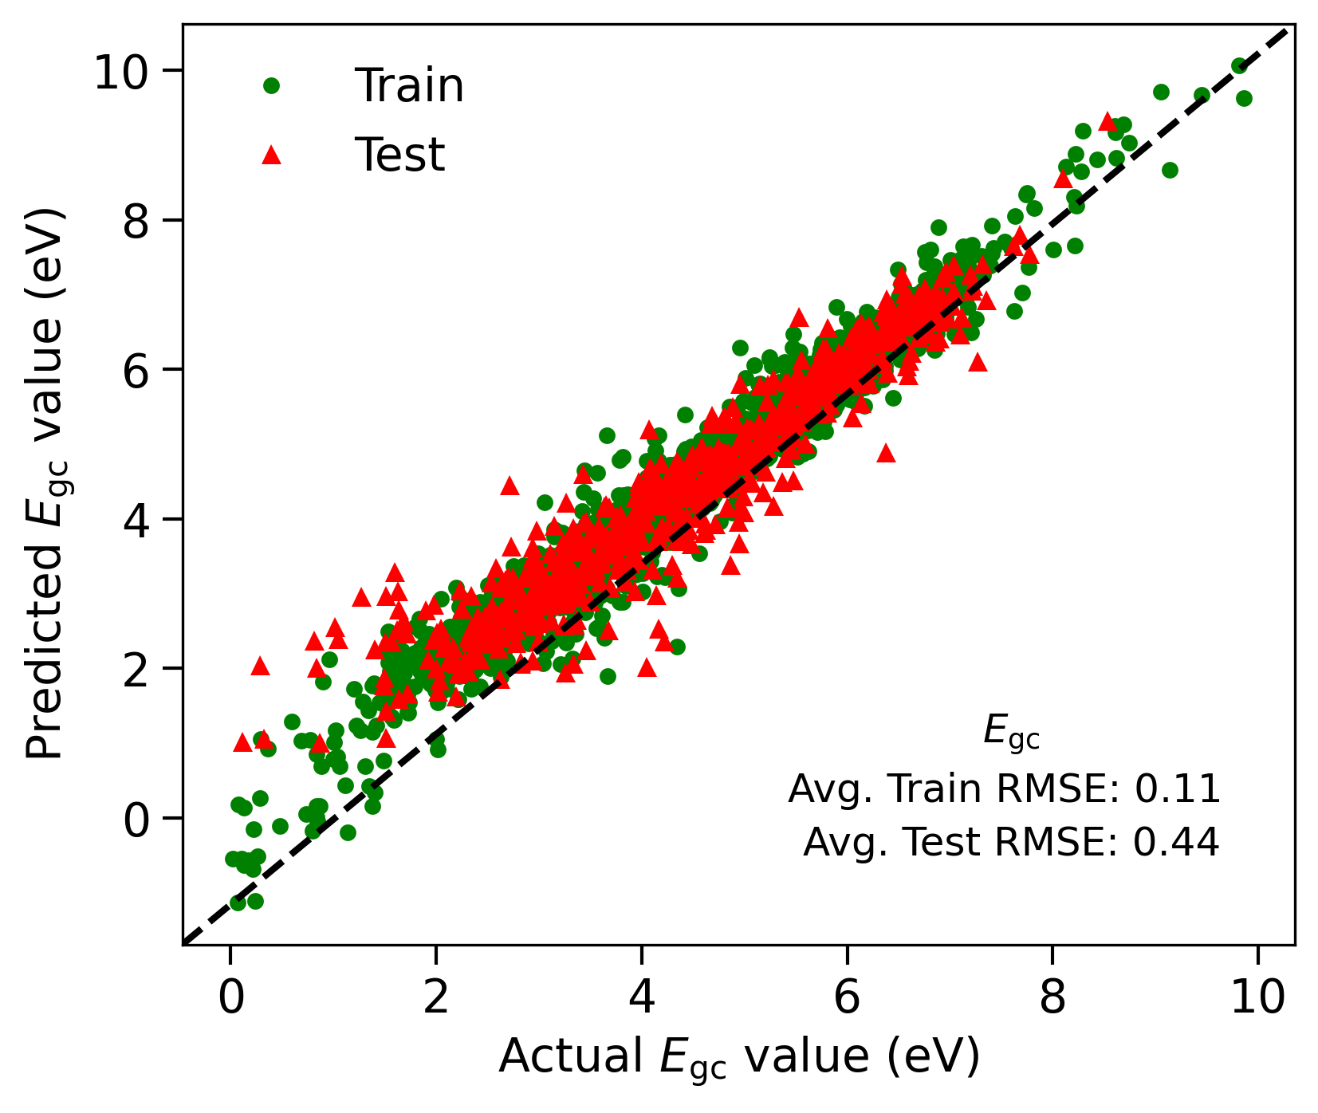
a)
b)
c)
d)

Slide 8
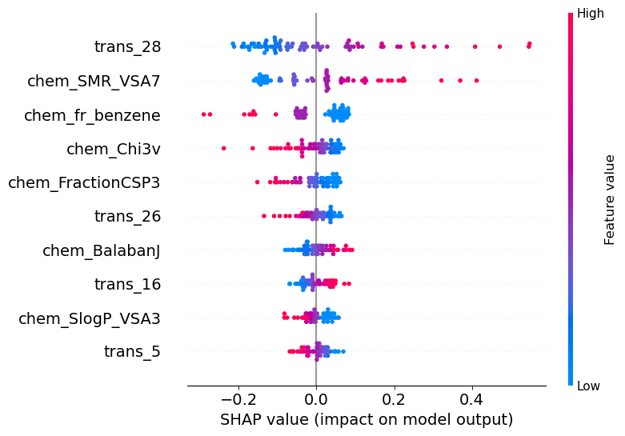
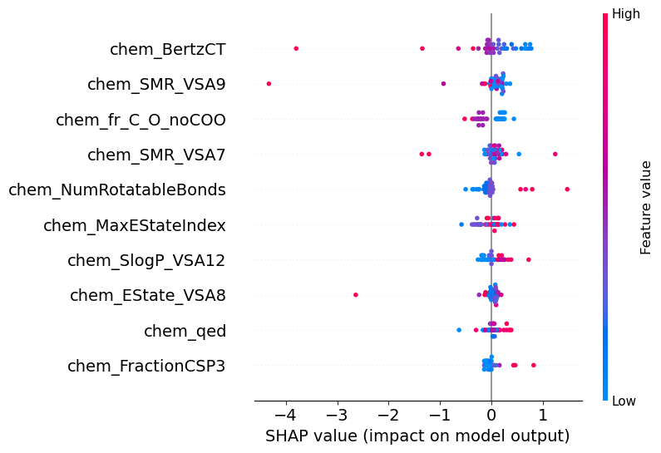
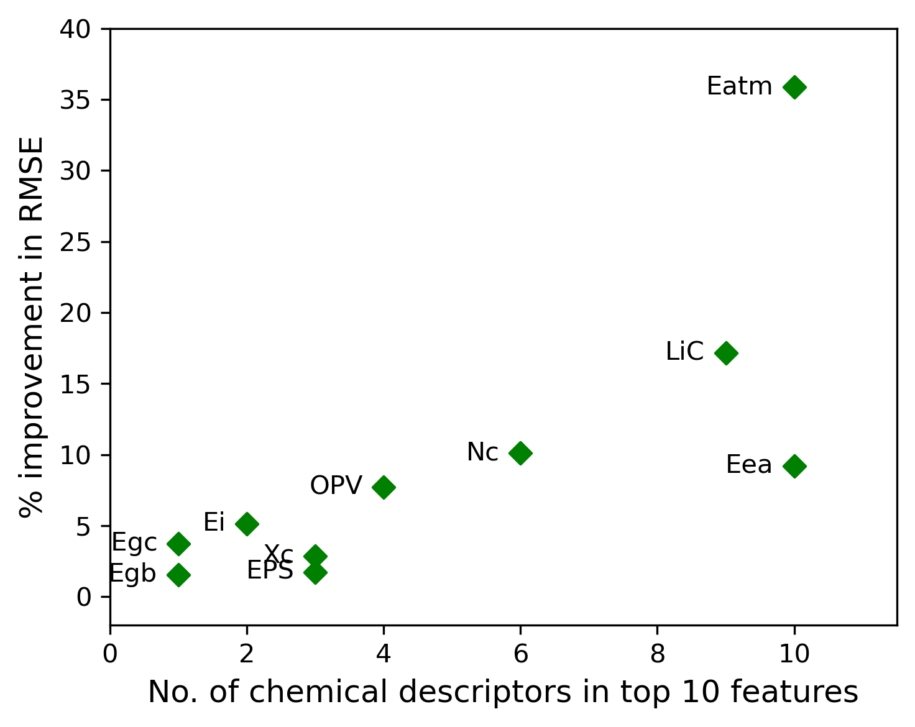
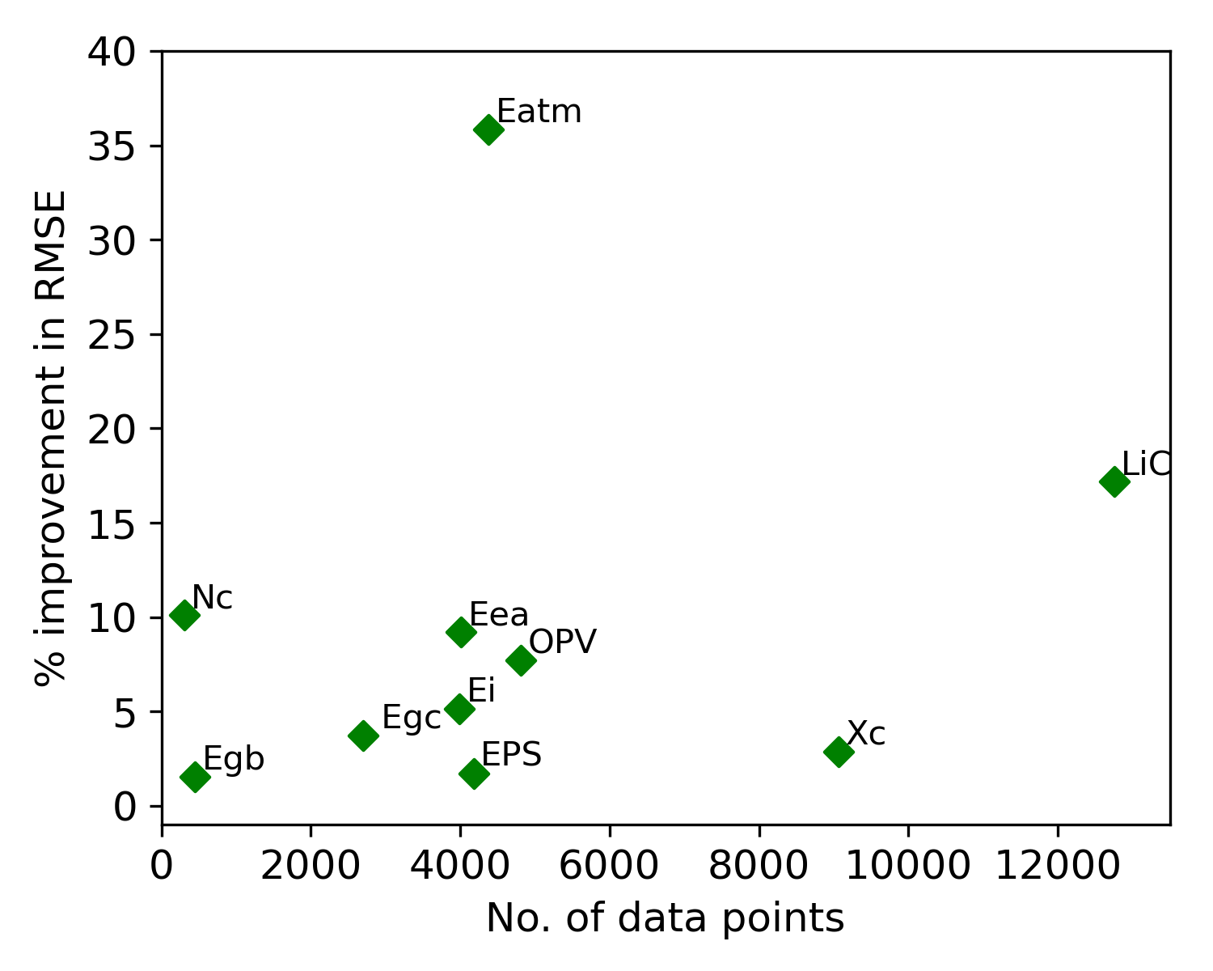
Fig3
Nc
Eatm
a)
b)
c)
d)

Slide 9
Egb | 450
Eea : | 4013
EI | 3990
Egc | 2705
Xc | 9070
OPV | 4810
EPS | 4180
Nc | 307
LiC | 12757
Eatm | 4381

Slide 10
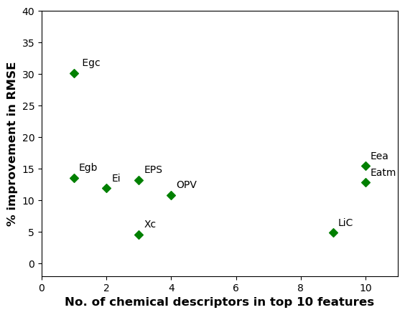

Slide 12
