Slide 1
Excel Data Analysis Report
Comprehensive Analysis of Lead Database
December 03, 2025

Slide 2
Executive Summary
📊 Total Records: 194,831
✅ Active Leads: 183,565 (94.2%)
🌍 Countries: 426
🏢 Companies: 50,869
Regional Distribution:
• ME Region: 54,909 (28.2%)
• EU Region: 82,314 (42.2%)
• USA: 8,030
• Others: 20,618

Slide 3
Dataset Overview
Total Rows: 194,831
Total Columns: 40
Data Quality: 76.1% complete
Duplicate Rows: 0 (0%)
Key Metrics:
• Contacts: 118,413
• Leads: 52,260
• Disqualified: 10,939
• Won: 133
• Lost: 190

Slide 4
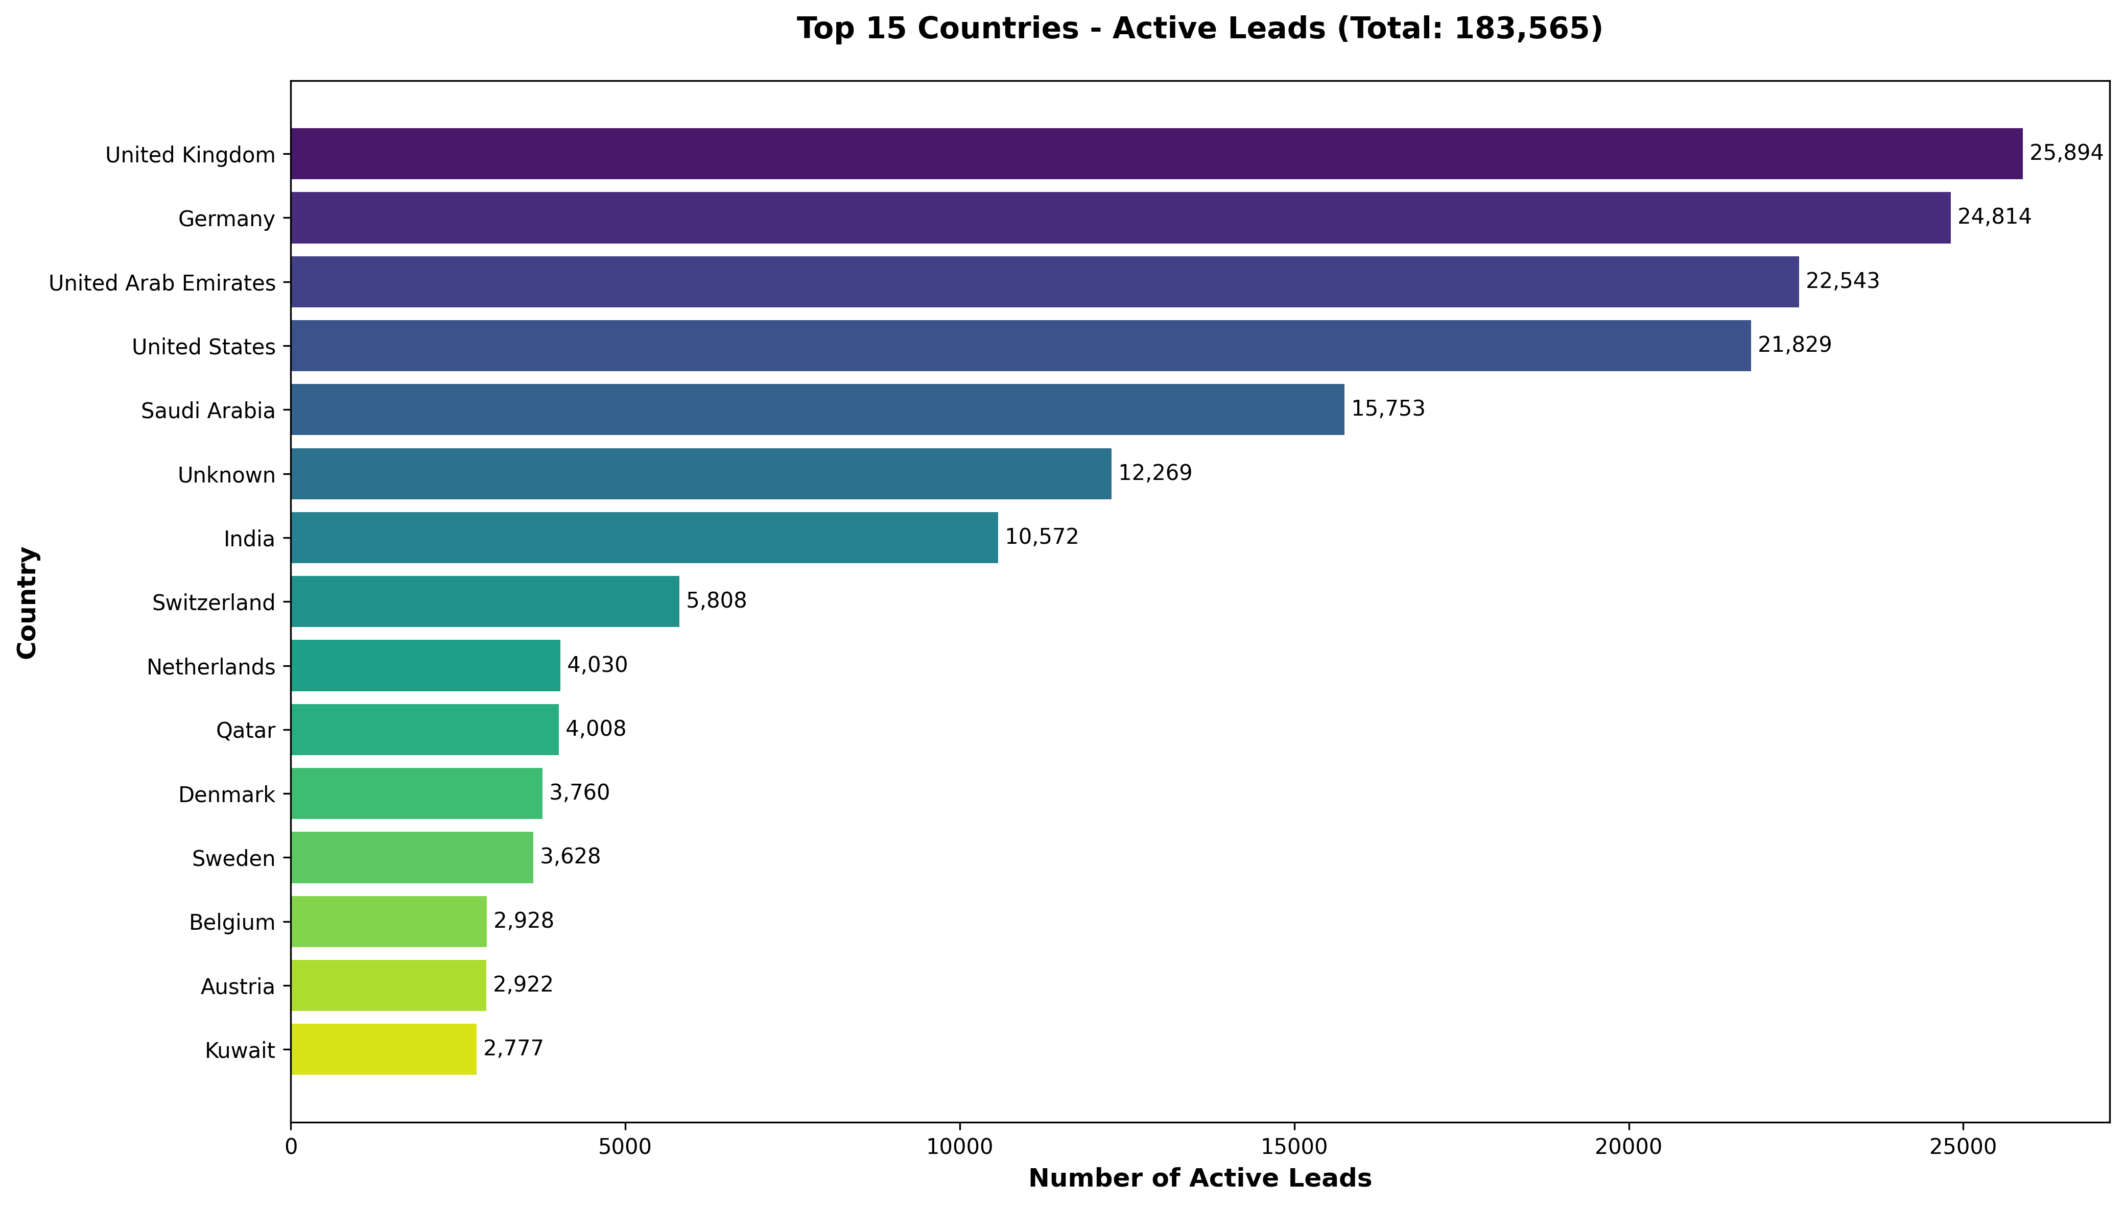
Active Leads by Country (Top 15)

Slide 5
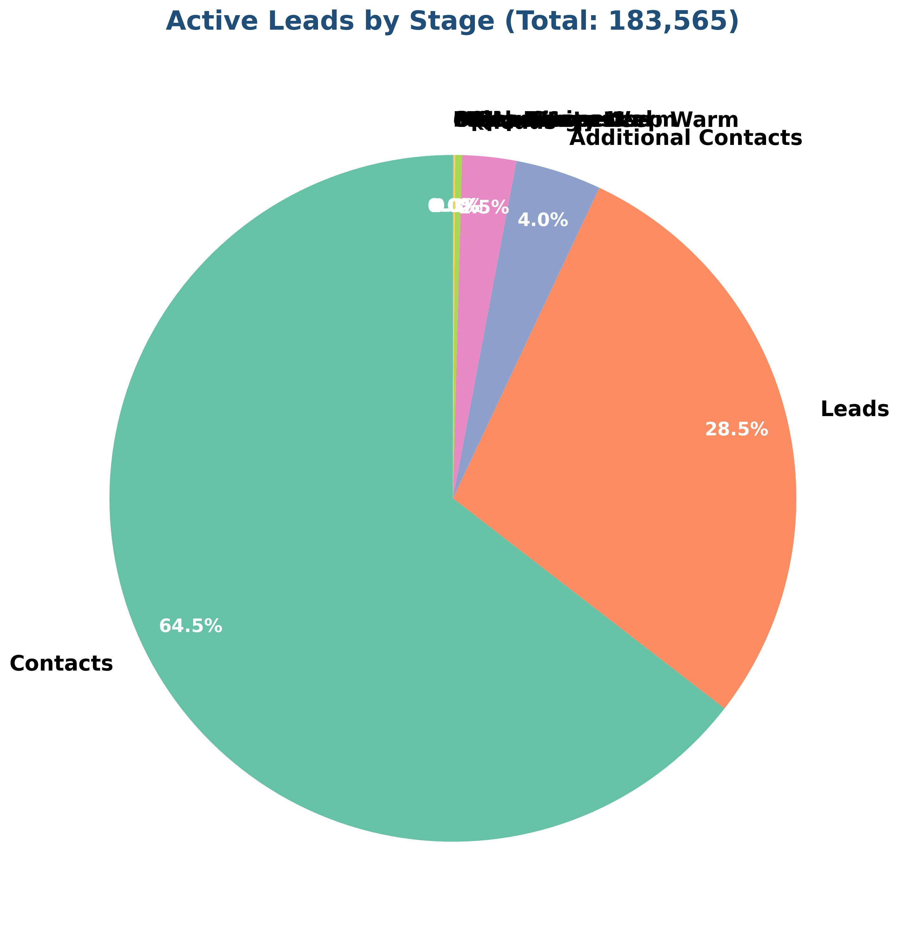
Active Leads Distribution by Stage
Stage Breakdown:
Contacts
118,413 (64.5%)
Leads
52,260 (28.5%)
Additional Contacts
7,427 (4.0%)
leads
4,667 (2.5%)
Marketing - Keep War
573 (0.3%)
MQL - Suspect
82 (0.0%)
Sales - Keep Warm
65 (0.0%)
MQL - Interested
29 (0.0%)
SQL - Prospect
12 (0.0%)
Opportunity
8 (0.0%)
contacts
1 (0.0%)
Prospect
1 (0.0%)

Slide 6
Top 15 Countries
Country | Count | Percentage
Germany | 26636 | 13.67%
United Kingdom | 26235 | 13.47%
United Arab Emirates | 24281 | 12.46%
United States | 22055 | 11.32%
Saudi Arabia | 17352 | 8.91%
India | 12798 | 6.57%
Switzerland | 6060 | 3.11%
Qatar | 4406 | 2.26%
Netherlands | 4090 | 2.1%
Denmark | 3815 | 1.96%
Sweden | 3747 | 1.92%
Kuwait | 3147 | 1.62%

Slide 7
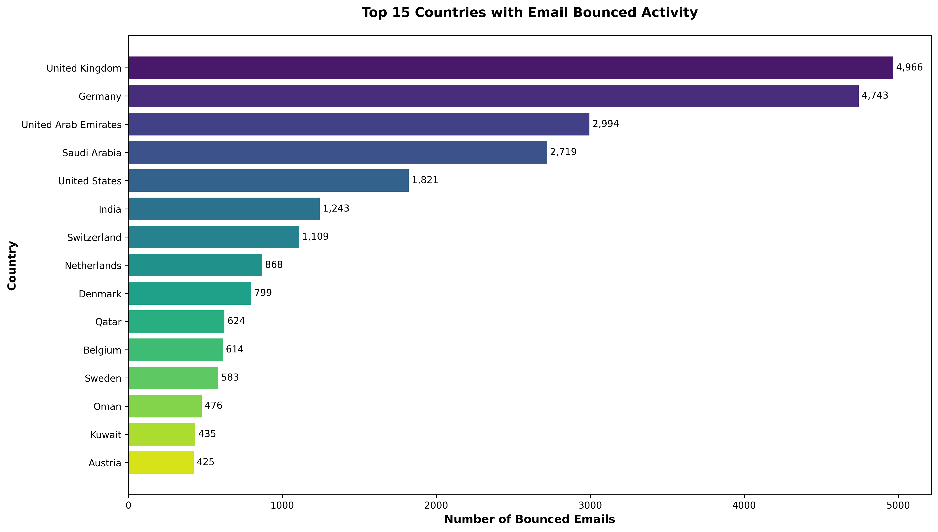
Email Bounced Analysis
Total Email Bounced: 27,021
Percentage of Total: 13.87%
Top 5 Countries with Bounced Emails:
• United Kingdom: 4,966 (18.4%)
• Germany: 4,743 (17.6%)
• United Arab Emirates: 2,994 (11.1%)
• Saudi Arabia: 2,719 (10.1%)
• United States: 1,821 (6.7%)

Slide 8
Top Industries
Industry Vertical | Count | Percentage
Discrete Manufacturing | 52269 | 27.71%
Process Manufacturing | 25947 | 13.76%
Others | 23809 | 12.62%
EPC | 23713 | 12.57%
Oil & Gas, Energy | 14678 | 7.78%
Retail , Distribution & Trading | 12170 | 6.45%
Discrete manufacturing | 8917 | 4.73%
Auto suppliers | 5681 | 3.01%
Auto Suppliers | 5406 | 2.87%
Manufacturing | 4415 | 2.34%
Government Administration | 1943 | 1.03%
Process manufacturing | 912 | 0.48%

Slide 9
Lead Sources
Lead Source | Count | Percentage
Database | 120830 | 63.56%
Email | 44172 | 23.24%
Lead Feeder | 2678 | 1.41%
LinkedIn_Clicks | 2654 | 1.4%
email | 2600 | 1.37%
Direct Traffic | 2348 | 1.24%
Zoominfo_Intent DB | 2151 | 1.13%
ComX | 1843 | 0.97%
Factors.ai | 1299 | 0.68%
Factors_Website_Traffic | 1197 | 0.63%

Slide 10
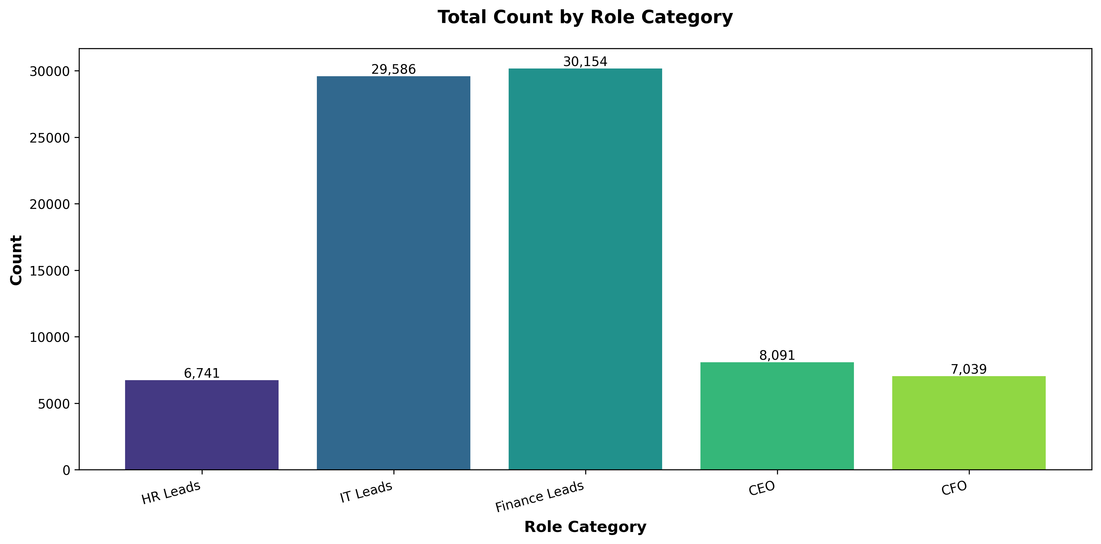
Role Analysis - Overview
Key Role Categories Identified:
• Finance Leads: 30,154 records
• IT Leads: 29,586 records
• CEO: 8,091 records
• CFO: 7,039 records
• HR Leads: 6,741 records
Total: 81,611 records across all categories

Slide 11
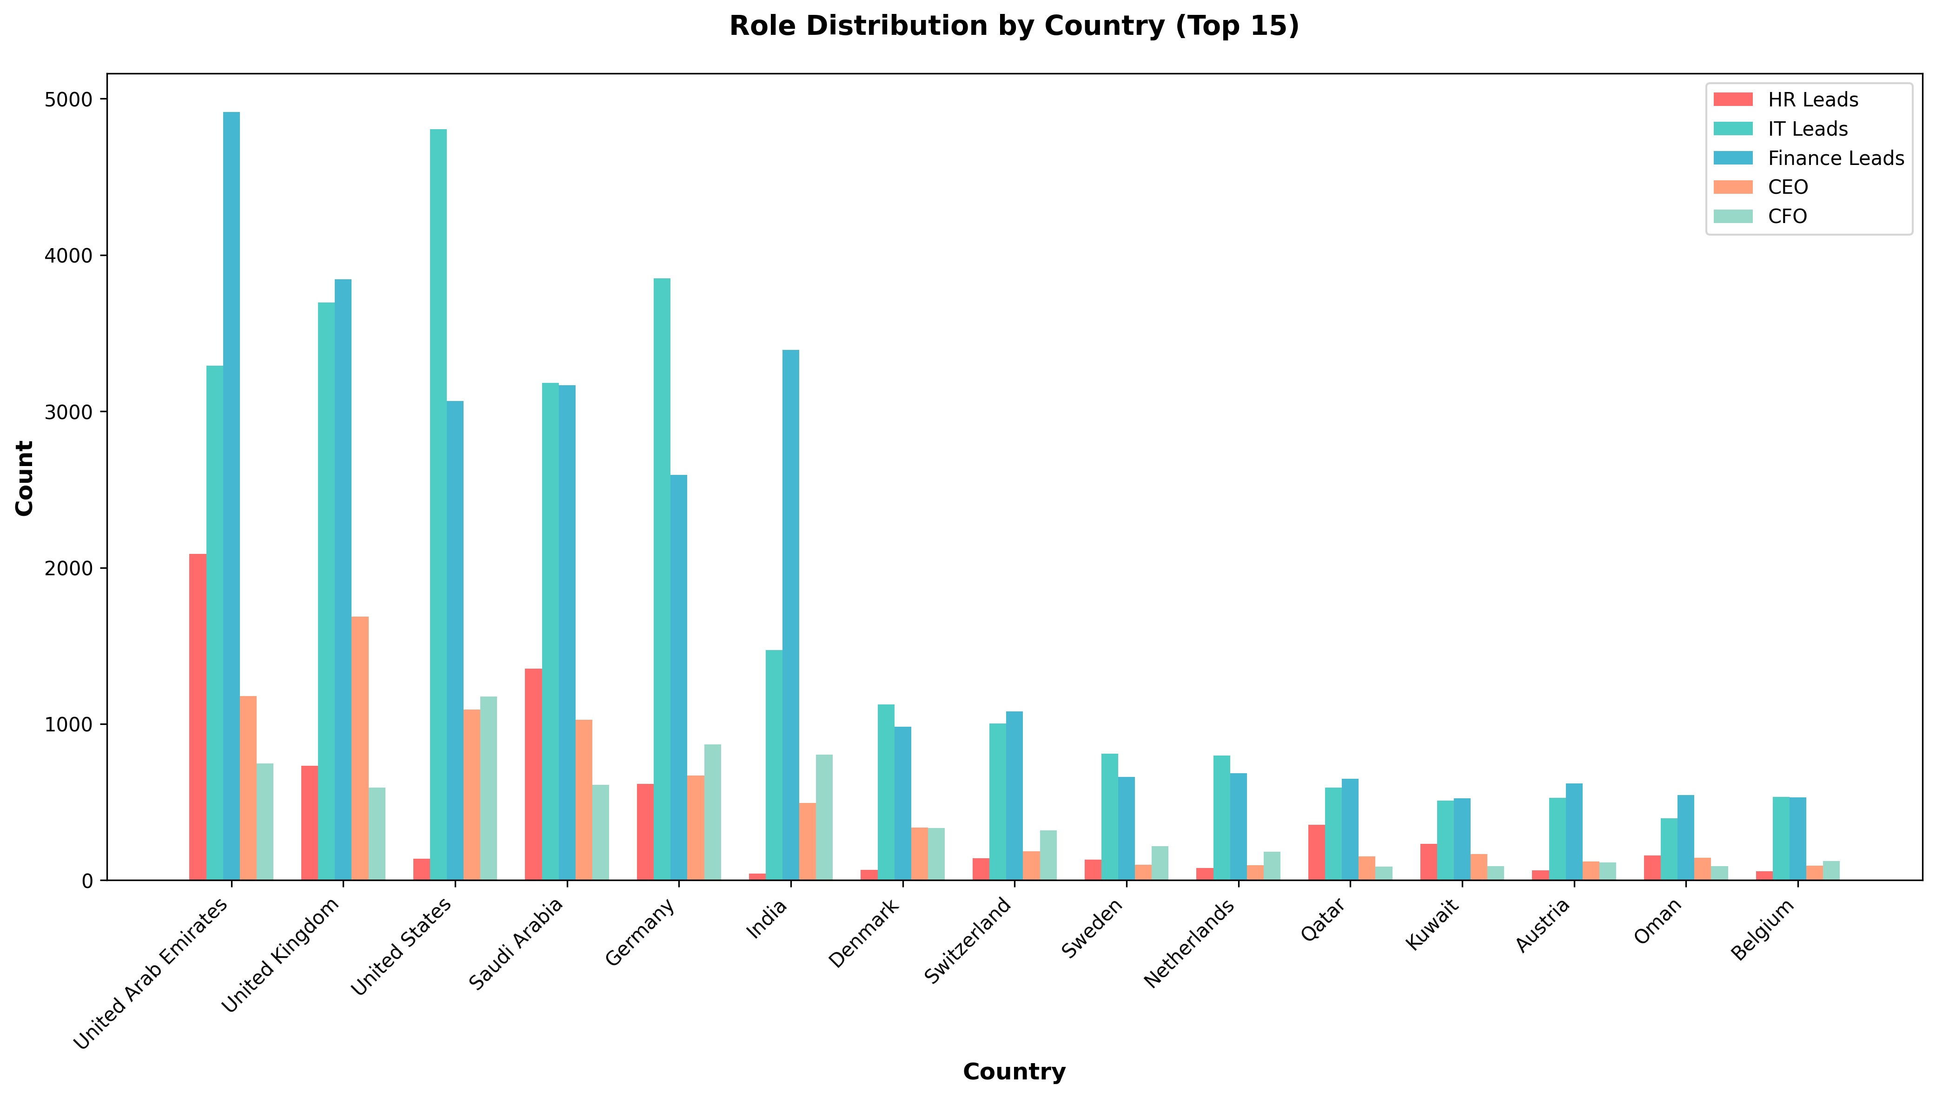
Role Distribution by Country (Top 15)

Slide 12
HR Leads by Country
Top 5 Countries with HR Leads:
1. United Arab Emirates: 2,088 (30.97%)
2. Saudi Arabia: 1,353 (20.07%)
3. United Kingdom: 733 (10.87%)
4. Germany: 617 (9.15%)
5. Qatar: 356 (5.28%)
Total HR Leads: 6,741

Slide 13
IT Leads by Country
Top 5 Countries with IT Leads:
1. United States: 4,806 (16.24%)
2. Germany: 3,852 (13.02%)
3. United Kingdom: 3,696 (12.49%)
4. United Arab Emirates: 3,291 (11.12%)
5. Saudi Arabia: 3,183 (10.76%)
Total IT Leads: 29,586

Slide 14
Finance Leads by Country
Top 5 Countries with Finance Leads:
1. United Arab Emirates: 4,916 (16.30%)
2. United Kingdom: 3,844 (12.75%)
3. India: 3,394 (11.26%)
4. Saudi Arabia: 3,168 (10.51%)
5. United States: 3,065 (10.16%)
Total Finance Leads: 30,154

Slide 15
CEO & CFO Analysis
CEO Distribution (Top 5):
• United Kingdom: 1,687 (20.85%)
• United Arab Emirates: 1,178 (14.56%)
• United States: 1,092 (13.50%)
• Saudi Arabia: 1,027 (12.69%)
• Germany: 669 (8.27%)
CFO Distribution (Top 5):
• United States: 1,175 (16.69%)
• Germany: 868 (12.33%)
• India: 805 (11.44%)
• United Arab Emirates: 746 (10.60%)
• Saudi Arabia: 611 (8.68%)

Slide 16
Regional Classification
Region Specific Updates:
ME Region Countries:
• Saudi Arabia, UAE, Qatar, Kuwait, Oman, Bahrain
• Total: 54,909 records
EU Region Countries:
• UK, Germany, Switzerland, Austria, Belgium,
Netherlands, Luxembourg, Denmark, Sweden,
Norway, Finland
• Total: 82,314 records

Slide 17
Data Quality Insights
Top Columns with Missing Data:
• created_date: 194,831 (100.0%)
• Notes: 180,693 (92.7%)
• Address 2: 175,694 (90.2%)
• Job Title: 163,498 (83.9%)
• Contact number: 149,993 (77.0%)
• Mobile Number: 120,614 (61.9%)
• Practice: 117,849 (60.5%)
• Lead Location: 99,631 (51.1%)
• Company size: 80,503 (41.3%)
• Zoom Info Id: 70,748 (36.3%)

Slide 18
Key Insights & Findings
🔍 Key Findings:
1. Active Lead Rate: 94.2% of database
2. Geographic Focus:
• UAE, UK, and USA are top markets
• Strong presence in ME and EU regions
3. Decision Makers:
• 81,611 identified in key roles
• Finance and IT leads dominate
4. Email Engagement:
• 27,021 bounced emails identified
• UK and Germany highest bounce rates

Slide 19
Recommendations
📋 Recommendations:
1. Focus on Active Leads (183,565 records)
2. Prioritize UAE, UK, and USA markets
3. Target Finance and IT decision makers
4. Clean up bounced email addresses
5. Fill missing data gaps in:
• Job Titles, Contact Numbers, Practice
6. Leverage strong ME and EU presence

Slide 20
Thank You
Questions?

