Slide 1

Energy Consumption Analysis

Slide 2
About me
Nakka Vijaya Lakshmi
Master’s of Computer Applications (MCA)
LinkedIn

Slide 3
Agenda
Objective of the Project
Database Context & Setup
Key analysis questions (use cases)
Key Research Domains
Conclusion (Key finding overall)
Your Experience/Challenges working

Slide 4
Objective of the Project
To compare key energy metrics across countries
To evaluate historical trends
To establish per capita consumption and emission rates
To identify environmental improvement/challenge
To analyze the correlation : between a country's economic power (GDP), energy consumption, and environmental impact (emissions)

Slide 5
Database Context & Setup:
The project involves a structured dataset consisting of six interconnected tables
Country: The central reference table linking all other data.
Emission_3: Tracks CO2 output and per-capita metrics.
GDP_3: Records the economic power (Gross Domestic Product) of nations.
Population: Tracks the number of people in each country.
Consumption: Details how much energy is used.
Production: Details how much energy is generated.

Slide 6
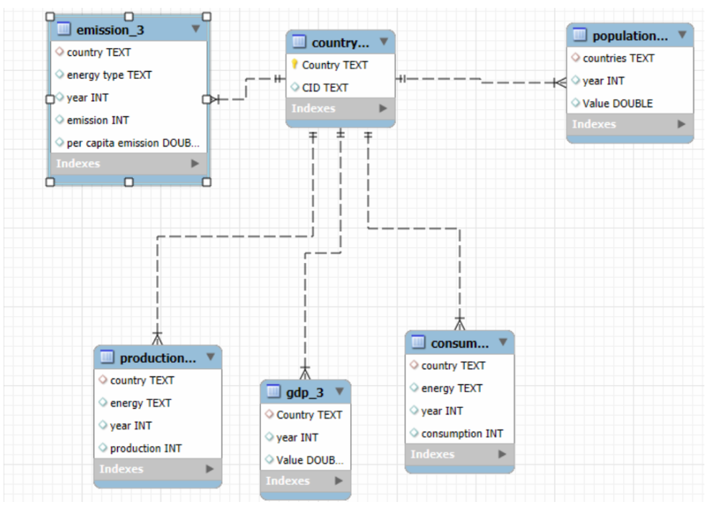
Schema Diagram

Slide 7
Explanation about ER DIAGRAM:
1. Primary Key (The Unique Identifier)
A Primary Key is a specific column in a table that uniquely identifies each row. No two rows can have the same Primary Key value, and it cannot be empty (NULL) .
In country table: The Primary Key is CID. This unique ID (like "USA" or "IND") ensures that every country is represented as a single, distinct entity .
Purpose: It prevents duplicate entries for the same country in your central hub
2. Foreign Key (The Connector)
A Foreign Key is a column in one table that links to the Primary Key of another table. It is used to "point" back to the original source of information.
In your data tables: Tables like emission_3, population, production, gdp_3, and consumption all use country (or countries) as a Foreign Key.
The Link: This Foreign Key connects the rows in your data tables back to the Country column in your main country table.

Slide 8
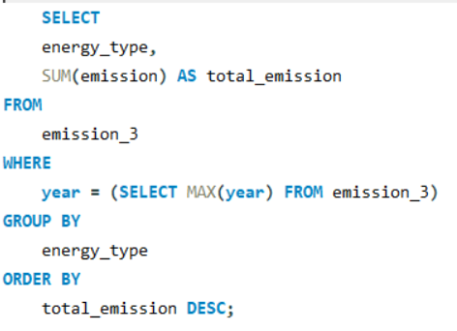
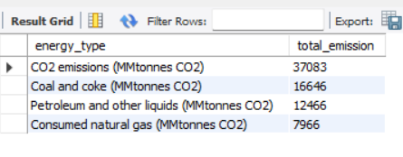
Which energy types contribute most to emissions across all countries?
Query: Output:
Key Insight :
Dominance of Fossil Fuels: Traditional energy sources like Coal and Oil still contribute the largest share of global emissions.

Slide 9
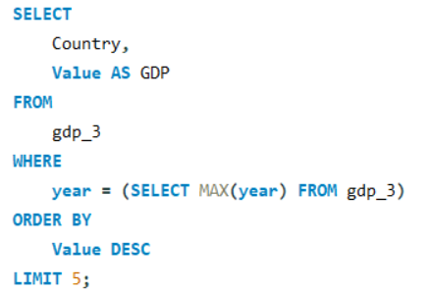
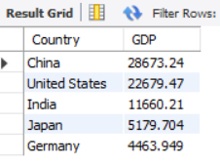
What are the top 5 countries by GDP in the most recent year?
Query: Output:
Key Insight :
In the most recent year , China has the hight GDP , followed by United States.
India , Japan , and Germany complete the top 5.There is a significant gap between the top two economies and the rest.

Slide 10
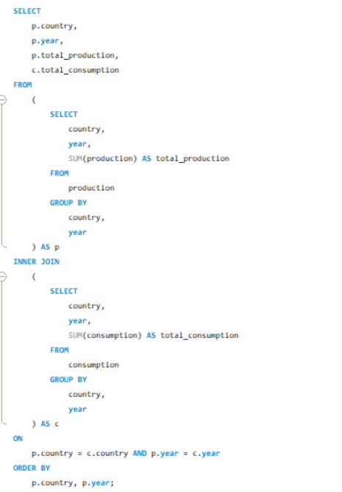
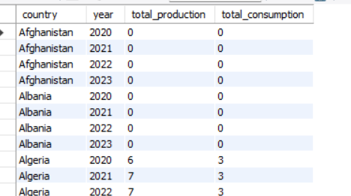
Compare energy production and consumption by country and year.
Query: Output:

Slide 11
Key insight:
Comparing energy production and consumption helps identify whether a country is an energy surplus (producer) or energy deficit (consumer) nation.
Some countries show equal or near-equal production and consumption, indicating balanced energy usage.
In certain cases, energy production is higher than consumption, suggesting the possibility of energy exports or excess supply.

Slide 12
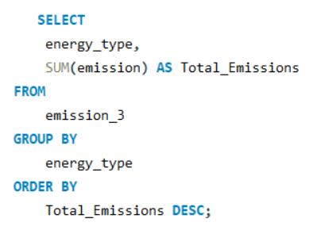
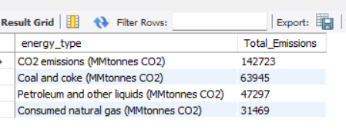
Which energy types contribute most to emissions across all countries?
Query: Output:
Key Insight :
CO2 emissions are the largest contributor to emission globally , accounting for 142,723
Coal and coke are the second largest contributor with 63,965 Millionnes CO2
Petroleum and other liquid rank third , contributing 47,297 Millionnes CO2
Consumed natural gas contributes the least amonge the top energy types , with 31,469 Millionnes CO2

Slide 13
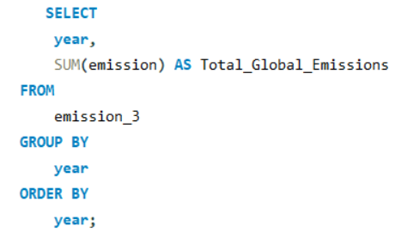
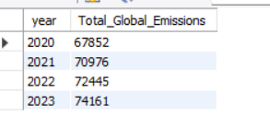
How have global emissions changed year over year?
Query: Output:
Key Insight :
Global emissions increased consistently from 2020 to 2023, showing a year-over-year upward trend.
The largest annual increase occurred between 2020 and 2021, where emissions increased by 3,124.

Slide 14
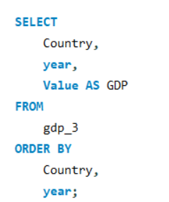
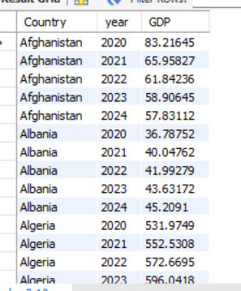
What is the trend in GDP for each country over the given years?
Query: Output:
Key Insight :
Most countries show a gradual increase in GDP over the years, indicating overall economic growth.
Some countries experience temporary declines or fluctuations, reflecting economic instability, policy changes, or external factors.
Countries with stronger economies tend to show more consistent GDP growth trends compared to smaller or developing economies.

Slide 15
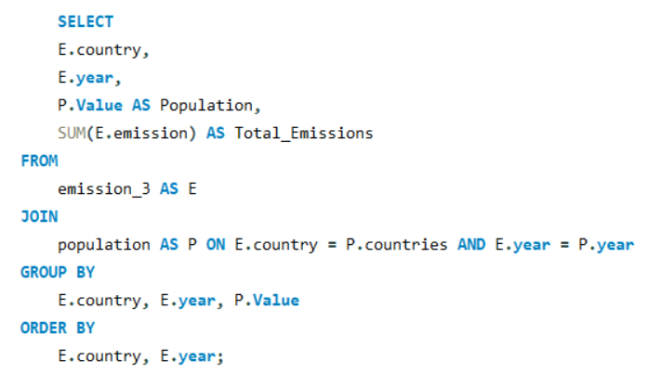
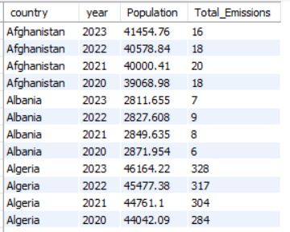
How has population growth affected total emissions in each country?
Query: Output:
Key Insight:
In many countries, population growth is accompanied by an increase in total emissions, suggesting higher energy demand and industrial activity.
Countries with rapidly growing populations often show a steady rise in emissions over the years.
The relationship between population and emissions is not always proportional—some countries manage population growth with smaller emission increases due to cleaner energy or efficient policies.

Slide 16
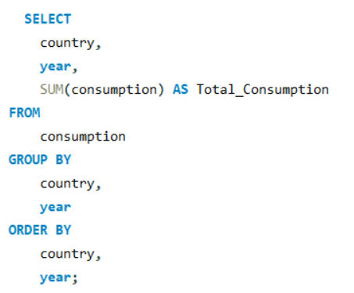
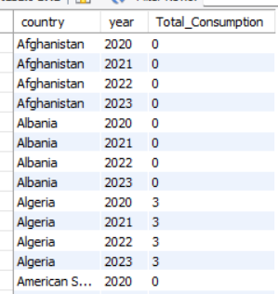
Has energy consumption increased or decreased over the years for major economies?
Query: Output:
Key Insight :
Energy consumption trends vary across countries, with some major economies showing steady increases over the years, indicating growing industrial and economic activity.
Certain countries display stable or minimal changes in consumption, suggesting consistent energy demand patterns.
Some countries may show declining or unchanged energy usage, potentially due to energy efficiency improvements or shifts toward sustainable practices.

Slide 17
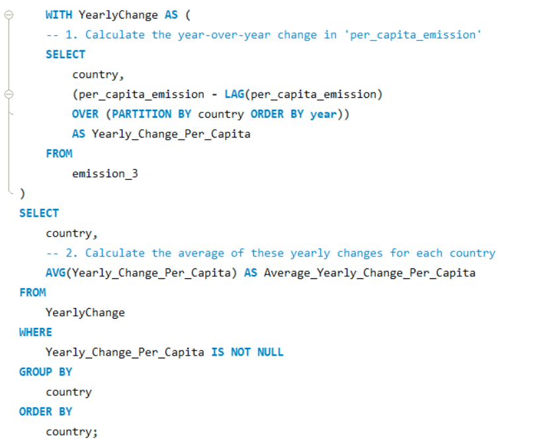
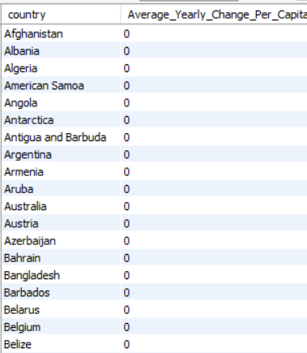
What is the average yearly change in emissions per capita for each country?
Query: Output:

Slide 18
Key Insight :
Tracking Environmental Progress
Identifying Economic Development Stages
Performance Comparison

Slide 19
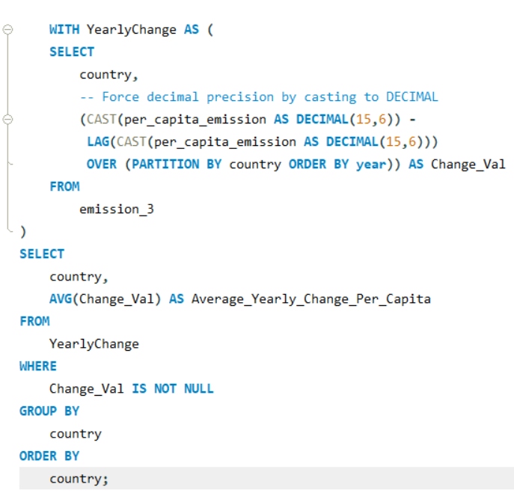
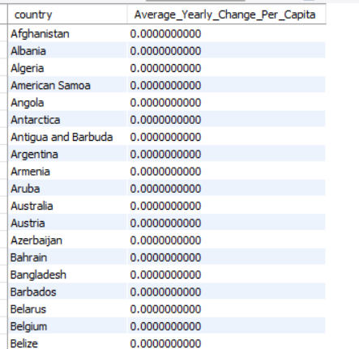
.
What is the average yearly change in emissions per capita for each country?
Query: Output:

Slide 20
Key Insight :
Environmental Direction: A negative value means the country is successfully reducing its carbon footprint per person. A positive value shows that emissions are growing faster than the population.
Efficiency Milestone: Countries with values near zero have hit a plateau, meaning their emissions have stabilized relative to their population size.
Industrial Progress: Rapidly developing nations often show higher positive changes as they build infrastructure and increase energy consumption.

Slide 21
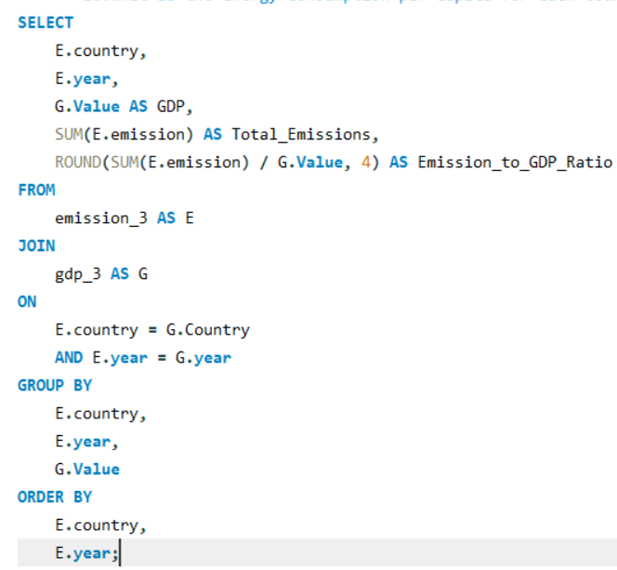
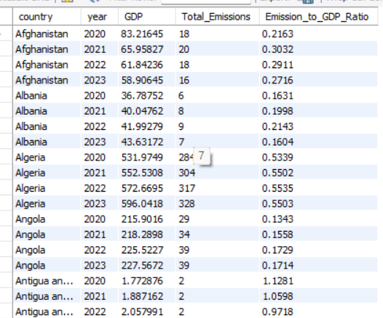
What is the emission-to-GDP ratio for each country by year?
Output:
Query:

Slide 22
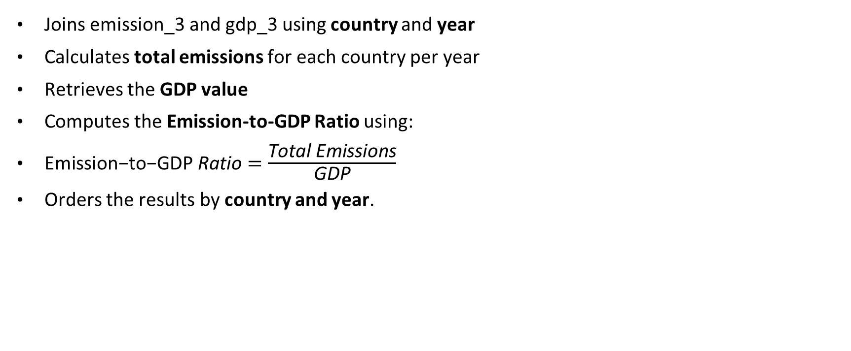
What this query does:
Joins emission_3 and gdp_3 using country and year
Calculates total emissions for each country per year
Retrieves the GDP value
Computes the Emission-to-GDP Ratio using:
$\text{Emission}\text{−}\text{to}\text{−}\text{GDP} \text{Ratio}=\frac{\text{Total} \text{Emissions}}{\text{GDP}}$
Orders the results by country and year.

Slide 23
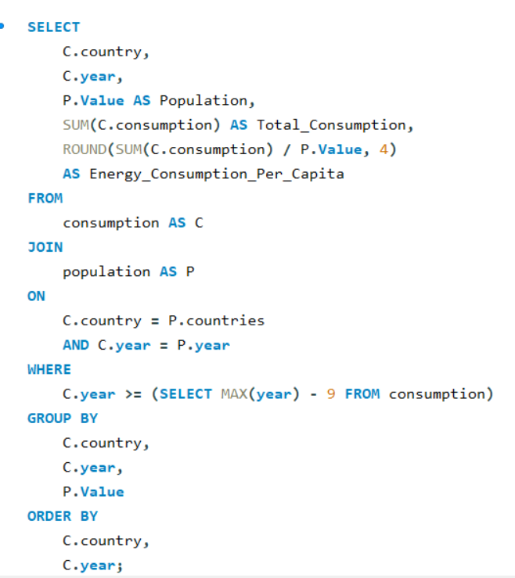
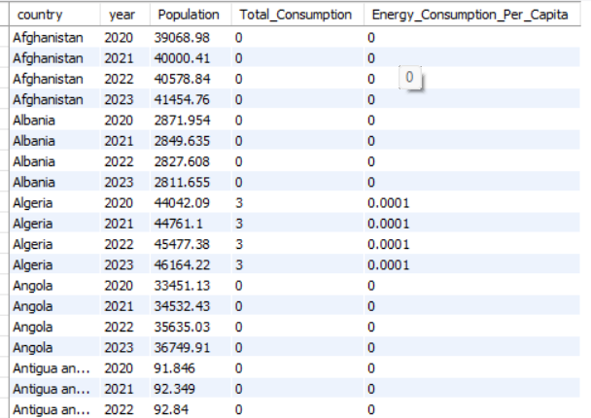
What is the energy consumption per capita for each country over the last decade?
Query:
Output:

Slide 24
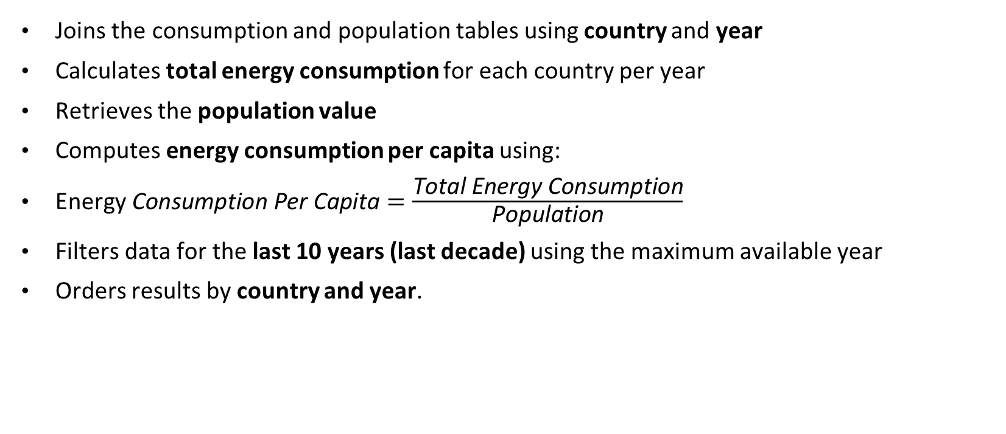
What this query does :
Joins the consumption and population tables using country and year
Calculates total energy consumption for each country per year
Retrieves the population value
Computes energy consumption per capita using:
$\text{Energy} \text{Consumption} \text{Per} \text{Capita}=\frac{\text{Total} \text{Energy} \text{Consumption}}{\text{Population}}$
Filters data for the last 10 years (last decade) using the maximum available year
Orders results by country and year.

Slide 25
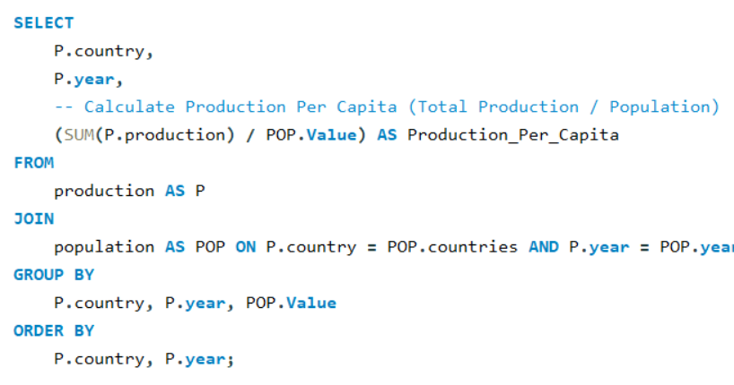
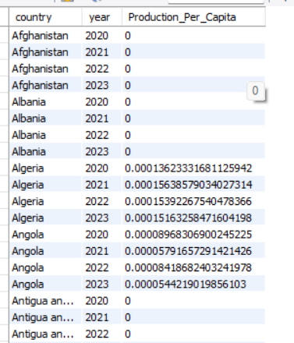
How does energy production per capita vary across countries?
Query:
Output

Slide 26
Key Insight:
The query helps compare energy production per person across different countries and years.
Countries with high production per capita likely have strong energy sectors or smaller populations relative to production levels.
Countries with low production per capita may have limited energy generation or large populations that reduce per-person availability.
Changes in production per capita over time can indicate growth in energy infrastructure, industrial expansion, or population changes.

Slide 27
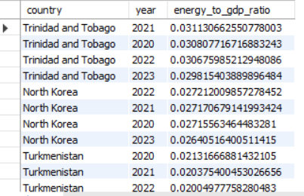
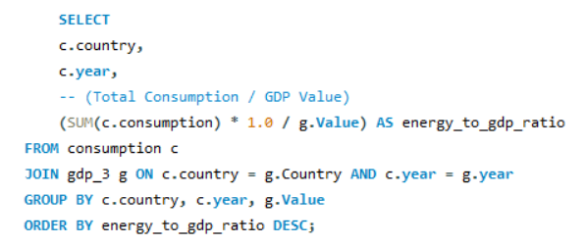
Which countries have the highest energy consumption relative to GDP?
Query : Output:

Slide 28
Key Insights:
Energy Efficiency Indicator: A high ratio means a country is "energy inefficient". It indicates that the country must burn a lot of fuel or electricity to generate its wealth.
Economic Structure: Countries with the highest ratios are often those with heavy industrial or manufacturing bases (like steel or mining) rather than service-based economies

Slide 29
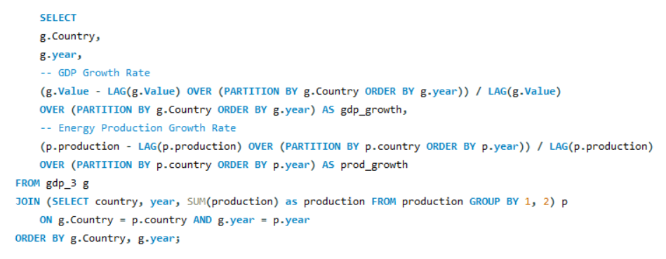
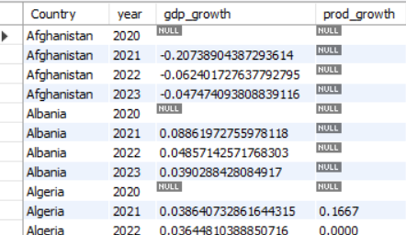
What is the correlation between GDP growth and energy production growth?
Query: Output:

Slide 30
Key Insight:
Strong Link: If GDP and energy production both go up together, the economy depends heavily on its own energy industry.
Efficiency: If GDP grows but energy production stays flat, the country is likely importing energy or using it more efficiently.
Economic Health: A high correlation often identifies "industrial" nations, while low correlation identifies "service-based" nations.

Slide 31
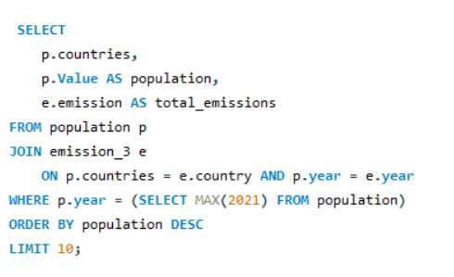
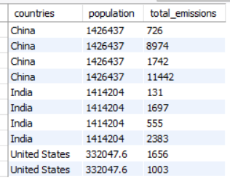
What are the top 10 countries by population and how do their emissions compare?
Query: Output :
Key insights:
The Power of Scale: The most populated countries are almost always the largest total polluters, showing that population is the primary driver of global energy demand.

Slide 32
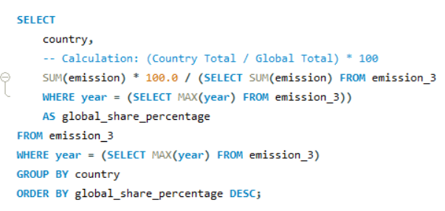
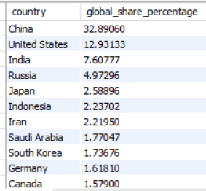
What is the global share (%) of emissions by country?
Query: Output:
Key Insight :
Concentration of Emissions: This query typically reveals that a very small number of countries (the "Top 5") often account for more than 50% of all global emissions.

Slide 33
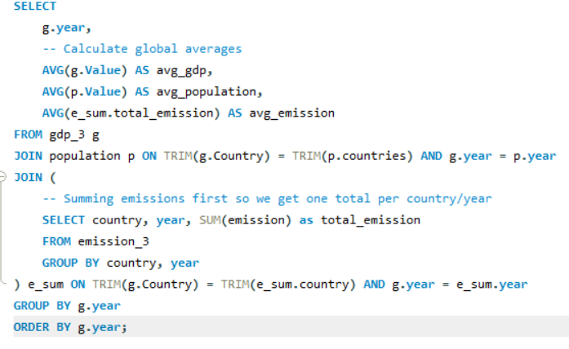
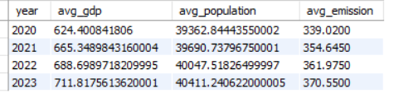
What is the global average GDP, emission, and population by year?
Query: Output:

Slide 34
Key Insights :
Global Progress: These averages provide a "baseline" for the world. You can use them to see if a specific country is performing better or worse than the global average
The Growth Link: Usually, you will see all three lines (GDP, Population, and Emissions) moving upward together over time. This shows how human growth and wealth are traditionally tied to pollution.
Efficiency Check: If you see GDP going up faster than Emissions, it is a great sign! It means the world is finding ways to create wealth using cleaner energy.

Slide 35
Key Research Domains:
General & Comparative Analysis: Identifying top performers in GDP and comparing production vs. consumption.
Trend Analysis Over Time: Looking at how emissions, GDP, and population have evolved year-over-year.
Ratio & Per Capita Analysis: Normalizing data (e.g., Emission-to-GDP ratio) to allow fair comparisons between small and large nations.
Global Comparisons: Determining global shares of pollution and identifying countries that have successfully reduced their carbon footprint.

Slide 36
Conclusion
Money isn't always dirty: Your data shows that countries can grow their GDP (wealth) without always increasing their pollution, as long as they use energy wisely
Efficiency is key: The most "modern" countries are the ones that make the most money while using the least amount of energy.
The Big 10 matter most: A small group of 10 highly populated countries produces the majority of the world's emissions. Global change depends on them.
Progress is happening: Over the last 10 years, many countries have successfully lowered their emissions per person by switching to cleaner energy.
People vs. Power: While more people usually means more energy use, technology and better energy types are helping to break that link.

Slide 37

THANK YOU

