Slide 1

ASP.NET 5 + Raspberry PI 2

Slide 2
Jürgen Gutsch
Web Developer, Trainer, Consultant
User group Leader
.NET-Stammtisch Konstanz-Kreuzlingen
.NET User Group Nordwest-Schweiz
Blogger
http://www.aspnetzone.de/blogs/juergengutsch/
Author
Dotnetpro

Slide 3
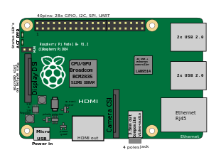
Agenda
Setup the PI
Working with the PI
About the GPIOs
Working with the GPIOs
IoT Scenarios
Demo

Slide 4
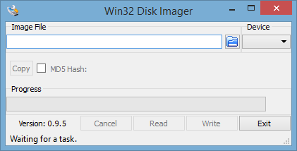
Installing the PI
Downloading the latest Raspian image from raspberry.org
Use Win32 Disk Imager to prepare a SD Card
Install Raspian on the PI

Slide 5

Preparing the PI
Add and configure a Network
Connect to the PI via SSH e. g. via Putty

Slide 6
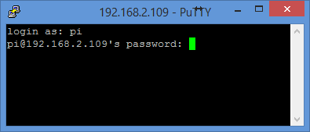
Update the System
sudo apt-get update
sudo apt-get upgrade

Slide 7
Install the latest Mono
sudo apt-key adv --keyserver keyserver.ubuntu.com --recv-keys 3FA7E0328081BFF6A14DA29AA6A19B38D3D831EF
echo "deb http://download.mono-project.com/repo/debian wheezy main" | sudo tee /etc/apt/sources.list.d/mono-xamarin.list
sudo apt-get update
sudo apt-get install mono-complete
Notes:
apt-get mono ist zu alt
aktuelles mono läuft nicht auf RPIB+ Speicherproblem
MONO 4.0

Slide 8

Test the Mono installation
mono -V

Slide 9
Getting ASP.NET 5 samples
mkdir ~/sources/aspnet5 & cd ~/sources/aspnet5
git clone git://github.com/aspnet/home.git
sh ~/sources/aspnet5/dnvminstall.sh
source ~/.dnx/dnvm/dnvm.sh
dnvm upgrade

Slide 10
Import needed Certificates
sudo certmgr -ssl -m https://go.microsoft.com
sudo certmgr -ssl -m https://nugetgallery.blob.core.windows.net
sudo certmgr -ssl -m https://nuget.org
sudo certmgr -ssl -m https://www.myget.org
mozroots --import --sync

Slide 11
Build and install Libuv for Kestrel
sudo apt-get install gyp
wget http://dist.libuv.org/dist/v1.4.2/libuv-v1.4.2.tar.gz
tar -xvf libuv-v1.4.2.tar.gz
cd libuv-v1.4.2/
./gyp_uv.py -f make -Duv_library=shared_library
make -C out
sudo cp out/Debug/lib.target/libuv.so
usr/lib/libuv.so. 1.4.2
sudo ln -s libuv.so. 1.4.2 /usr/lib/libuv.so.1

Slide 12
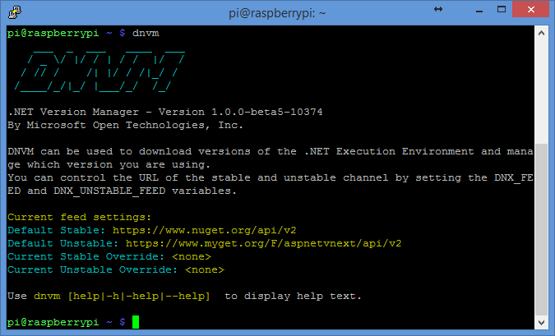
Install the latest DNVM
curl -sSL https://raw.githubusercontent.com/aspnet/Home/dev/dnvminstall.sh | DNX_BRANCH=dev sh && source ~/.dnx/dnvm/dnvm.sh
dnvm upgrade
Test the DNVM
dnvm

Slide 13

Install node.js
wget http://node-arm.herokuapp.com/node_latest_armhf.deb
sudo dpkg -i node_latest_armhf.deb
Notes:
apt-get ist zu alt

Slide 14


Install grunt & bower
sudo npm install -g grunt
sudo npm install -g bower

Slide 15
Possible IDEs
Working on the PI
vi Startup.cs
Nano Startup.cs
Working on Windows
Visual Studio
Visual Studio Code

Slide 16

Using Git
Transfer files with Git
Git is easy to use
Git is integrated in Raspian
Git is integrated in Visual Studio 2015

Slide 17
Setup a Git workspace on Windows
git init
git add –all
git commit -m „initial commit“
Push initially:
git add origin https://github.org/juergengutsch/...
git push -u origin master
Push the latest changes:
git push

Slide 18
Setup a Git workspace on the PI
Setup a the IDE on the PI
mkdir ~/projects/dnc15 & cd ~/projects/dnc15
Initial clone
git clone https://github.org/juergengutsch/...
Get the latest changes
git pull

Slide 19
Setup the first ASP.NET 5 App
Add Dependencies:
"Microsoft.AspNet.Hosting": "1.0.0-beta4"
"Kestrel": "1.0.0.0-beta4”
Add Command:
"kestrel": "Microsoft.AspNet.Hosting --server Kestrel --server.urls http://localhost:5004"

Slide 20
Start the sample web
Prepare the Start
cd ~/projects/dnc15/Sensors/src/Sensors
dnvm install latest
dnu restore
Starting the web server
dnx . kestrel
Notes:
Demo?

Slide 21
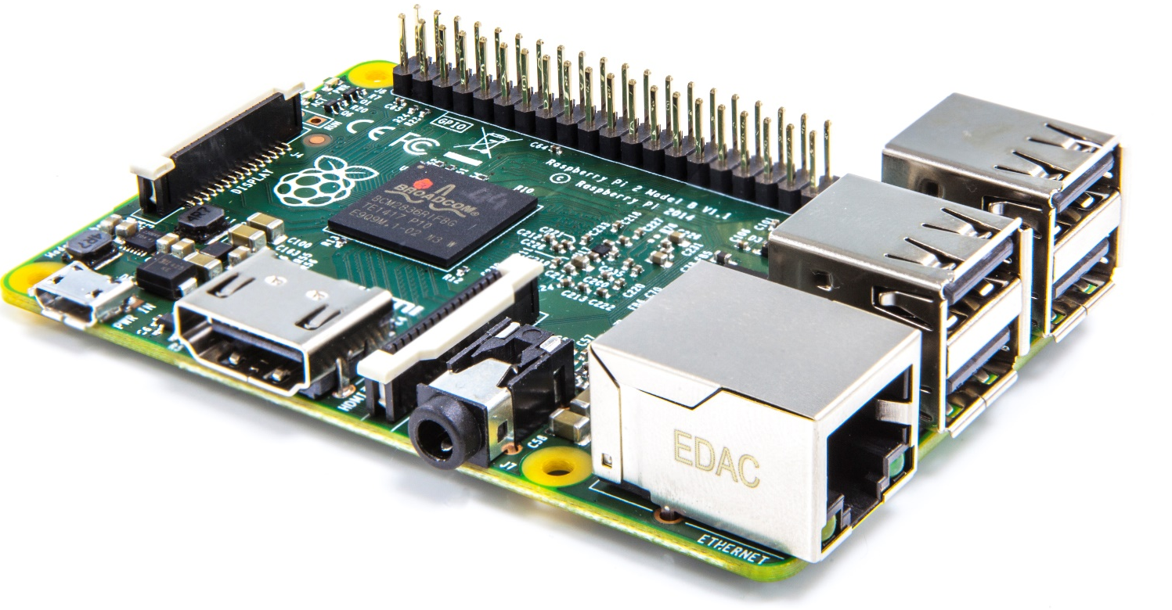
About the GPIOs
General purpose input/output
GPIO numbering vs. physical/pin numbering
2 x output 5V
2 x output 3.3V
8 x ground
26 x GPIO
(2x ID EEPROM)

Slide 22
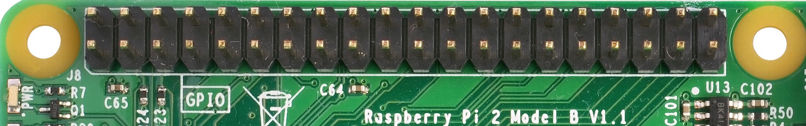
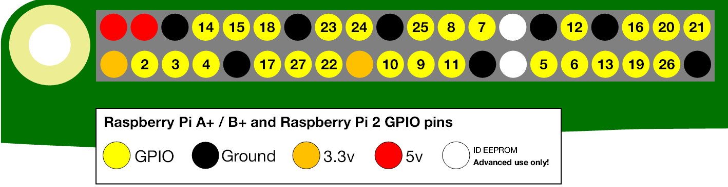
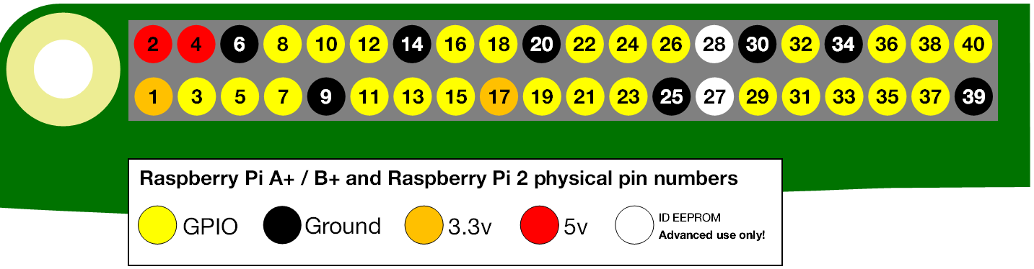
About the GPIOs

Slide 23
Working with the GPIOs
Calling the Raspian native API to connect the GPIOs
Using existing C# libraries to access the pins:
Raspberry.System
https://github.com/raspberry-sharp/raspberry-sharp
Raspberry.IO.GeneralPurpose
https://github.com/raspberry-sharp/raspberry-sharp-io
RPI.GPIO
https://github.com/fatihboy/RPI.GPIO

Slide 24
Good to know: Be carefully
Read carefully the GPIO specification
Wrong connected pins can kill the sensor or the PI
Read carefully the sensor specification
Be carefully with external power

Slide 25
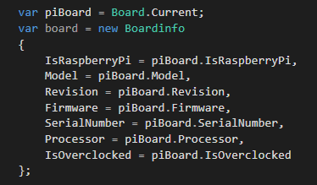
Raspberry.System
Getting common information about the PI:

Slide 26
Raspberry.IO.GeneralPurpose
Includes drivers to access the GPIO Pins
Includes Pin connections
Includes conversions between pin numberings
ConnectorPin: Pin using physical pin numbers
ProcessorPin: Pin using GPIO pin numbering
Includes methods to work with the pins

Slide 27
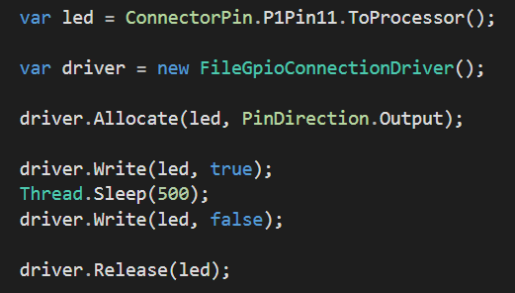
Simple blinking LED

Slide 28
Good to know: Cheat with node.js
node.js is pretty cool on the PI ☺
It‘s easy to write
It runs fast
many GPIO examples written in Javascript
node.js is a pretty awesome tool to tryout things, you want to implement with C#

Slide 29
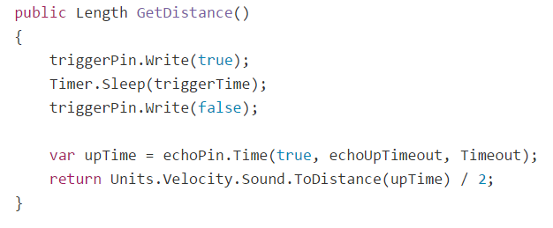
Connecting the distance sensor
Needs to trigger the measurement
Needs to measure the time until the echo pings back
Needs to divide the resulting time by 2

Slide 30
TODO: Connecting the distance sensor
/* demo */

Slide 31
Mobile RC buggy
Running a mobile web app on the PI
The page fetches accelerator data from the mobile device
The page controls one or more servos in the pi
The page uses the accelerator data to control the servos

Slide 32
Plant watering system
Get the weather forecast via network from weather API
Get the current temperature via sensors
Get the current pressure via sensors
Control servos / switches to start watering plants
Send text message on error / case of no water
Provide mobile web app to show current information

Slide 33
Segway like vehicle
Use accelerator sensor
Control a servo on a two wheel vehicle
Use the accelerator data to steer the servo to keep the vehicle vertical

