Slide 1
Cognitive Self-Service Agent for Wager

Slide 2
Cognitive Self-Service Agent for Banking
Client is Malaysian banking and financial services company
Challenges/Requirements
Solution
Benefits
Replace human agents for common services like balance enquiry and statement generation.
Provide ability to integrate with existing contact centers.
Integrate it with Voice Gateway to answer in human like manner.
Make it cognitive so that it evolves and improves over time.
Create a self-service conversational agent with Watson Speech-to-Text and Text-to-Speech capabilities.
Use Twilio to connect the customer via phone and provide responses to his/her queries in conversational manner rather than typical IVR based button-press approach.
Common queries can be handled by the bot and human agents can concentrate on cases which require manual intervention.
This solution can be embedded in mobile apps and IVRs
Tools and Technologies
IBM Watson Conversation API
IBM Watson Speech-to-Text/Text-to-Speech API
Twilio API
Voice Gateway for Watson

Slide 3
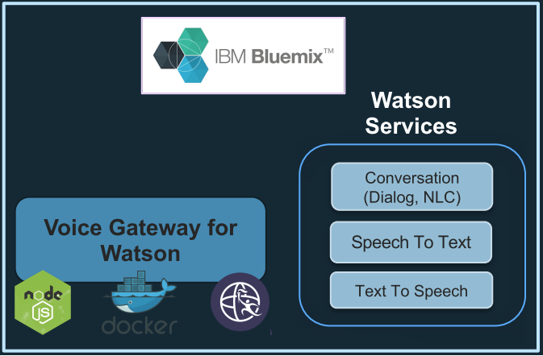


Architecture
Ask Watson about…
CASE: Wager Voice.
SIP

Slide 4


Use Case
Dial +1 916 764 3514
good evening, which meeting and race would you like today?
Singapore race 1
singapore. race 1. what is your bet type please?
trio
trio, understood. what is your bet?
1 2 3 5 6 4 units
Watson Conversation
User
Please confirm your bet. Singapore Race 1. bet type, trio. total sum 40 dollars.please confirm yes or no ?
yes
bet accepted , thank you, bet accepted. Do you have another Bet?.
No
Thank you and have a nice day

Slide 5
Thank you!
www.persistent.com

