Slide 1
Project Based Learning V (22AI014)
Team Details: Vaidehi Vij (2310993945)
Yasha Vaid (2310993964)
Shubh Jain (2310993933)
Department: CSE(AI)
Section: C
Faculty Coordinator: Dr. Harshvardhan
:
Chitkara University Institute of Engineering and Technology,
Chitkara University, Punjab

Slide 2
Table of Contents
Introduction
Problem Statement
Technical Details
Key Features
Project Highlights
Conclusion
References

Slide 3
Introduction
In today’s fast-paced innovation ecosystem, countless ideas emerge daily, but only a few transform into successful ventures. The primary reason is the lack of early-stage validation and structured feedback. IdeaCritic bridges this gap through an AI-powered multi-agent evaluation platform that delivers data-driven, balanced insights on new ideas. By simulating an expert panel using AI agents — the Optimist, Critic, Evaluator, Market Analyst (RAG), and Investor Bot — the system provides both supportive and critical perspectives. This structured debate ensures founders and students receive holistic, factual, and actionable feedback to refine their ideas effectively.

Slide 4
Problem Statement
Most ideas fail to progress due to the lack of structured, data-driven evaluation in early stages. Innovators often rely on subjective opinions or limited research, leading to overlooked risks and poor decisions.
Traditional assessments are time-consuming, biased, and inconsistent, offering little factual validation.
IdeaCritic solves this by using AI-powered multi-agent analysis to deliver objective, real-time, and evidence-based feedback, helping innovators refine and validate their ideas effectively.
It bridges the gap between human creativity and analytical precision, transforming vague concepts into actionable, well-assessed ideas.

Slide 5
Technical Details
AI & LLM: Google Gemma-3-12b-it for reasoning and critique generation.
Frameworks: LangChain & LangChain Google GenAI for agent orchestration and Gemini API integration.
Frontend & Backend: Streamlit interface handling idea input, real-time debate streaming, and report history.
Market Intelligence: RAG pipeline using Tavily/Serper.dev APIs for real-time data retrieval.
Evaluation Engine: Custom multi-factor scoring for innovation, feasibility, market fit, risk, and scalability.
Data Utilities: pandas, numpy, pydantic, python-dotenv for handling and validation.
Storage & Reporting: MongoDB for analysis history and ReportLab/python-docx for generating downloadable reports.

Slide 6
Key Features
Multi-agent debate between Optimist, Critic, Evaluator, and Investor bots.
Real-time RAG-based market research using Tavily API.
Automated investment scoring and actionable recommendations.
Interactive Streamlit UI for seamless user experience.
PDF/Word report generation for documentation and sharing.
Persistent storage with MongoDB for revisiting past analyses.

Slide 7
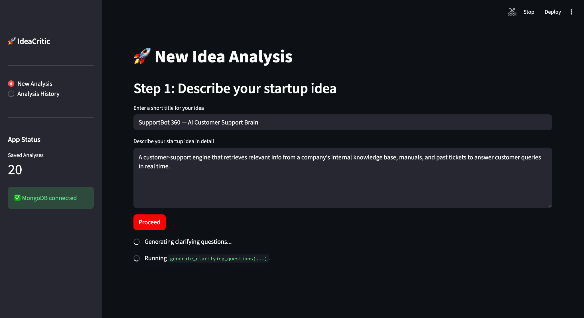
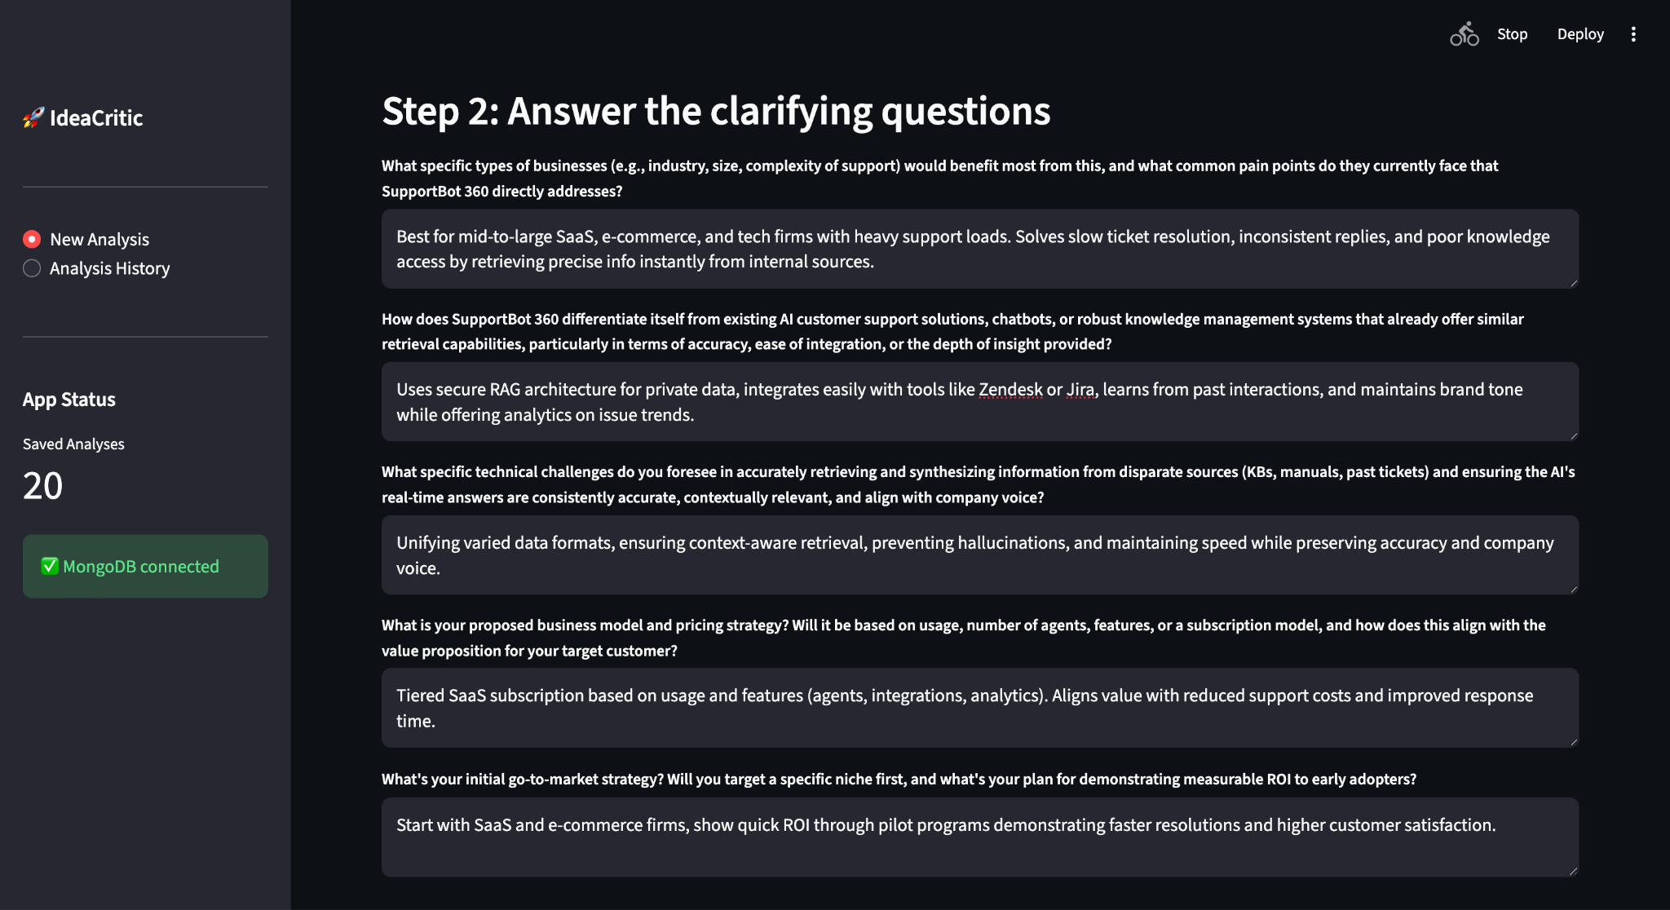
Project Highlights

Slide 8
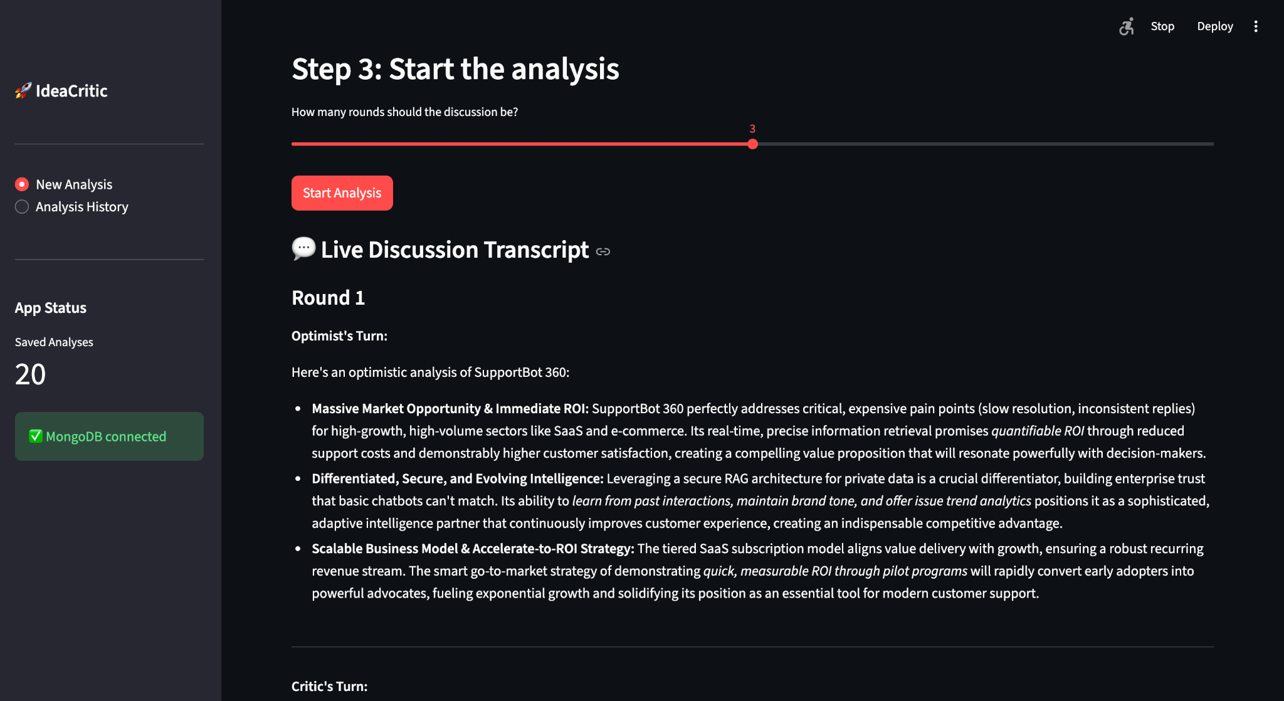
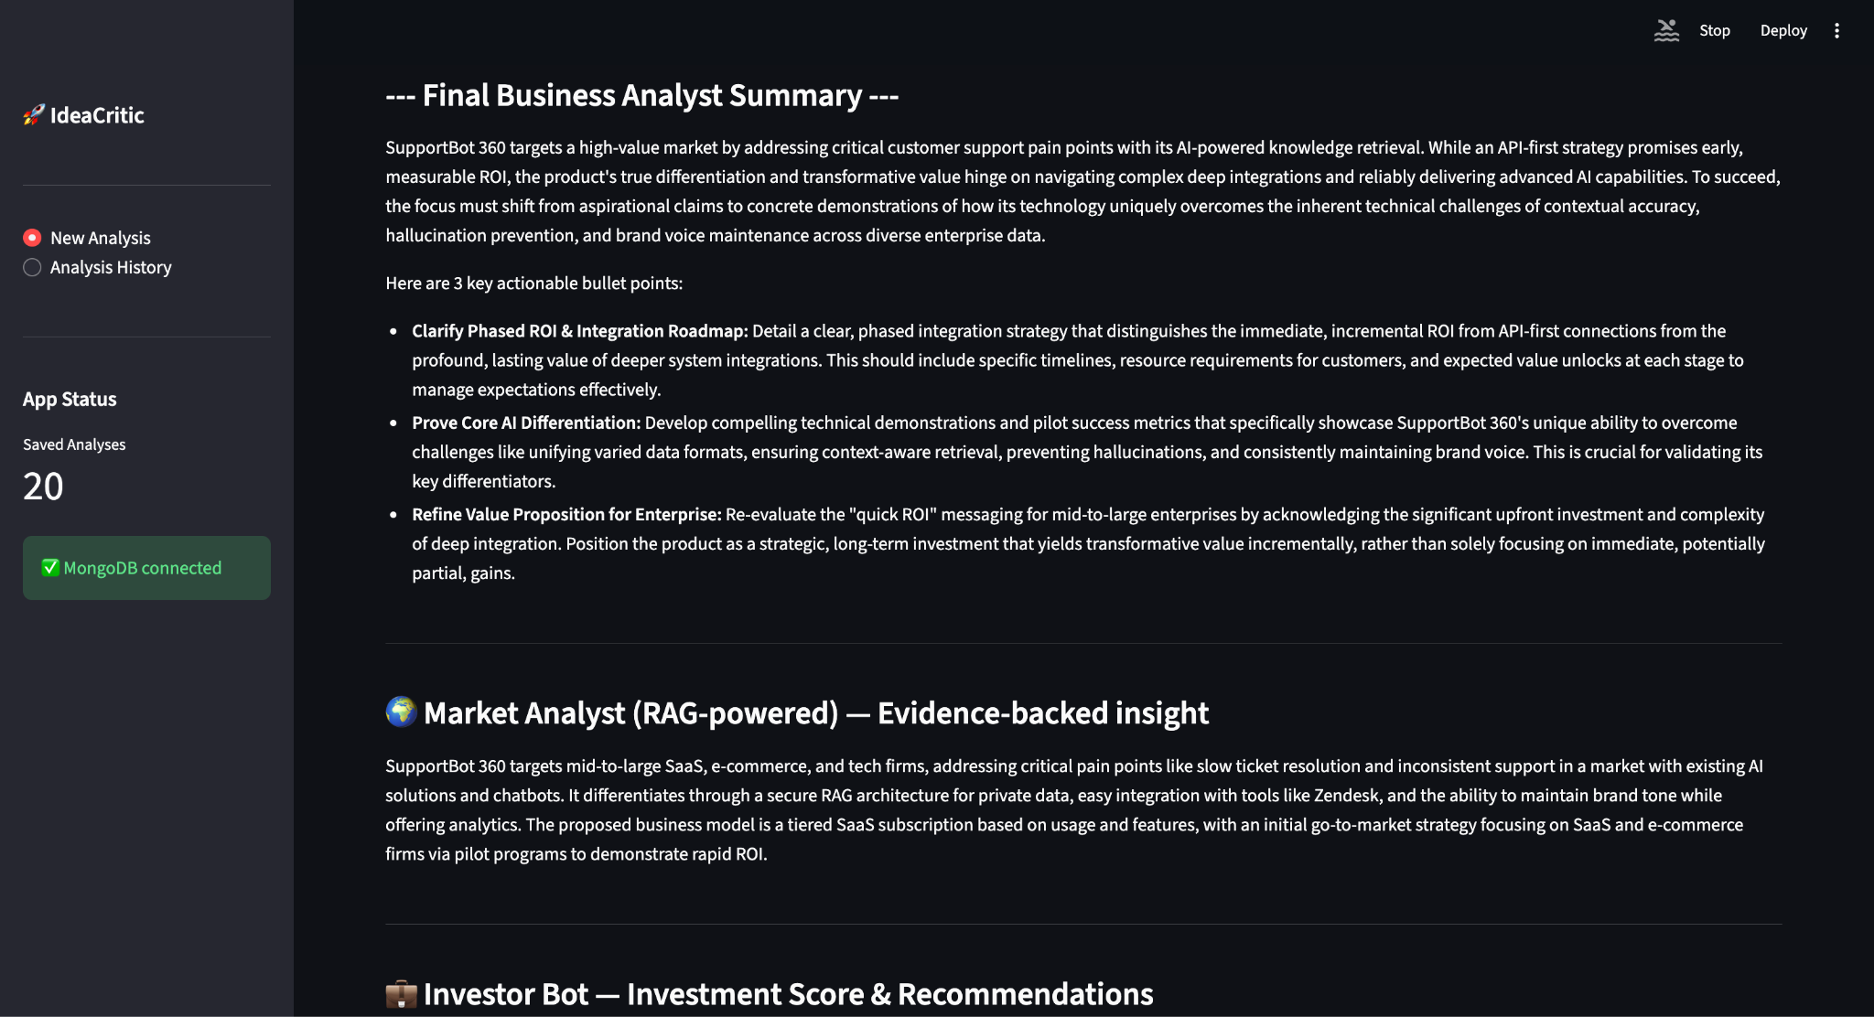

Slide 9
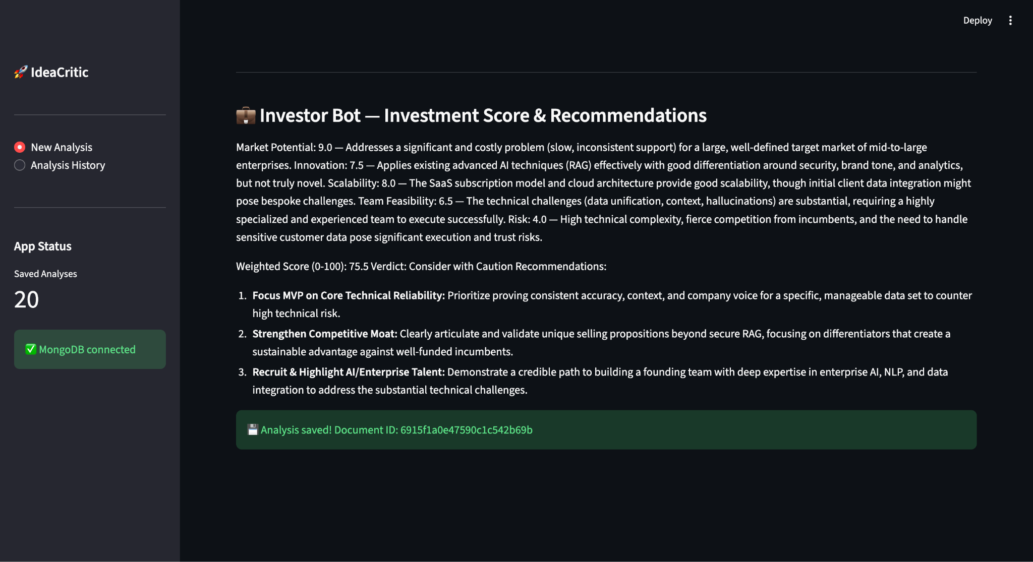
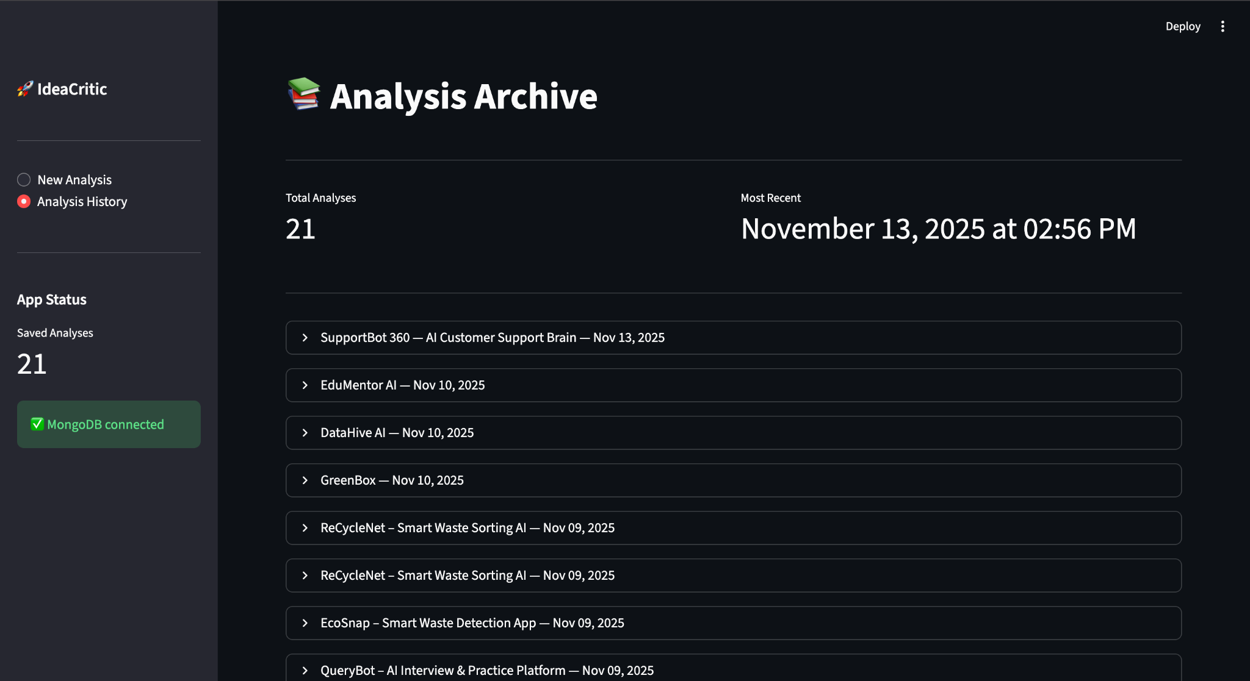

Slide 10
Conclusion
IdeaCritic represents a major advancement in merging AI with creative ideation. It transforms subjective brainstorming into a structured, data-backed process, allowing anyone to validate, refine, and strengthen their concepts using automated expert insights. The project showcases how AI can democratize innovation by making critical evaluation accessible, scalable, and intelligent.
Future enhancements include trend-aware RAG updates, progress tracking, customizable agent panels, and collaborative pitch deck analysis.

Slide 11
References
LangChain — https://python.langchain.com/docs/introduction/
Tavily API — https://docs.tavily.com/
Streamlit — https://docs.streamlit.io/
Flask — https://flask.palletsprojects.com/
MongoDB — https://www.mongodb.com/docs/
Python — https://docs.python.org/3/
Google Gemini — https://aistudio.google.com/
Hugging Face — https://huggingface.co/

Slide 12


