Slide 1

unipool
Timeslot exchange

Slide 2
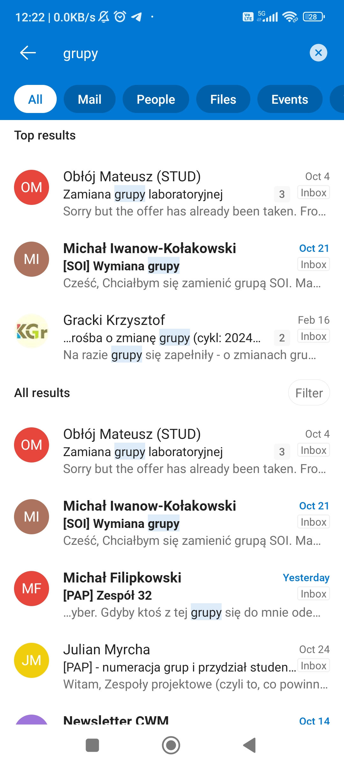
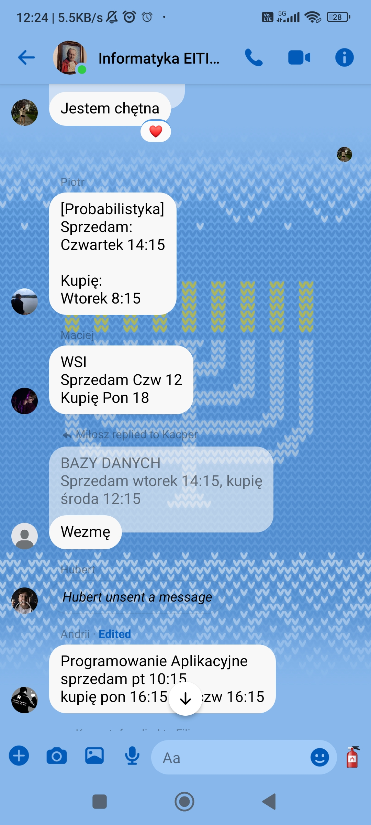
Semester starts
People are assigned groups randomly
People search for people to exchange timeslots

Slide 3
Problems with current approach
Multiple chats, multiple places
Some people are not in the chat
Exchange messages are lost in between other messages
N happy exchanges => N emails to the teacher
Hard to conclude circular exchanges (A to B, B to C, C to A)
Hard to keep track of concluded exchanges
Time-consuming to see what slots exists for the subject, in other words linking USOS course timetable to chat exchange conversation.

Slide 4
Solution
Platform to exchange timeslots

Slide 5
Features / Flow (abstract)
Student’s assignments to groups are added to the system
(or) By student himself
(or) Scraped from USOS
(another way) – courses are scraped from USOS, student can select courses he is on, then select timeslots for these courses
Student selects what timeslots he would be willing to take
Time passes, students fill their preferences (???)
Student sees the timetable for the course, with exchange possibilities for every timeslot
They select, they propose, they accept

Slide 6
There are many ways to implement that in terms of user experience

Slide 7
Possible big features
For course A, to finalize exchanges with a SINGLE letter generated to course A’s teacher
Scraping off each course from USOS
To know the possible timeslots
Importing (via calendar feature for example) person’s timetable

Slide 8
Roadmap is huge
That’s why we called it UNIPOOL – as it may later become a platform with MORE useful tools for students
There are many-many ways to improve how students exchange timeslots, we will implement one for now..

Slide 9
Tech stack
Any SQL database: Postgres or MySQL/MariaDB
Some CRM: Prisma
Node.js on the backend
Remix or Next.js – To further discuss, as we might not need SEO optimization at all.
React, react-router (if not using remix or next), some state manager, etc.
shadcn/ui and tailwind for EASY styling.

