Slide 1
Python Programming
Session -1
Presented By: Hetal Patel
(Software Engineer - DevOps Engineer)

Slide 2
Topics for todays session - 1
What is programming
What is Python and Why Python?
What is PyCharm?
Variables, Data types and Code flow
Basic functions of Python (print, input, and some string manipulation)
Demo Lab - 1

Slide 3
What is programming?
Programming is the process of designing and building an executable computer program to accomplish a specific computing result.

Slide 4
What is Python Programming?
Python is an interpreted, object-oriented, high-level programming language with dynamic semantics. Its high-level built in data structures, combined with dynamic typing and dynamic binding, make it very attractive for Rapid Application Development, as well as for use as a scripting or glue language to connect existing components together.
The Python interpreter and the extensive standard library are freely available in source or library form for all major platforms from the Python website.
https://www.python.org/

Slide 5
What is PyCharm?
Integrated development environment (IDE) only for Python development
Excellent code hinting
Built–in formatting help
Project navigation

Slide 6
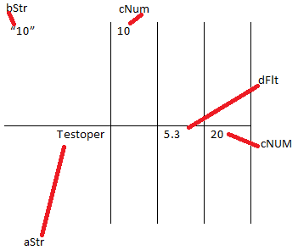
What is Variables and Data Types in Python
Variable is the object name which holds some value of that object in a computer memory to identify that object
A Python variable is reserve memory location to store values.
Every value of variable in python has datatype.

Slide 7
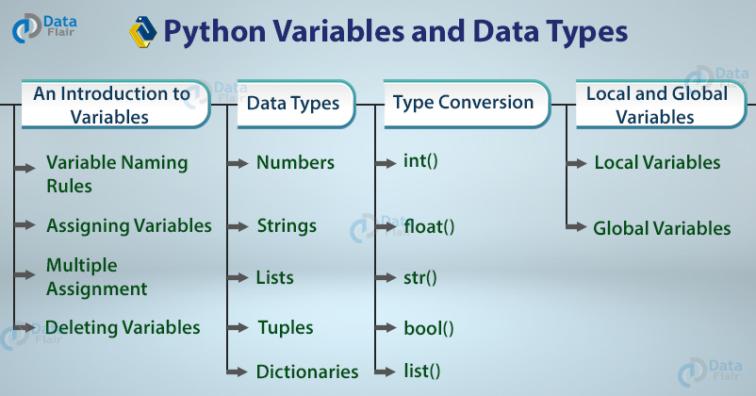
Let’s learn about variables and string manipulation through exercise in Pycharm.

Slide 8
Reserved words (keywords) cannot be used as identifier names.
and | def | False | import | not | True
as | del | finally | in | or | try
assert | elif | for | is | pass | while
break | else | from | lambda | print | with
class | except | global | None | raise | yield
continue | exec | if | nonlocal | return

Slide 9
Lab and exercise link
https://github.com/testoper/Codeathon/blob/master/BeginnersTrack/Exercise/PythonLabs/StringLab1

Slide 10
References
https://en.wikipedia.org/wiki/Computer_programming
https://www.python.org/
https://www.python.org/doc/essays/blurb/
https://www.linkedin.com/learning/learning-python-with-pycharm/what-is-pycharm
https://data-flair.training

