Slide 1
Identifying trends and market opportunities in the service industry
Vikaasa Ramdas Thandu Venkat Kumar
UFID: 4400-5810
Pattern Recognition – EEL6825
University of Florida

Slide 2
Introduction
Yelp is a popular crowd-sourced reviews platform for businesses primarily in the service industry
The dataset contains data for more than 77,000 businesses, with more than 2.2M reviews.
Crowd-sourced review websites have become a major source of attracting customers to businesses
The role of customer reviews and ratings can be instrumental in predicting the success and sustainability of businesses.
Our objective is to identify trends and potentially lucrative business opportunities from the Yelp dataset

Slide 3
Our approach
Our approach involves generating sets of features through simple manipulation of the given data, including weighting reviews in terms of recentness and user popularity.
The businesses are also clustered geographically which will help us to identify popular business categories by location.
The future business attention is then predicted using a regression model, and rules are mined to identify connections between various business categories.
Finally, potentially lucrative business locations are identified by finding clusters with a large number of complementary businesses and low number of competing businesses.

Slide 4
methodology
Data Extraction
Feature Extraction
Feature Selection
Geographical Clustering of Businesses
Random Forests Regression Model
Association Rule Mining

Slide 5
Data extraction
The data is in JSON format, with separate files for different object types, and one JSON object per line in each file.
Here, a subset of the Yelp dataset has been chosen for the purpose of this project. This subset chosen is limited to the state of Pennsylvania.
The businesses from the state ‘PA’, and the corresponding reviews and users’ information are extracted.
The data is split into two such that all reviews after the date June 1, 2015 are removed from the training dataset.
Thus, metadata about the businesses in the state of ‘PA’ is collected by aggregating its review information through the years until June 1, 2015, and is stored as the training dataset.

Slide 6
Feature extraction
Simple manipulation of the data is performed to create time-dependent features.
These features include:
number of reviews in the set,
average number of stars across reviews in the set,
recentness of the review,
number of the fans of the user who posted the review,
number of votes received,
minimum number of stars,
number of unique users logging these reviews every six months, and so on.

Slide 7
Feature extraction
The second category of features are related to the business metadata, such as:
Location
Number of businesses within 1km
Business category
Other business attributes

Slide 8
Feature selection
There might often be redundant or irrelevant features that can inhibit the performance of a learning algorithm.
The best features are those that make data easily separable or predictable.
Some approaches include using a dimensionality reduction technique such as Principal Component Analysis (PCA), or feature selection techniques such as Greedy Feature Removal, Scaling, or Univariate Feature Analysis.
The feature selection method used in this project uses Random Forests.
This method is selected primarily because of compatibility, as the Random Forests regression model is used to solve the regression problem as well.

Slide 9
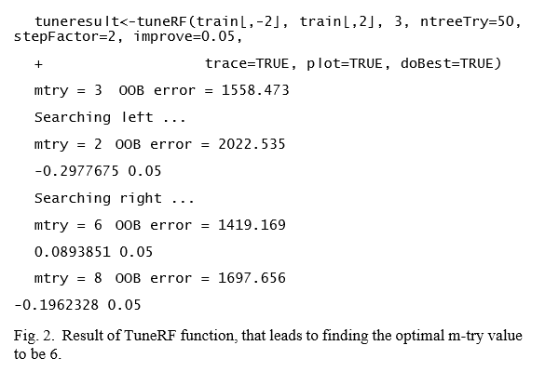
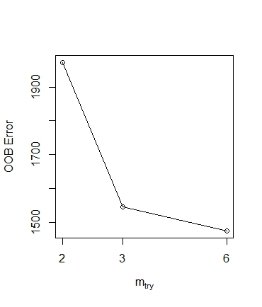
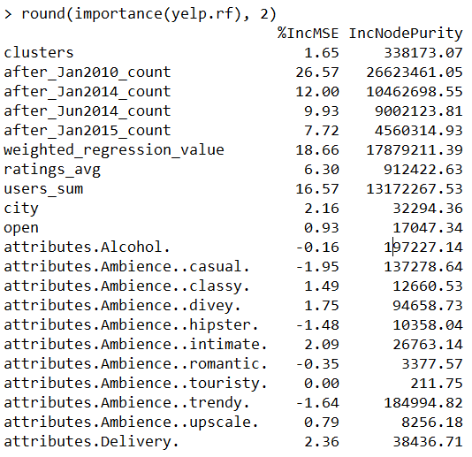
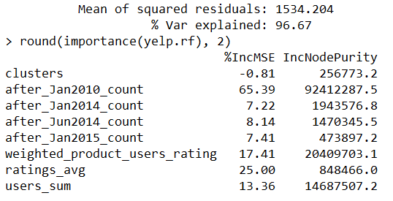
Feature selection
Result of TuneRF function
Before feature selection
After feature selection

Slide 10
Geographical clustering
The objective of this phase of the project is to group businesses in a 1-mile radius into clusters.
The hierarchical clustering approach was chosen in this project, because of the following reasons.
k-means requires a value of ‘k’ clusters to be specified before-hand, and is not ideal.
DBSCAN forms clusters on the basis of density, which is not applicable here as we want to cluster strictly based on the 1 mile radius.
Hierarchical clustering, combined with the Haversine distance function, can determine clusters that are within a specified geographical distance.
In this case, we can specify the geographical distance as 1 mile (1.60934 km).

Slide 11
Geographical clustering
The hierarchical clustering algorithm works as follows:
First, every data point is put in its own cluster.
Then, the closest two clusters are identified and combined into one new cluster.
The above step is repeated till all the data points are combined into a single cluster.
The approach followed here involves complete linkage clustering, where the distance between two clusters is defined as the longest distance between two points in each cluster.
Complete linkage tends to find compact clusters of approximately equal diameters.

Slide 12
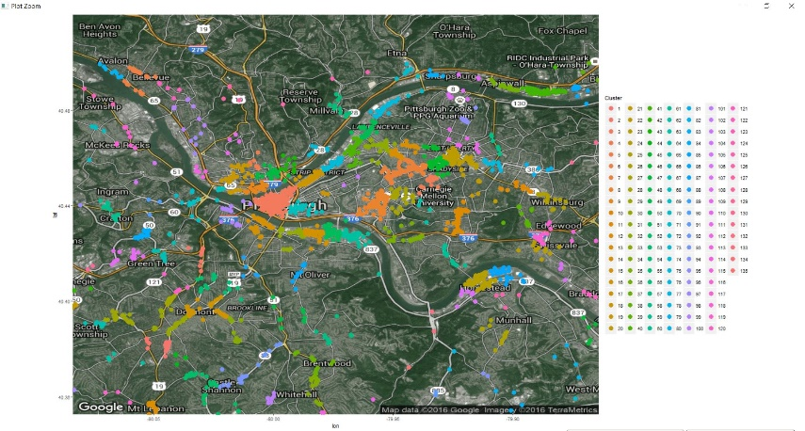
Geographical clustering
Plot showing geographical clusters of businesses in 1-mile radius

Slide 13
Random Forests Regression Model
The second phase of this project implements Breiman’s random forest algorithm for regression, to predict the product of review count and average rating for businesses.
Here are some of the reasons why this approach was chosen to solve the regression problem over other methods:
Random Forests runs efficiently on big data bases.
It consists of an ensemble of different regression trees that are aggregated over to determine a better prediction.
It can handle a large number of input variables without variable deletion, and does not suffer from overfitting problems.
It gives good estimates of what variables are important to the regression model.
It has an efficient process for estimating missing data and preserves accuracy even when a large proportion of the data are missing.
Another advantage is that generated forests may be stored for future use on other data.

Slide 14
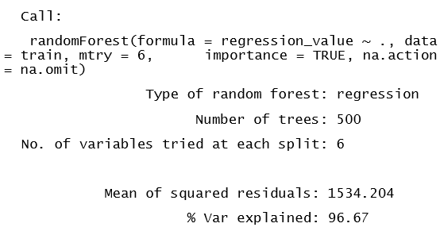
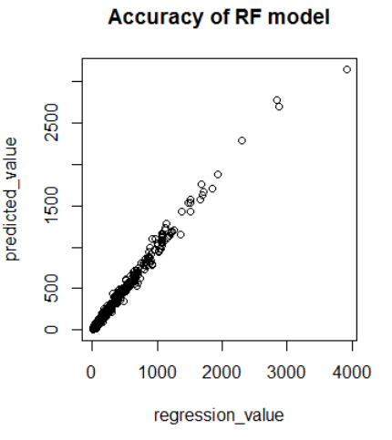
Random Forests Regression Model
Result of Random Forests Regression Algorithm
Output graph plotting the predicted value of the RF model against the actual data

Slide 15
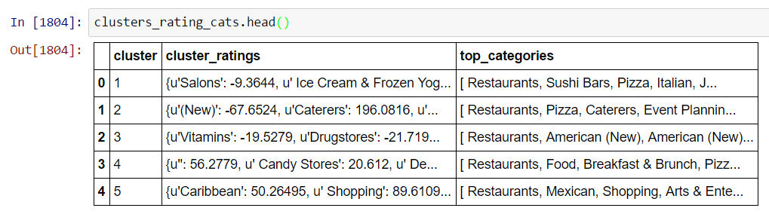
Identifying Business Opportunities using Association Rule Mining
This is the third and final phase of the project.
The predicted variable for each of these businesses (which is the product of their star rating and review count), was assigned as +ve for popular businesses (where the average rating >= 3.5) and -ve for the other businesses (average rating < 3.5),
It was then summed up, and finally sorted to get a list of the most popular categories in a cluster, as shown below:

Slide 16
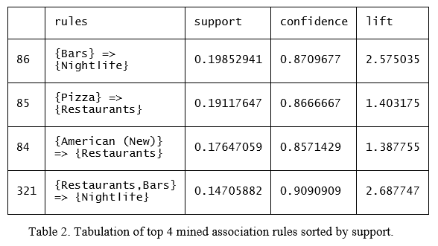
Identifying Business Opportunities using Association Rule Mining
This list represented complementary and popular categories of businesses in a cluster.
After converting this list to a transactional data set, association rule mining was performed in order to mine rules that identify such complementing business categories, with a constraint that they should have support greater than 0.015 and confidence greater than 0.75

Slide 17
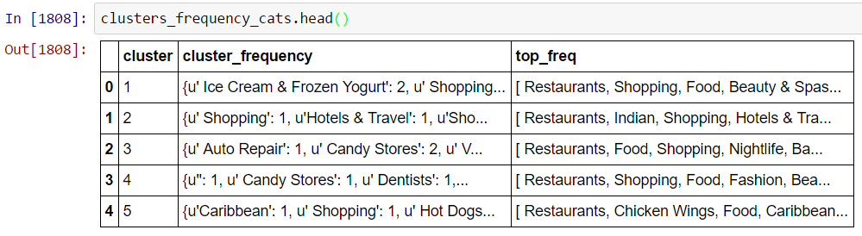
Identifying Business Opportunities using Association Rule Mining
From the dataset, a set of most frequently occurring categories was identified for every cluster.
Then, this set of most frequently occurring categories was compared with the list of mined rules to see if there are any common elements.
If any one or more categories from the mined rules were missing in the set of frequently occurring categories for that cluster, these were labelled as potential opportunities to establish a new business of that category in that cluster’s geographical locality.

Slide 18
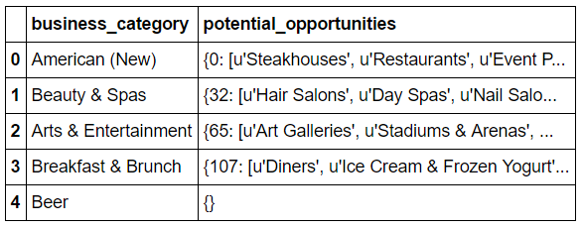
Identifying Business Opportunities using Association Rule Mining
Here, the category “Beer” has no potential opportunities listed.
This is because there are no missing categories from the rule in any of the clusters.
On the other hand, for business category “Beauty and Spas”, for example, there are potential business opportunities in cluster 32 to open a hair salon, day spa, and nail salon.

Slide 19
conclusion
This project has introduced a novel approach to identify business trends and market opportunities from the Yelp dataset.
The project successfully incorporated geographic clustering of businesses using hierarchical clustering and predicting future business attention using the Random Forest Regression model.
Association rule mining was applied to find complementary business categories, and finally to identify opportunities to open new businesses within specific geographic clusters.
This data can be very useful for entrepreneurs who are looking for a good location to establish their business.
It can also help current businesses stay relevant by proactively observing trends in their geographical vicinity, and tweaking their business model to stay competitive.

Slide 20
FUTURE Scope
Semantic analysis of text reviews is something that can be incorporated into this project in the future, which would add a new dimension into analyzing and rating the categories of businesses.
By parsing the review text and identifying keywords and associating sentiment ratings to these keywords, it would be possible to identify and explore more connections between different businesses and business categories.
It would also be interesting to cluster the users based on the locations they frequent, to identify trends in their travel patterns to businesses of different categories, which may offer potential information on identifying further business opportunities.

