Slide 1
Pharmacological Interventions for Alcohol Abuse
Shuang chen, sonia Gill, rebecca Nourse & Anne PaumGarten
PH121: Decision and Cost-Effectiveness Analysis
The dartmouth Institute for Health Policy &clinical Practice

Slide 2
Background
Alcohol use disorders affect over 17 million adults in the United States as of 2012¹
Only a third of the population seeks treatment and less than ten percent receives medication for alcohol abuse²
The purpose of this decision analysis is to determine which drug out of naltrexone, disulfiram, acamprosate and topiramate is most effective at increasing the number of non-drinking days among those who have received a score of 15 or higher on the Alcohol Use Disorders Identification Tool (AUDIT) screening

Slide 3

Primary Project Objective
Use decision tree Markov modeling to determine which pharmacological intervention for alcohol abuse has the highest payoff in number of sober months per 12-month period
Primary care providers can then utilize this tool to decide which pharmacologic therapy should be prescribed

Slide 4
Decision Tree Structure
Markov Model
  Relapse common and recurring
Primary Outcome: Months of Sobriety
12 Month Timeframe
Incremental Rewards: Four 3-Month Payoff Cycles
  Abstinence (3 months)
  Partial Abstinence (1.5 months)
  Any Drinking (0 months)
  Death (0 months)

Slide 5
Probabilities for Alcohol States
Alcohol States Selected for Inclusion:
  Abstinence vs. Continued Drinking
  Drug Discontinuation due to Adverse Effects vs. Continuation
  Assumption: Continued drinking is at an unhealthy abusive level (studies did not provide heavy drinking vs. any drinking across all included drugs)
A meta-analysis was used to obtain probabilities for the no treatment, naltrexone, acamprosate arms of our decision tree³
RCT studies were used to collect probabilities for disulfiram and topiramate^{4,5}
Assumption: Studies used to derive probabilities are methodologically rigorous and accurate

Slide 6
Mortality Rates for Alcohol States
All-cause mortality probabilities for the abstinence group by age
  Assumption: All-cause mortality is being used as proxy for recovery after abstinence assuming no serious complications such as cirrhosis have occurred
Alcohol-attributable mortality probabilities by age
  CDC alcohol-attributable deaths for the numerator
  2010 Census data for denominator
  Conversation from rate to probabilities

Slide 7
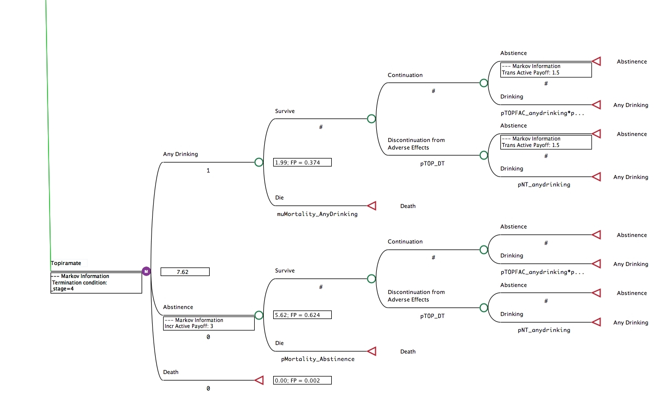
Results: Topiramate is preferred arm with 7.62 months of abstinence

Slide 8
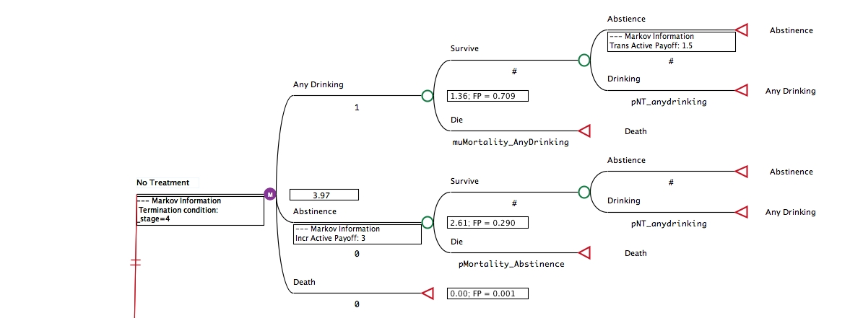
Results
Intervention | No Treatment | Naltrexone | Acamprosate | Disulfiram | Topiramate
Abstinence months | 3.97 | 4.63 | 7.17 | 5.65 | 7.62

Slide 9
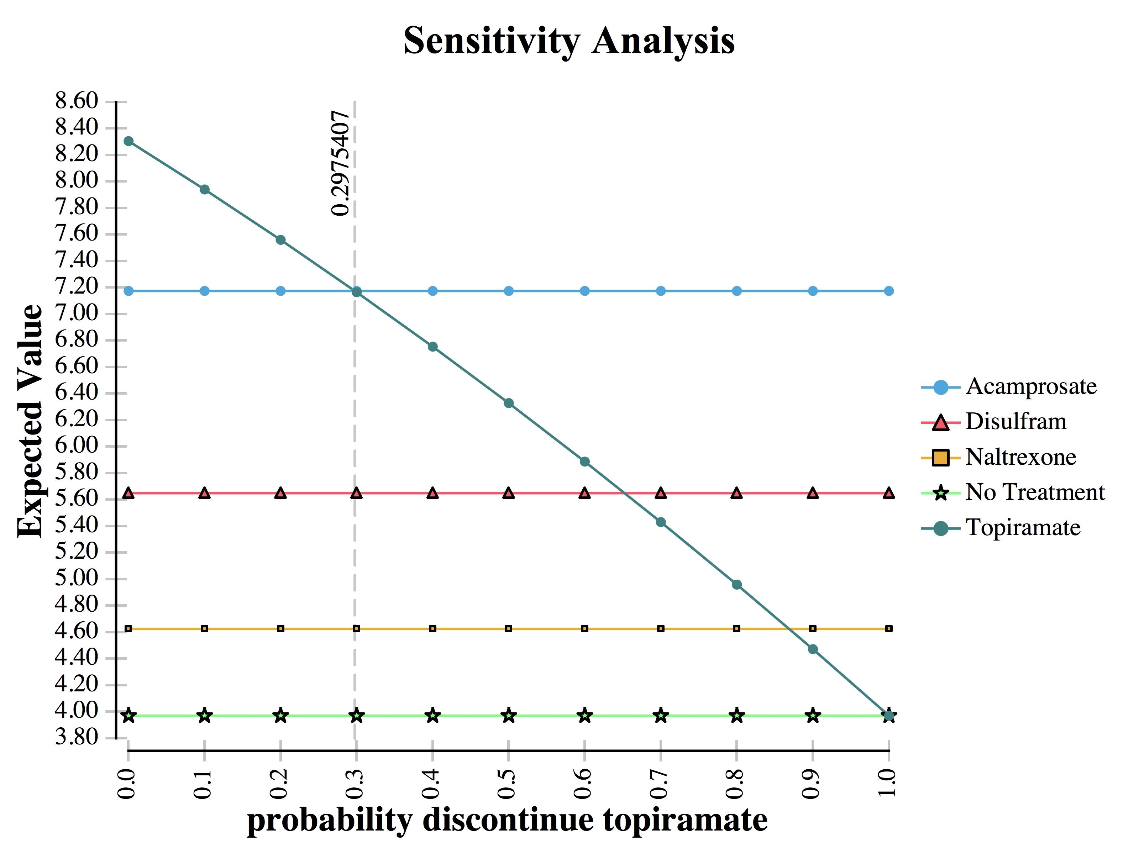
Sensitivity Analysis

Slide 10
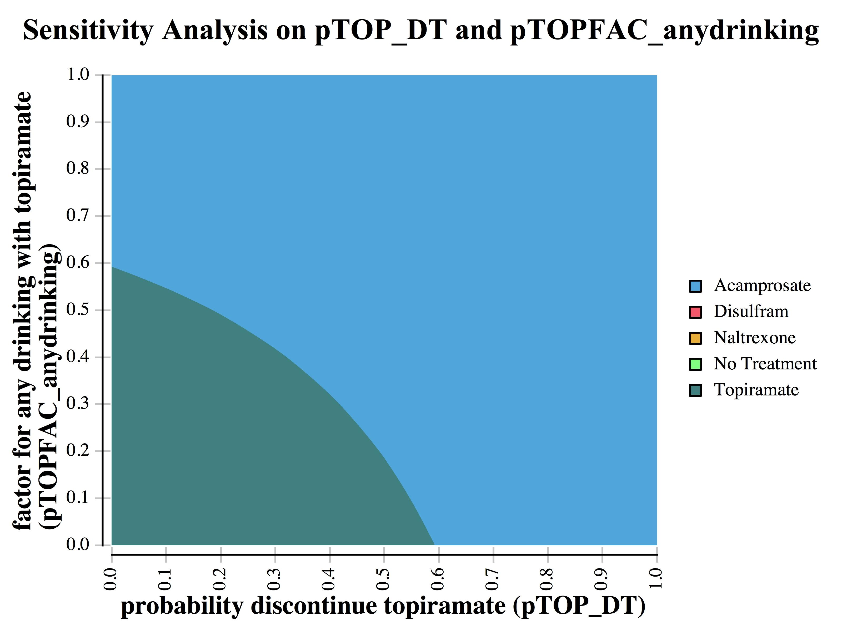
Sensitivity Analysis

Slide 11
Discussion
The major determinants in what drug is most effective for promoting abstinence in heavy drinkers are:
  Rate of any drinking
  Rate of discontinuation of the drug
The metric of mortality rate does not significantly alter results as it is applied evenly to all drugs

Slide 12
Discussion
Topiramate has the highest efficacy of any drug available and a moderate discontinuation rate, making it the preferred drug
While less effective, acamprosate and naltrexone have much lower discontinuation rates
Acamprosate becomes the preferred drug if topiramate’s discontinuation rate goes above ~0.30 for its current rate of drinking
If topiramate’s discontinuation rate goes above ~0.65 even disulfiram will become favored over topiramate but not acamprosate

Slide 13
Conclusions
Heavy drinkers wishing to abstain from drinking should begin treatment with topiramate
Topiramate is found to be most effective as it has the lowest rate of returning to drinking in combination with a moderate drop out rate

Slide 14
Future Directions
More longitudinal studies are needed with timeframes longer than 3-6 months to further validate our claims
All drugs should be studied using an universal outcome of reduced drinking days
Topiramate should be considered for FDA approval to treat alcohol abuse

Slide 15
References
Alcohol Facts and Statistics. National Institute on Alcohol Abuse and Alcoholism. https://www.niaaa.nih.gov/alcohol-health/overview-alcohol-consumption/alcohol-facts-and-statistics. Accessed May 20, 2017.
Jonas DE, Amick HR, Feltner C, et al. Pharmacotherapy for adults with alcohol use disorders in outpatient settings: A systematic review and meta-analysis. JAMA. 2014;311(18):1889-1900.
Donoghue K, Elzerbi C, Saunders R, Whittington C, Pilling S, Drummond C. The efficacy of acamprosate and naltrexone in the treatment of alcohol dependence, Europe versus the rest of the world: a meta‐analysis. Addiction. 2015;110(6):920-930.
Johnson BA, Rosenthal N, Capece JA, et al. Topiramate for treating alcohol dependence: A randomized controlled trial. JAMA. 2007;298(14):1641-1651.
Ulrichsen, J, Nielsen, MK, Ulrichsen, M. Disulfiram in severe alcoholism – an open controlled study. Nordic Journal of Psychiatry, 64, 356-362.

