Slide 1
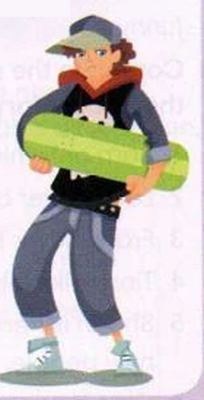
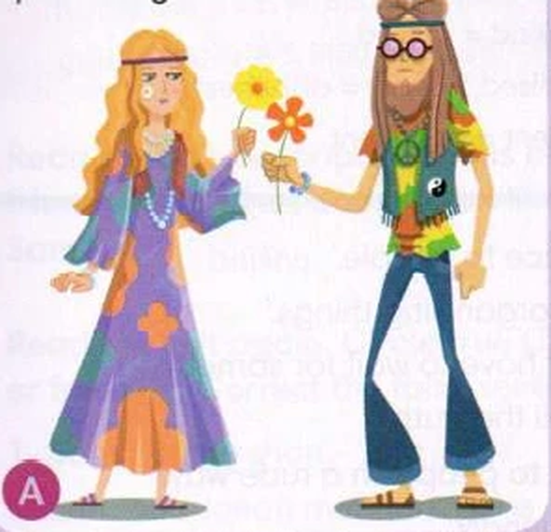
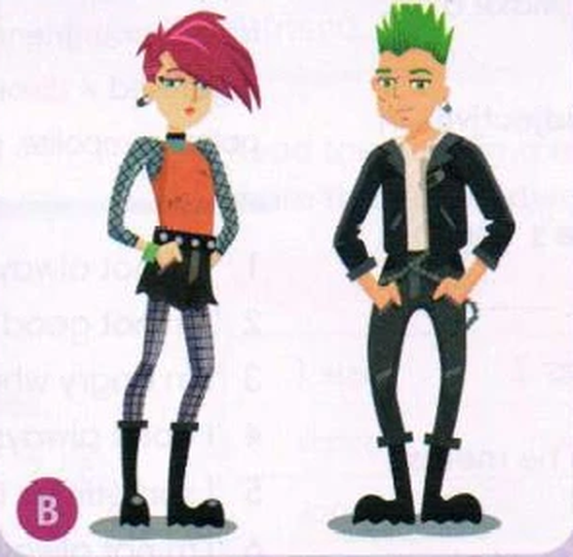
Fashion Time Machine
Go Getter 4 · 1.5 Teenage fashions · Speaking games
Notes:
Додатковий урок-гра на говоріння до Go Getter 4, урок 1.5 «Teenage fashions» (хіпі, панки, скейтери; лексика Hairstyles; опис зовнішності; Past Simple). 35–45 хв. Розділіть клас на команди, бали — на дошці.

Slide 2




How we play
★
Teams
1 point
+1 bonus
Lingo Coins
Work in teams of 2–3. Choose a team name.
for every full answer in English: say why!
for a new hair word or the Past Continuous: she was wearing…
The best speakers get up to 5 coins today.
Rule number one: English only!
Notes:
Бонус +1: нове слово з Hairstyles (curly, dyed, shaved, spiky, straight, wavy, bald, beard, moustache) або Past Continuous (She was wearing a red leather jacket). Lingo Coins — за правилами школи.

Slide 3
Who are they?
1
Hippies, punks or skaters? When was it popular? What are they wearing? What's their hair like?
In picture A, they're wearing … · She's got long wavy hair · It was popular in the …
Notes:
5 хв. Без підручника! Команди по черзі описують одну картинку (2–3 речення). Відповіді: A — hippies, 1960s; B — punks, 1970s–80s; C — skater, 1990s–2000s.

Slide 4
Name a famous person with…
2
curly hair
spiky hair
a beard
a moustache
dyed hair
straight hair
wavy hair
no hair: bald!
… has got curly hair. · … is bald. · In the film …, he's got a moustache.
Notes:
5 хв. Команда за 20 секунд називає відому людину/персонажа з такою зачіскою (співаки, футболісти, мультики). +1 бал за правильну відповідь повним реченням.

Slide 5
Guess who?
3
look
height
build
face
hair
pretty, good-looking, cool
tall, short, medium height
slim, well-built, strong
blue eyes, freckles, a big smile
short, long, curly, straight, dyed …
Describe a classmate or a famous person. Don't say the name! The others guess.
This person is quite tall and slim. · He's got short straight hair. · She's got blue eyes.
Notes:
5 хв. Зв'язок із впр. 2–3 SB. Учень описує однокласника або зірку за 5 категоріями, інші вгадують. Стежте, щоб описи були доброзичливими.

Slide 6
This or that? Fashion edition
4
baggy jeans or skinny jeans
trainers or boots
a hoodie or a leather jacket
a baseball cap or no hat
dyed hair or natural hair
long hair or short hair
I'd wear … because … · I prefer … because it's more comfortable / cool / …
Notes:
4 хв. Швидко по колу. Можна рухливо: ліва сторона класу — перший варіант, права — другий.

Slide 7
Hippies, punks or skaters?
5
1
They wore safety pins as earrings.
2
They painted their faces with flowers.
3
They wore baseball caps or hoodies.
4
Their music was loud and angry.
5
They wanted peace and freedom.
6
They wanted to be comfortable.
7
Men had long hair and beards.
8
Blue, pink and green hair was popular.
Show H, P or S! Then say: I think it's the punks because …
Notes:
5 хв. Кожна команда має 3 картки H / P / S і показує відповідь одночасно. Відповіді — на наступному слайді.

Slide 8
Answers
5
punks: They wore safety pins as earrings.
hippies: They painted their faces with flowers.
P
H
skaters: They wore baseball caps or hoodies.
punks: Their music was loud and angry.
S
P
hippies: They wanted peace and freedom.
skaters: They wanted to be comfortable.
H
S
hippies: Men had long hair and beards.
punks: Blue, pink and green hair was popular.
H
P
Which fashion do you like the most? Why?
Notes:
Покажіть відповіді, порахуйте бали. Перехід до SB впр. 6: кожен відповідає, який стиль йому подобається і чому.

Slide 9

Time machine interview
6
Student A: you are a hippie in 1968
Student B: you are a journalist
What are you wearing today?
What's your hair like?
What music do you like?
Why do you dress like this?
What do your parents think about it?
Student A: you are a punk in 1979
Student A: you are a skater in 1999
I'm wearing … · My hair is … · I dress like this because I want to …
Notes:
7 хв. Рольова гра в парах: A — хіпі/панк/скейтер з минулого (говорить у Present Simple/Continuous), B — журналіст. 2 хв, потім обмін ролями. Кілька пар показують класу.

Slide 10
Family fashion detectives
7
What did your mum or dad wear when they were teenagers?
What was your grandma's hair like when she was young?
Did anyone in your family have a beard or a moustache?
Have you ever seen a funny old family photo? What were people wearing?
Would you wear your parents' old clothes today? Why? Why not?
Is there a family member who still loves an old style?
My mum wore … · She was wearing … · Her hair was …
Notes:
6 хв. Зв'язок із коментарями Suzie і Leo та SB впр. 7. Пари обговорюють, потім кожен розповідає про родича партнера (+1 за Past Continuous).

Slide 11




Design a teen fashion for 2040
8
Name
Clothes
Hair
Music
Give your style a cool name.
What do people wear?
What's their hair like?
What music do they love?
Plan in teams (3 minutes), then present your style in 1 minute. The class votes for the best one!
Our style is called … · People wear … · Their hair is … · They want to …
Notes:
8 хв. Креативне завдання: команди вигадують молодіжну моду 2040 року, малюють ескіз (за бажанням) і презентують. Голосування: за свою команду голосувати не можна.

Slide 12

Would you rather…?
9
…dye your hair green for a month or shave your head?
…wear your grandma's clothes for a week or your little brother's?
…wear only one colour for a year or never wear jeans again?
…have spiky blue hair for a week or a moustache for a day?
I'd rather … because … · No way! I'd never …
Notes:
4 хв. Швидкий фінальний раунд для сміху: кожен обирає й пояснює.

Slide 13

Who's the winner?
Count your points. Lingo Coins for the best speakers!
Today I can talk about fashions from the past and describe people's hair.
Notes:
Підрахунок балів, Lingo Coins (до 5). Рефлексія: кожен називає 2 нові слова про зачіски і одне речення про моду минулого.

