Slide 1

Best Maui Neighborhood to buy a property.

Slide 2
Introduction
Maui, Hawaii is one of the best places for tourism in the United States and therefore is a good location for a property investment. Using location data to explore a geographical location, I'll be trying to determine which neighborhood of Maui will be the best place for that purpose. One of the main factors is, of course, the place is being close to the Pacific ocean. However, the place should also be located near some popular venues (preferably walking distance). I will use location data to find the best property to buy.

Slide 3
Data
I created a dataframe which consist of Zip Codes and City names for Cities that have the most population. Then, I added longitude and latitude for all Cities.

Slide 4
Methodology
After that, I explored the dataframe with Foursquare API. I got get the top 100 venues for each city within a radius of 500 meters.
I visualized and analyzed data with Python.

Slide 5
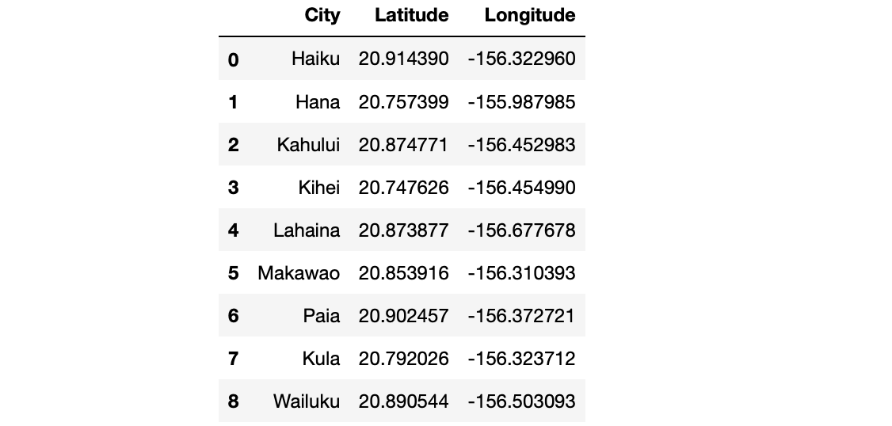
Here is the final dataframe I worked with:

Slide 6
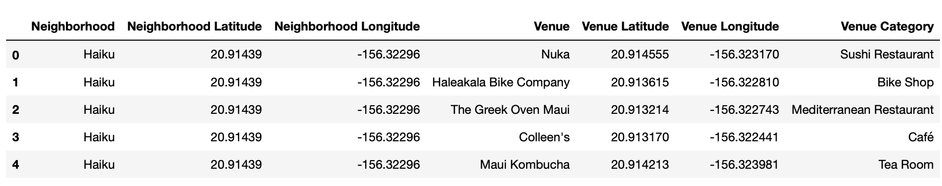
234 venues were returned by Foursquare. Here is a merged table of Cities and venues.

Slide 7
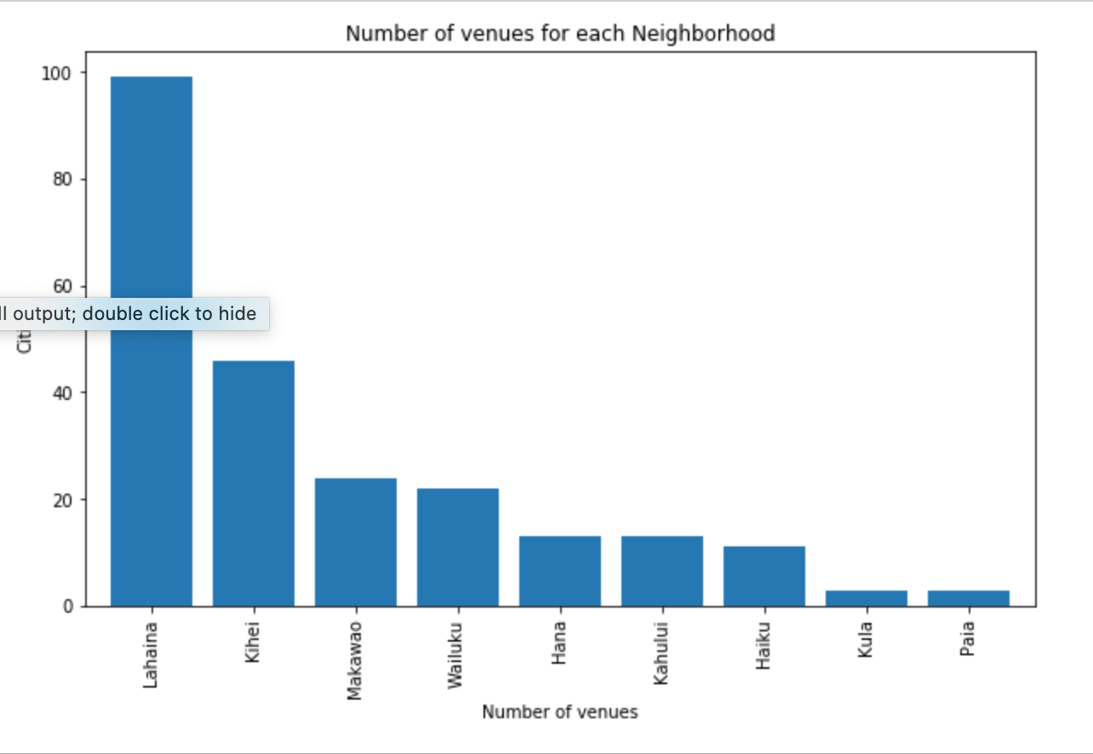
I then created a plot bar in order to visualize top cities with the most venues:

Slide 8
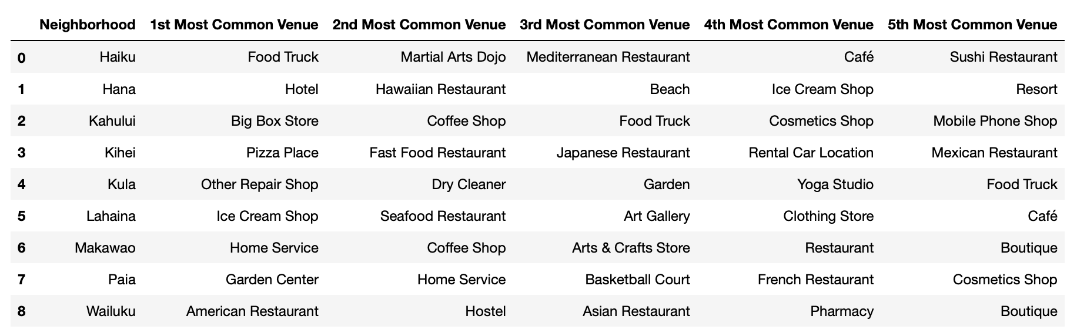
Results:

Slide 9
Discussion and Conclusion:
As I already mentioned, Hawaii is one of the best places in the United States (or even in a word?) to visit as a tourist. I've limited my investigation to Maui island only because I believe it has more potential than other islands. It's less rural than Kauai and not overpopulated as Oahu.
According to the data I analyzed, these three neighborhoods, Lahaina, Kihei, and Wailuku should be good to buy an investment property (Airbnb rent or similar). They have the most population, conveniently located and have many venues within 500 meters of a city's center.

Slide 10
References
Wiki: https://en.wikipedia.org/wiki/Module:Location_map/data/United_States_Maui
Zip codes: https://www.zip-codes.com/county/hi-maui.asp
Foursquare: https://foursquare.com

