Slide 1
Anatomy of Large Language Models
Understanding the Engine Behind Agentic AI
Agentic AI for Developers • Feb 6-7, 2026 • 1 Hour Module

Slide 2
Module Agenda
Transformer Architecture Deep Dive
Embeddings vs Seq2Seq Models
Self-Attention & Multi-Head Magic
Training: Pretrain → Fine-tune → Instruction
Context Windows & Hallucination Traps

Slide 3
What Powers Modern AI Agents?
Transformer Architecture (2017 → )
Replaced RNNs/LSTMs (sequential, slow)
Parallel processing via self-attention
Foundation for GPT-4o, Claude 3.5, Gemini

Slide 4
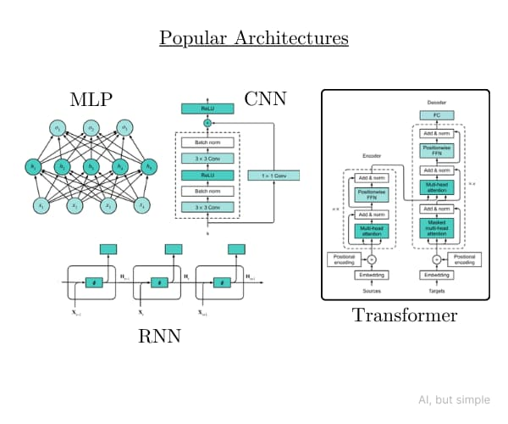
Transformer Architecture
Encoder-Decoder stack with multi-head attention layers

Slide 5
Core Building Block: Embeddings
Token → Vector Magic
Words → High-dimensional numbers (e.g., 4096 dims)
Captures semantic similarity
Example: "king" - "man" + "woman" ≈ "queen"
Positional encodings add sequence order

Slide 6
Embeddings vs Seq2Seq
Transformers (Embeddings)
Parallel processing, global context, 1T+ params
RNNs (Seq2Seq)
Sequential, limited context, ~1B max params

Slide 7
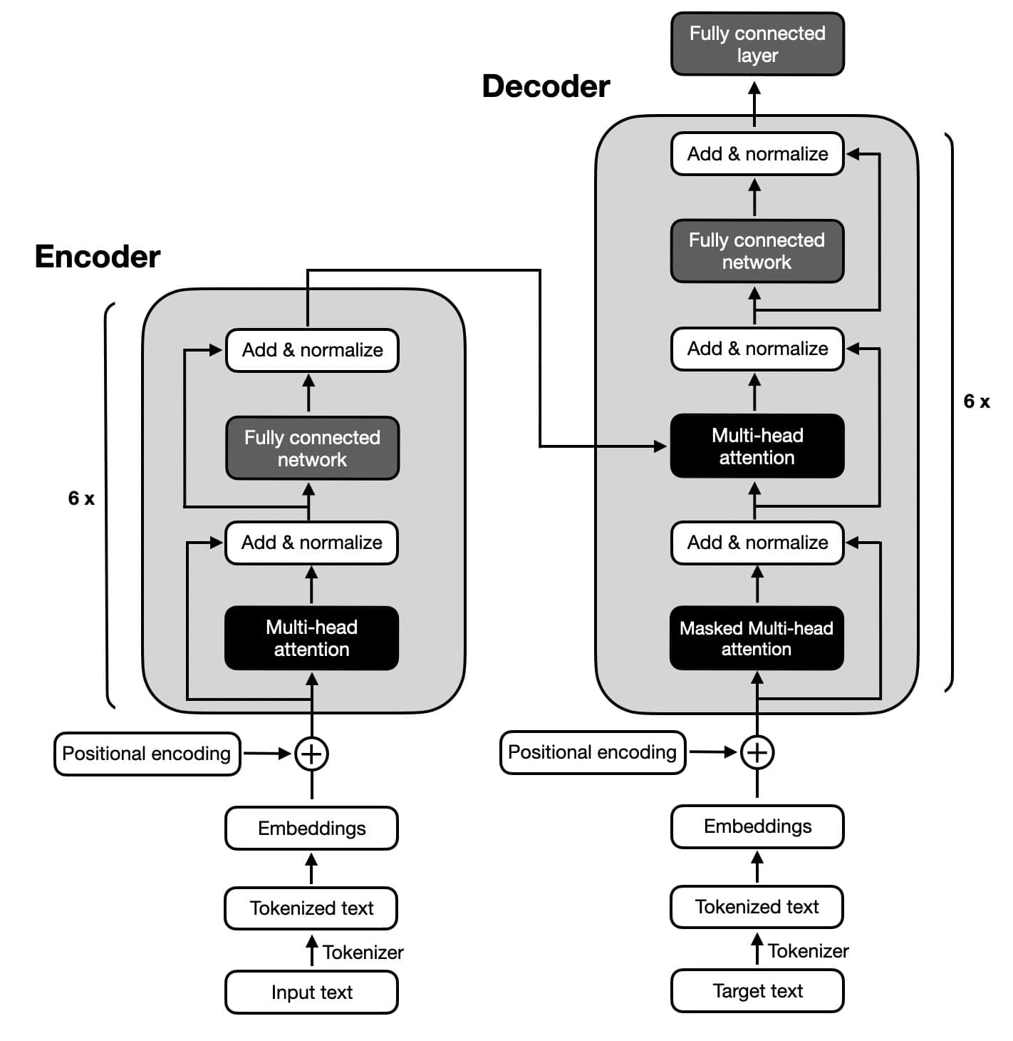
Encoder-Decoder Architecture
Encoder processes input, decoder generates output

Slide 8
Transformer Encoder Anatomy
Input → Self-Attention → Feed Forward
Multi-head self-attention layer
Residual connections + LayerNorm
Position-wise Feed Forward Network (MLP)
Stack 6-96 layers for depth

Slide 9
Self-Attention Deep Dive
"Where to Look?" Mechanism
Query (Q), Key (K), Value (V) matrices
Attention = softmax(QK / √d) × V
Computes relevance weights dynamically

Slide 10
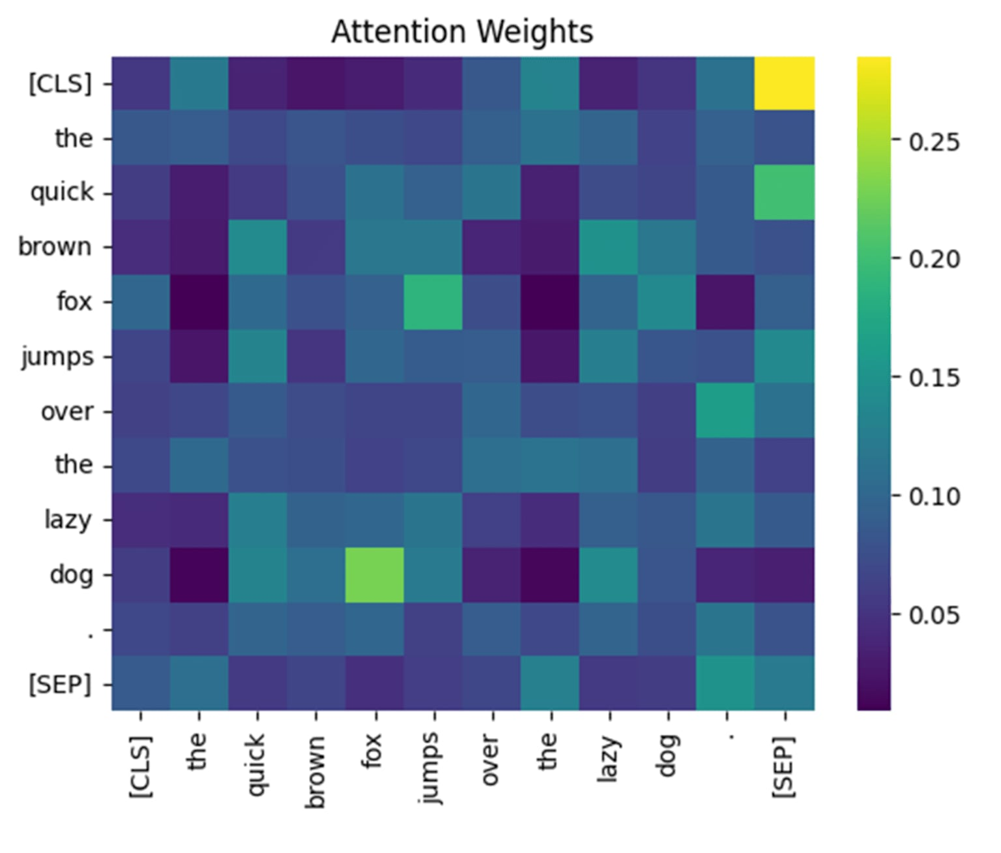
Self-Attention Visualization
Attention weights show which tokens influence each other

Slide 11
Multi-Head Attention
Parallel Relevance Detection
8-128 heads, each learns different patterns
Head 1: Syntax patterns, Head 2: Semantics
Concatenate outputs → Linear projection
Enables diverse pattern recognition

Slide 12
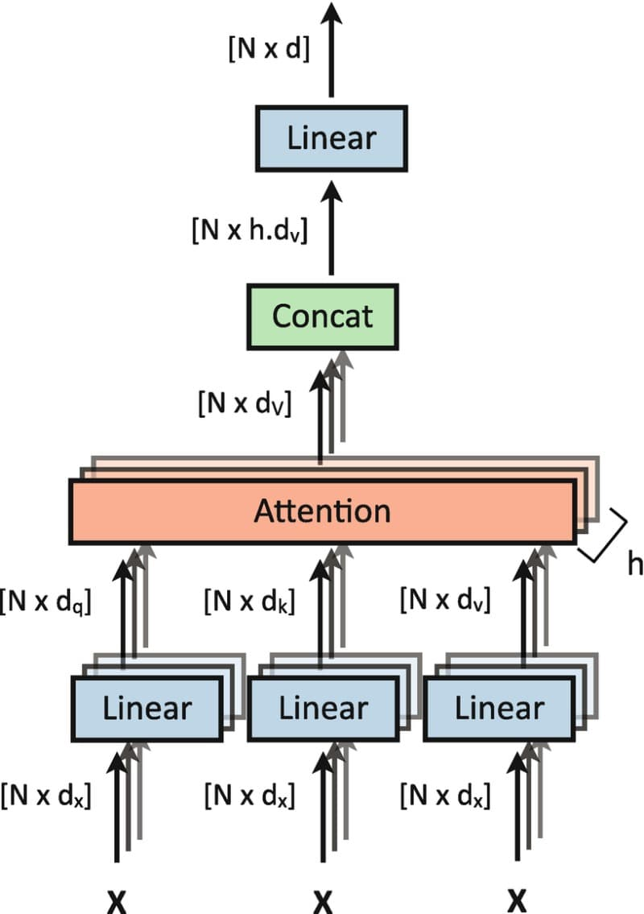
Multi-Head Attention Block
Multiple attention heads process in parallel

Slide 13
Decoder Differences
Masked Self-Attention + Cross-Attention
Prevents future peeking (autoregressive)
Cross-attention to encoder outputs
Generates one token at a time
GPT series uses decoder-only architecture

Slide 14
Scale = Capability
GPT-1: 117M params (2018)
GPT-3: 175B params (2020)
GPT-4o: ~1.8T params (2025)
7 years = 15,000x parameter growth

Slide 15
How LLMs Learn
Pattern Recognition at Scale
Next-token prediction on internet data
Learns grammar, facts, reasoning via statistics
No explicit programming—emergent abilities
Trained on trillions of tokens

Slide 16
Training Paradigms
Pretraining → Fine-tuning → RLHF
Pretrain: Massive unsupervised corpus
Supervised Fine-tune: Q&A pairs
RLHF: Human preference alignment

Slide 17
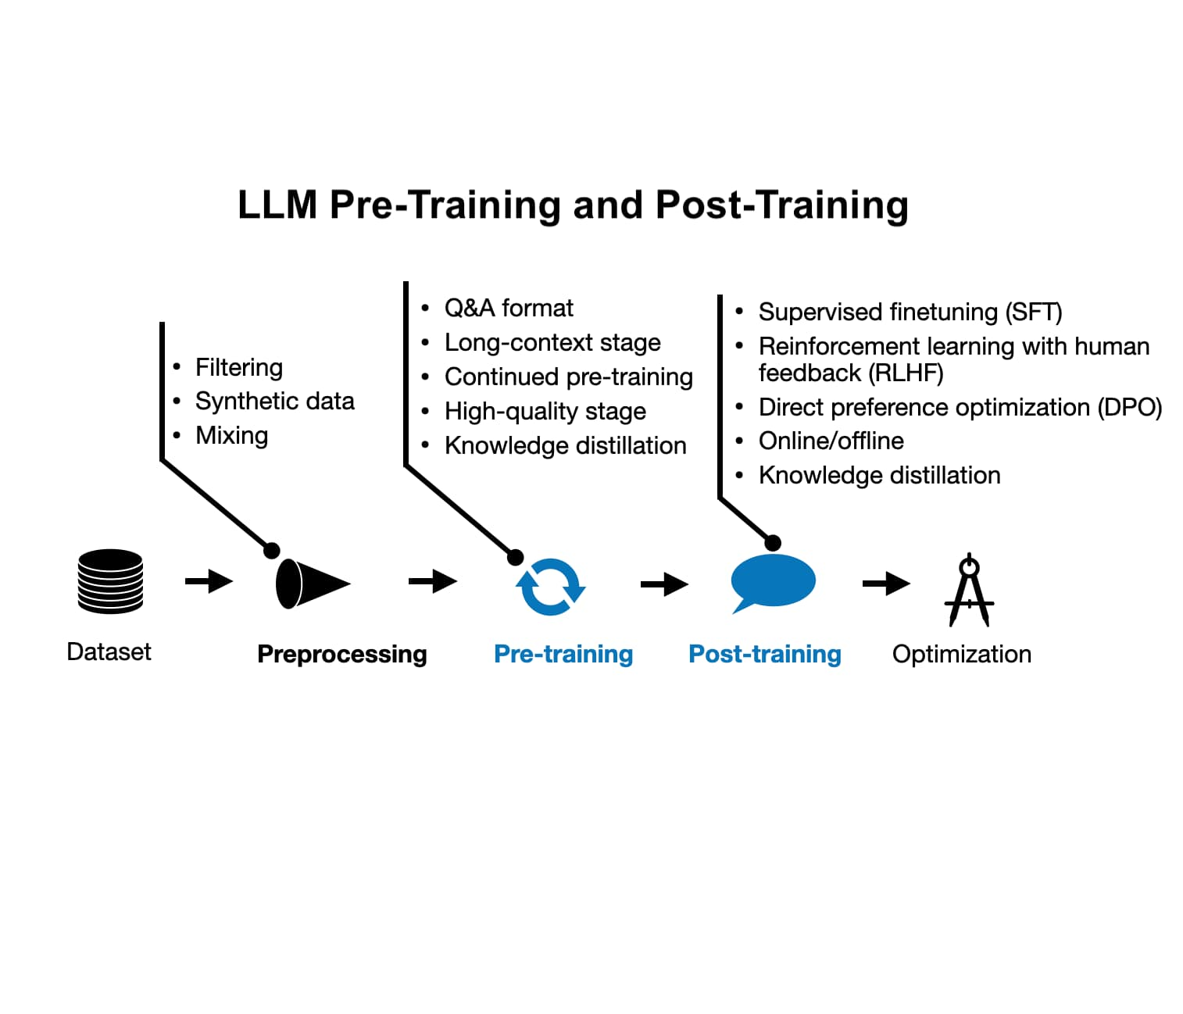
LLM Training Pipeline
Pre-training → Post-training paradigm evolution

Slide 18
Fine-tuning Methods
Full Fine-tune
100% params, $$$, new domains
LoRA
0.1% params, $, custom tasks
Prompt Tuning
0.01% params, ¢, quick adapt

Slide 19
Instruction Tuning
From Completion → Conversation
InstructGPT breakthrough (2022)
System prompts + structured outputs
Enables agentic workflows (tools, memory)
GPT-4o, Claude 3.5 are instruction-tuned

Slide 20
Context Window Evolution
GPT-3: 4K tokens (~3K words)
GPT-4o: 128K tokens
Gemini 2.0: 2M+ tokens (2026)
From 2K to 2M in 5 years

Slide 21
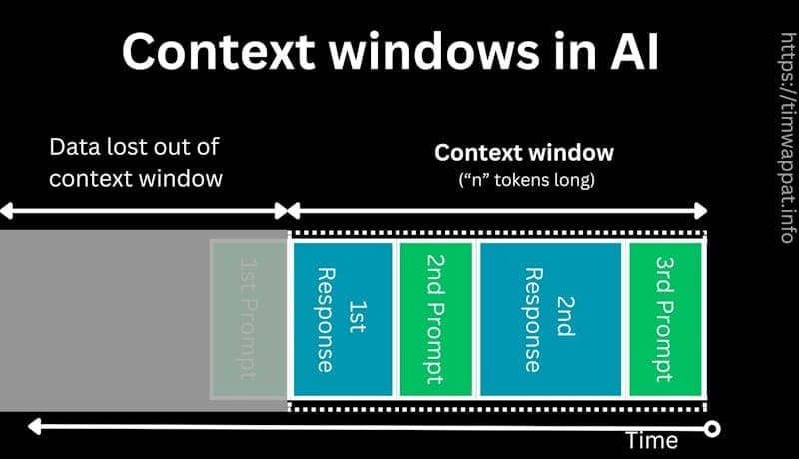
Context Window Visualization
Sliding window of tokens the model can process

Slide 22
Why Models Hallucinate
Top Causes
Training data gaps (rare facts missing)
Context overflow (forgot early information)
Overgeneralization (plausible fiction)
No true reasoning (pattern matching only)

Slide 23
Hallucination Mitigation
Developer Strategies
RAG (Retrieval Augmented Generation)
Guardrails + fact-checking layers
Chain-of-Verification prompting
Smaller domain-specific models

Slide 24
Why Transformers Won
vs Legacy Seq2Seq
Massive parallelization (GPU-friendly)
True long-range dependencies
Transfer learning supremacy
Multimodal extension (ViT, CLIP, Flamingo)

Slide 25
Developer Takeaways
Practical LLM Insights
Prompts > Fine-tuning (80% gains faster)
Context window = your working memory budget
Hallucinations inevitable—design defensively
Agentic = Tools + Memory + Planning

Slide 26
Hands-On Next
Live API Exploration (15 min)
OpenAI Playground (text/vision)
Hugging Face Hub (open models)
Compare GPT-4o vs Llama 3.2
Questions? Let's explore together.

Slide 27
Key References
"Attention is All You Need" (Vaswani 2017)
GPT Series Technical Reports (OpenAI)
Lilian Weng: Transformer Blog Series
Course repo: notebooks + playground links

