Slide 1
Multimodal LLMs & Context Engineering
From Text-Only to Vision, Audio, Video
Agentic AI for Developers • Feb 6-7, 2026 • 1.5 Hour Module

Slide 2
Module Agenda
What Are Multimodal LLMs?
Leading Models: GPT-4V, Claude 3.5, Gemini
Context Engineering Fundamentals
Prompt Patterns: Good vs Bad (10+ Examples)
System Prompts & Few-Shot Learning

Slide 3
What Are Multimodal LLMs?
Beyond Text: Processing Multiple Input Types
Text + Image: Analyze charts, photos, documents
Text + Audio: Transcribe, summarize conversations
Text + Video: Understand scenes, extract insights
Use Cases: Document analysis, accessibility, creative workflows

Slide 4
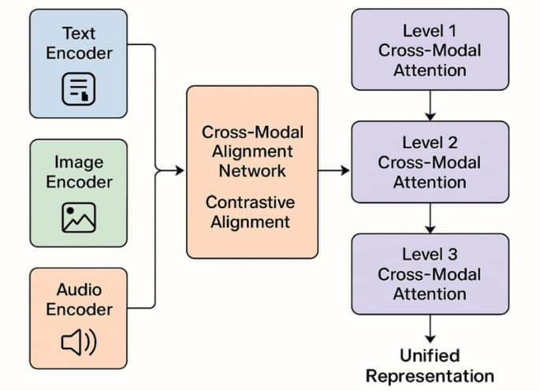
Multimodal AI Architecture
Text, image, audio inputs → Unified embeddings → Single model

Slide 5
Leading Multimodal Models (2026)
GPT-4V
Broad image understanding, creative tasks, diverse data
Claude 3.5
Document analysis, PDFs, charts, technical precision
Gemini 2.0
Native multimodal, real-time video, audio integration

Slide 6
GPT-4V: Vision Capabilities
Strength: Open-ended vision-language tasks
Use Cases: Image captioning, visual Q&A, meme interpretation
API: OpenAI integration, straightforward for existing users
Limitation: Less precise in highly technical domains

Slide 7
Claude 3.5: Document Intelligence
Specialization: Structured visual content (PDFs, charts)
Use Cases: Business docs, financial reports, technical diagrams
Precision: 77.2% SWE-bench Verified (coding + docs)
Trade-off: Less versatile for creative visual tasks

Slide 8
Gemini 2.0: Native Multimodal
Architecture: Text, image, audio, video from ground up
Real-time: Process multimodal inputs during conversations
Context: 2M+ token window (longest in 2026)
Best For: Collaborative workflows, temporal understanding

Slide 9
What Is Context Engineering?
Crafting the Information Architecture of Prompts
Definition: Designing how information is structured & presented to LLMs
Goal: Clear intent, reduced ambiguity, better outputs
Components: System prompts, examples, constraints, formatting

Slide 10
Core Principles
Eliminate Ambiguity: Be explicit, not vague
Provide Examples: Few-shot learning (2-5 examples)
Structure Output: Specify format (JSON, Markdown, lists)
Set Boundaries: Define what NOT to do

Slide 11
Bad Prompt Example #1
❌ Vague Request
Problem: No clear steps, tools undefined, output format missing

Slide 12
Good Prompt Example #1
✅ Explicit Instructions

Slide 13
Bad Prompt Example #2
❌ Underspecified Context
Problem: No language, no input/output types, no error handling

Slide 14
Good Prompt Example #2
✅ Idiomatic Style Specified

Slide 15
Bad Prompt Example #3
❌ Mixing Concerns
Problem: Three unrelated tasks → model confused about priority

Slide 16
Good Prompt Example #3
✅ Single Task Focus
Then: Create separate prompts for translation and quiz generation

Slide 17
System Prompts: Setting Agent Behavior
Persistent Instructions Across Conversation
Purpose: Define role, tone, constraints globally
Example: "You are a Python expert. Always use type hints."
Scope: Applies to all user messages in session

Slide 18
System Prompt Example
✅ Agentic System Prompt

Slide 19
Few-Shot Learning: Teaching by Example
2-5 Examples = Powerful Pattern Recognition
Zero-shot: No examples (relies on pretrained knowledge)
Few-shot: 2-5 input-output pairs guide behavior
Best Practice: Show diverse, canonical examples

Slide 20
Few-Shot Prompt Example

Slide 21
Structured Outputs: JSON, Markdown, Tables
JSON: For API responses, structured data extraction
Markdown: For documentation, formatted text
Tables: For comparisons, data grids
Tip: Specify exact schema in prompt

Slide 22
Structured Output Example

Slide 23
Guardrails: What NOT to Do
Negative Constraints: "Never include personal opinions"
Length Limits: "Keep response under 200 words"
Content Filters: "Avoid technical jargon, explain simply"
Safety: "Do not generate harmful or biased content"

Slide 24
Prompt Engineering Anti-Patterns
❌ Vague asks: "Make it better" (no criteria)
❌ Underspecified: Missing format, length, style
❌ Mixing concerns: Multiple unrelated tasks
❌ Edge case laundry list: Stuffing all exceptions

Slide 25
Managing Context Windows
Your Working Memory Budget
Problem: Long conversations = context overflow
Solution 1: Summarize and compress periodically
Solution 2: Use RAG to retrieve relevant chunks
Claude Code: Auto-compresses history + recent files

Slide 26
RAG: Retrieval-Augmented Generation
Technique: Fetch relevant docs from vector DB
Insert: Top-k results into prompt context
Benefit: Grounded answers without retraining
Tools: LangChain, LlamaIndex, Chroma, FAISS

Slide 27
Key Takeaways
Multimodal = Text + Image + Audio + Video (2026 standard)
Context engineering = Information architecture for prompts
Good prompts: Explicit, structured, example-driven
Avoid: Vague asks, mixed concerns, edge case overload

Slide 28
Hands-On Exercise (15 min)
Transform a bad prompt into a good prompt
Practice: Express route middleware generation
Repo: context-engineering-examples.md

