Slide 1
Mr. robot
IBM Mini project
Vth semester
GROUP-14

Slide 2
Objective
DESCRIPTION:
Mr robot VM has three keys hidden in different locations,
our goal is to find all three.
Link to download Mr. Robot-
Download (Mirror): https://download.vulnhub.com/mrrobot/mrRobot.ova
Download (Torrent): https://download.vulnhub.com/mrrobot/mrRobot.ova.torrent

Slide 3
MY SETUP
I am running a Windows OS with VMware Workstation installed.
2 virtual machines.
1- kali Linux
2- Mr robot (given by IBM)
a host-only network with DHCP enabled attached to these VMs.

Slide 4
TECHNIQUE USED
RECONNAISSANCE
WEB DIRECTORY ENUMERATION
BRUTE FORCE ATTACK
PRIVIEGE ESCALATION

Slide 5
TOOLS USED
netdiscover
Nmap
hydra
WPScan
MD5 converter

Slide 6
COMMAND USED
Cat
Find
Whoami
Ls
Nc-Lvp 443

Slide 7
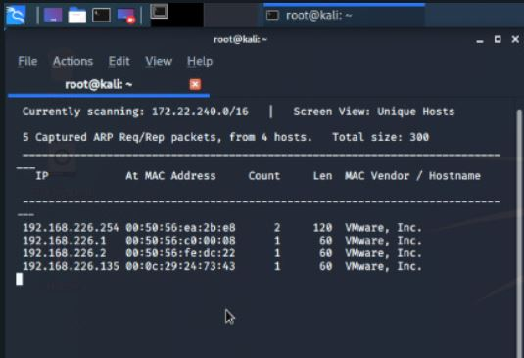
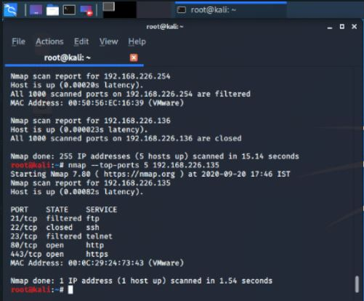
Reconnaissance
1. First, we need to identify the IP of this machine. We use netdiscover command for this.
2. Now we got the ip address so we will use nmap to enumerate the open ports of the host machine.

Slide 8
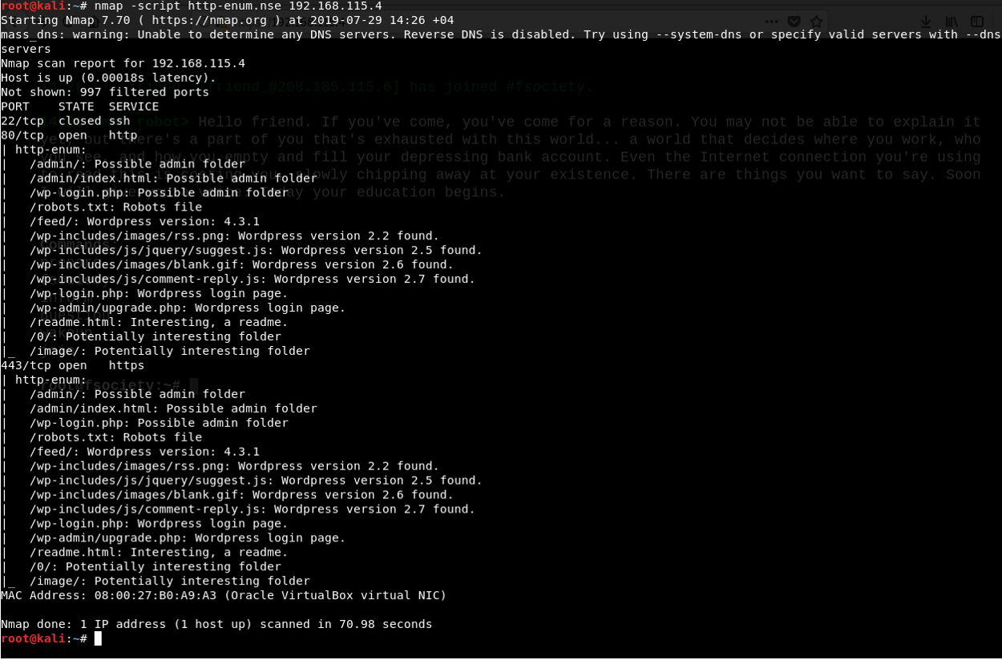
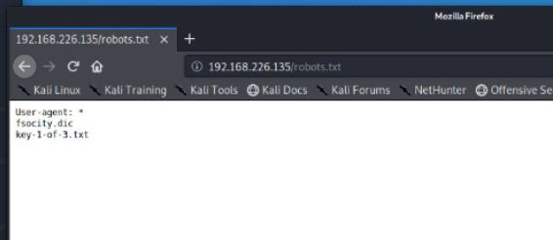
Web Directory Enumeration
3. I begin web directory enumeration using nmap with -script switch and the script as http-enum. Once complete, the result was a list of working sub-directories associated with the website hosted on the target.
4. From above result we get a hint from the creator of the target VM. and a file which include the 1st key. Look for known pages such as robots.txt.

Slide 9
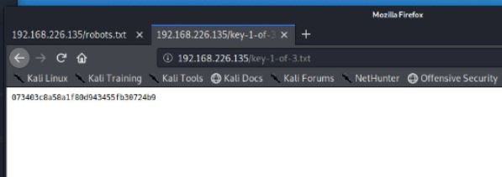
First key
5. The file located at http://192.168.1.100/key-1-of-3.txt is the first of the three keys in this CTF.

Slide 10

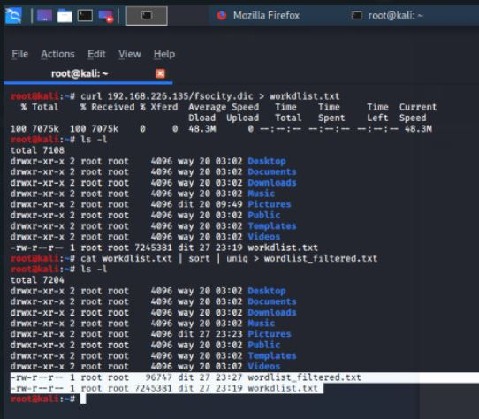
Another step
6. Trying out the 2nd file initiates a download of the file fsocity.dic. The file on inspection, is a wordlist with 858160 lines of words.

Slide 11
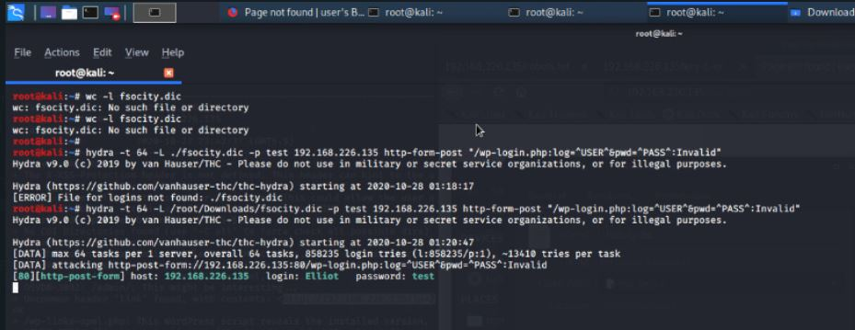
Brute force attack
7. To gain access to the WordPress admin panel, I need both the username and password. Since I have neither, I attempted to brute force my way in. I used the word-list fsocity.dic I receive previously.
For username- I used hydra to brute-force the username using the file fsocity.dic and a single word password. The parameter used can be derived from the source of the wp-login page. The username field is ‘log’ and password field is ‘pwd’. The response I tested against is “Invalid”.

Slide 12
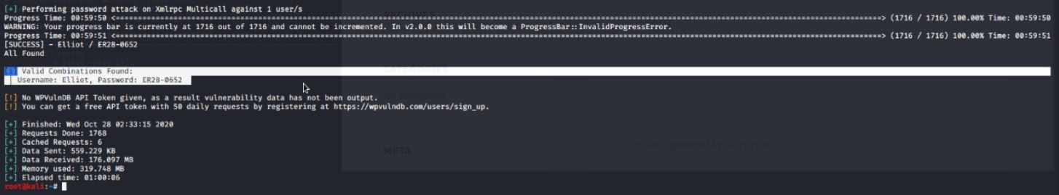
Brute force attack
For Password
Now that I knew the name of one of the accounts, I went back to the word list previously obtained and then passed this to WPScan to brute force the account using
wpscan –u 192.168.226.135 –username Elliot –wordlist /root/Downloads/fsociety-u.dics

Slide 13
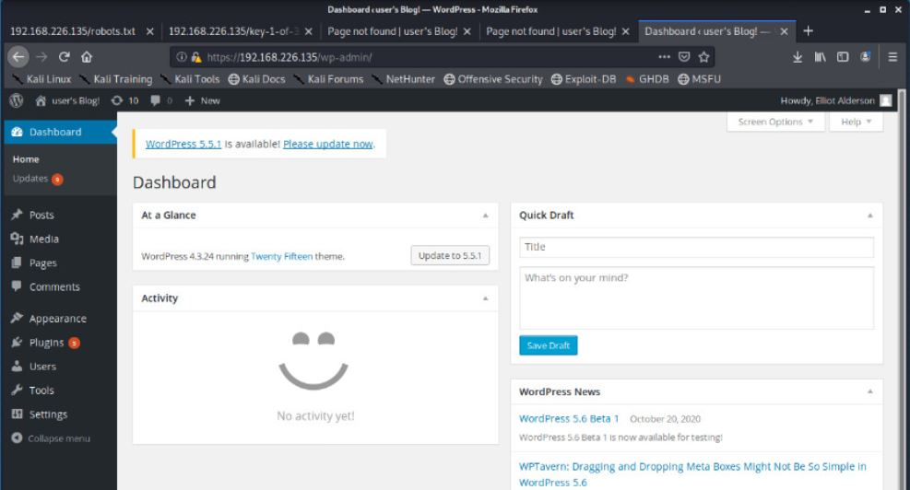
Brute force attack
8. Using Elliot’s information, we log into the site, and we see that Elliot is an administrator for this WordPress instance.

Slide 14
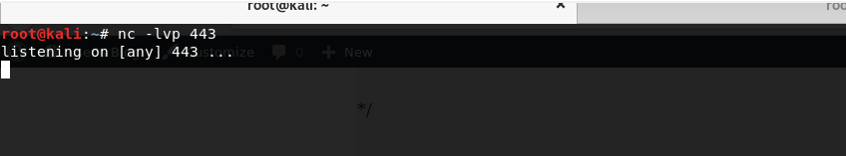
Brute force attack
9. I can exploit the WordPress administrator and I have received access to it’s ability to modify the page code. Once this is done and saved, I open up a terminal and type in nc -lvp 443 to listen for connection attempt from the target machine.
10. This initiates the session and give limited shell access on the target with user ‘daemon’.

Slide 15
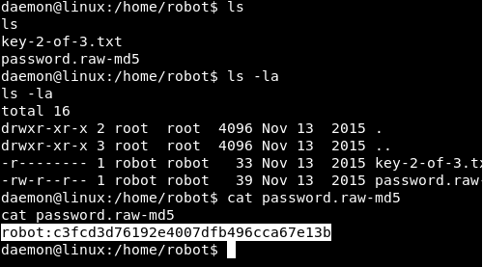
Brute force attack
11. Within this shell I am unable to access much or switch to another user, but I can navigate some of the file system. I navigate to /home directory and found a directory for the user robot. Within this directory, there are 2 files. One is the 2nd key to this box. The second file is a md5 password hash for the user robot. The file permission for the file key-2-of-3.txt does not allow read access except by the user robot. The password.raw-md5 file on the other hand can be read. I cat out the file, copied the hash string and had it reversed from here.

Slide 16
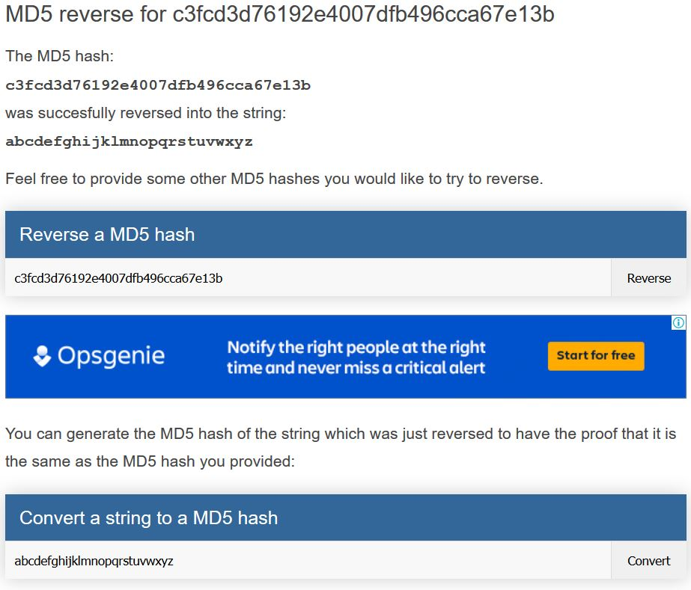
MD5 convert
12. After finding this, I did a reverse lookup of the MD5 hash, to find that the password for the robot account

Slide 17
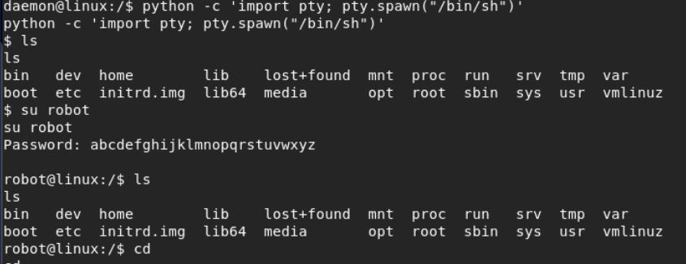
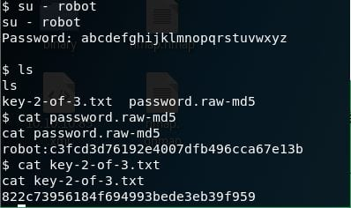
Brute force attack
13. Now that I had the credentials for the robot account, I dropped into a TTY shell, and switched to the robot user to access the second key .
14. And we got our second key

Slide 18
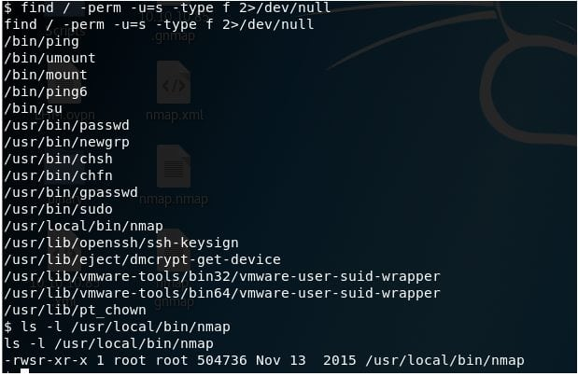
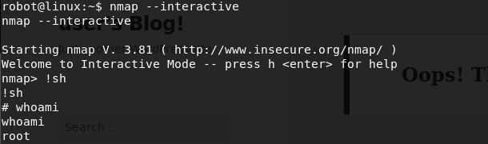
Privileged escilation
Following a super checklist here, I looked for a SUID bit set (which will run the binary as owner rather than who invokes it) and got a hit for nmap in /usr/local/bin.
16. Earlier versions of nmap had an interactive mode, which allowed execution of shell command within the interactive mode. In our case, the version on this MV allowed it. I entered the interactive mode, and open a new shell. On checking the user identity, I find that I am now functioning as root.

Slide 19

Privileged escilation
17. To retrieve the 3rd key, I searched for a file which has name beginning with ‘key-3-’. The 3rd key file is located in the root directory.
18. Catting out the file provides the 3rd and final key .

Slide 20

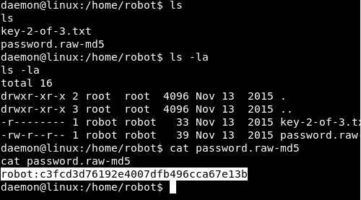
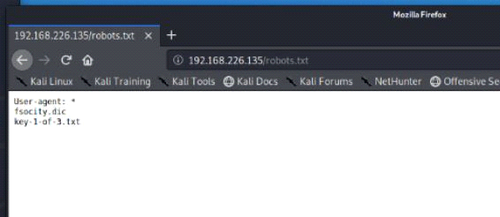
Extracted keys
1. The file located at http://192.168.1.100/key-1-of-3.txt
2. key-2-of-3.txt
3. Key-3-of-3.txt

Slide 21
result
In this CTF project we came to learn the usage and implementation of various tools and techniques for virtual machine penetration and reconnaissance and in order to extract information from VM.

Slide 22
GROUP – 14 > vikash gupta – 52 (181530056) > aadarsh Awasthi – 01 (181530001) > dhruv Awasthi – 11 (181530011) > aparmita – 07 (181530007)
THANK YOU

