Slide 1
Minor Project on
Stolen Motion Object Identification Using OpenCV

Slide 2
Contents
Abstract
Introduction
Existing System
Proposed System
Objectives
Modules
Sample Images
System Requirements
  Hardware Requirements
  Software Requirements

Slide 3
Abstract
This project proposes a new design and implementation method in supporting a smart surveillance system that can automatically identify abandoned and stolen objects in our homes or office and alert sms to our phones
The developing system is implemented by using image processing technique. In the circumstance such as when suspicious events have been detected.
In this project stolen object detection using python and opencv for the image processing or image capture.(stolen image)

Slide 4

Introduction
In this project we are identification the stolen objects. As we see that the during absence in the house means whenever we go out like tours, outings, parties. We left our home by locking the house(doors ,gates)
OpenCV is used in this project , it is a great tool for image processing and performing computer vision tasks. It is an open-source library that can be used to perform tasks like face detection, object detection and much more.
Using of Tkinter module is used for the interface of the application. Tkinter is standard used GUI(Graphical user interface)

Slide 5
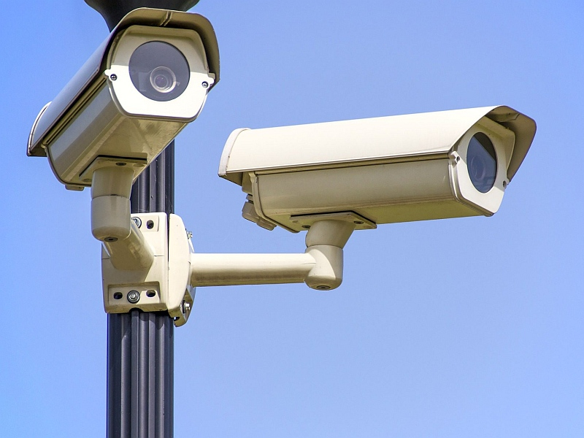
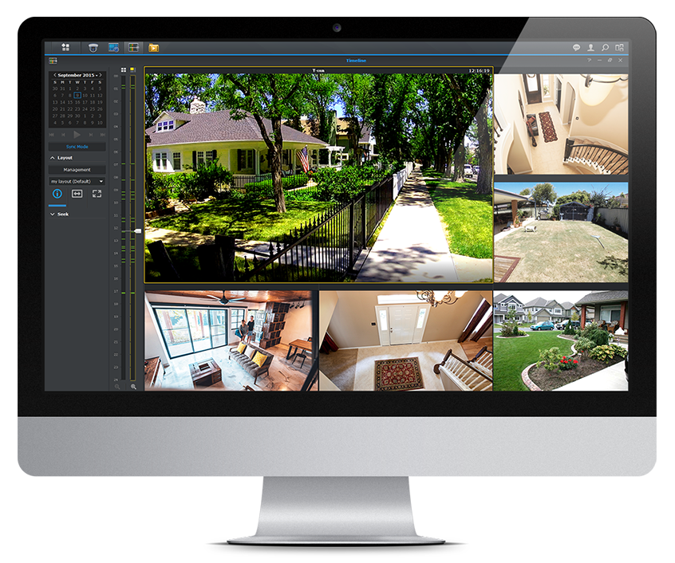
Existing System
In previous, the cctv surviellence are used in this cctv surviellence only the video is recorded.
If any robbery occur, after we known the robbery as ocuured we will see the cctv recorded video upto that time we don’t know that the robbery is has occurred.

Slide 6
Proposed System
In this project by seeing the real-time incidents. Compared to existing system not only recoding of the cctv, I am going to implement the object stolen identification.
By using opencv(computer vision) it gone be identify the object which as be stolen or the object is invisible.
Motion of an stationary object.
And Send Alert SMS to our phones

Slide 7
Objective
Our Moto is to develop a application on stolen object identification. Where we will leave our homes in occasion times or office at that time we don’t know that the robbery is going to be happened. Also we have cctv but it will only record. In this by motion of object it gone be identify and send sms to our phones By using of opencv the object gone identify. And we develop a interface in this project.

Slide 8
Modules
Tkinter : Tkinter is the standard GUI library for Python. Python when combined with Tkinter provides a fast and easy way to create GUI applications. Tkinter provides a powerful object-oriented interface to the Tk GUI toolkit. Creating a GUI application using Tkinter is an easy task.
Time : The Python time module provides many ways of representing time in code, such as objects, numbers, and strings. It also provides functionality other than representing time, like waiting during code execution and measuring the efficiency of your code.
Skimage : It can crop images. We crop images to remove the unwanted portion of the image or to focus on a particular part of the image.

Slide 9
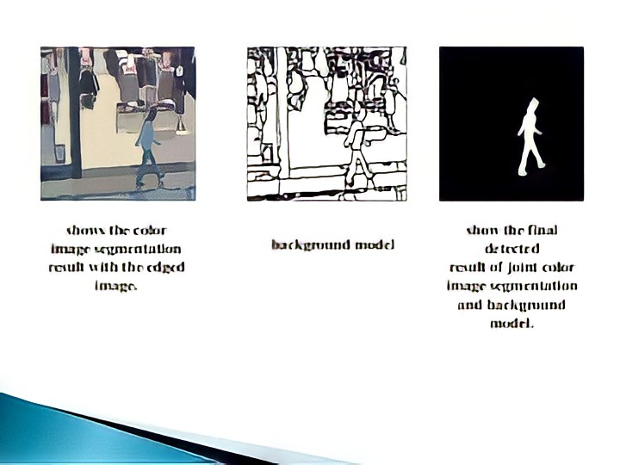
Opencv : It is huge source library for computer vision, image processing. It can process to identify objects, faces, or even the handwriting of a human
Cv2 –python makes use of numpy, which is highly optimized library for numerical operations.

Slide 10

Tkinter
Skimage

Slide 11
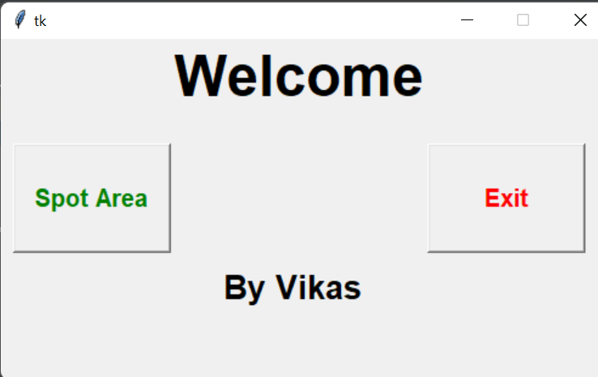
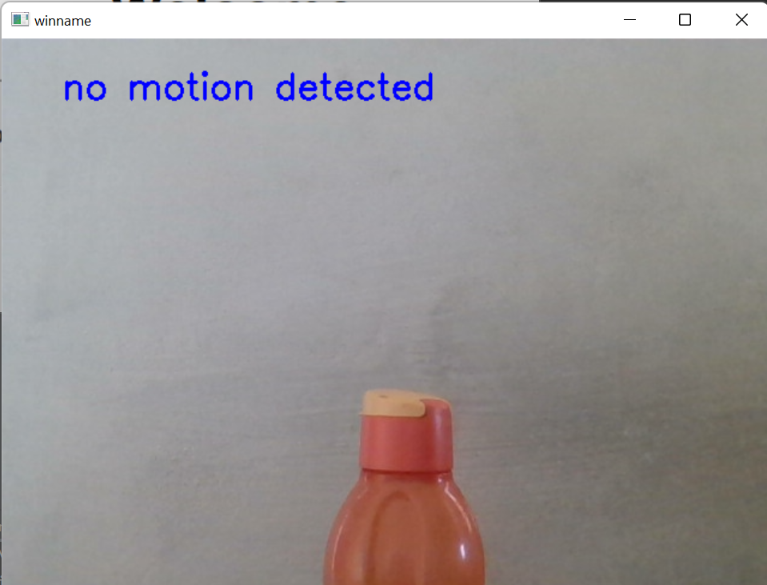
Sample Images

Slide 12
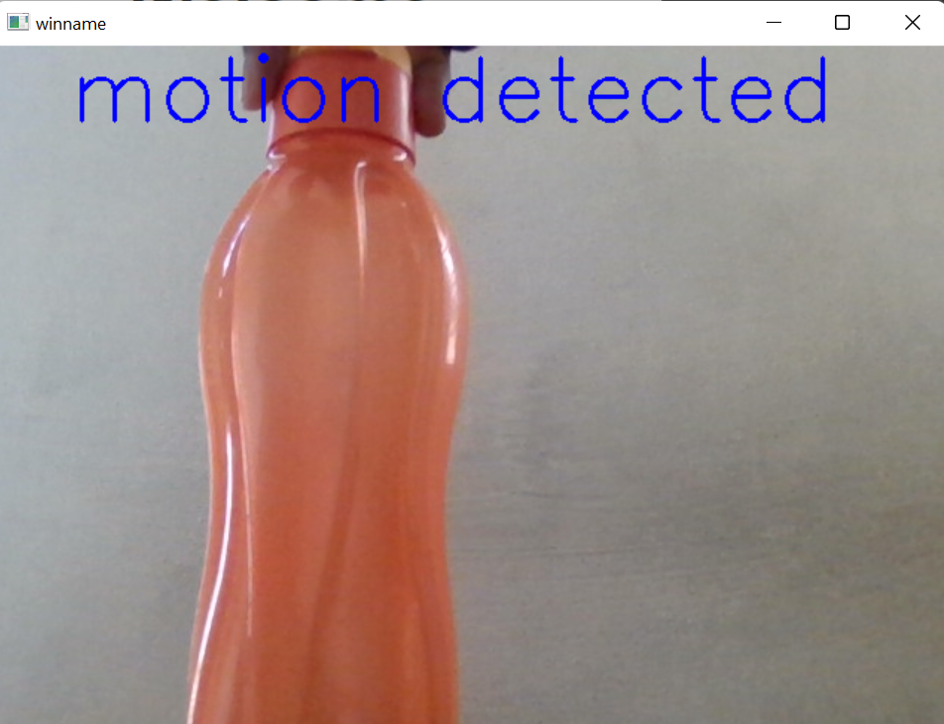
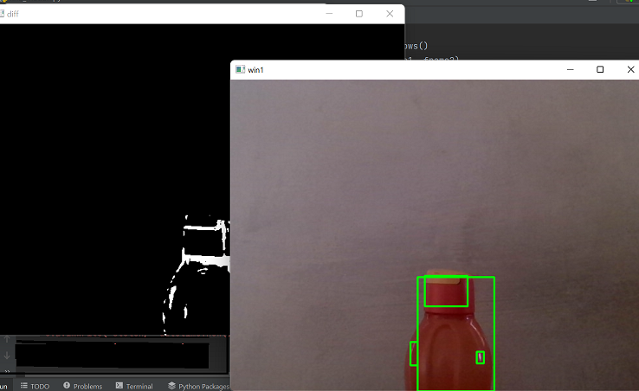
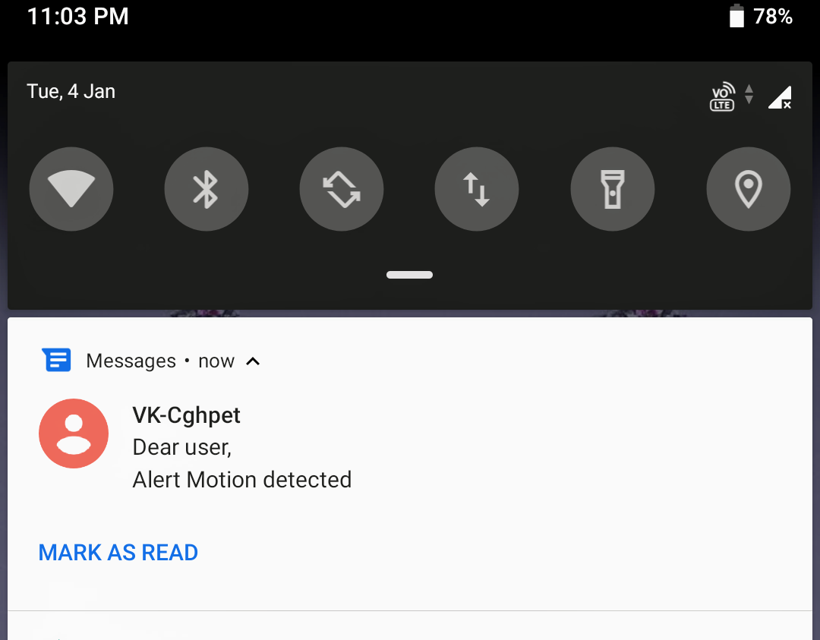

Slide 13
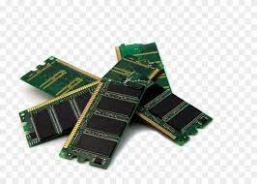
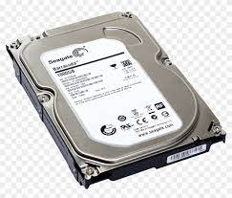
System Requirements
Hardware Requirement
Processor Speed : 2.4GHz
Ram : 4GB DD Ram
Hard Disk : 250GB

Slide 14

SR
Software Requirements
Operating System : Windows(7/8/10)
Platform : Pycharm
Programming Language : Python.

Slide 15


