Slide 1
Stock Price Prediction using LSTM
.

Slide 2
Project Goal
• Build a model to predict stock prices using past historical data.
• Use LSTM (Long Short-Term Memory) for time-series forecasting.
• Visualize predictions and analyze performance.

Slide 3
Data Acquisition
• Data fetched using yfinance library.
• Stock chosen: Apple (AAPL).
• Date range: 2020–2024.
• Columns: Open, High, Low, Close, Volume.

Slide 4
Data Preprocessing
• Flattened multi-index column names.
• Selected 'close' price for prediction.
• Scaled values using MinMaxScaler (0–1 range).
• Created 60-day look-back sequences.

Slide 5
Sequence Preparation
• Converted scaled data into (X, y) form.
• X = previous 60 days' prices.
• y = next day price.
• Reshaped X into 3D for LSTM: (samples, 60, 1).

Slide 6
LSTM Model Architecture
Layer 1: LSTM(50 units, return_sequences=True).
Dropout(0.2).
Layer 2: LSTM(50 units).
Dropout(0.2).
Output: Dense(1).
Loss: Mean Squared Error.
Optimizer: Adam.

Slide 7
Evaluation Results
These are the results after training the model.
Root Mean Squared Error (Train): 4.14
Root Squared Mean Error(Test): 3.85
Indicates good fit with minimal overfitting.

Slide 8
Visualization
Plotting the stock price prediction
Train predictions track historical trend well.
Test predictions closely follow actual trend.

Slide 9
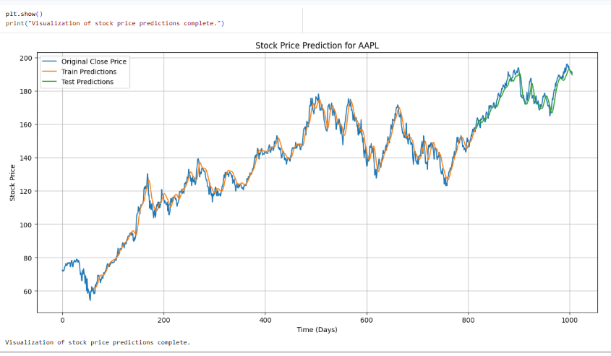

Slide 10
Summary & Future Improvements
Complete ML pipeline built successfully.
LSTM performs well on stock time-series.
Future ideas:
Add technical indicators (RSI, MACD).
Use GRU / Bi LSTM / Transformer models.
Multi-feature model (Open, High, Low, Volume).

Slide 11
-:Thank You:-
NAME: VIKAS DEV PANDEY
(BTECH-CSE)
ROLL NUMBER: 22150050022

