Slide 1
FEVOURD-K × UiPATH · AGENTHACK 2026
ImpactOps Maestro
The agentic back-office for NGOs & CSR — read, act, escalate, write back.
Team Fevourd-K — Vikas Chandra Guru · Kavan Kumar KR · Nithin Annaiah · Hemanth Gowda AP

Slide 2
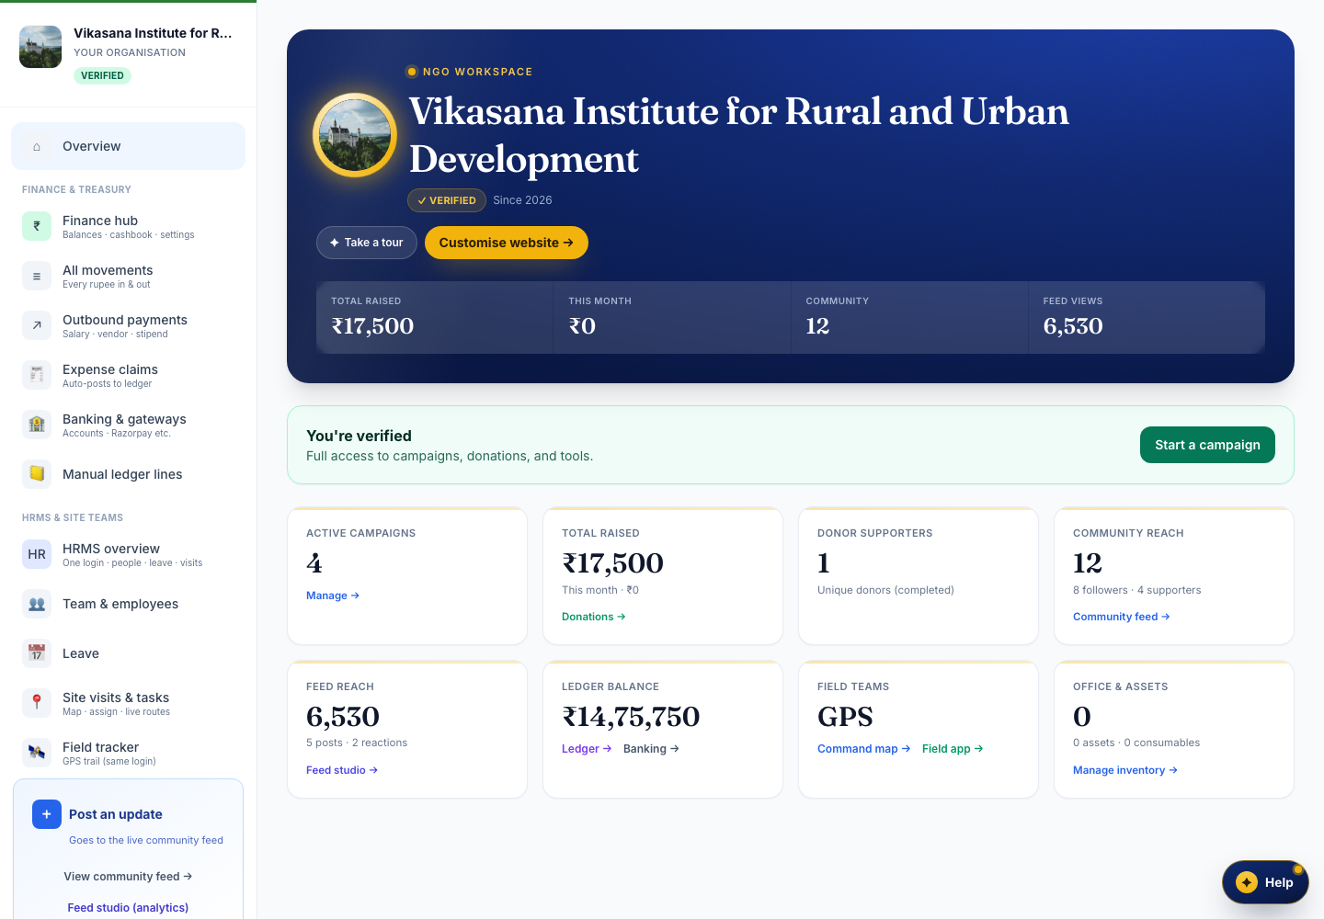
NGOs lose days to back-office paperwork
Compliance renewals, campaign updates, field proof, finance claims, and CSR reports — repeatable, rules-based chores with occasional judgment calls, scattered across disconnected tools.
6
5×
staff-days / month lost to manual busywork
disconnected tools & spreadsheets

Slide 3
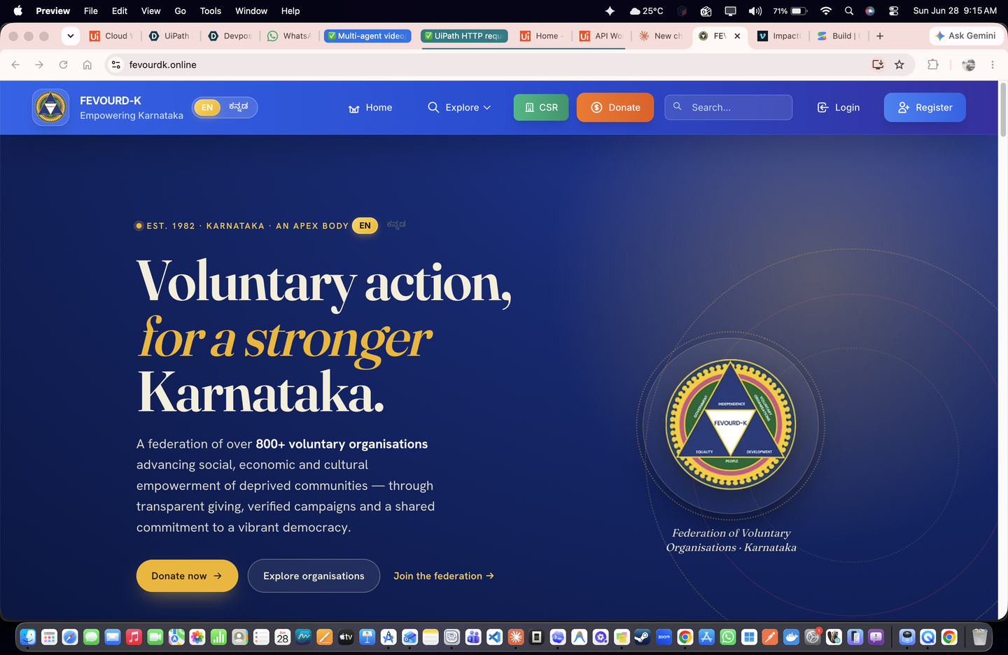
An agentic layer on the system of record
ImpactOps Maestro is a UiPath Maestro process running six workflows on top of Fevourd-K. It reads live state, runs the repeatable work, escalates only the judgment calls, then writes the result back.
1
Read
→
2
Act
→
3
Escalate
→
4
Write back

Slide 4
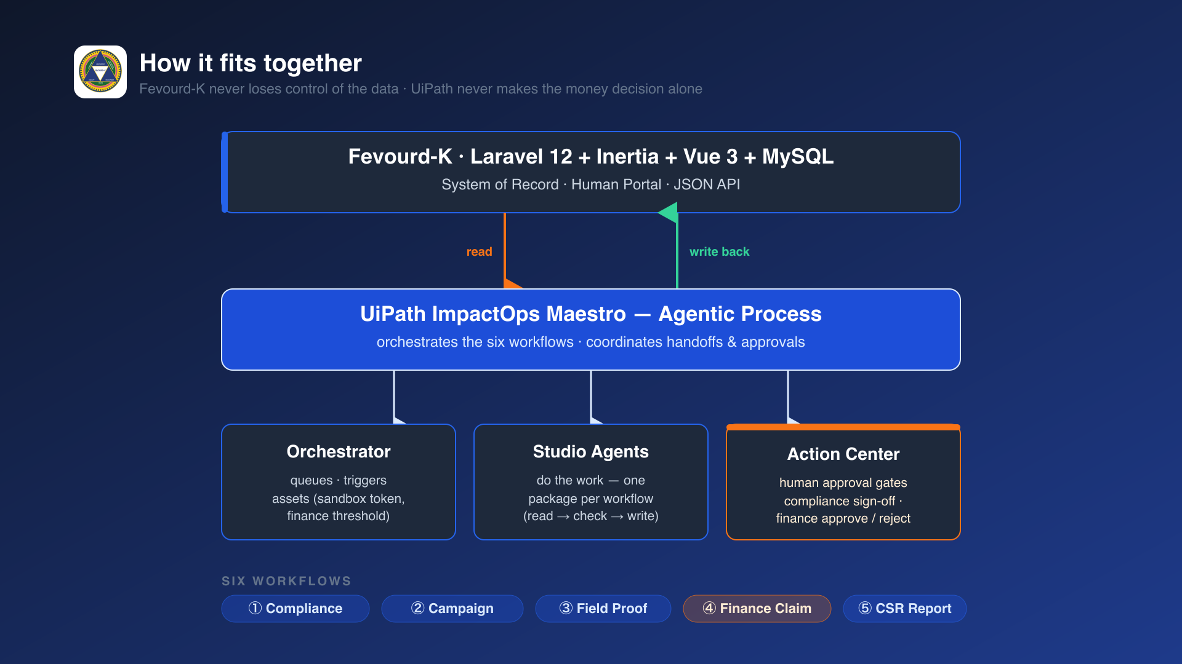
How we harness UiPath
Fevourd-K = system of record · UiPath Maestro = agentic layer · Action Center = human gates

Slide 5
UiPath components
Maestro | Runs the ImpactOps Maestro agentic process (6-node flow + human-approval nodes)
Studio | One package per workflow: Compliance, Campaign, Field Proof, Finance, CSR
Orchestrator | Folder Fevourd-K-Demo: queues, credential + config assets, event + cron triggers
Action Center | Human-in-the-loop gates: compliance sign-off, finance approve/reject
API Workflows | Agents read Fevourd-K state and write results back over JSON APIs
Agent Type: Low-code Agents (Studio + API Workflows + Maestro + Action Center). No Coded Agents.

Slide 6
Six workflows, one loop
1
Compliance Review
2
Campaign Draft
3
Field Proof
checks renewal docs, routes to sign-off
assembles donor updates as drafts
verifies GPS trails against sites
4
Finance Claim
5
CSR Report
6
Maestro Process
checks claims, escalates over-threshold
assembles verified impact summaries
orchestrates the handoffs + approvals
Every workflow runs the same loop: perceive → act → escalate → write back.

Slide 7
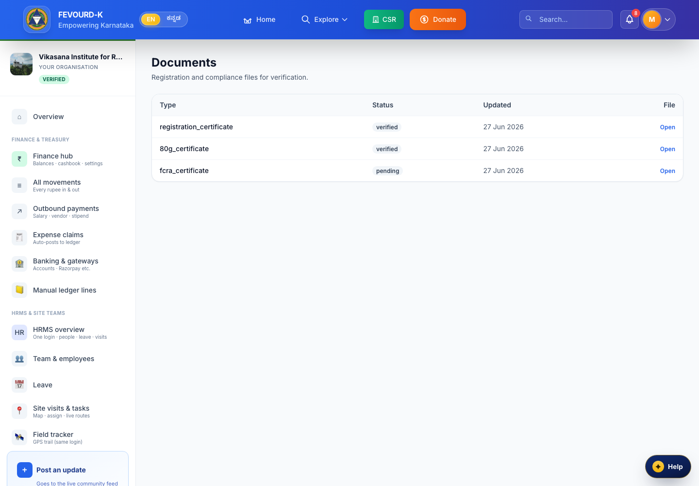
1
Compliance Review — human sign-off
Pulls NGO 12A/80G renewal documents, checks expiry, mandatory fields, and registration status, then routes a clean summary to a compliance officer in Action Center. One click signs off — and the status writes straight back into Fevourd-K.

Slide 8
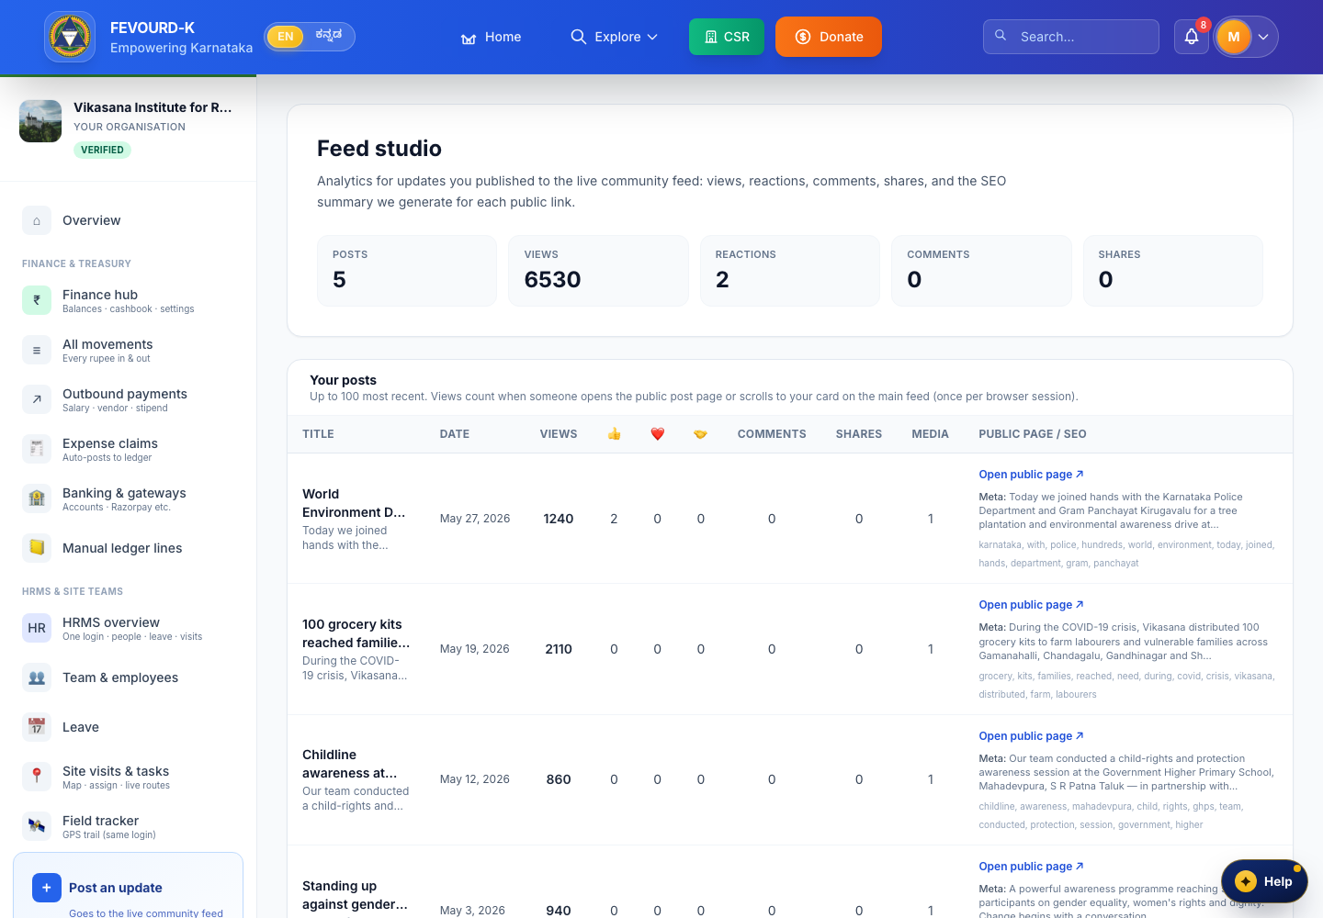
2
Campaign Draft — control stays human
Reads the latest campaign and field progress and assembles a donor-ready update — copy, impact numbers, hashtags. It stops at a draft, never auto-posted. The NGO reviews and schedules.

Slide 9
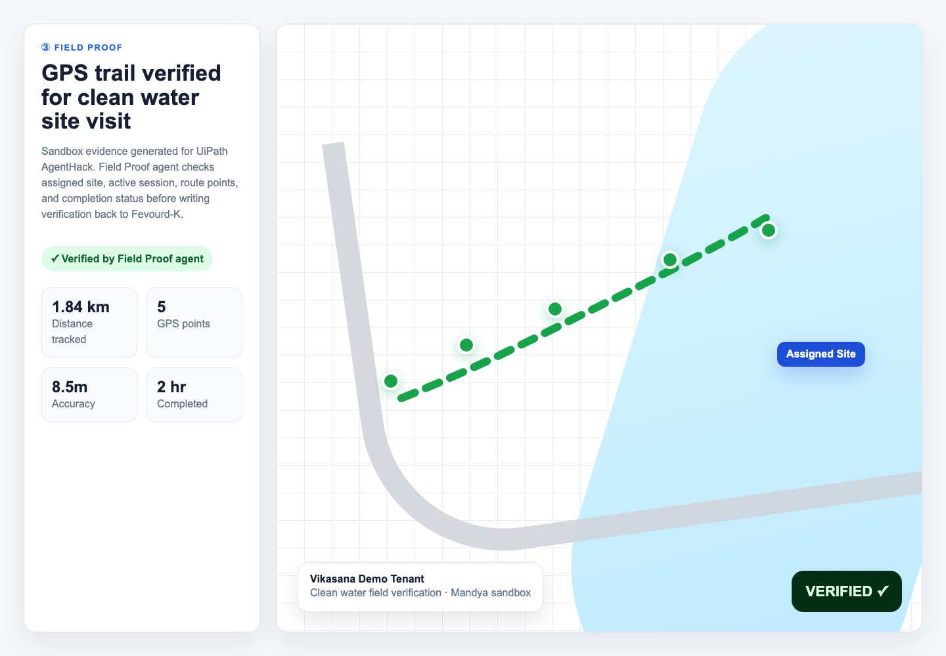
3
Field Proof — verifiable, not self-reported
Verifies a field session's live GPS trail against the assigned site and confirms completion, then marks the task Verified — proof a funder can trust.

Slide 10
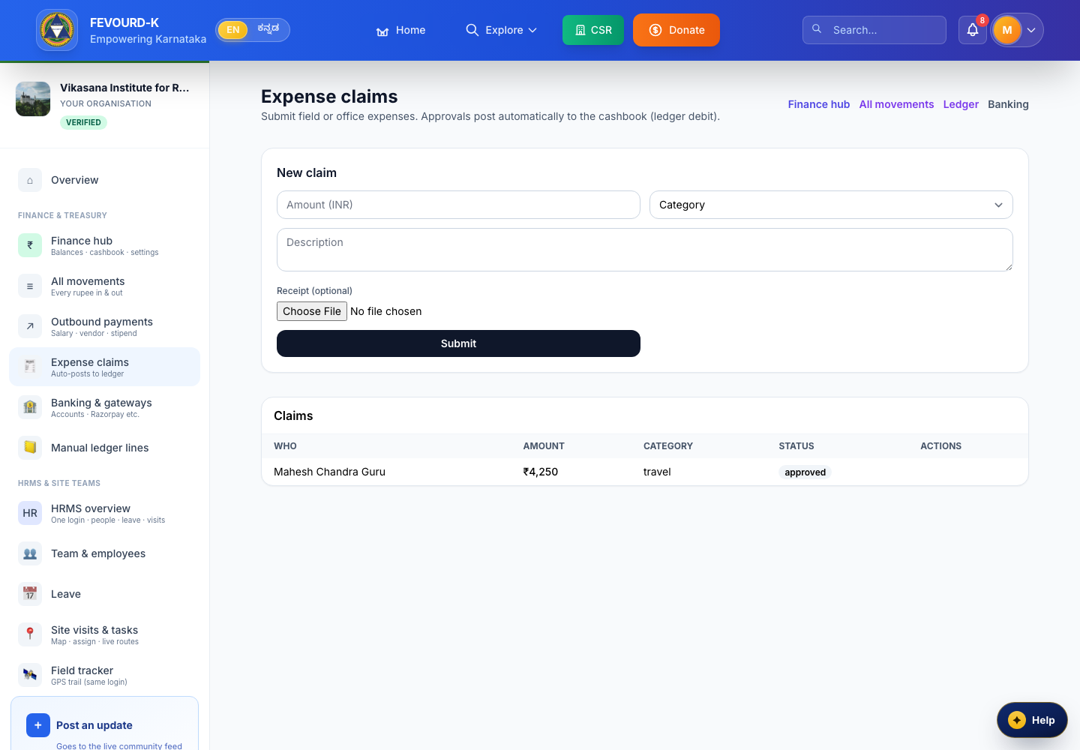
4
Finance Claim — money is always human
Checks each expense claim against the budget line and policy limits. Over threshold, it escalates to Action Center for Approve/Reject. On approval, the entry posts straight to the NGO ledger — no manual re-keying.

Slide 11
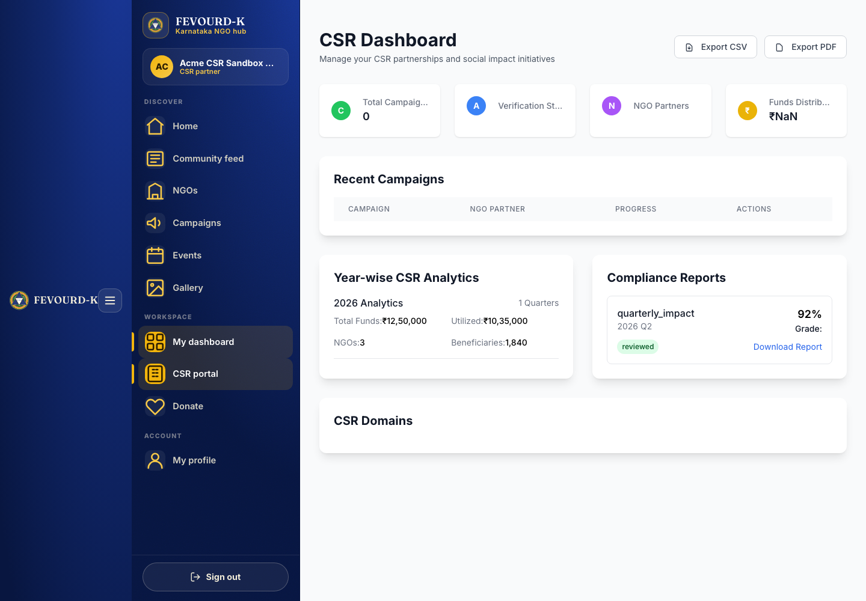
5
CSR Report — on demand
On a schedule, the CSR agent gathers verified field proof, approved spend, and compliance status into one CSR-ready summary — every number traceable to a verified source. A week of chasing teams becomes ready on demand.

Slide 12
The line we never cross
Fevourd-K never loses control of the data.
UiPath never decides the money alone.
Money and compliance are mandatory human approvals via Action Center. Lower-risk steps run unattended — agentic never means unsupervised where it matters.

Slide 13
Real platform, real impact
1,240
12
SDG 6
₹14.75L
beneficiaries reached
villages GPS-verified
clean water & sanitation
tracked, full audit trail
Built over ~4.5 months — 44 commits since Feb 2026. ImpactOps Maestro is the UiPath agentic layer on top of a real, maturing platform.

Slide 14
Team Fevourd-K
Vikas Chandra Guru
Architect
Kavan Kumar KR
Senior Full-Stack Developer
Nithin Annaiah
Senior Full-Stack Developer
Hemanth Gowda AP
Tester / QA
Live demo: fevourdk.online Code: github.com/vikas-guru/fevourdk
ImpactOps Maestro — the agentic back-office for social impact.

