Slide 1
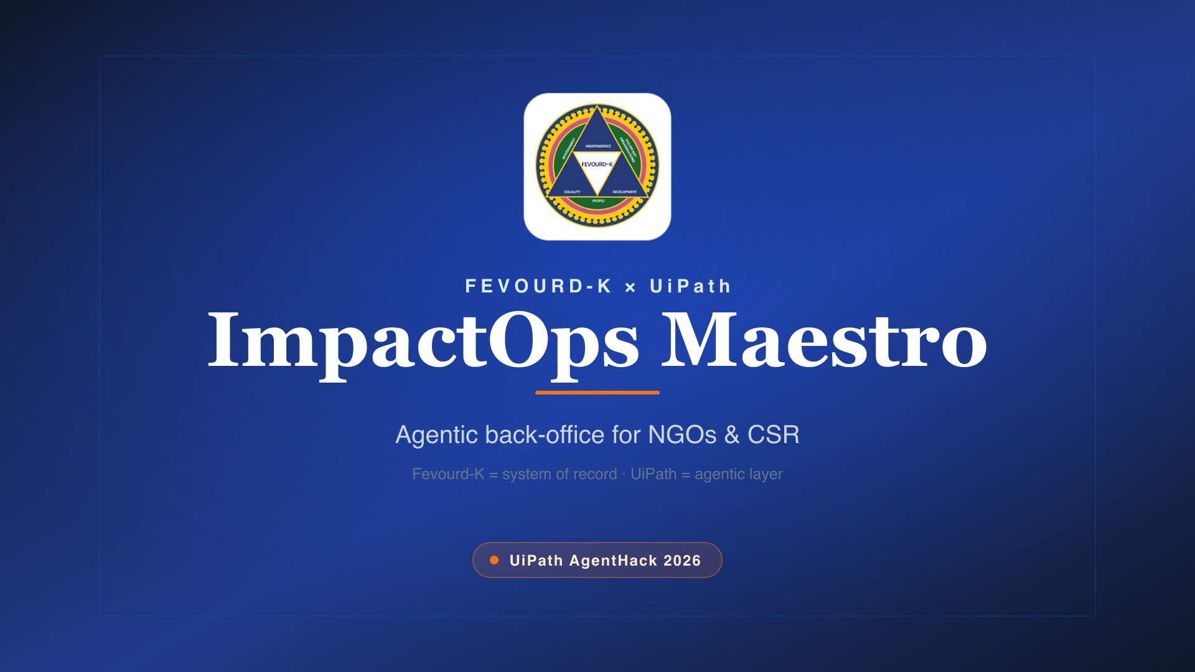

Slide 2
THE GAP
The system is modern. The operations are still manual.
Compliance
Chasing renewal documents & expiry dates
~6
Campaigns
Hand-writing every donor / CSR update
recurring staff-days / month
of cross-tool busywork
Field proof
Eyeballing photos with no verifiable trail
Finance
Re-keying receipts into ledgers by hand
CSR reports
A week of email threads to assemble one report
These are rules-based chores with occasional judgment calls — the exact shape of agentic automation.

Slide 3
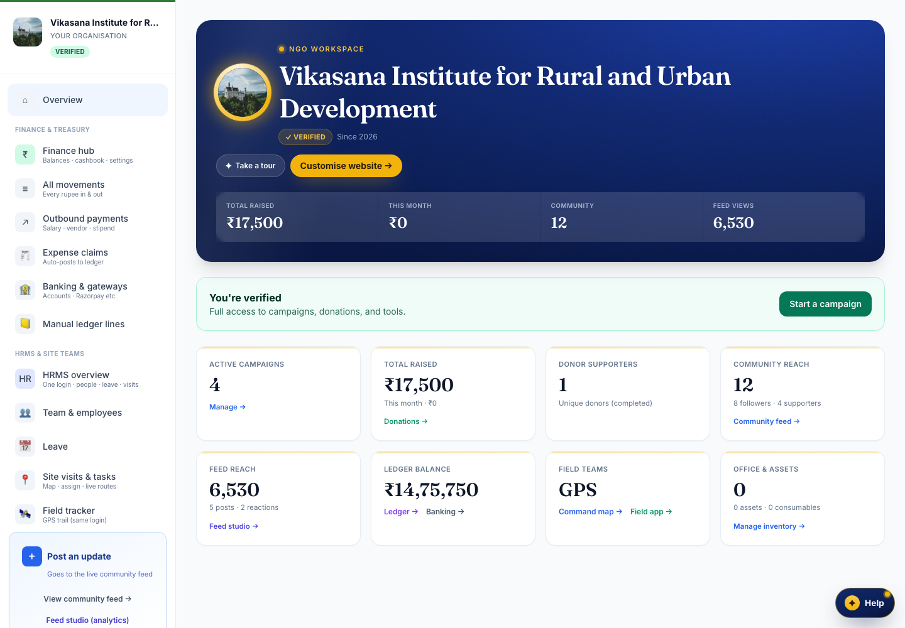
ONE REAL NGO, ONE REAL CAMPAIGN
Vikasana: Clean Drinking Water for Mandya Villages
A Karnataka NGO on Fevourd-K runs a live fundraising campaign — borewells and water filters for villages in Mandya district. We follow this one campaign through all six agentic workflows.
₹5.12L
12
Acme CSR
raised of ₹8.0L target
village field sessions
GPS-verified
corporate funder
(sandbox)
Demo / sandbox tenant — fake amounts & redacted PII. No production data.

Slide 4
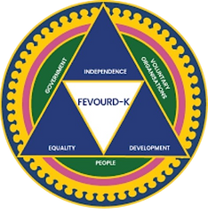
THE MODEL
Fevourd-K is the system of record. UiPath ImpactOps Maestro is the agentic layer.
1
2
3
4
→
→
→
Read
Act
Escalate
Write back
live state from Fevourd-K
run the repeatable work
judgment calls to a human
results into the record
A closed perceive → act loop, coordinated by Maestro — humans only where it matters.

Slide 5
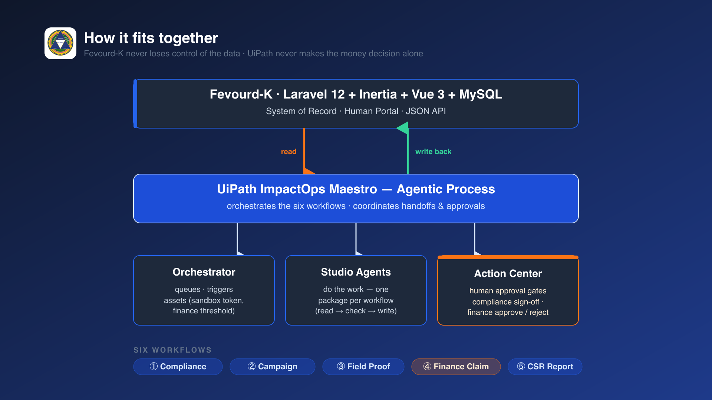

Slide 6
WHAT MAESTRO ORCHESTRATES
Six workflows, one agentic process
1
Compliance Review
2
Campaign Draft
3
Field Proof
Checks renewal docs, expiry, status → human sign-off
Assembles a donor-ready update as a draft
Verifies GPS trail & completion evidence
4
Finance Claim
5
CSR Report
6
Maestro Process
Policy check → human approve → posts to ledger
Gathers verified proof into one summary
Coordinates handoffs + approvals across all

Slide 7
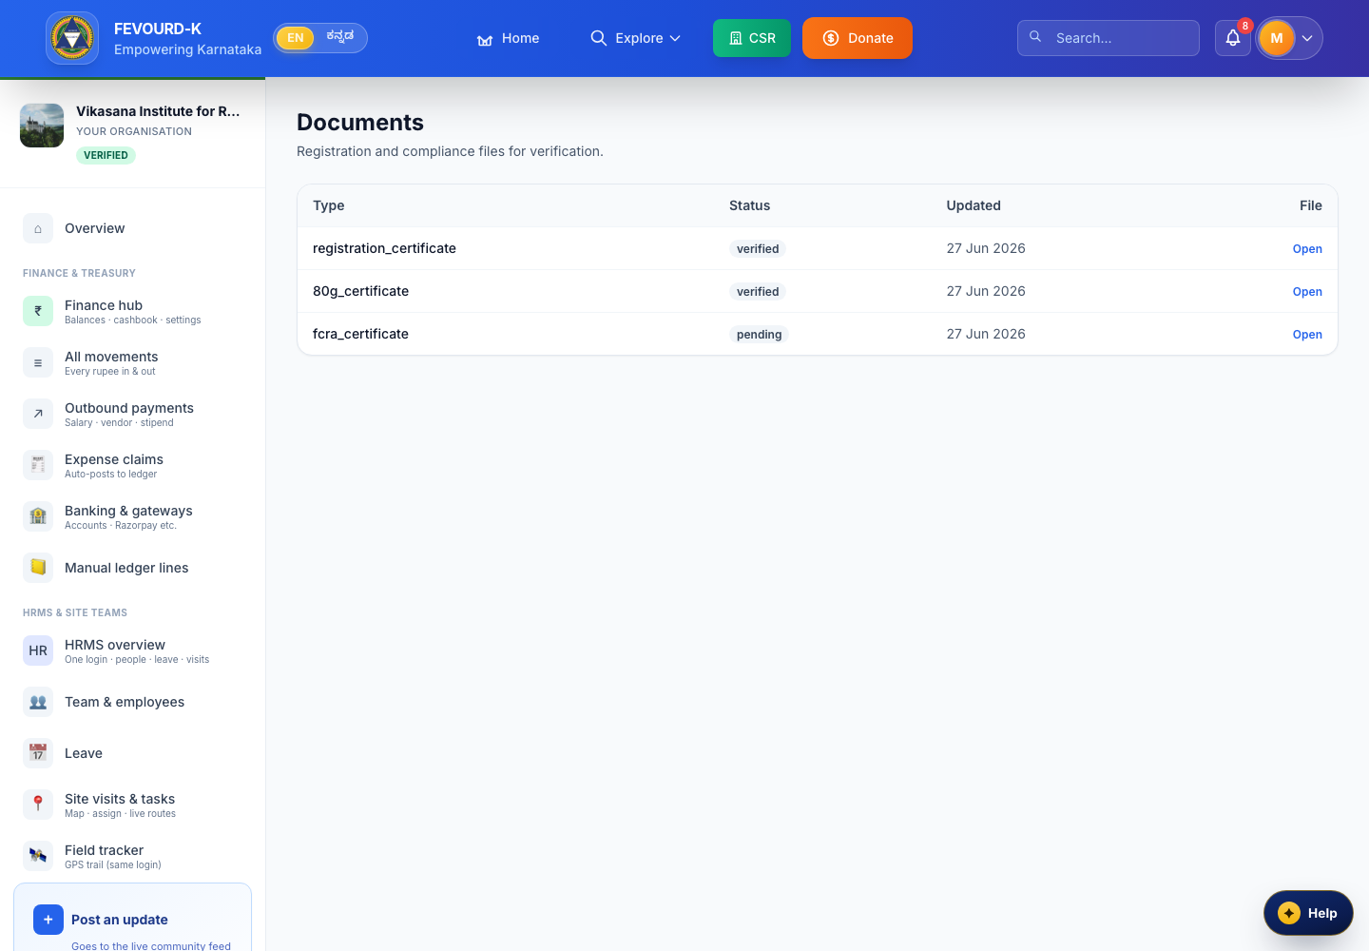
1
Compliance Review
Vikasana's 12A/80G renewal docs, checked automatically
READ
Pulls registration docs from Fevourd-K via API
ACT
Validates expiry, mandatory fields, status
ESCALATE
Flags one doc expiring soon → officer
WRITE BACK
Status flips to “Reviewed” in Fevourd-K
Human signs off in UiPath Action Center — one click.

Slide 8
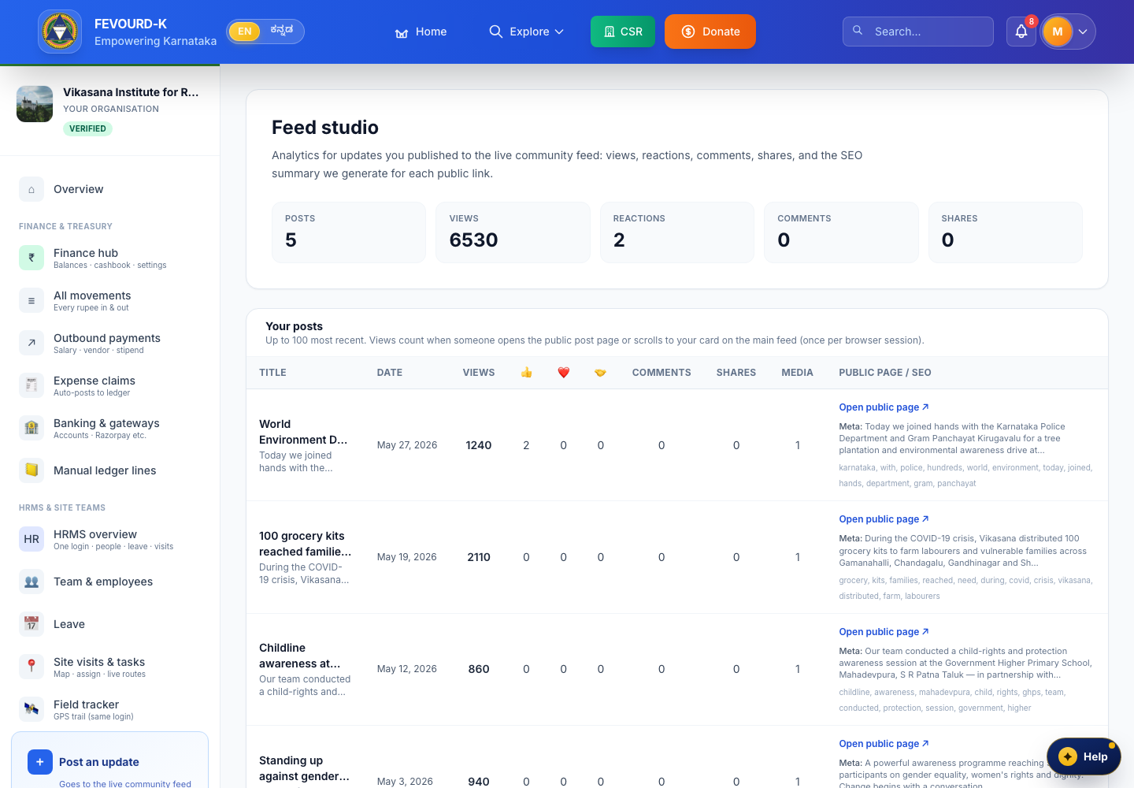
2
Campaign Draft
A donor update for the water campaign — drafted, not posted
READ
Latest campaign + field progress (₹5.12L raised)
ACT
Writes copy, impact numbers, hashtags
DRAFT
Lands in Feed Studio as an editable draft
HUMAN
NGO reviews & schedules — keeps control
Agent writes; the NGO keeps editorial control — never auto-posts.

Slide 9
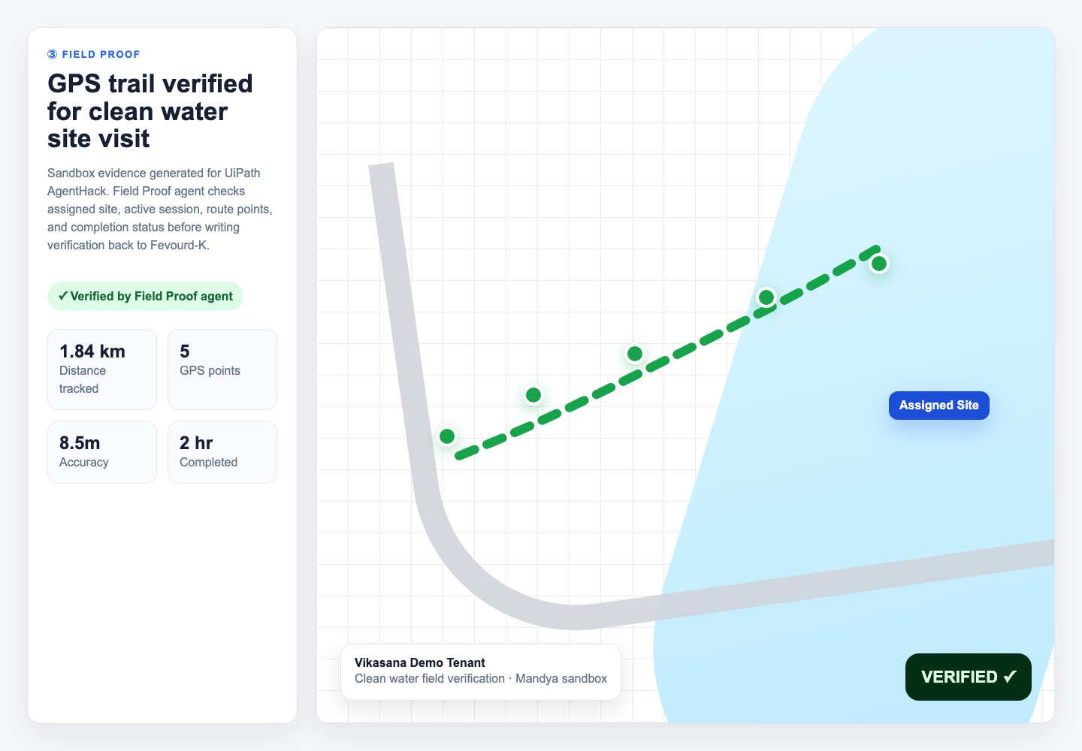
3
Field Proof
Borewell visit in Mandya — verified by GPS trail, not a photo
READ
Field session + GPS trail points from the app
ACT
Checks active session vs. assigned village
VERIFY
Confirms the task was actually completed
WRITE BACK
Task badge flips to “Verified ✓”
Verifiable proof for funders — not self-reported.

Slide 10
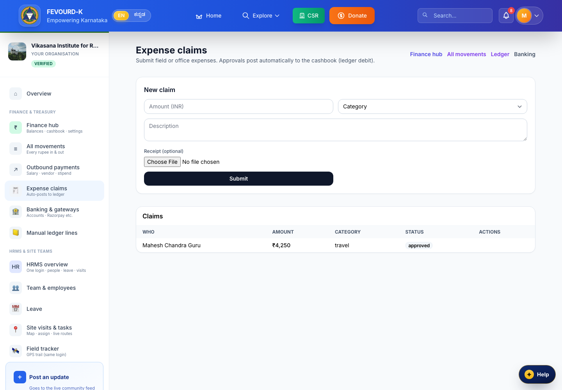
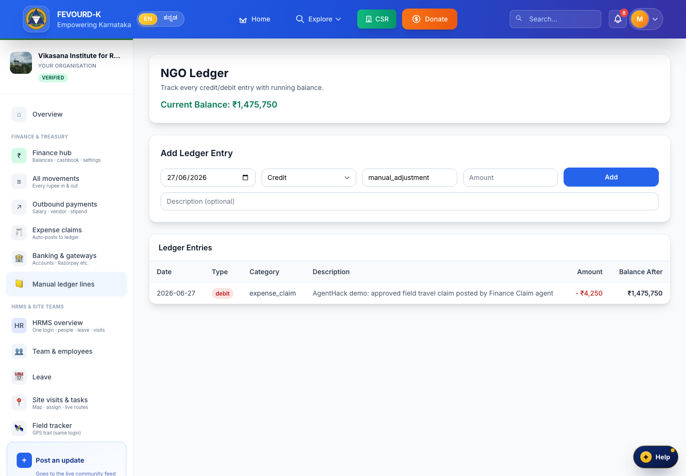
4
FINANCE CLAIM · THE HERO FLOW
₹4,250 field-travel claim → human approval → posted to ledger
Claim + receipt
→
Approve / Reject
→
Posted to ledger
Fevourd-K /ngo/finance/claims
UiPath Action Center (human)
Fevourd-K /ngo/ledger
Real bidirectional integration, end-to-end — no manual re-keying. Money decisions are always human.

Slide 11
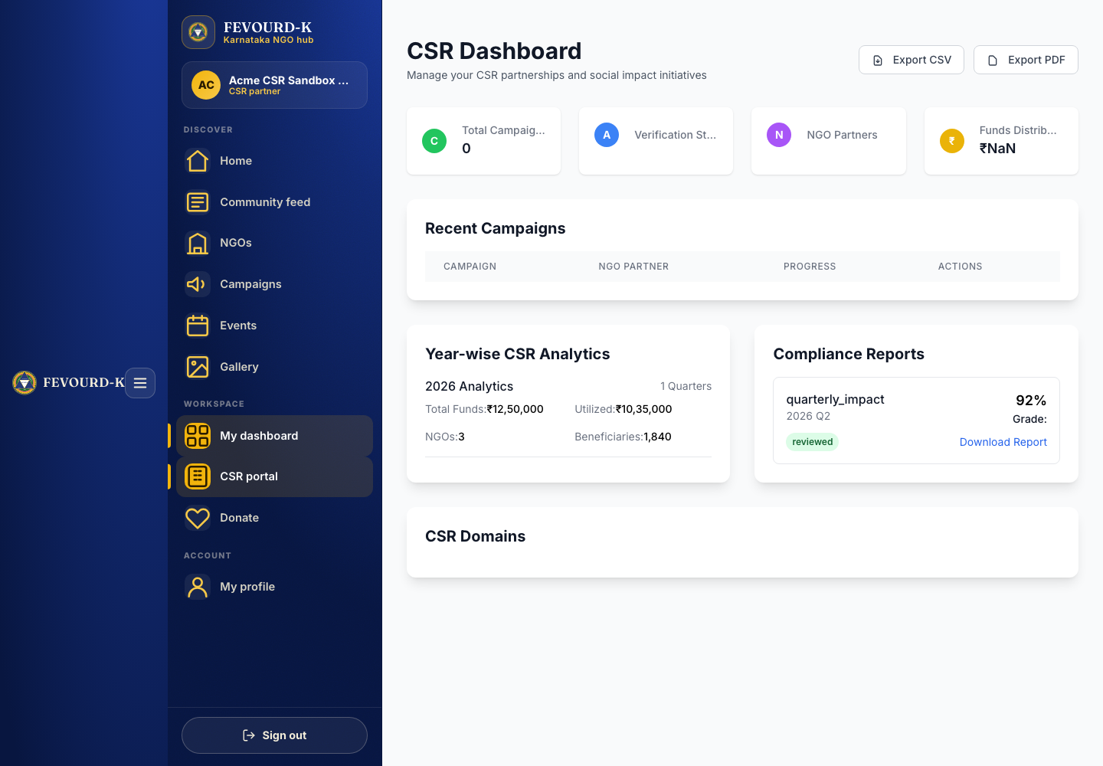
5
CSR REPORT
Acme CSR's quarterly impact report — assembled on demand
On a schedule, the CSR Report agent gathers verified field proof, approved spend, and compliance status from Fevourd-K into one CSR-ready summary — every number traceable to a verified source.
1,240
SDG 6
0 days
beneficiaries
reached
clean water &
sanitation
report time —
was ~1 week
What used to take a week of chasing teams is ready in seconds, with a full audit trail.

Slide 12
WHY IT'S TRUSTWORTHY & WHAT'S NEXT
Agentic ≠ unsupervised
🔒 Compliance sign-off
🔒 Finance approve / reject
every finding → human in Action Center
every claim over threshold → human
Built with
UiPath Maestro · Studio · Orchestrator · Action Center │ Laravel 12 · Inertia · Vue 3 · MySQL · Tailwind
What's next
Donor reconciliation + grant-milestone workflows
Multi-NGO tenancy (per-NGO Orchestrator folders)
Confidence scoring — auto-approve only the clearest cases
In-app trust dashboard: every agent action + approver

Slide 13
