Slide 1

DPC++ Programming
Day 5

Slide 2
Contents
Intel oneAPI and DPC++ Fundamentals
Unified shared memory
Parallel processing
Logical Programming (Exercises)

Slide 3
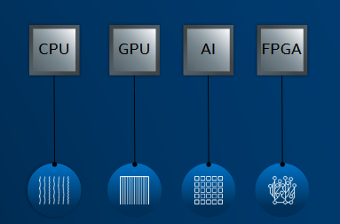
Programming Challenges
Diverse set of data centric Hardwares
No common programming languages or APIs
Each platform requires unique software

Slide 4
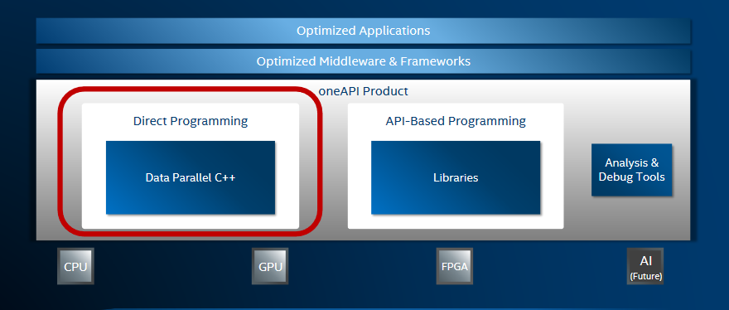
OneAPI

Slide 5
OneAPI
The Intel® oneAPI Base Toolkit (Base Kit) is a core set of tools and libraries for developing high-performance, data-centric applications across diverse architectures
Why oneAPI?
Freedom of choice for accelerated computing across multiple architectures: CPU, GPU, and FPGA
An open alternative to proprietary lock-in
Data Parallel C++ (DPC++)—an open, standards-based evolution of ISO C++ and Khronos SYCL*
Optimized libraries for API-based programming
Advanced analysis and debug tools

Slide 6
What is DPC++
Data Parallel C++ (DPC++) is oneAPI's implementation of SYCL compiler. It takes advantage of modern C++.
Programmers use familiar C++ and library constructs with added functionalities like a queue for work targeting, buffer for data management, and parallel_for for parallelism to direct which parts of the computation and data should be offloaded.
Data Parallel C++ = C++ and SYCL* standard and extensions

Slide 7
Complete DPC++ Program
#include <CL/sycl.hpp>
using namespace sycl;
static const int N = 16;
int main(){
//# define queue which has default device associated for offload
queue q;
std::cout << "Device: " << q.get_device().get_info<info::device::name>() << "\n";
//# Unified Shared Memory Allocation enables data access on host and device
int *data = malloc_shared<int>(N, q);
//# Initialization
for(int i=0; i<N; i++) data[i] = i;
//# Offload parallel computation to device
q.parallel_for(range<1>(N), [=] (id<1> i){
data[i] *= 2;
}).wait();
//# Print Output
for(int i=0; i<N; i++) std::cout << data[i] << "\n";
free(data, q);
return 0;
}

Slide 8
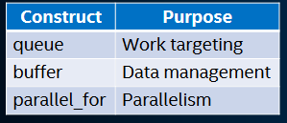
Complete DPC++ Program

Slide 9
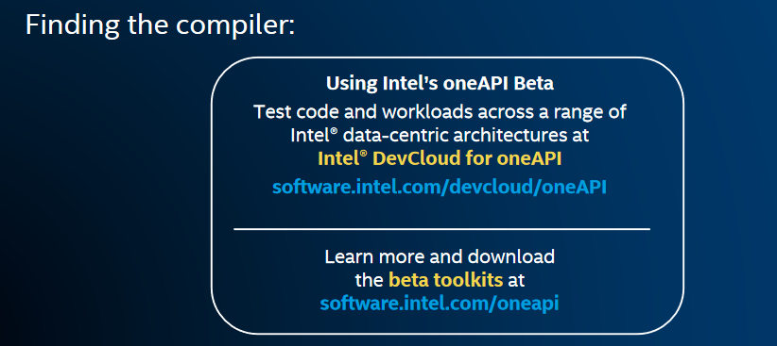
Compiling DPC++ Program

Slide 10
Intel DevCloud for Compile and Run DPC++
OneAPI is available on DevCloud
A development sandbox to develop, test and run your workloads across arrange of Intel CPUs, GPUs, and FPGAs using Intel’s oneAPI beta software
https://devcloud.intel.com/oneapi/

Slide 11
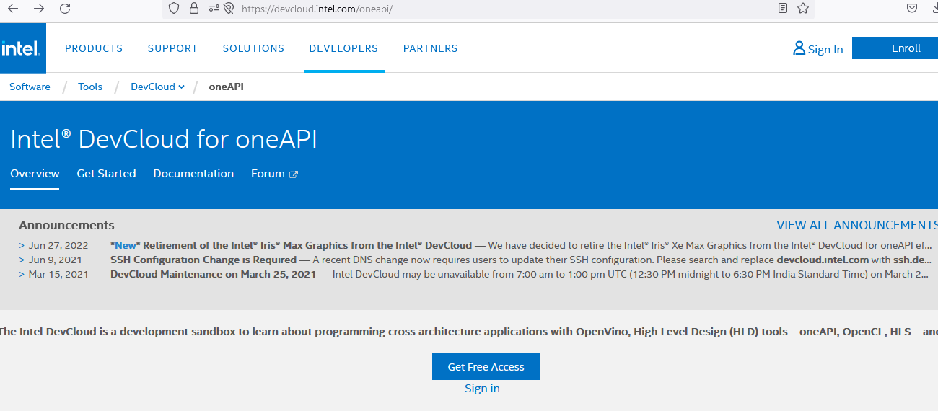
Intel DevCloud for Compile and Run DPC++
Create a DevCloud account
https://devcloud.intel.com/oneapi/

Slide 12
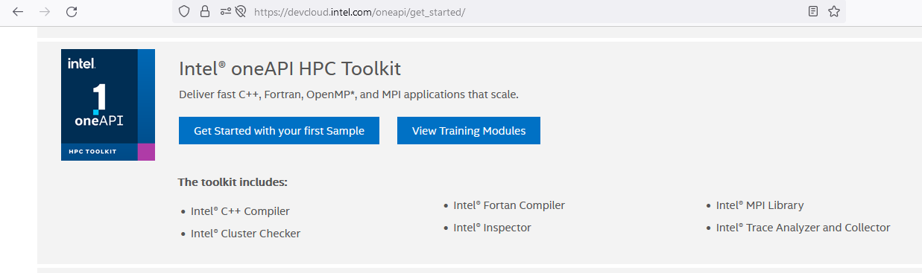
Intel DevCloud for Compile and Run DPC++
Login to DevCloud (https://devcloud.intel.com/oneapi/)
Click on get Started. Select Intel One API HPC Toolkit-View Training Modules

Slide 13
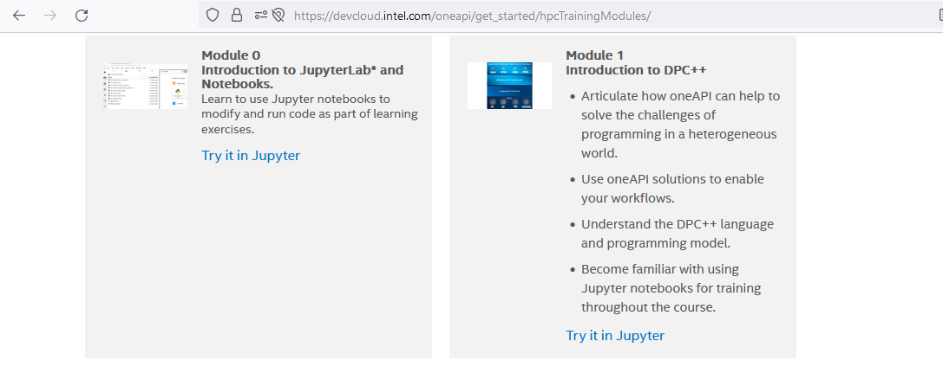
Intel DevCloud for Compile and Run DPC++
Select jupyter notebook.
We are compiling and running programs here

Slide 14
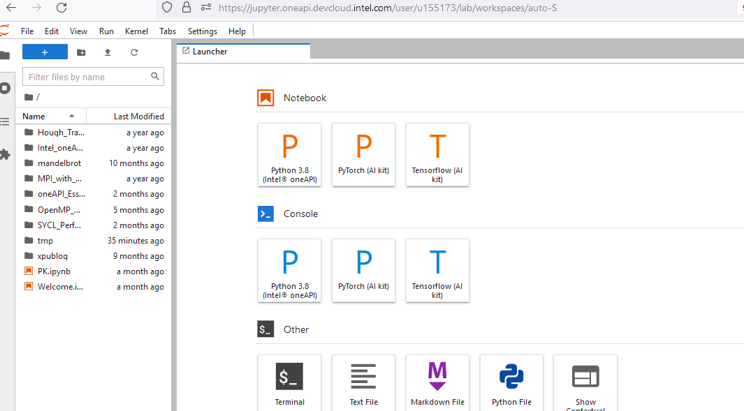
Intel DevCloud for Compile and Run DPC++

Slide 15
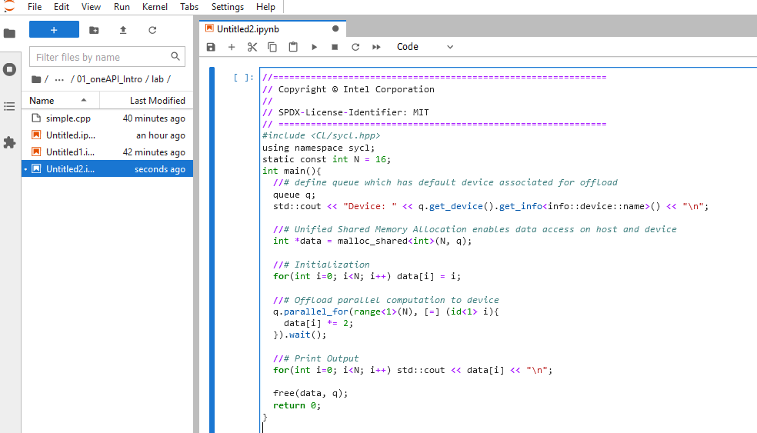
Intel DevCloud for Compile and Run DPC++
Create a new notebook and write the program

Slide 16
Intel DevCloud for Compile and Run DPC++
Create a new notebook and write the program
Run the first cell to compile and execute the code.
Inspect the code cell below, then click run ▶ to save the code to a file
Run ▶ the cell in the Build and Run section below the code snippet to compile and execute the code in the saved file
Build and Run
Select the cell below and click Run ▶ to compile and execute the code above:
! chmod 755 q; chmod 755 run_simple.sh;if [ -x "$(command -v qsub)" ]; then ./q run_simple.sh; else ./run_simple.sh; fi

Slide 17
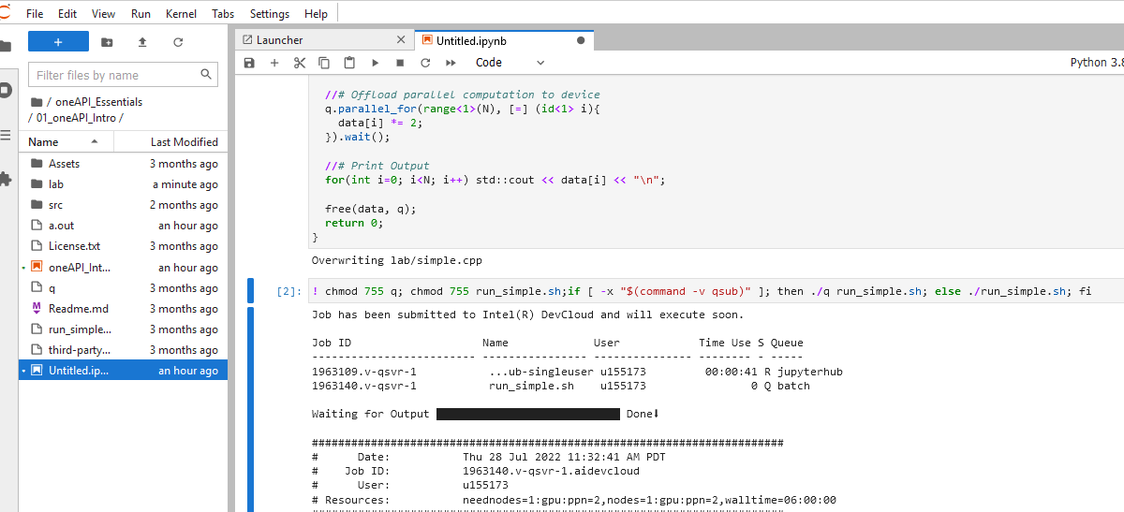
Intel DevCloud for Compile and Run DPC++

Slide 18

Please contact
Foundation for Innovation and Collaborative
Education
mentor@fice.in
www.fice.in
Please contact
Foundation for Innovation and Collaborative
Education
info@fice.in
mentor@fice.in
Notes:
Here are the lessons we are going to learn today.

