Slide 1



Slide 2



Slide 3
WRITING LINKS
<a href="http://www.imdb.com">IMDB</a>
Notes:
Click: Value of the href attribute is highlighted
- Explain that this is the 'value' of the href attribute
Click: Clickable area is highlighted (what the user sees)

Slide 4
WRITING LINKS
THE PAGE THE LINK TAKES YOU TO
<a href="http://www.imdb.com">IMDB</a>
Notes:
Click: Value of the href attribute is highlighted
- Explain that this is the 'value' of the href attribute
Click: Clickable area is highlighted (what the user sees)

Slide 5
WRITING LINKS
THE PAGE THE LINK TAKES YOU TO
<a href="http://www.imdb.com">IMDB</a>
THE TEXT THE USER CLICKS ON
Notes:
Click: Value of the href attribute is highlighted
- Explain that this is the 'value' of the href attribute
Click: Clickable area is highlighted (what the user sees)

Slide 6
LINKING TO OTHER SITES
<a href="http://www.empireonline.com"> Empire</a>

Slide 7


Slide 8
LINKING TO OTHER PAGES
ON THE SAME SITE
<a href=”index.html”>Home</a>
<a href=”about.html”>About</a>
<a href=”movies.html”>Movies</a>
<a href=”contact.html”>Contact</a>
Notes:
Explain: when linking to pages in own site can use shorthand - Relative URLs
These links are to pages that are all in the same folder

Slide 9


Slide 10
DIRECTORY
STRUCTURE
examplearts
index.html
movies
cinema
index.html
listings.html
reviews.html
dvd
index.html
listings.html
reviews.html
music
index.html
listings.html
reviews.html
theater
index.html
listings.html
reviews.html
Notes:
Shows files used for a fictional site (compare to Finder / Windows explorer)
Home page, then sections about Movies, Music, and Theater
Movies has two sections: Cinema and DVD
Note: Folders often referred to as directories on server
Click: Root folder - folder that everything else sits inside
Click: Child folder
Click: Parent folder
Click: Granchild folder
Click: Grandparent folder
Note use of terms similar to those of a family tree

Slide 11
DIRECTORY
STRUCTURE
examplearts
index.html
movies
cinema
index.html
listings.html
reviews.html
dvd
index.html
listings.html
reviews.html
music
index.html
listings.html
reviews.html
theater
index.html
listings.html
reviews.html
ROOT FOLDER
Notes:
Shows files used for a fictional site (compare to Finder / Windows explorer)
Home page, then sections about Movies, Music, and Theater
Movies has two sections: Cinema and DVD
Note: Folders often referred to as directories on server
Click: Root folder - folder that everything else sits inside
Click: Child folder
Click: Parent folder
Click: Granchild folder
Click: Grandparent folder
Note use of terms similar to those of a family tree

Slide 12
DIRECTORY
STRUCTURE
examplearts
index.html
movies
cinema
index.html
listings.html
reviews.html
dvd
index.html
listings.html
reviews.html
music
index.html
listings.html
reviews.html
theater
index.html
listings.html
reviews.html
CHILD
Notes:
Shows files used for a fictional site (compare to Finder / Windows explorer)
Home page, then sections about Movies, Music, and Theater
Movies has two sections: Cinema and DVD
Note: Folders often referred to as directories on server
Click: Root folder - folder that everything else sits inside
Click: Child folder
Click: Parent folder
Click: Granchild folder
Click: Grandparent folder
Note use of terms similar to those of a family tree

Slide 13

DIRECTORY
STRUCTURE
examplearts
index.html
movies
cinema
index.html
listings.html
reviews.html
dvd
index.html
listings.html
reviews.html
music
index.html
listings.html
reviews.html
theater
index.html
listings.html
reviews.html
PARENT
Notes:
Shows files used for a fictional site (compare to Finder / Windows explorer)
Home page, then sections about Movies, Music, and Theater
Movies has two sections: Cinema and DVD
Note: Folders often referred to as directories on server
Click: Root folder - folder that everything else sits inside
Click: Child folder
Click: Parent folder
Click: Granchild folder
Click: Grandparent folder
Note use of terms similar to those of a family tree

Slide 14

DIRECTORY
STRUCTURE
examplearts
index.html
movies
cinema
index.html
listings.html
reviews.html
dvd
index.html
listings.html
reviews.html
music
index.html
listings.html
reviews.html
theater
index.html
listings.html
reviews.html
GRANDCHILD
Notes:
Shows files used for a fictional site (compare to Finder / Windows explorer)
Home page, then sections about Movies, Music, and Theater
Movies has two sections: Cinema and DVD
Note: Folders often referred to as directories on server
Click: Root folder - folder that everything else sits inside
Click: Child folder
Click: Parent folder
Click: Granchild folder
Click: Grandparent folder
Note use of terms similar to those of a family tree

Slide 15

DIRECTORY
STRUCTURE
examplearts
index.html
movies
cinema
index.html
listings.html
reviews.html
dvd
index.html
listings.html
reviews.html
music
index.html
listings.html
reviews.html
theater
index.html
listings.html
reviews.html
GRANDPARENT
Notes:
Shows files used for a fictional site (compare to Finder / Windows explorer)
Home page, then sections about Movies, Music, and Theater
Movies has two sections: Cinema and DVD
Note: Folders often referred to as directories on server
Click: Root folder - folder that everything else sits inside
Click: Child folder
Click: Parent folder
Click: Granchild folder
Click: Grandparent folder
Note use of terms similar to those of a family tree

Slide 16
RELATIVE URLS
examplearts
index.html
movies
cinema
index.html
listings.html
reviews.html
dvd
index.html
listings.html
reviews.html
music
index.html
listings.html
reviews.html
theater
index.html
listings.html
reviews.html
Notes:
Shows the same directory structure as previous slide, but this time shows the relative URL
Click: Same folder - from music home page to music reviews page
Click: Child - from main home page to music listings page
Click: Parent - from music listings to main home page
Click: Grandchild - from main home page to DVD reviews page
Click: Grandparent: from DVD reviews to main home page

Slide 17
RELATIVE URLS
examplearts
index.html
movies
cinema
index.html
listings.html
reviews.html
dvd
index.html
listings.html
reviews.html
music
index.html
listings.html
reviews.html
theater
index.html
listings.html
reviews.html
SAME
reviews.html
Notes:
Shows the same directory structure as previous slide, but this time shows the relative URL
Click: Same folder - from music home page to music reviews page
Click: Child - from main home page to music listings page
Click: Parent - from music listings to main home page
Click: Grandchild - from main home page to DVD reviews page
Click: Grandparent: from DVD reviews to main home page

Slide 18


RELATIVE URLS
examplearts
index.html
movies
cinema
index.html
listings.html
reviews.html
dvd
index.html
listings.html
reviews.html
music
index.html
listings.html
reviews.html
theater
index.html
listings.html
reviews.html
CHILD
music/index.html
Notes:
Shows the same directory structure as previous slide, but this time shows the relative URL
Click: Same folder - from music home page to music reviews page
Click: Child - from main home page to music listings page
Click: Parent - from music listings to main home page
Click: Grandchild - from main home page to DVD reviews page
Click: Grandparent: from DVD reviews to main home page

Slide 19

RELATIVE URLS
examplearts
index.html
movies
cinema
index.html
listings.html
reviews.html
dvd
index.html
listings.html
reviews.html
music
index.html
listings.html
reviews.html
theater
index.html
listings.html
reviews.html
PARENT
../index.html
Notes:
Shows the same directory structure as previous slide, but this time shows the relative URL
Click: Same folder - from music home page to music reviews page
Click: Child - from main home page to music listings page
Click: Parent - from music listings to main home page
Click: Grandchild - from main home page to DVD reviews page
Click: Grandparent: from DVD reviews to main home page

Slide 20


RELATIVE URLS
examplearts
index.html
movies
cinema
index.html
listings.html
reviews.html
dvd
index.html
listings.html
reviews.html
music
index.html
listings.html
reviews.html
theater
index.html
listings.html
reviews.html
GRANDCHILD
movies/dvd/index.html
Notes:
Shows the same directory structure as previous slide, but this time shows the relative URL
Click: Same folder - from music home page to music reviews page
Click: Child - from main home page to music listings page
Click: Parent - from music listings to main home page
Click: Grandchild - from main home page to DVD reviews page
Click: Grandparent: from DVD reviews to main home page

Slide 21

RELATIVE URLS
examplearts
index.html
movies
cinema
index.html
listings.html
reviews.html
dvd
index.html
listings.html
reviews.html
music
index.html
listings.html
reviews.html
theater
index.html
listings.html
reviews.html
GRANDPARENT
../../index.html
Notes:
Shows the same directory structure as previous slide, but this time shows the relative URL
Click: Same folder - from music home page to music reviews page
Click: Child - from main home page to music listings page
Click: Parent - from music listings to main home page
Click: Grandchild - from main home page to DVD reviews page
Click: Grandparent: from DVD reviews to main home page

Slide 22
EMAIL LINKS
<a href="mailto:jon@example.org">Email Jon
</a>
Notes:
Click: highlights the mailto: before email address

Slide 23
EMAIL LINKS
<a href="mailto:jon@example.org">Email Jon
</a>
Notes:
Click: highlights the mailto: before email address

Slide 24
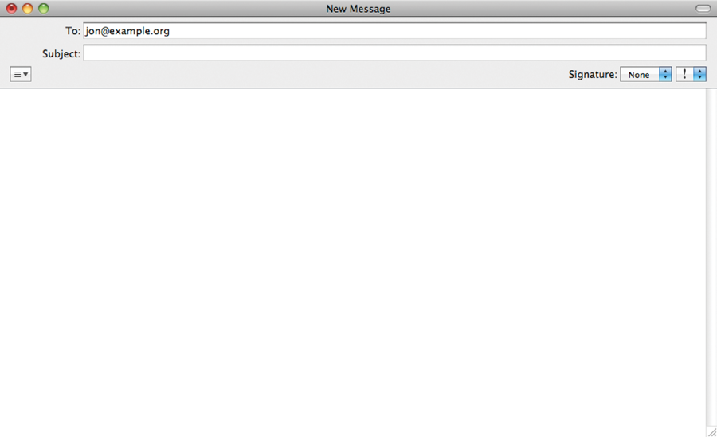


Slide 25
OPENING LINKS IN
A NEW WINDOW
<a href="http://www.imdb.com"
target="_blank">IMDB</a> (opens in a
new window)
Notes:
Click: highlights target="_blank"
Note: tell users when link opens in a new window

Slide 26
OPENING LINKS IN
A NEW WINDOW
<a href="http://www.imdb.com"
target="_blank">IMDB</a> (opens in a
new window)
Notes:
Click: highlights target="_blank"
Note: tell users when link opens in a new window

Slide 28
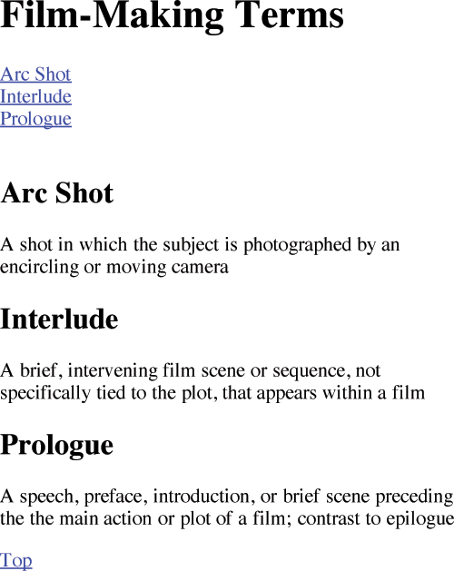
LINKING TO A SPECIFIC PART OF
THE SAME PAGE
<h1 id="top">
Film-Making Terms</h2>
<a href="#arc-shot">
Arc shot</a><br />
<a href="#interlude">
Interlude</a><br />
<a href="#prologue">
Prologue</a><br />
<h2 id="prologue">
Prologue</h2>
<a href="#top">Top</a>
Notes:
Explain: on a long page you can link from one part of page to another
Typical use = back to top links at bottom of pages and links from content at top of page to lower part
Click: Arrow indicates clicking on prologue link takes you to that part of the page (content page will scroll down)
Highlighting indicates how the link relates to the element with the corresponding id attribute
Click: Arrow points to clicking on Top link, page scrolls back up
Highlighting shows how the link relates to the element with the corresponding id attribute
Note: The value of the id attribute must be unique to that page
Must start with letter or underscore (not a number)

Slide 29
LINKING TO A SPECIFIC PART OF
THE SAME PAGE
<h1 id="top">
Film-Making Terms</h2>
<a href="#arc-shot">
Arc shot</a><br />
<a href="#interlude">
Interlude</a><br />
<a href="#prologue">
Prologue</a><br />
<h2 id="prologue">
Prologue</h2>
<a href="#top">Top</a>
<h1 id="top">
Film-Making Terms</h2>
<a href="#arc-shot">
Arc shot</a><br />
<a href="#interlude">
Interlude</a><br />
<a href="#prologue">
Prologue</a><br />
<h2 id="prologue">
Prologue</h2>
<a href="#top">Top</a>
Notes:
Explain: on a long page you can link from one part of page to another
Typical use = back to top links at bottom of pages and links from content at top of page to lower part
Click: Arrow indicates clicking on prologue link takes you to that part of the page (content page will scroll down)
Highlighting indicates how the link relates to the element with the corresponding id attribute
Click: Arrow points to clicking on Top link, page scrolls back up
Highlighting shows how the link relates to the element with the corresponding id attribute
Note: The value of the id attribute must be unique to that page
Must start with letter or underscore (not a number)

Slide 30
LINKING TO A SPECIFIC PART OF
THE SAME PAGE
<h1 id="top">
Film-Making Terms</h2>
<a href="#arc-shot">
Arc shot</a><br />
<a href="#interlude">
Interlude</a><br />
<a href="#prologue">
Prologue</a><br />
<h2 id="prologue">
Prologue</h2>
<a href="#top">Top</a>
<h1 id="top">
Film-Making Terms</h2>
<a href="#arc-shot">
Arc shot</a><br />
<a href="#interlude">
Interlude</a><br />
<a href="#prologue">
Prologue</a><br />
<h2 id="prologue">
Prologue</h2>
<a href="#top">Top</a>
<h1 id="top">
Film-Making Terms</h2>
<a href="#arc-shot">
Arc shot</a><br />
<a href="#interlude">
Interlude</a><br />
<a href="#prologue">
Prologue</a><br />
<h2 id="prologue">
Prologue</h2>
<a href="#top">Top</a>
Notes:
Explain: on a long page you can link from one part of page to another
Typical use = back to top links at bottom of pages and links from content at top of page to lower part
Click: Arrow indicates clicking on prologue link takes you to that part of the page (content page will scroll down)
Highlighting indicates how the link relates to the element with the corresponding id attribute
Click: Arrow points to clicking on Top link, page scrolls back up
Highlighting shows how the link relates to the element with the corresponding id attribute
Note: The value of the id attribute must be unique to that page
Must start with letter or underscore (not a number)

Slide 31
LINKING TO A SPECIFIC PART OF
THE SAME PAGE
<h1 id="top">
Film-Making Terms</h2>
<a href="#arc-shot">
Arc shot</a><br />
<a href="#interlude">
Interlude</a><br />
<a href="#prologue">
Prologue</a><br />
<h2 id="prologue">
Prologue</h2>
<a href="#top">Top</a>
<h1 id="top">
Film-Making Terms</h2>
<a href="#arc-shot">
Arc shot</a><br />
<a href="#interlude">
Interlude</a><br />
<a href="#prologue">
Prologue</a><br />
<h2 id="prologue">
Prologue</h2>
<a href="#top">Top</a>
Notes:
Explain: on a long page you can link from one part of page to another
Typical use = back to top links at bottom of pages and links from content at top of page to lower part
Click: Arrow indicates clicking on prologue link takes you to that part of the page (content page will scroll down)
Highlighting indicates how the link relates to the element with the corresponding id attribute
Click: Arrow points to clicking on Top link, page scrolls back up
Highlighting shows how the link relates to the element with the corresponding id attribute
Note: The value of the id attribute must be unique to that page
Must start with letter or underscore (not a number)

Slide 32
LINKING TO A SPECIFIC PART OF
THE SAME PAGE
<h1 id="top">
Film-Making Terms</h2>
<a href="#arc-shot">
Arc shot</a><br />
<a href="#interlude">
Interlude</a><br />
<a href="#prologue">
Prologue</a><br />
<h2 id="prologue">
Prologue</h2>
<a href="#top">Top</a>
<h1 id="top">
Film-Making Terms</h2>
<a href="#arc-shot">
Arc shot</a><br />
<a href="#interlude">
Interlude</a><br />
<a href="#prologue">
Prologue</a><br />
<h2 id="prologue">
Prologue</h2>
<a href="#top">Top</a>
Notes:
Explain: on a long page you can link from one part of page to another
Typical use = back to top links at bottom of pages and links from content at top of page to lower part
Click: Arrow indicates clicking on prologue link takes you to that part of the page (content page will scroll down)
Highlighting indicates how the link relates to the element with the corresponding id attribute
Click: Arrow points to clicking on Top link, page scrolls back up
Highlighting shows how the link relates to the element with the corresponding id attribute
Note: The value of the id attribute must be unique to that page
Must start with letter or underscore (not a number)

Slide 33
SUMMARY
Links are created using the <a> element.
Notes:
Clicks: Load individual bullets

Slide 34
SUMMARY
The <a> element uses the href attribute to indicatethe page you are linking to.
Notes:
Clicks: Load individual bullets

Slide 35
SUMMARY
If you are linking to a page within your own site, it is best to use relative links rather than qualified URLs.
Notes:
Clicks: Load individual bullets

Slide 36
SUMMARY
You can create links to open email programs with an email address in the
"to" field.
Notes:
Clicks: Load individual bullets

Slide 37
SUMMARY
You can use the id attribute to target elements within a page that can be linked to.
Notes:
Clicks: Load individual bullets

Slide 38
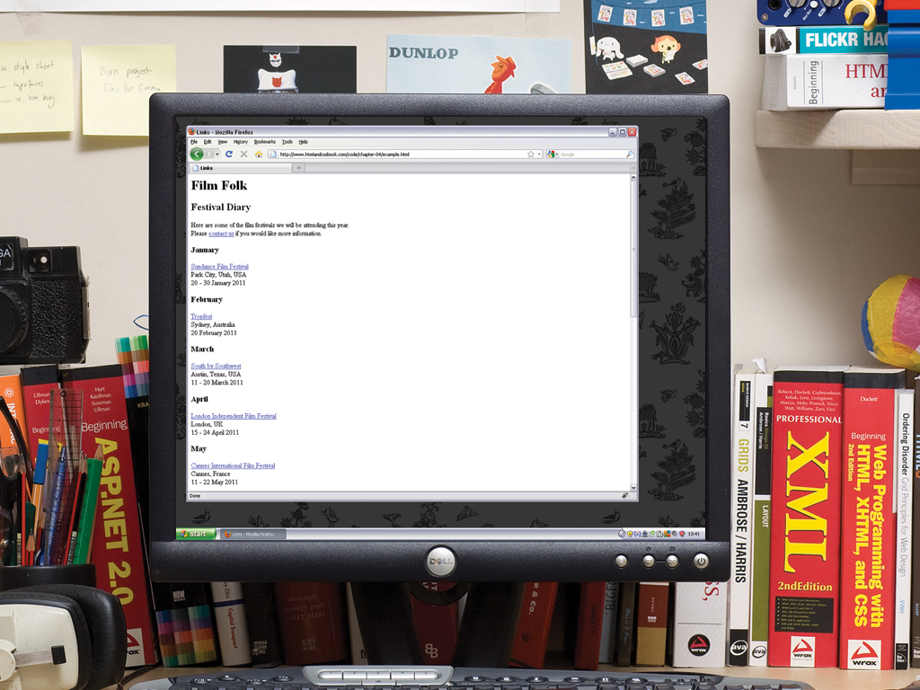

Slide 39


