Slide 1
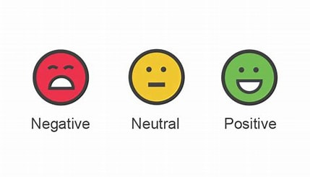


Data 603 – Big Data Platforms Amazon Review Sentiment Analysis

Slide 2
Team Kanyarashi
Team Members: Vikas Reddy Nagulapelly
Sanjeev Sriram

Slide 3
Introduction
Sentiment Analysis is used to extract subjective information from text data written by users.
In case of Amazon reviews the goal is to predict the user review as positive or negative

Slide 4
Problem Statement
The project is about predicting the Amazon reviews as positive or negative.
The number of reviews for a product in amazon are huge, it is highly impossible to get sentiment for that manually.

Slide 5
Impact on Real World
Brands that sell their products on amazon want to know the sentiment of their product.
Based on the sentiment of the product, if it is negative then they can plan accordingly to improve their product or if the sentiment is positive, they can come up with a new strategy in order to increase sales.

Slide 6
About Dataset
The dataset is taken from the Google drive directory of Xiang Zhang , who is a professor at University of Berkeley.
The size of the dataset is 613.9 mb
The number of rows in the dataset are 400k

Slide 7
About Dataset
The dataset consists of two columns with one being the review and the other one is Label
The label column is categorized into two, which are 0,1
The dataset is balanced with the equal number of 0 and 1 labels that are 200k
The Label 0 means negative and 1 means positive

Slide 8
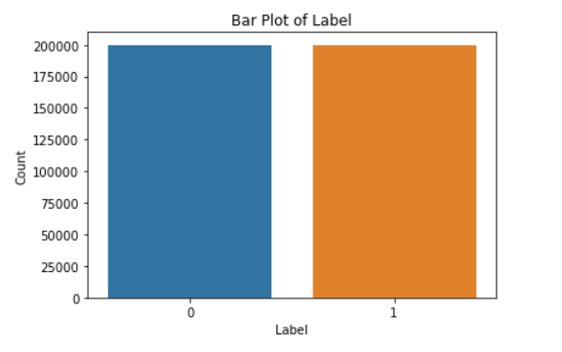
As you can see the number of 0&1 label counts are equal.

Slide 9
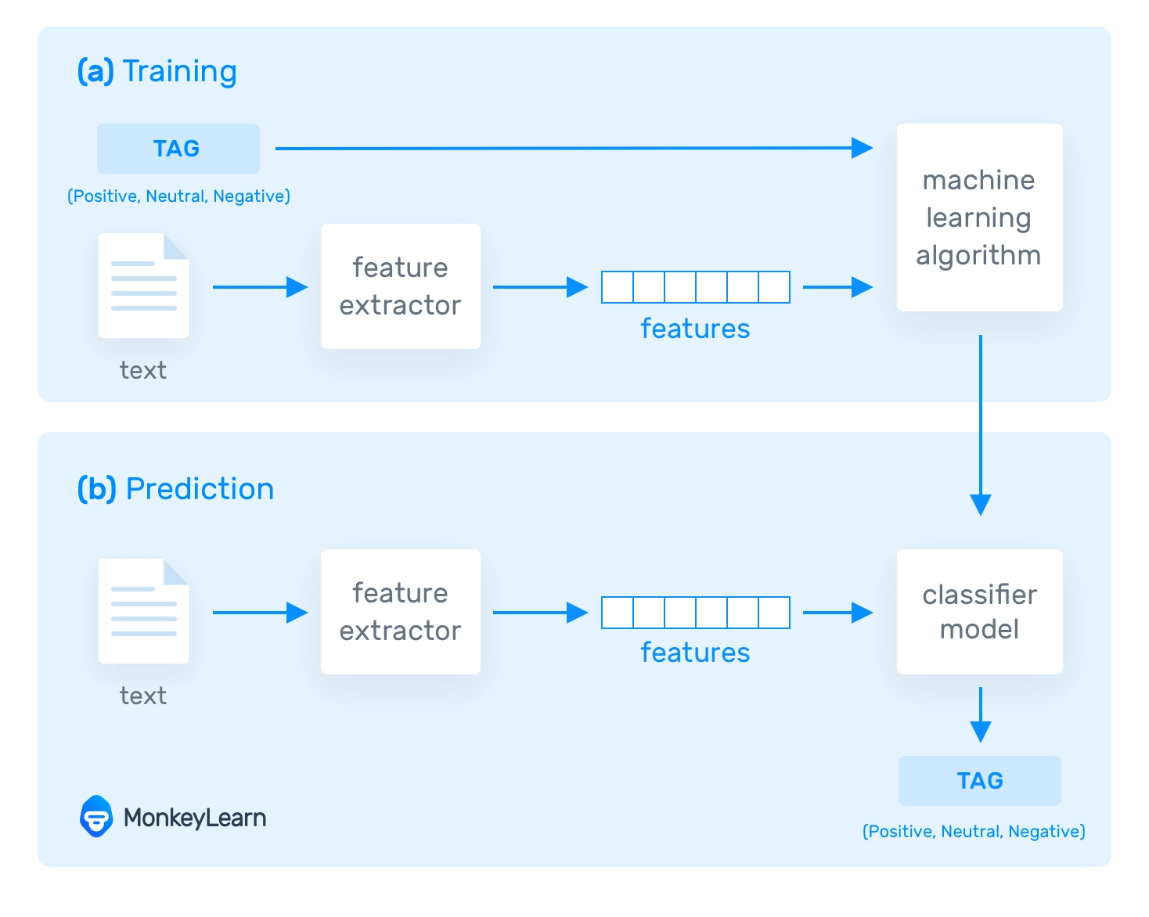
How does Sentiment analysis Work
Based on the samples, the model learns to associate text with the corresponding tag during the training process. The feature extractor converts the input text into a feature vector. Pairs of feature vectors and tags like positive and negative are fed into the machine learning algorithm to generate a model.
The feature extractor is used in the prediction process to convert unseen text inputs into feature vectors. These feature vectors are then fed into the model, which generates positive and negative predicted tags.

Slide 10
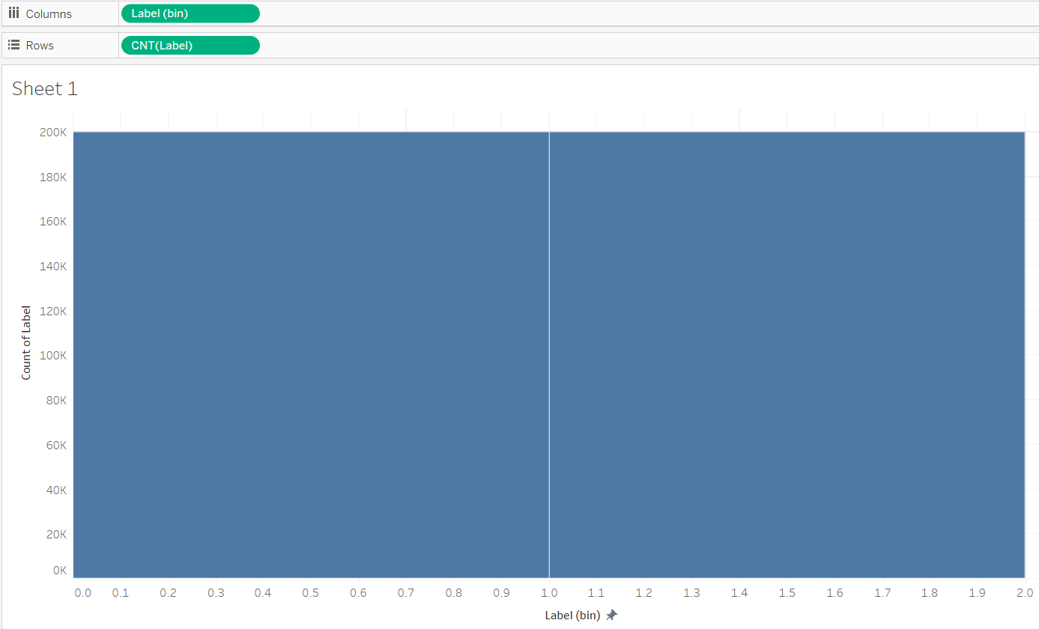
We have used the Tableau software and Seaborn library for data visualization.

Slide 11
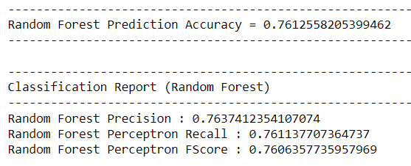
Algorithm Used
We have used Random Forest Algorithm and got accuracy for testing as 76%

Slide 12
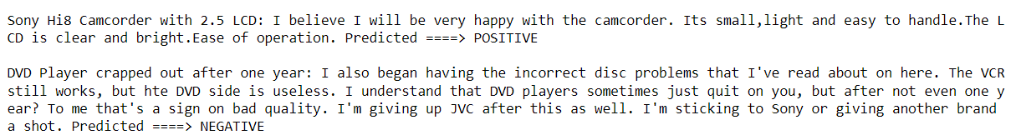
Results
We have got the results as expected.
Our model has predicted the sentiment of reviews accurately.

Slide 13
Further work/challenges
The accuracy we got is only 76%, by using other models we may get better accuracy.
We can create a method where we can just give the product url and get the sentiment of it.

