Slide 1
IBM University Engagement Project Submission
“Exploring the Power of Agentic AI with IBM Granite and IBM Bob”

Slide 2

Project Tile – MindGuard AI
Domain of Project – Health care
Faculty Name | Recent Passport Photo | Email ID | Mobile number [WhatsApp]
Vikas. Shanabhog |  | vikas.v.shanabhog@gmail.com | +91 8296689623

Slide 3
Problem Statement -
Problem Statement: Agentic AI for Mental Health Awareness & Suicide Prevention
The Challenge
Mental health issues such as depression, anxiety, and suicidal thoughts are growing worldwide. Stigma, lack of awareness, and limited access to timely help prevent many individuals from seeking support. Traditional systems are often reactive, leaving gaps in early detection and preventive care.
The Objective
Build an Agentic AI-powered Mental Health Awareness & Suicide Prevention Agent that is empathetic, proactive, and safe. The solution should:
1. Promote Awareness & Education – Share accessible resources on mindfulness, coping strategies, and self-care.
2. Enable Early Detection (RAG) – Use Retrieval-Augmented Generation to identify distress signals in conversations, journaling inputs, or safe online data.
3. Provide Empathetic Support – Build a conversational agent that listens actively and responds with empathy (with clear disclaimers: not a substitute for professional medical advice).
4. Predict & Prevent Risks – Forecast stress peaks, suggest preventive strategies, and issue alerts when high-risk signals are detected (with consent).
5. Connect to Human Support – Link users to helplines, counselors, or community support for timely intervention.
Tech Stack (Mandatory)
IBM Langflow / IBM Orchestrate + IBM Models

Slide 4
Proposed Solution -
MindCare AI is an Agentic AI mental wellness assistant built using IBM Orchestrate, IBM Langflow, and IBM Granite Models to provide intelligent, coordinated mental health support.
It promotes mental health awareness through personalized self-care tips, mindfulness exercises, and RAG-based evidence-backed guidance from trusted mental health resources.
The system analyzes conversations, journal entries, mood logs, sleep patterns, and optional wearable data (with user consent) to detect early signs of stress, anxiety, depression, and burnout.
It provides empathetic, non-judgmental support and proactively predicts mental health risks, while clearly stating that it is not a substitute for professional medical care.
In high-risk situations, the AI safely escalates users to helplines, counselors, or trusted contacts (with consent), while ensuring privacy, encryption, and responsible AI safety guardrails.

Slide 5
Technology Used
IBM Bob platform -For designing and orchestrating multi-agent workflows visually
IBM Grainte model - for eg – ibm-granite-3-2-8b – For natural language understanding, reasoning, and personalization
IBM Cloud – It provides the infrastructure to build, deploy, and scale the Nutrition Agent efficiently. IBM Cloud enables a reliable, secure, and scalable environment for deploying the Nutrition Agent.
RAG– RAG to fetch real data first, then generate intelligent answers, making the Nutrition Agent more trustworthy and effective.
IBM Watsonx.ai - For model deployment, embeddings, and AI governance
Vector Database (FAISS/Chroma) – For RAG-based nutritional data retrieval

Slide 6
Required Files created using IBM bob -
App.py
Requirements.txt
run.bat

Slide 7
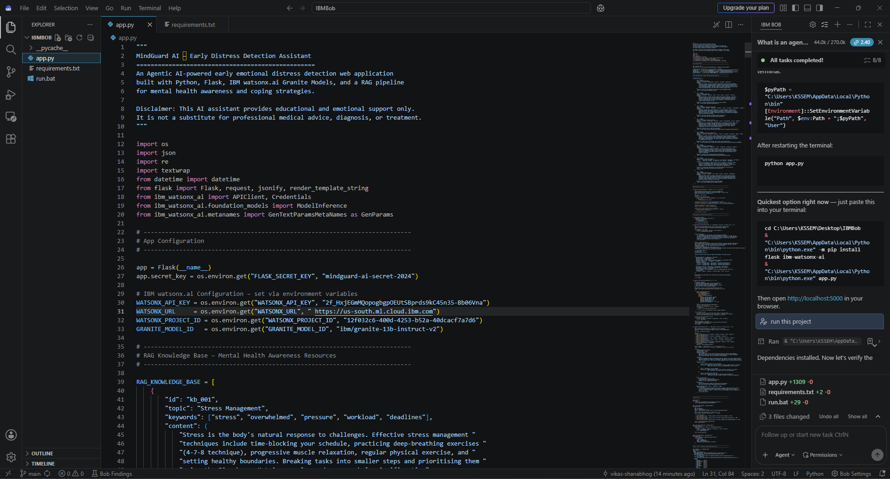
IBM Bob Screenshots:

Slide 8

Role of Agentic AI in the solution
Role of Agentic AI in Nutrition Agent
Agentic AI enables the Nutrition Agent to function as an intelligent, autonomous system rather than a simple chatbot. Using IBM watsonx.ai and IBM Granite models, it coordinates multiple specialized agents to deliver personalized nutrition guidance.
Each agent performs a specific role—such as retrieving nutritional data, generating diet plans, providing health advice, and analyzing food logs—while working collaboratively. This multi-agent approach ensures efficient task execution and accurate results.
Agentic AI also brings context awareness, understanding user details like age, health conditions, and fitness goals to generate tailored recommendations. It supports real-time adaptation, continuously updating suggestions based on user inputs like daily meals.
Additionally, agents communicate with each other, enabling better decision-making and improved outcomes.
Overall, Agentic AI makes the system proactive, personalized, and goal-driven, acting like a smart digital nutritionist that helps users maintain a healthy lifestyle.

Slide 9
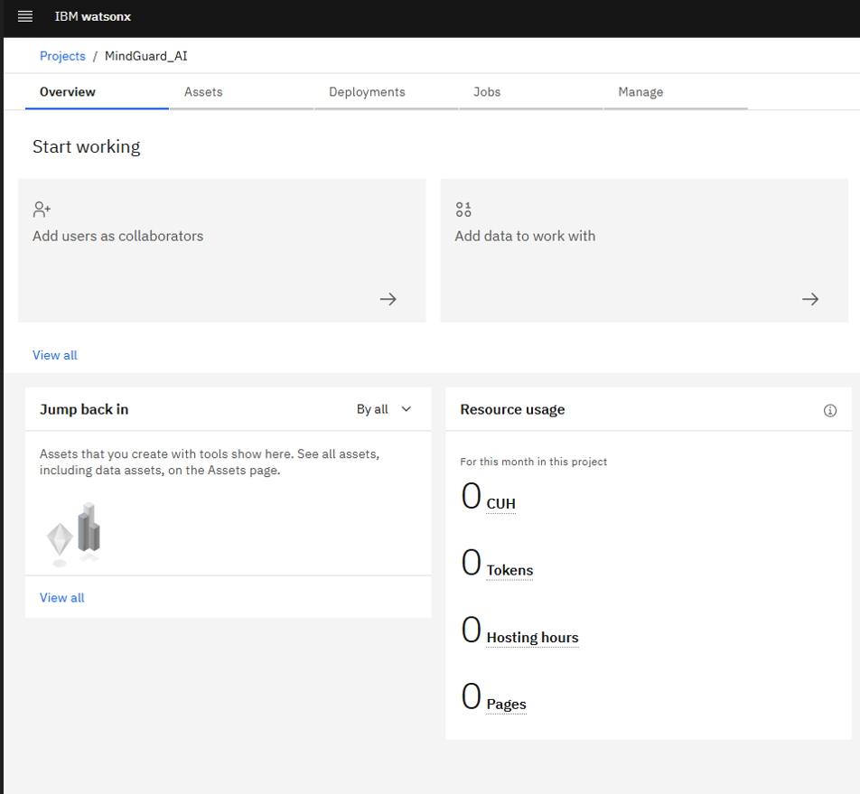
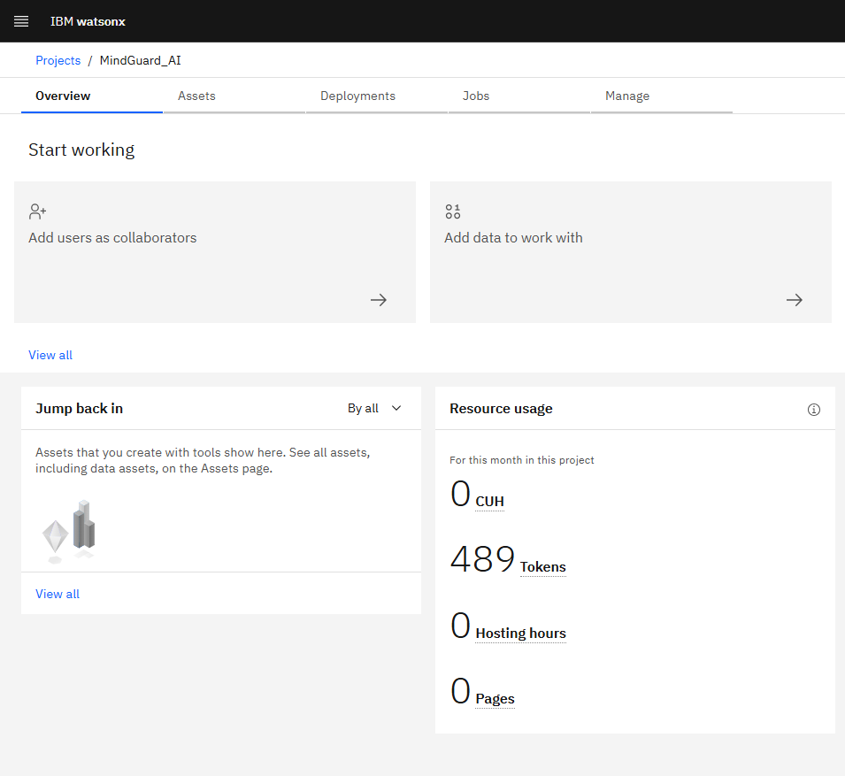
Token Usage
489 token are used
Before Prompt
After the Prompt

Slide 10
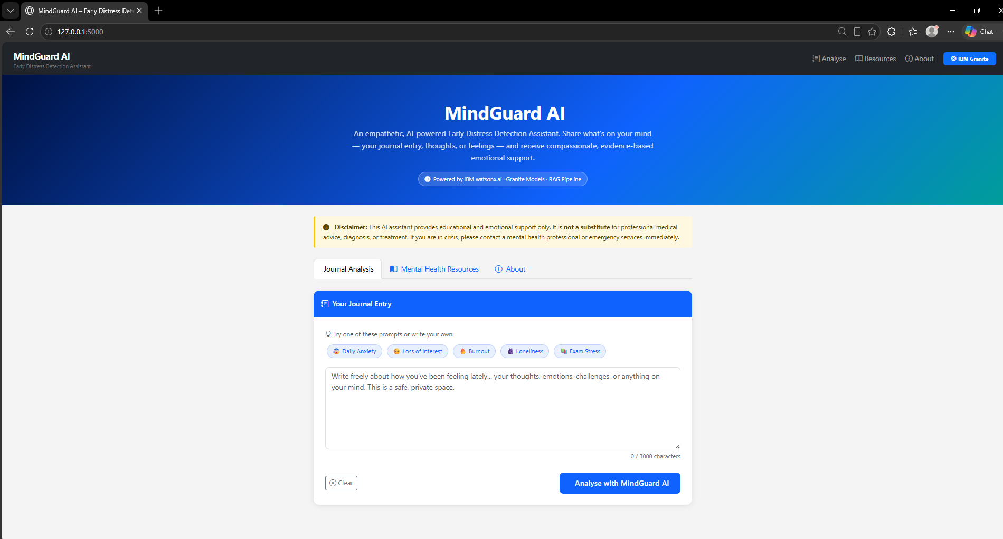
Project Output Screenshot
·
·
·

Slide 11
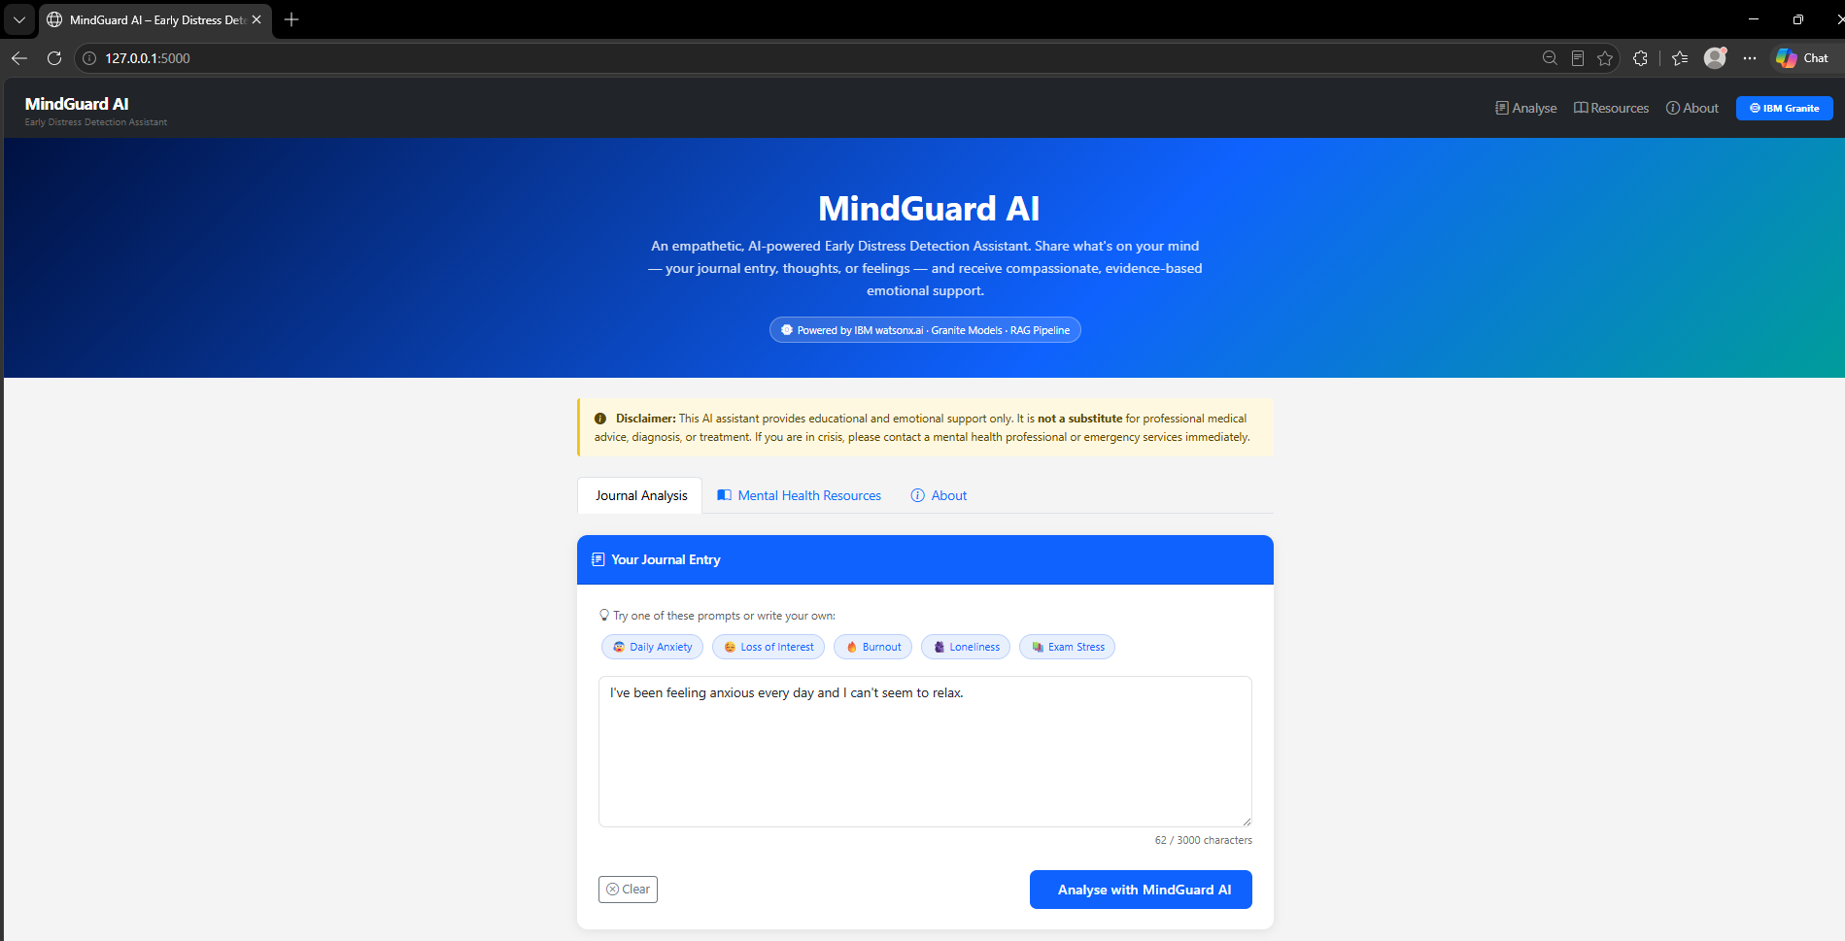
Project Output Screenshot

Slide 12
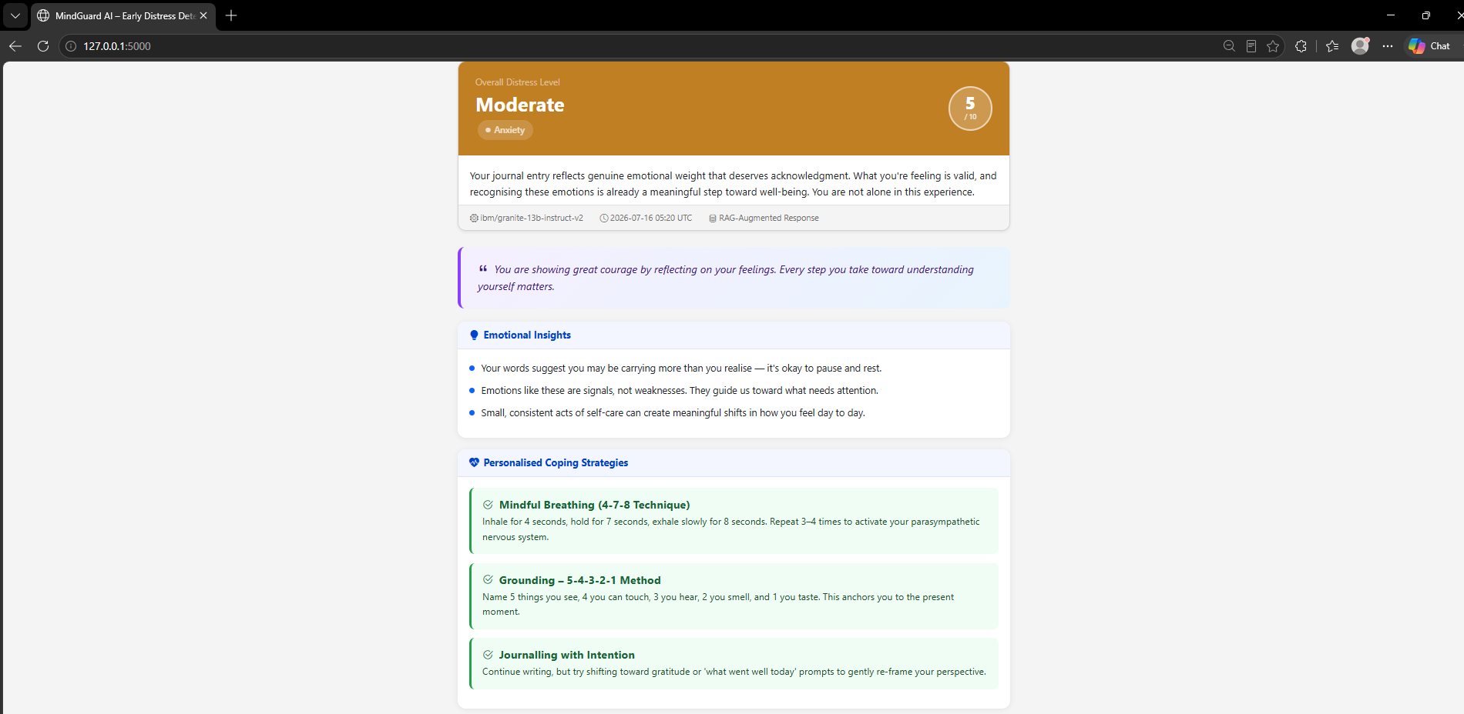
Project Output Screenshot

Slide 13
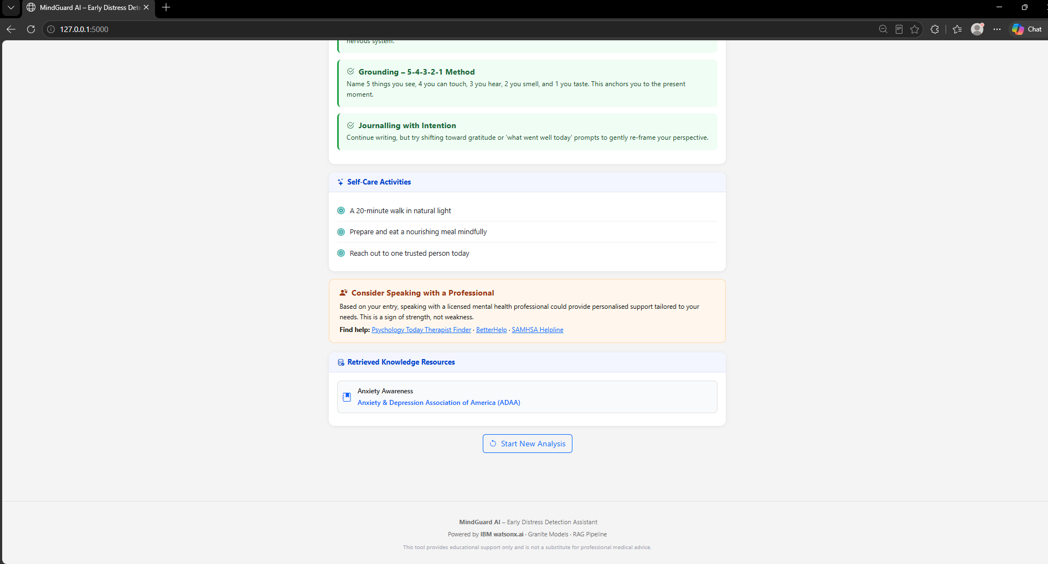
Project Output Screenshot

Slide 14
Novelty and Uniqueness
Multi-Agent AI System: Uses specialized AI agents for awareness, early detection, empathetic support, prediction, and crisis escalation, coordinated by IBM Orchestrate.
Proactive Risk Prediction: Identifies stress, anxiety, and burnout trends early, enabling preventive support before a mental health crisis develops.
Trusted RAG-Based Responses: Combines IBM Granite Models with Retrieval-Augmented Generation (RAG) to provide accurate, evidence-based mental health guidance.
Consent-Driven Human Escalation: Detects high-risk situations and securely connects users to helplines, counselors, or trusted contacts with user consent.
Personalized & Safe Experience: Delivers tailored wellness recommendations from mood logs and journals while ensuring privacy, AI safety guardrails, and clear medical disclaimers.

Slide 15
Git Hub Link
https://github.com/vikas-shanabhog/Mindguard_AI_using_ibm_bob

Slide 16
Future Scope
Multilingual & Voice Support: Expand to regional languages and voice-based interactions to improve accessibility for diverse users.
Wearable & Health App Integration: Connect with smartwatches and fitness trackers for real-time monitoring of sleep, heart rate, and stress levels (with user consent).
Advanced Predictive Analytics: Use AI to forecast long-term mental health trends and provide personalized preventive wellness plans.
Healthcare & Workplace Integration: Integrate with hospitals, educational institutions, and corporate wellness platforms for seamless referrals and support.
Personalized AI Coaching: Introduce adaptive wellness programs, CBT-based exercises, and continuous follow-ups tailored to each user's progress while maintaining strong privacy and ethical AI standards.

Slide 17
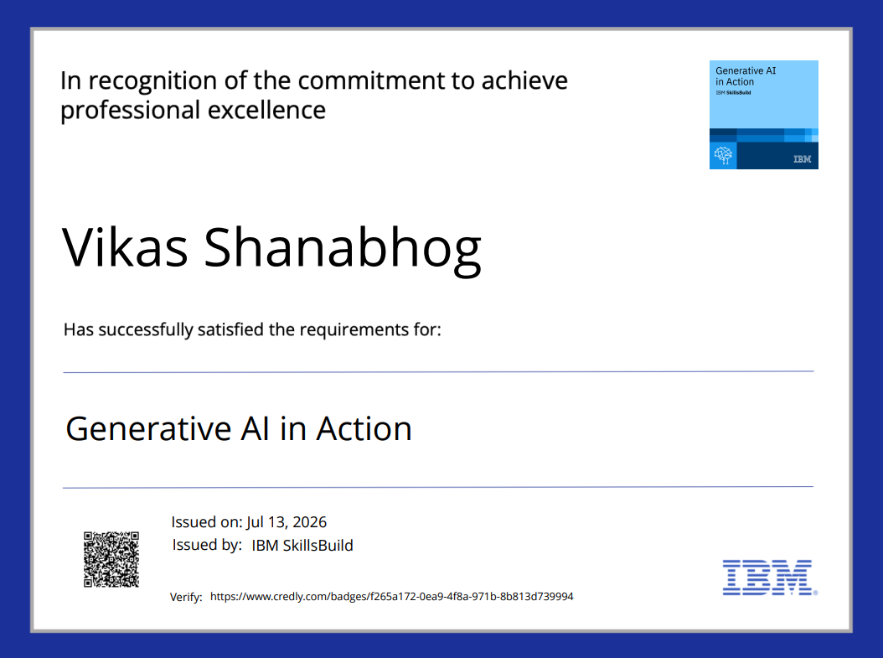
Certificates Earned:

Slide 18
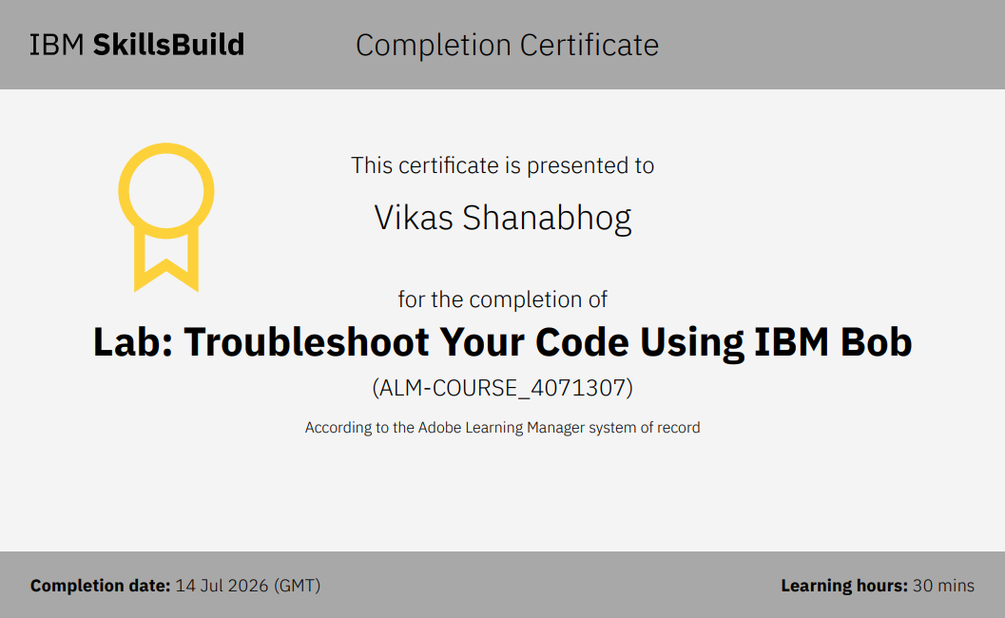
Certificates Earned:​

Slide 19


