Slide 1

Responsive Web Design
Full stack Skills Bootcamp

Slide 2
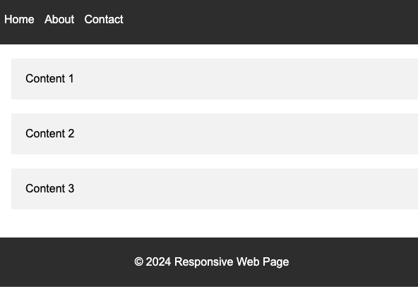
CSS Resets, media queries and CSS grid
Lesson Overview:
In this lesson, we will be looking at CSS Reset stylesheets, why they exist and how they’re used and then we’ll move on to how Media Queries can be used to enhance responsive page behaviour. Finally we’ll take a look at CSS Grid and where it can be used on modern websites.

Slide 3
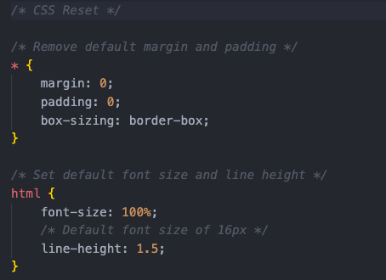
CSS Reset Stylesheets
What is a CSS Reset?
Definition: A CSS reset is a set of rules that removes inconsistent default browser styling.
Purpose: Ensures uniform styling across different browsers by “resetting” default styles.
Why is a CSS Reset Needed?
Different browsers have their own default styles for elements (e.g., margins, padding).
A reset stylesheet creates a clean slate, avoiding unintended design quirks.

Slide 4
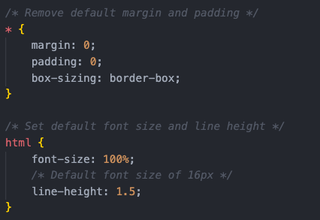
How to Implement a CSS Reset
Popular resets: Normalize.css
Eric Meyer's Reset CSS
Usage: Add the reset stylesheet at the beginning of your CSS file or often a separate CSS file.
Demo…

Slide 5
Media Queries
What are Media Queries?
Definition: Media queries are CSS techniques used to apply styles based on the device's characteristics, like screen size.
How it works: They check conditions such as screen width, height, orientation, or resolution.

Slide 6
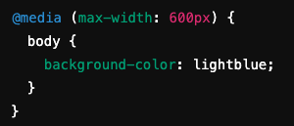
How Media Queries are Used
Syntax example:
Responsive breakpoints: Implementing different layouts for mobile, tablet, and desktop

Slide 7


Typical Use Cases
Changing layouts for different screen sizes (e.g., hiding sidebars on mobile).
Optimizing font sizes for readability on various devices.
Adjusting images (e.g., switching to smaller images for slower mobile connections).
Changing Menus (e.g. switching between a desktop nav menu and a mobile “burger” menu)
Demo…

Slide 8
What is CSS Grid?
Definition: CSS Grid Layout is a two-dimensional layout system for the web.
Why it’s powerful: Allows developers to create complex, responsive layouts without relying heavily on floats or positioning.

Slide 9
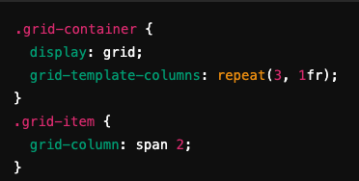
How CSS Grid Works
Grid container and items:
Define a grid with rows and columns in the container.
Place items using grid-row, grid-column, and other properties.

Slide 10
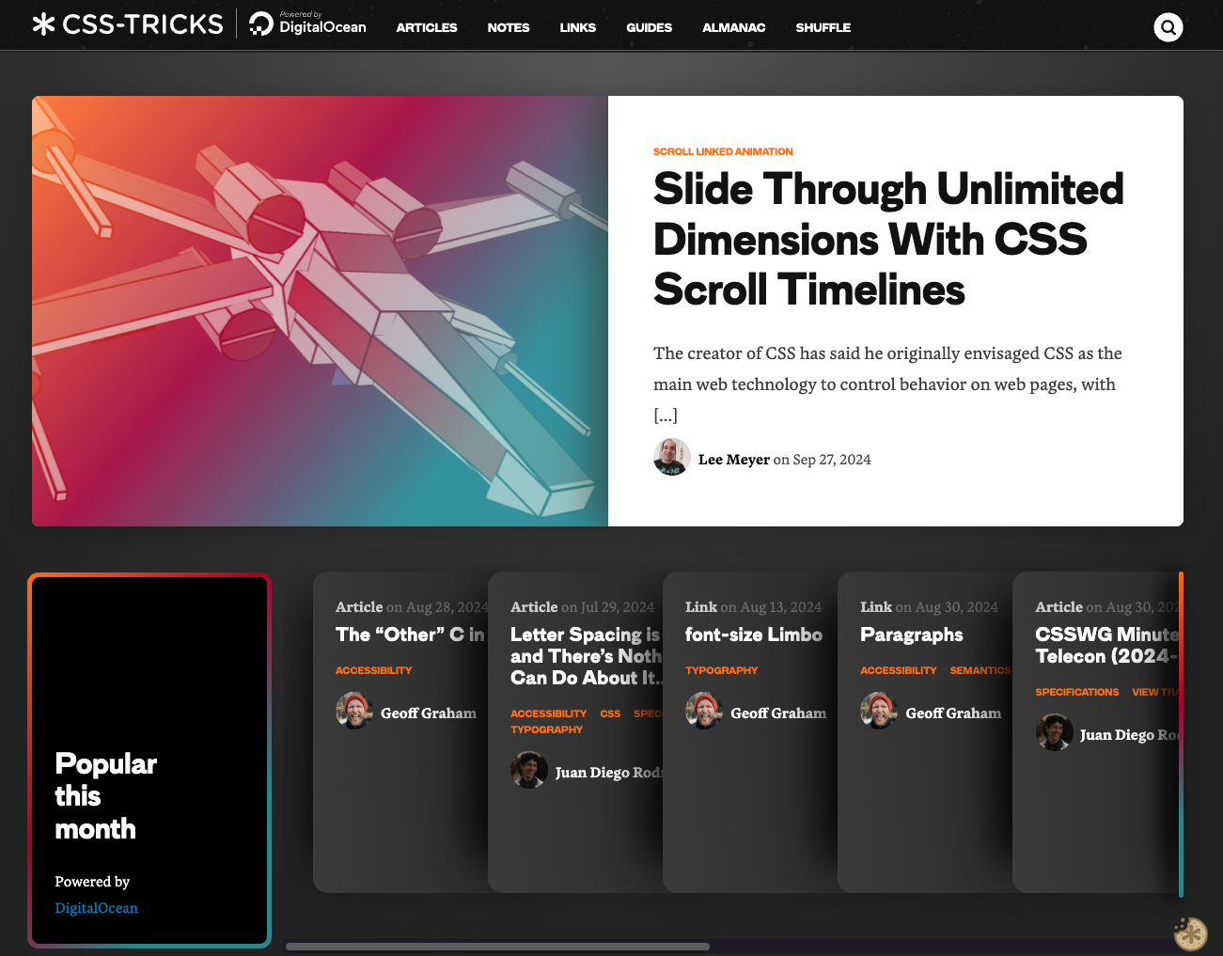
Examples of Real-World Use
Real-world sites: Many modern, grid-based layouts, such as news websites, blogs, and dashboards, rely on CSS Grid.
Case study: An example (https://css-tricks.com/) demonstrating flexible grid-based designs. Demo…

Slide 11
Recap
Summary: Recap the key tools for building responsive websites:
CSS Resets: Eliminate inconsistencies in default styles.
Media Queries: Apply styles based on device characteristics.
CSS Grid: Create flexible, responsive layouts.
Using media queries - MDN Web Docs: https://developer.mozilla.org/en-US/docs/Web/CSS/CSS_media_queries/Using_media_queries CSS-Tricks - A Complete Guide to Grid: https://css-tricks.com/snippets/css/complete-guide-grid/

Slide 12
Questions?

