Slide 1

Understanding CSS Bootstrap
Full stack Skills Bootcamp

Slide 2
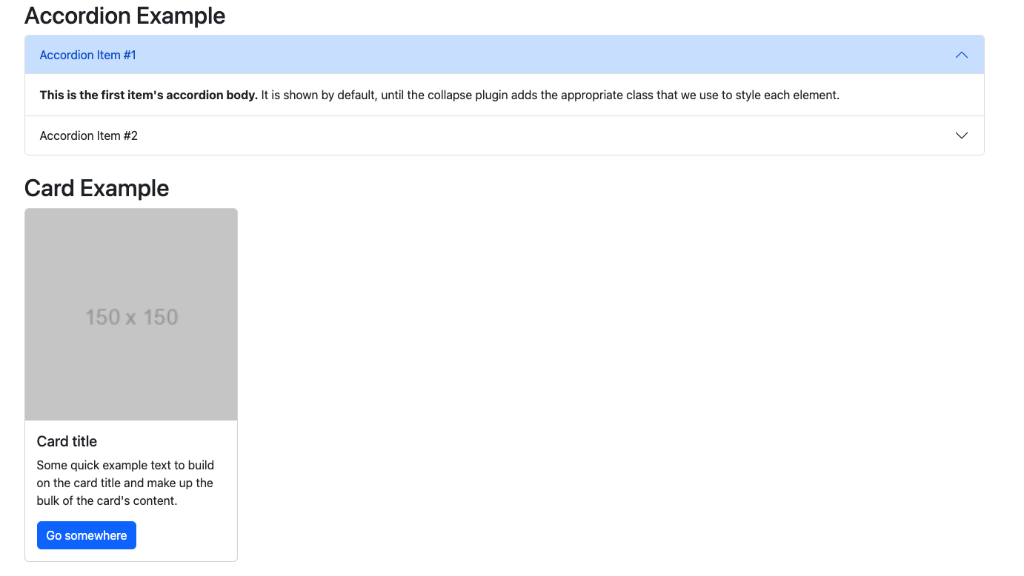
Simplifying Web Development with Bootstrap
Lesson Overview:
In this lesson, we will be introduced to:
CSS Bootstrap layouts and utility classes
Customisation of Bootstrap default styles
Using Bootstrap pre-made components

Slide 3

What is Bootstrap?
What is Bootstrap? A popular open-source CSS framework for building responsive, mobile-first websites.
Why use Bootstrap? Speeds up development, offers pre-built components, and provides responsive design out-of-the-box.

Slide 4
Bootstrap Layout: The Grid System
What is the Bootstrap Grid System?
A responsive, flexible layout system based on a 12-column grid.
Key Concepts:
Rows and Columns: Used to create structure.
Breakpoints: Responsive layout for various devices (xs, sm, md, lg, xl).

Slide 5
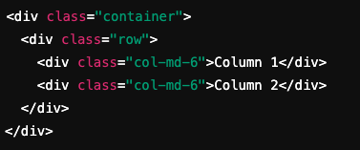
Bootstrap Grid Example
Basic Structure:
Explanation: .container: Wraps content to create margins and padding.
.row: Defines a row of content.
.col-md-6: Creates two equal-width columns on medium-sized screens (and larger).

Slide 6

Utility Classes
What are Utility Classes? Predefined Bootstrap classes that simplify applying common styles (e.g., spacing, display, colors).
Examples: .text-center, .p-3, .bg-light, .d-flex.
Use Case: Quickly apply styles without writing custom CSS. Demo…

Slide 7

Bootstrap Customization: Colors & Fonts
Built-in Colors & Fonts:
Bootstrap offers a set of predefined colors (e.g., primary, secondary, success).
Standard typography with built-in fonts (e.g., font size, weight).

Slide 8

Overriding Bootstrap with Custom Styles
Customizing Bootstrap: You can override Bootstrap’s default styles by adding your own CSS file after the Bootstrap link in the HTML.

Slide 9
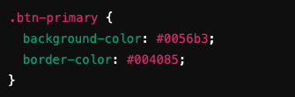
Customizing Colors Example
Customizing Colors Example: Use Case: Apply custom branding or specific design elements.

Slide 10

Custom Fonts Example
How to Change Fonts: You can apply custom fonts by adding them to your CSS file
Use Case: Branding-specific fonts that aren’t included in Bootstrap by default. Demo…

Slide 11
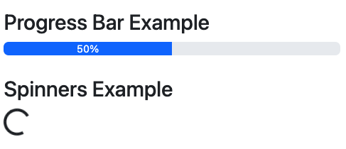
Using Bootstrap Components
What are Bootstrap Components?
Pre-built UI elements like buttons, navbars, modals, carousels, and cards.
Easy to implement, responsive, and customizable.

Slide 12

Examples of Bootstrap Components
Button
Navbar

Slide 13
Why Bootstrap Components Speed Up Development
Consistency: Ensures design consistency across the site.
Time Saving: Pre-built components reduce the need to write complex CSS from scratch.
Responsiveness: Components adapt to different screen sizes by default.
Ease of Customization: All components can be customized with Bootstrap's utility classes or your custom CSS.

Slide 14
Conclusion
Grid System: Create responsive layouts using Bootstrap’s columns and rows.
Customisation: Modify colors, fonts, and styles easily with your custom CSS.
Components: Use pre-built UI elements to speed up development.
Official Bootstrap Documentation: https://getbootstrap.com/

Slide 15
Questions?

