Slide 1

JavaScript Objects, Arrays, and Loops
Full stack Skills Bootcamp

Slide 2
loops, objects, and arrays in JavaScript
Lesson Overview:
In this lesson, we will be introduced to:
Traditional for loops and how they work.
Introduction to objects and arrays.
Adding custom methods to objects.
Using built-in methods for objects and arrays.
Common string methods

Slide 3

Understanding the Traditional For Loop
What is a for loop? A for loop allows you to run a block of code a specified number of times.
Example:

Slide 4

Including JavaScript in a Web Page
Syntax of a for loop: Initialization: A variable is initialized (e.g., var i = 0). Condition: The loop runs as long as the condition is true (e.g., i < 10). Increment: The value is updated after every iteration (e.g., i++). Demo…

Slide 5
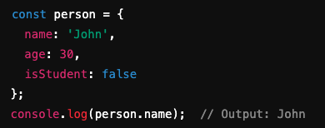
Objects in JavaScript
Definition: Objects are collections of key-value pairs. Objects allow you to store related data and functions (called methods) in one structured format. Objects can store primitive values (strings, numbers, booleans) and functions.

Slide 6

Arrays in JavaScript
Definition: Arrays are ordered lists of items. Arrays are used to store multiple values in a single variable. Arrays are zero-indexed, meaning the first element is at index 0.

Slide 7
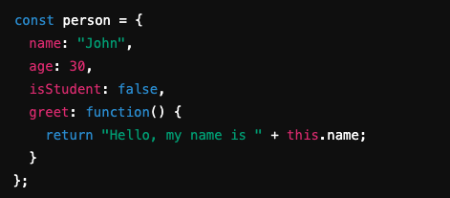
Adding Methods to Objects
Definition: A method is simply a function stored as a property in an object. Methods allow objects to perform actions based on their properties. Example: Adding a method to an object The this keyword refers to the current object.

Slide 8

Example of Object Usage
Example: Accessing and manipulating an object: Use dot notation (person.name) or bracket notation (person["name"]) to access properties.

Slide 9



Common Object Methods
Object.keys(): Returns an array of the object's property names
Object.values(): Returns an array of the object's property values.
Object.entries(): Returns an array of the object's key-value pairs.

Slide 10

Common Array Methods
push(): Adds an item to the end of the array..
pop(): Removes the last item from the array..
shift(): Removes the first item from the array..
unshift(): Adds an item to the beginning of the array.
map(): Creates a new array by applying a function to each element

Slide 11
Common String Methods
length: Returns the length of the string
toUpperCase(): Converts the string to uppercase.
toLowerCase(): Converts the string to lowercase
indexOf(): Returns the index of the first occurrence of a substring.
slice(): Extracts a portion of the string.

Slide 12
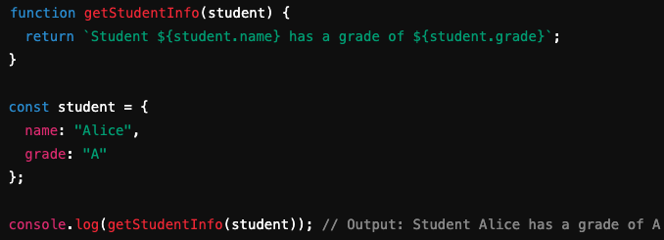
Practical Example
Task: Create a function that accepts an object representing a student and returns a message with the student’s name and grade.

Slide 13
Conclusion
Objects are collections of key-value pairs.
Arrays are ordered lists of items.
Common methods help manipulate both objects and arrays efficiently.
Strings in JavaScript come with many built-in methods for text processing.
Objects in JavaScript:
MDN Web Docs: Working with Objects
Arrays:
W3Schools: Arrays
Object Methods:
MDN Web Docs: Object Methods
String Methods:
W3Schools: JavaScript String Methods

Slide 14
Questions?

