Slide 1

Introduction to NodeJS and Debugging
Full stack Skills Bootcamp

Slide 2
Introduction to NodeJS and Debugging
Lesson Overview:
In this lesson, we will be introduced to:
The NodeJS environment
Debugging techniques
Modern ES6/7 techniques
Using the file system

Slide 3
What is NodeJS?
Definition: Node.js is a JavaScript runtime built on Chrome's V8 engine.
Purpose: Allows JavaScript to run server-side, outside the browser.
Key Features: Non-blocking I/O, event-driven, fast and lightweight.

Slide 4
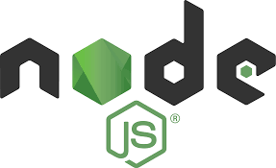
Installing NodeJS
Step-by-Step Installation: Go to NodeJS Official Website.
Download the latest stable version for your OS.
Run the installer and verify installation with node -v in the terminal.
NPM (Node Package Manager): Automatically installed with Node.js. Allows for easy installation of libraries.

Slide 5

Running a Simple JavaScript File
File Example: index.js
How to Run: Open terminal, navigate to the directory containing index.js.
Run the command: node index.js.

Slide 6
Debugging Simple Scripts and Functions
How to Start Debugging: Use the Run | Start Debugging command in VSCode to start debugging.
Key Debugging Actions: step over: executes the function then stops
step into: steps into the function
step out: runs to the end of the function then stops
continue: Continue until breakpoint.
stop: stops the application and debugging demo…

Slide 7
ES6/7 vs Traditional JavaScript
Differences: Syntax improvements (arrow functions, modules). More readable and concise code. Focus on better handling of asynchronous operations (e.g., async/await).

Slide 8
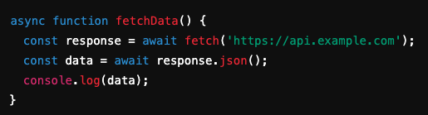
Async/Await
What is Async/Await?: An easier way to work with asynchronous code.
Example:

Slide 9
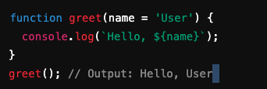
Default Function Parameters
Definition: Set default values for parameters in functions.
Example:

Slide 10

Destructuring
Purpose: Extract values from objects and arrays.
Example

Slide 11

Arrow Functions
Definition: A shorter syntax for writing functions.
Example

Slide 12

Spread Operator
Definition: Expands iterable elements (arrays, objects) into individual elements.
Example:

Slide 13

Var vs Let vs Const
Differences: var: Function-scoped, can be re-declared. let: Block-scoped, cannot be re-declared. const: Block-scoped, cannot be reassigned or re-declared.
Example:

Slide 14

ES6 Modules
Importing and Exporting Modules: Export functions or variables from one file. Import them in another file.

Slide 15
Passing Command Line Parameters
How to Access Command Line Arguments in Node.js: Use process.argv.
Example:

Slide 16
The Filesystem in Node.js
Core Functions:
readFile: Reads the contents of a file.
writeFile: Writes data to a file, overwriting existing content.
appendFile: Adds data to an existing file without overwriting.

Slide 17
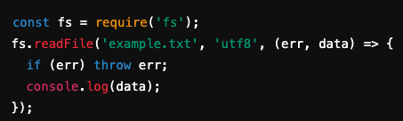
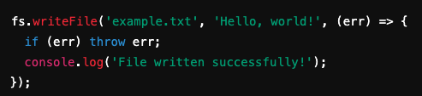
Reading and Writing Files
Reading a File Example:
Writing to a File Example:

Slide 18
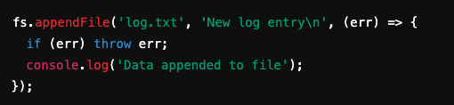
Using appendFile
Appending Data to a File:

Slide 19
Conclusion
Installed and ran Node.js.
Debugged simple JavaScript scripts.
Explored key features of modern JavaScript (ES6/ES7).
Worked with the filesystem using readFile, writeFile, and appendFile.

Slide 20
Questions?

