Slide 1

Node Package Manager (NPM) and Test Driven Development (TDD)
Full stack Skills Bootcamp

Slide 2
An introduction to NPM, automated testing, and best practices
Lesson Overview:
In this lesson, we will be introduced to:
Node Package Manager (NPM)
Test Driven Development (TDD)
Testing JavaScript with Jest
Mocking with Jest
Excluding content from GitHub (gitignore)

Slide 3

What is NPM?
Definition: NPM is the default package manager for Node.js.
Key Features:
Allows installation and management of third-party libraries and tools.
Includes tools for dependency management and running scripts.

Slide 4


Start Commands and Running a Simple Script
Scripts in NPM: Define custom commands for your application in the package.json file.
Example: How to Run:

Slide 5
Installing Packages for Production and Development
Production vs Development:
Production dependencies: Essential packages required for running the app.
Command: npm install <package>
Development dependencies: Tools needed for development and testing, not for production.
Command: npm install --save-dev <package>
Example:
express for production.
jest for testing in development. Demo…

Slide 6
What is TDD (Test Driven Development)?
Definition: A software development process where tests are written before the actual code.
Workflow:
Write a test.
Run the test (it should fail).
Write the minimal amount of code to make the test pass.
Refactor and repeat.

Slide 7
Real World Applications for TDD
Key Benefits:
Ensures code correctness before implementation.
Facilitates debugging and refactoring.
Enhances code reliability in applications with critical operations (e.g., payment gateways, APIs).
Common Use Cases: API development, legacy system updates, user authentication.

Slide 8
Introducing Jest for JavaScript
What is Jest?: A JavaScript testing framework, commonly used for unit and integration testing.
Key Features: Easy to set up. Built-in assertions. Supports mocking and spying.

Slide 9

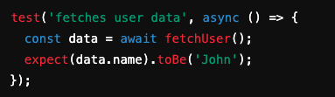
Default Function Parameters
Example of Typical Jest Tests Basic Test Example: Asynchronous Test:

Slide 10
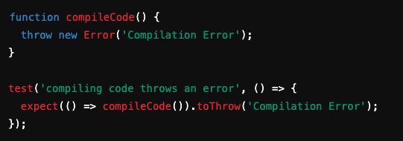
Testing Exceptions in Jest
Example of Testing an Error

Slide 11

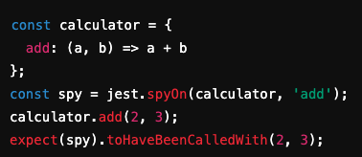
Mocks and spyOn in Jest
What are Mocks?: Simulate the behavior of real functions in tests.Example with jest.fn()
spyOn Example: Track calls to a method demo…

Slide 12

GitIgnore: How to Exclude Files and Folders from a Repository
Purpose of .gitignore: Prevent certain files or folders from being tracked by Git.
Typical Example

Slide 13
Real World Examples of .gitignore
Common Scenarios: Node.js projects: Exclude node_modules/. Environment files: Exclude .env to protect sensitive information. Log files: Prevent log files from cluttering the repository.

Slide 14
Conclusion
The importance of using NPM for dependency management.
How TDD improves software quality and maintainability.
The role of Jest in writing efficient, testable code.
Proper usage of .gitignore to manage project files in Git.

Slide 15
Questions?

